Slide 1
Yelp Dataset Analysis
ILS – Z534 SEARCH
GANESH NAGARAJAN, ADITYA TANIKANTI, SANJANA PUKALAY, ARUN SANKARANARAYANAN, KEERTHI TEJA NUTHI

Slide 2
Task – 1 : Category Prediction
Can we predict the category of the restaurant given the reviews?
Problem Definition:
Multi-Label Classification, i.e a review can point to a collection of labels, E.g [‘Bread & Breakfast’, ’Brunch’, ’Diners’]
Textual Data as raw data sources - Need to extract features from this data

Slide 3
Dataset Description
Complete dataset used for the tasks
Train : 1940708 records
Test : 523438 records
Tuning : 523438 records
Adopted stratified sampling for validation and tuning to create the dataset with similar distribution from the test data
Joined the JSON files - Reviews, Tips and Business using Apache Spark

Slide 4
Technology Stack
Apache Spark – Data Joining
Python – Main Driver program
NLTK – Stemming and stopwords
Scikit-learn – Machine Learning Library
Dato (Turi) - Recommender System

Slide 5
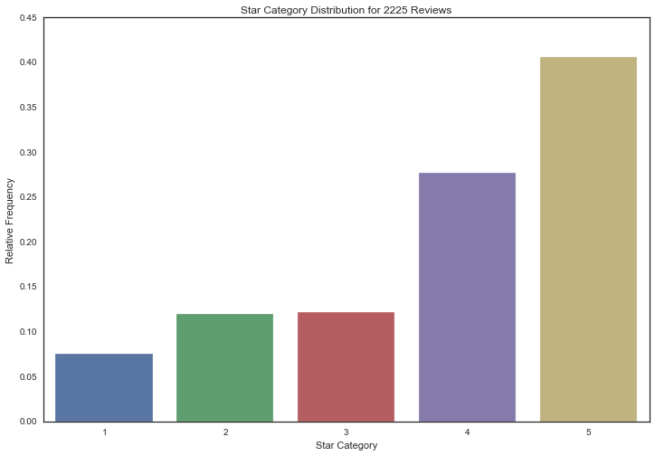
Exploratory Data Analysis

Slide 6
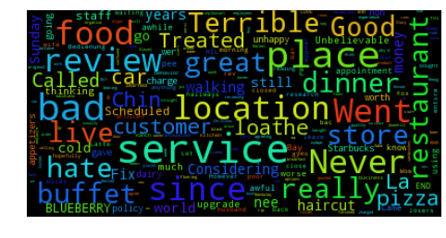
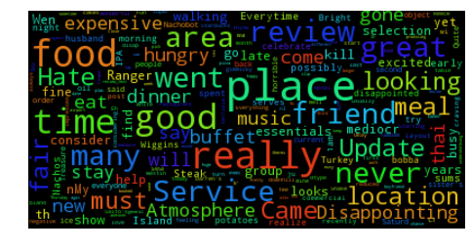
Word Cloud
Word Cloud

Slide 7
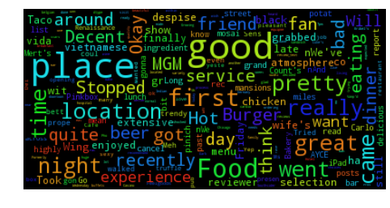
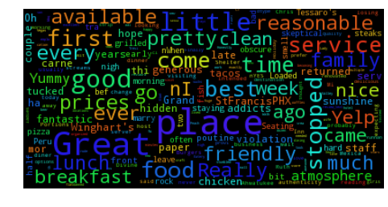
Word Cloud
Word Cloud

Slide 8
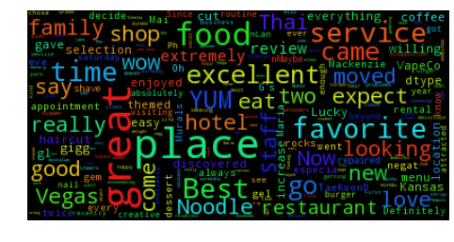
Word Cloud

Slide 9
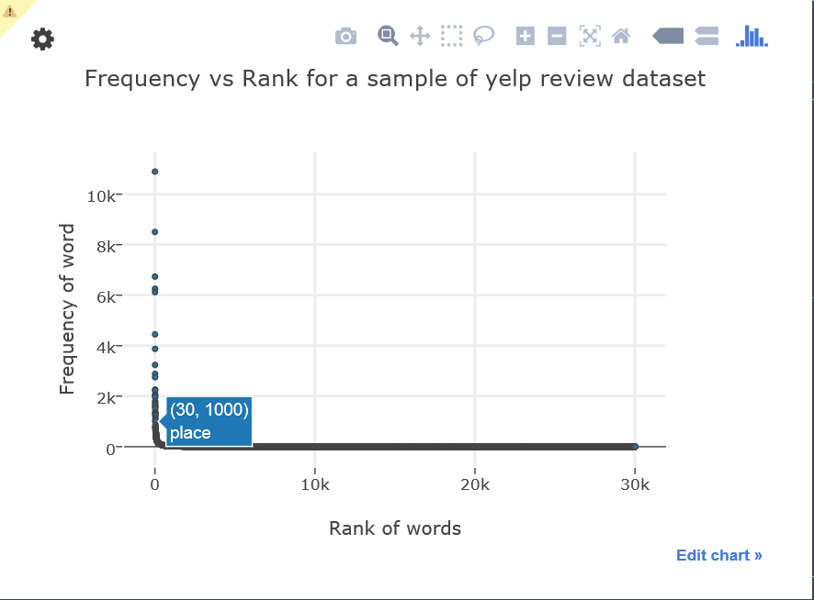

Slide 10
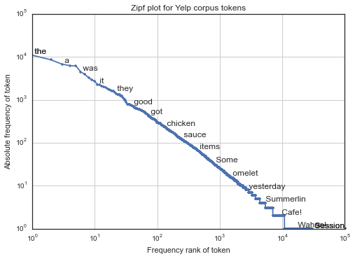

Slide 11
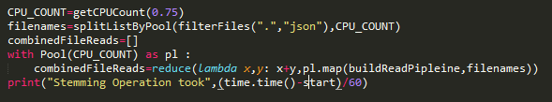
Map-Reduce framework
Developed MapReduce framework for parallel data processing
Python multiprocessing module for map and reduce processing

Slide 12
Data Pipelines and Data Flow
Text Feature Extraction
Model Building
Evaluation and Model Selection
Snowball Stemming
Stop words Removal
N-gram Model
Uni,bi,tri gram
Tf-idf weights
Naïve Bayes for Text Classification (Baseline)
Locality Sensitive Hashing ( Approximate Neighbours)
Precision
Recall
F-score

Slide 13
Naïve Bayes Model
Model assumes independence among dependent variables
Tf-Idf weighted Matrix input to the Naïve Bayes Model
Results for unigram – bigram – trigram
Proposed changes to the original naïve bayes algorithm
Instead of predicting most possible outcome, soft – predict the log probabilities for a data point
From the log probabilities, find the threshold after which the categories can be included in the result.
A data point can have multiple outcomes
These threshold are found using validation set

Slide 14
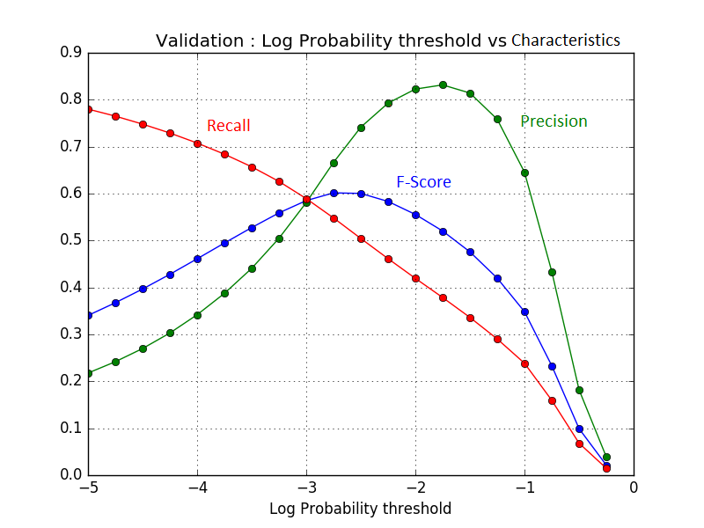
Validation Set - Unigram
Validation Set :
F-score Max at -2.75 log probability
Test Set Results:
F-score: 0.599
Precision: 0.66
Recall : 0.54

Slide 15
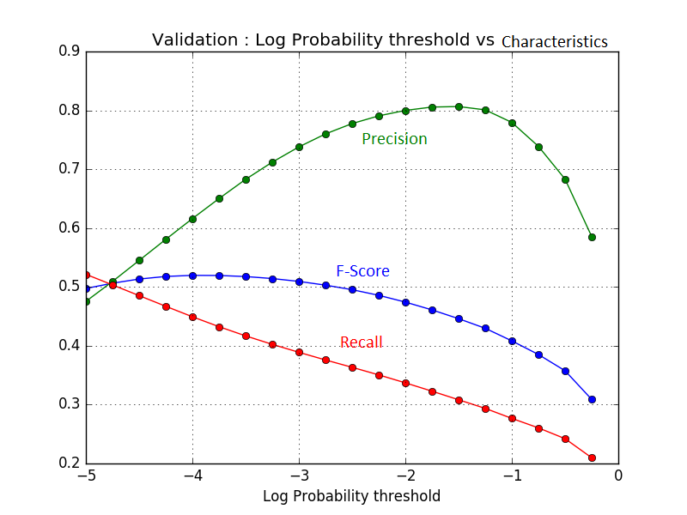
Validation Set - Bigram
Validation Set Results
Max – F-score : -4.75
Test Set Results:
Precision – 0.52
Recall – 0.53
F-score – 0.52

Slide 16
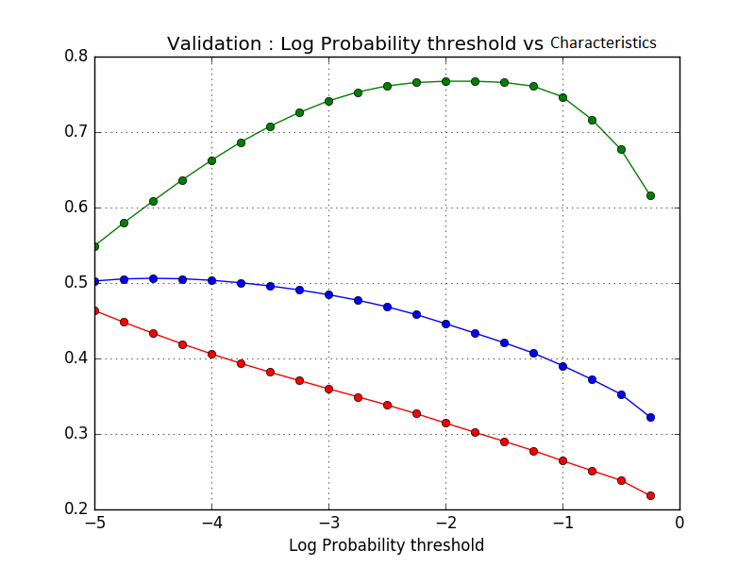
Trigram Results
Threshold: -5
Test Dataset Results:
Precision: 0.55
Recall : 0.48
F-score : 0.53

Slide 17
Naïve Bayes Conclusion
Unigram seems to give the highest balance between accuracy, recall and f-score
Ideally the assumption was that the higher grams should have more accuracy. But it is not the case.

Slide 18
Locality Sensitive Hashing
Approximate Nearest Neighbor
Uses min hash to calculate the similarity between shingles
Works on the assumption that there exists a hash function that could create a hash for feature vectors such that the similar features are put into same hash window
TF-IDF features as inputs
Goes well with our concept on multi-label classification since we are not predicting labels, rather finding similar training classes so that we could assign those training classes as predicted class

Slide 19
Proposed Changes to LSH
LSH being approximate nearest neighbor algorithm, this algorithm was chosen over nearest neighbors because of the number of data points.
Since we using the whole dataset, making a nearest neighbor match for every data point would take a huge amount of time
Instead, we find the k-nearest points using LSH, and we combine all classes of the training set as predicted class.
E.g: for k=2, predictions are [‘Restaurant’,’Chinese’] and [‘Chinese', 'Fast-Food’], we combine the Result as [‘Chinese’,’Fast-Food’,’Restaurant’]

Slide 20
LSH Results
Implementation using LSH – Forest using scikit-learn
Parameters:
N_estimators : Manages the LSH trees
N_candidates: # of Hash
K - # of extracted Nearest Neighbors

Slide 21
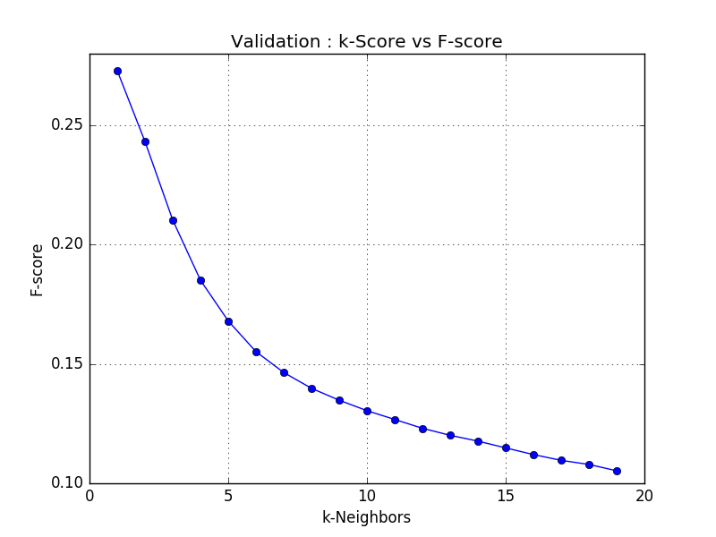
K vs F-score for 1 estimator, 10 candidates
F- Score highest for 1-NN
F- Score highest at 0.27 for 1-NN and progressively decreases for higher k-Numbers
Worse than the Naïve Bayes baseline

Slide 22
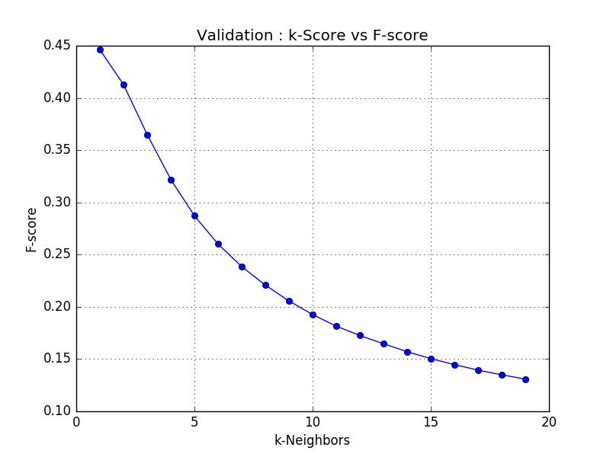
K vs F-score for 10 estimators, 10 candidates
This is better than the previous method. The Best F-score is of 1-NN with 0.45
Better than the previous method, but still worse than the Naïve Bayes baseline

Slide 23
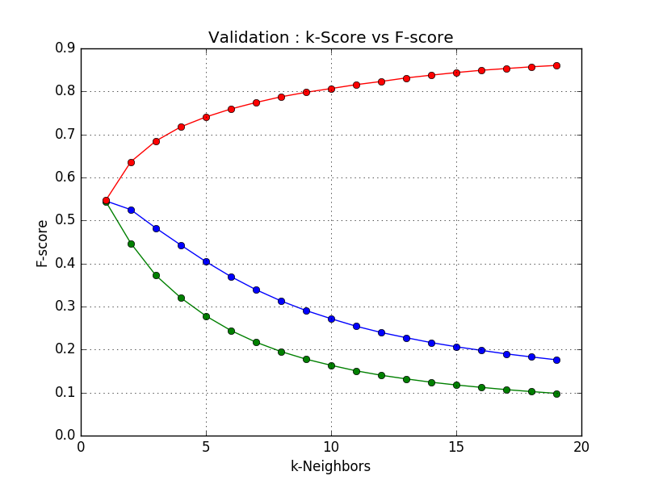
K-vs F-score, 10 candidates, 50 candidates
Better than the previous two methods
The F-score is 0.55, Better than the Baseline (Bigram, Trigram of Naïve Bayes)
The best is still 1-NN

Slide 24
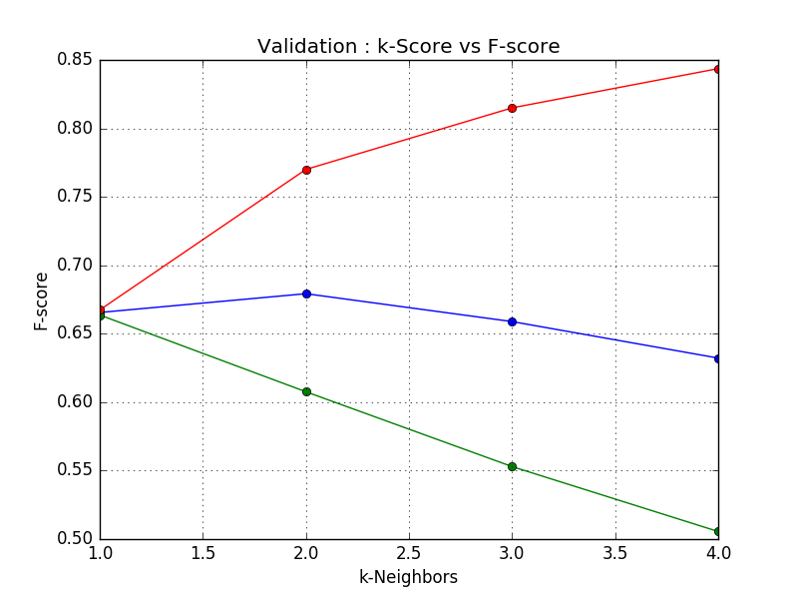
K vs F-score, 30 candidates, 500 candidates
Better than the previous two methods
The F-score is 0.55, Better than the Baseline (Bigram, Trigram of Naïve Bayes)
The best is still 1-NN
Test Results:
F-score : 0.6735
Precision : 0.6044
Recall : 0.76

Slide 25
Task -1 Conclusion
Naïve Bayes had a baseline highest f-score of 0.59.
However, when tuned, LSH Forest with 30 trees and 500 candidates, 1NN offers f-score of 0.67 and is the current best model among the models we tried.

Slide 26
Task - 2 : Research Question
Modeling user behaviour and predicting the restaurants that they would visit next
Dataset contains information about Users and the Restaurants they visited - 1363240 records
Based on Restaurant visited, extracted Cuisines - 110 Cuisines

Slide 27
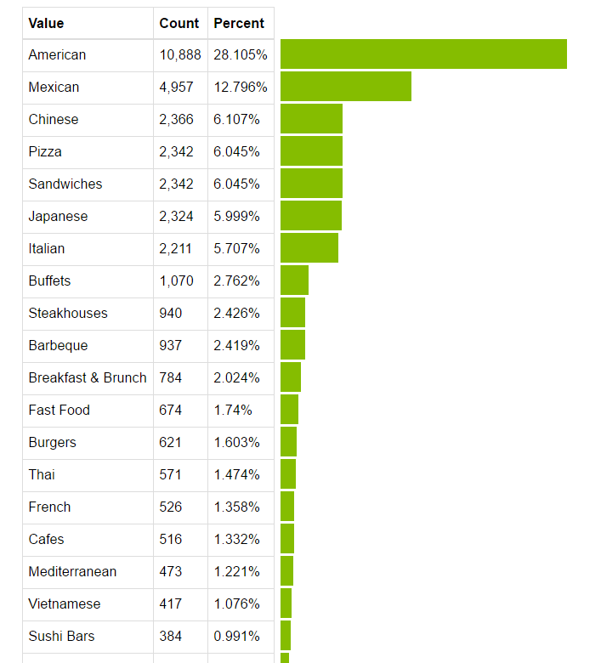
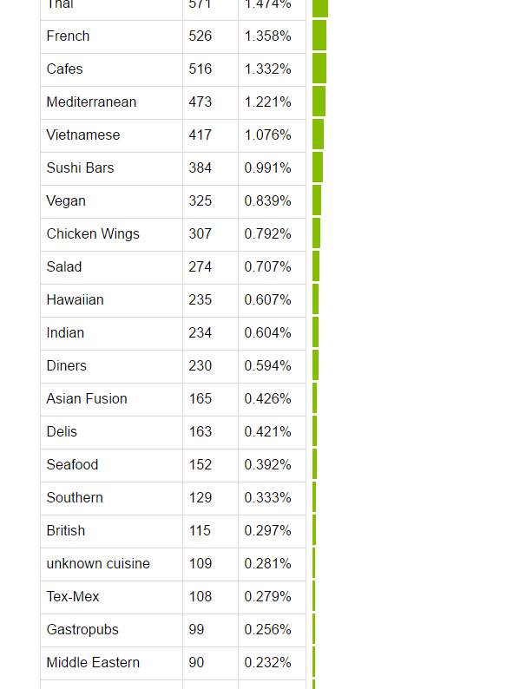
Data Distribution

Slide 28
Data Model - 0
Performed Matrix Factorization using user_id, Cuisine Combination(cuisine combined with week number)
A cuisine combination represents the number of times a customer visits a cuisine type on a given week
Tried with both complete data i.e. between every user and cuisines visited
Filtered with every user and the cuisine-week combination.
Key Parameters:
Number of Factors: 5, 50
Solver: ALS, SGD
Regularization: 1e-008

Slide 29
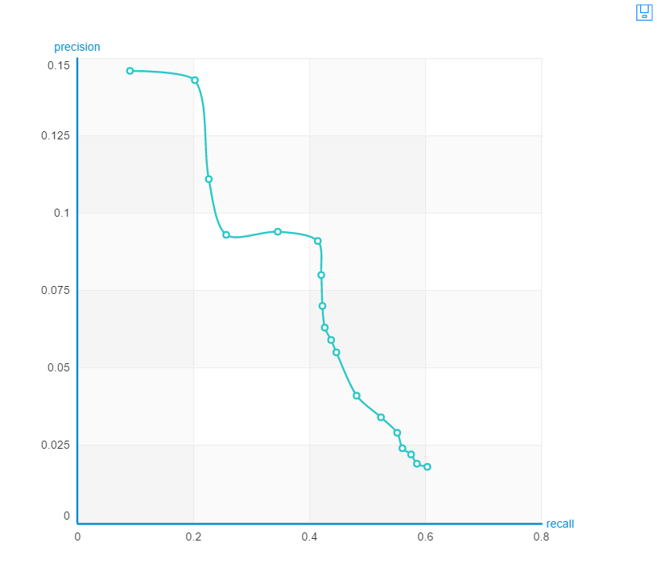
Model-0 Evaluation
SGD @ 5
Computing final objective value and training RMSE.
Final objective value: 0.937531
Final training RMSE: 0.96824
Precision and recall summary statistics by cutoff +--------+-----------------+-----------------+ | cutoff | mean_precision | mean_recall | +--------+-----------------+-----------------+ | 1 | 0.145833333333 | 0.0899801587302 | | 2 | 0.142857142857 | 0.202411477411 | | 3 | 0.111111111111 | 0.226295405983 | | 4 | 0.093005952381 | 0.255660485348 | | 5 | 0.0940476190476 | 0.34544223138 | | 6 | 0.0912698412698 | 0.413894612332 | | 7 | 0.0799319727891 | 0.420447954823 | | 8 | 0.0703125 | 0.421936050061 | | 9 | 0.0631613756614 | 0.426400335775 | | 10 | 0.058630952381 | 0.436916208791 | +--------+-----------------+-----------------+ [10 rows x 3 columns] ('Overall RMSE: ', 2.7604177035996567)

Slide 30
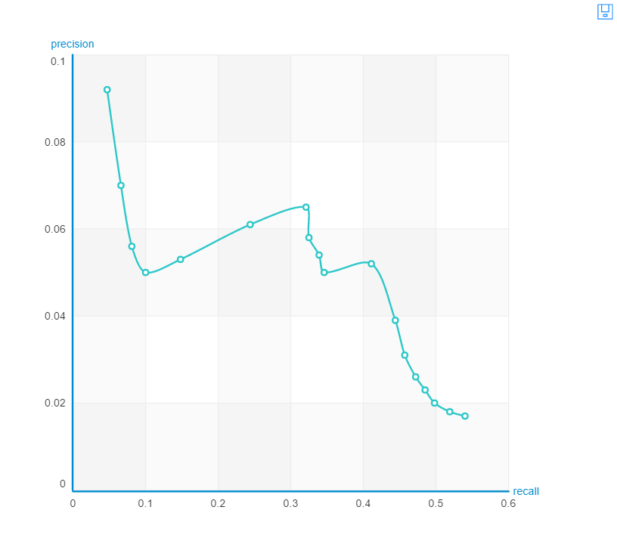
Model-0 Evaluation
SGD @ 50
Final training RMSE: 0.478214
Precision and recall summary statistics by cutoff +--------+-----------------+-----------------+ | cutoff | mean_precision | mean_recall | +--------+-----------------+-----------------+ | 1 | 0.0922619047619 | 0.0468063186813 | | 2 | 0.0699404761905 | 0.0663556929182 | | 3 | 0.0555555555556 | 0.0814407814408 | | 4 | 0.0498511904762 | 0.100265186203 | | 5 | 0.0529761904762 | 0.148479471917 | | 6 | 0.0610119047619 | 0.243717567155 | | 7 | 0.0654761904762 | 0.321079441392 | | 8 | 0.0580357142857 | 0.32504769536 | | 9 | 0.0542328042328 | 0.338669490232 | | 10 | 0.0497023809524 | 0.346109966422 | +--------+-----------------+-----------------+ [10 rows x 3 columns] ('\nOverall RMSE: ', 2.5706642746735713)

Slide 31
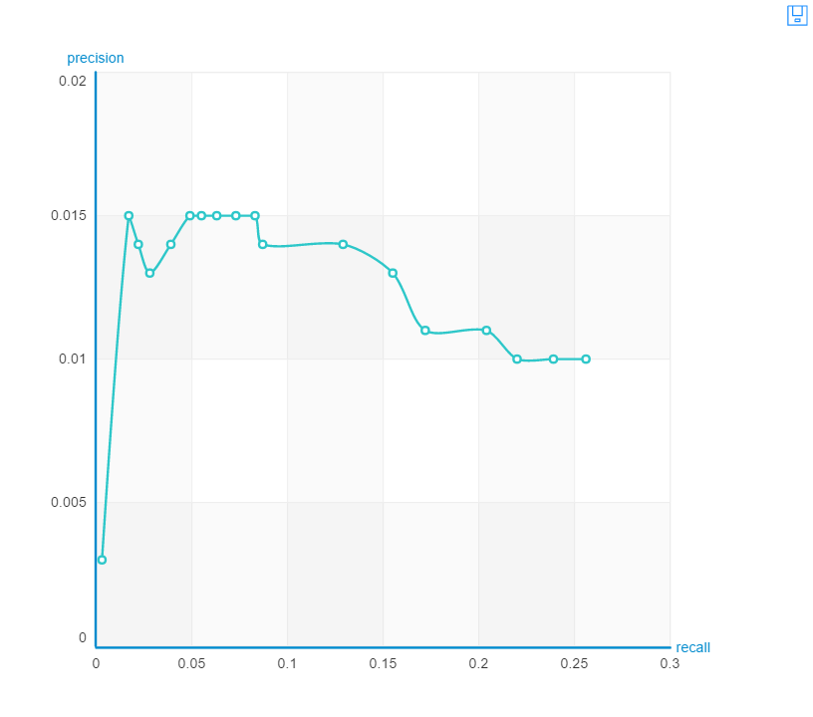
Model-0 Evaluation
ALS @ 50
Final training RMSE: 0.00731546
Precision and recall summary statistics by cutoff +--------+------------------+------------------+ | cutoff | mean_precision | mean_recall | +--------+------------------+------------------+ | 1 | 0.00297619047619 | 0.00297619047619 | | 2 | 0.014880952381 | 0.0165483821734 | | 3 | 0.0138888888889 | 0.0218807234432 | | 4 | 0.0126488095238 | 0.0284283424908 | | 5 | 0.0136904761905 | 0.0393219627595 | | 6 | 0.014880952381 | 0.0489945818071 | | 7 | 0.014880952381 | 0.0551759004884 | | 8 | 0.0145089285714 | 0.0628453144078 | | 9 | 0.0145502645503 | 0.0727659493284 | | 10 | 0.0145833333333 | 0.0831826159951 | +--------+------------------+------------------+ [10 rows x 3 columns] ('\nOverall RMSE: ', 6.695286353597653)

Slide 32
Data Model - 1
Performed Matrix Factorization using User_id, Cuisine and the number of times this User visited a particular Cuisine
Complete Data with every user and cuisines visited
Key Parameters:
Number of Factors: 5, 50
Solver: ALS, SGD
Regularization: 1e-008

Slide 33
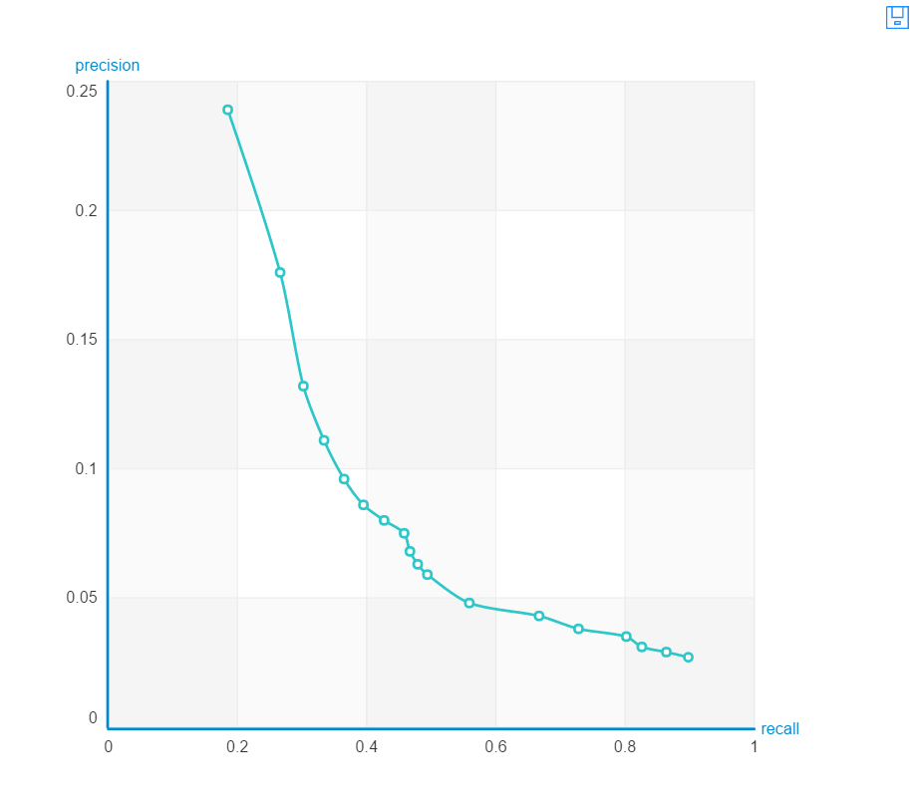
Model - 1 : Evaluation
SGD @ 5
Final training RMSE: 0.614477
Precision and recall summary statistics by cutoff +--------+-----------------+----------------+ | cutoff | mean_precision | mean_recall | +--------+-----------------+----------------+ | 1 | 0.239010989011 | 0.185034013605 | | 2 | 0.175824175824 | 0.265901360544 | | 3 | 0.131868131868 | 0.301844583987 | | 4 | 0.110576923077 | 0.334353741497 | | 5 | 0.0956043956044 | 0.365031397174 | | 6 | 0.0856227106227 | 0.394793301936 | | 7 | 0.0796703296703 | 0.427394034537 | | 8 | 0.075206043956 | 0.458464154893 | | 9 | 0.0683760683761 | 0.466797488226 | | 10 | 0.0631868131868 | 0.478702250131 | +--------+-----------------+----------------+
('\nOverall RMSE: ', 2.2845074939012826)

Slide 34
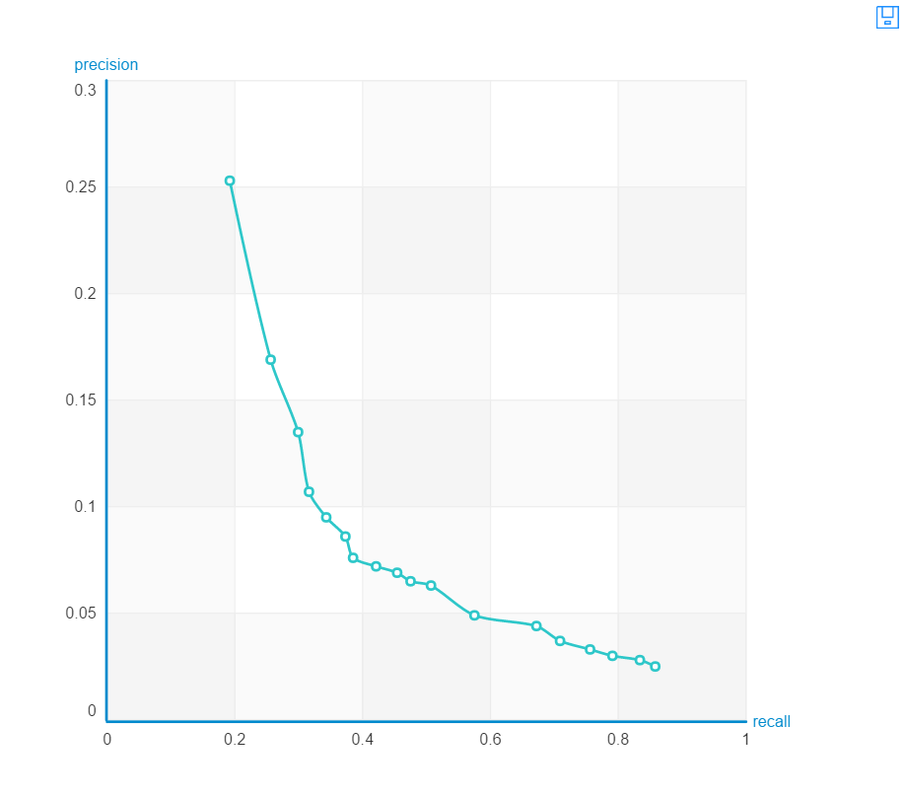
Model - 1 : Evaluation
SGD@50
Final training RMSE: 0.0830334
Precision and recall summary statistics by cutoff +--------+-----------------+----------------+ | cutoff | mean_precision | mean_recall | +--------+-----------------+----------------+ | 1 | 0.252747252747 | 0.191902145474 | | 2 | 0.168956043956 | 0.255664573522 | | 3 | 0.134615384615 | 0.29903192046 | | 4 | 0.107142857143 | 0.315835949765 | | 5 | 0.0945054945055 | 0.343406593407 | | 6 | 0.0856227106227 | 0.373495552067 | | 7 | 0.0757456828885 | 0.385400313972 | | 8 | 0.0721153846154 | 0.421297749869 | | 9 | 0.0686813186813 | 0.454035845107 | | 10 | 0.0648351648352 | 0.474869178441 | +--------+-----------------+----------------+ [10 rows x 3 columns]
('\nOverall RMSE: ', 1.1402851519093327)

Slide 35
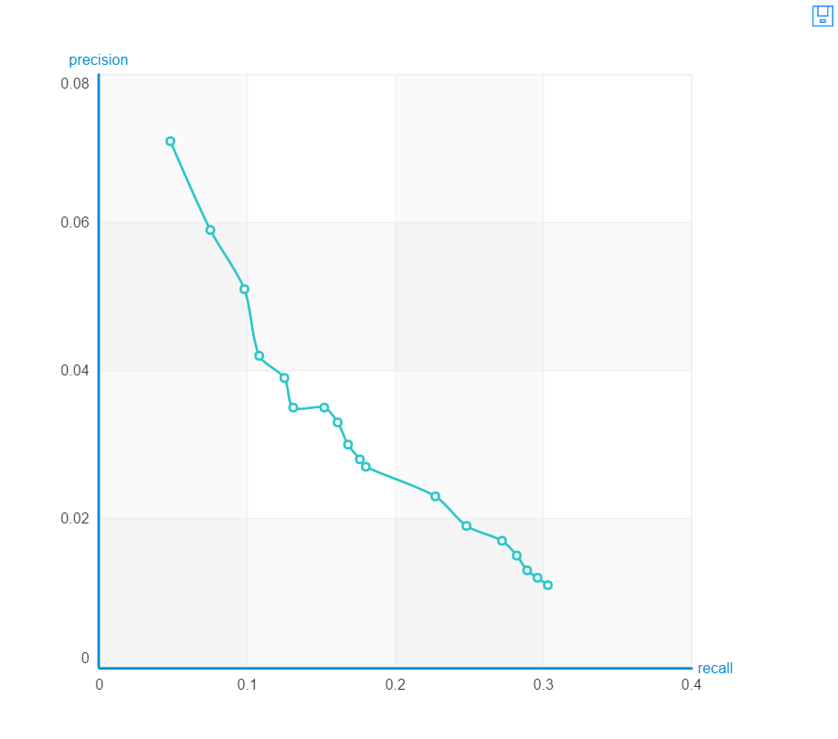
Model - 1 : Evaluation
ALS@50
RMSE Training: 0.0110711
Precision and recall summary statistics by cutoff +--------+-----------------+-----------------+ | cutoff | mean_precision | mean_recall | +--------+-----------------+-----------------+ | 1 | 0.0714285714286 | 0.048266614338 | | 2 | 0.0590659340659 | 0.0753074306646 | | 3 | 0.0512820512821 | 0.0975143903715 | | 4 | 0.0418956043956 | 0.107522239665 | | 5 | 0.039010989011 | 0.125085034014 | | 6 | 0.0352564102564 | 0.1306711146 | | 7 | 0.0353218210361 | 0.151988487703 | | 8 | 0.0326236263736 | 0.16114599686 | | 9 | 0.0302197802198 | 0.168243066457 | | 10 | 0.0282967032967 | 0.176026949241 | +--------+-----------------+-----------------+ [10 rows x 3 columns] ('\nOverall RMSE: ', 2.1236504553695967)

Slide 36
Data Model - 2
Performed Matrix Factorization using User_id, Cuisine and the number of times this User visited a particular Cuisine
Filtered Data used where every user visited 3 or more Cuisines
Key Parameters:
Number of Factors: 5, 50
Solver: ALS, SGD
Regularization: 1e-008

Slide 37
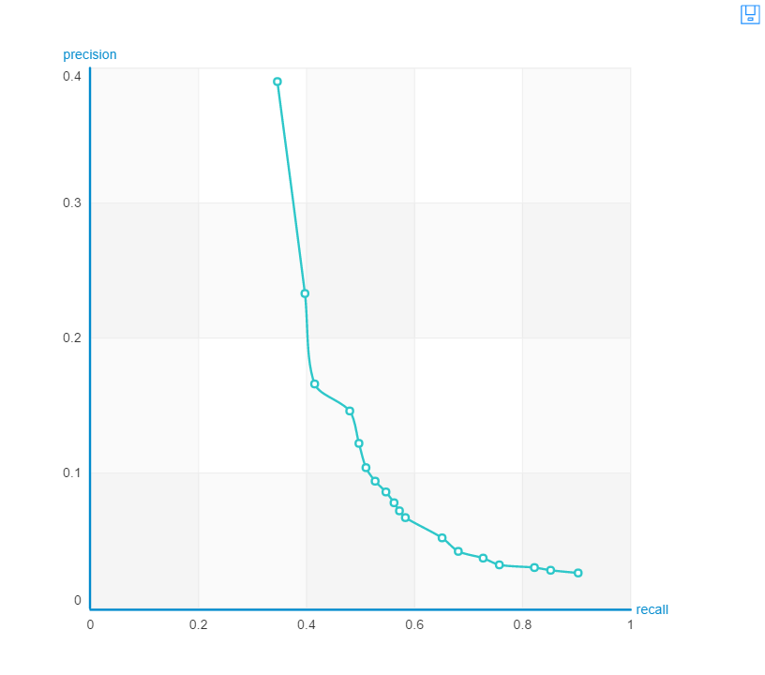
Model - 2 : Evaluation
SGD @ 5
Final training RMSE: 0.179561
Precision and recall summary statistics by cutoff +--------+-----------------+----------------+ | cutoff | mean_precision | mean_recall | +--------+-----------------+----------------+ | 1 | 0.384126984127 | 0.334973544974 | | 2 | 0.236507936508 | 0.392305366591 | | 3 | 0.198941798942 | 0.482993197279 | | 4 | 0.155555555556 | 0.495616024187 | | 5 | 0.126349206349 | 0.498715041572 | | 6 | 0.107936507937 | 0.50612244898 | | 7 | 0.0984126984127 | 0.53903250189 | | 8 | 0.0869047619048 | 0.542842025699 | | 9 | 0.0783068783069 | 0.547074829932 | | 10 | 0.072380952381 | 0.560831443689 | +--------+-----------------+----------------+ [10 rows x 3 columns] ('\nOverall RMSE: ', 5.216071750177229)

Slide 38
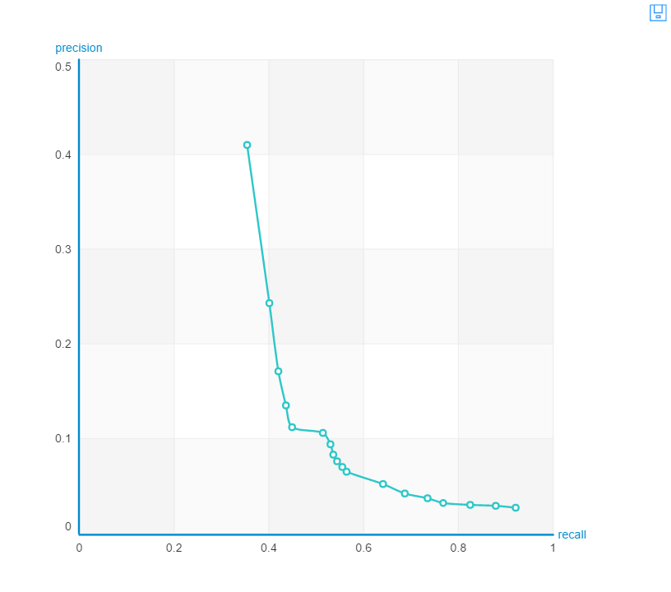
Model - 2 : Evaluation
SGD @ 50
Precision and recall summary statistics by cutoff +--------+-----------------+----------------+ | cutoff | mean_precision | mean_recall | +--------+-----------------+----------------+ | 1 | 0.409523809524 | 0.353597883598 | | 2 | 0.242857142857 | 0.401322751323 | | 3 | 0.171428571429 | 0.419682539683 | | 4 | 0.134920634921 | 0.436349206349 | | 5 | 0.111746031746 | 0.448518518519 | | 6 | 0.10582010582 | 0.514391534392 | | 7 | 0.0938775510204 | 0.530105820106 | | 8 | 0.0833333333333 | 0.535661375661 | | 9 | 0.0758377425044 | 0.543703703704 | | 10 | 0.0701587301587 | 0.55544973545 | +--------+-----------------+----------------+ [10 rows x 3 columns] ('\nOverall RMSE: ', 4.768527798015038)

Slide 39
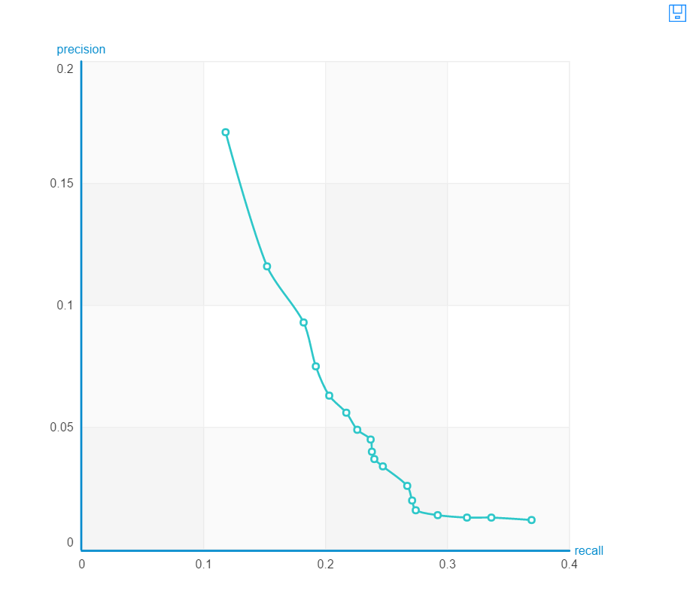
Model - 2 : Evaluation
ALS@50
Precision and recall summary statistics by cutoff +--------+-----------------+-----------------+ | cutoff | mean_precision | mean_recall | +--------+-----------------+-----------------+ | 1 | 0.0796703296703 | 0.040737833595 | | 2 | 0.0631868131868 | 0.0638932496075 | | 3 | 0.0558608058608 | 0.0856946624804 | | 4 | 0.0521978021978 | 0.104657247514 | | 5 | 0.0445054945055 | 0.113448456306 | | 6 | 0.0393772893773 | 0.121624803768 | | 7 | 0.0345368916797 | 0.12322736787 | | 8 | 0.0315934065934 | 0.126367085296 | | 9 | 0.0283882783883 | 0.127282836211 | | 10 | 0.0266483516484 | 0.1340855573 | +--------+-----------------+-----------------+ [10 rows x 3 columns] ('\nOverall RMSE: ', 1.9168109059685745)

Slide 40
Task-2 Conclusion
Without using any sort of feedback such as rating and reviews we have found that by just focusing on count of users visit to the business and the type of cuisine he/she is interested in ,
a)Matrix Factorization using Gradient Descent Solver with 50 factors gives the best accuracy and recall for the entire dataset
b)If the frequency of the visit to the cuisine is greater than 3 it increases all the more
c)Using week number information along with the cuisine is a cold start problem as there is not enough information available to make accurate predictions
d) Using the top two or three ranked cuisines(cut-off @ 1,2,3) we can use locations information(latitude, longitude) of the user to predict all the business he/she may visit

Slide 41
Future Work
Using locations information of the user to predict all the business with the cuisines he/she most likely would try.

Slide 42
Thank You!
Questions?

