Slide 1
Wind Turbine Power Prediction
Submitted By:
Dhrubajyoti Chakraborty
PGPDS
Praxis Business School

Slide 2
Problem Understanding
As the global warming situation worsens and the burning of fossil fuels causes air pollution and climate change, renewable energy development and deployment are becoming increasingly important.
Changes in the climate affect wind power forecasting under different weather conditions.
At all times in the power system, a balance between electricity demand and generation must be maintained.
Fluctuations of wind generation require power substitution from other sources that might not be available on a short notice.
When wind power accounts for more than a modest percentage of total electricity provided to the grid, the problem becomes more complicated.

Slide 3
Tools and Techniques Used
Spark
Python
Google Collaboratory
Pandas
Seaborn
Matplotlib

Slide 4
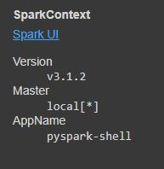
Setting up Spark Environment
Installed all the dependencies in Colab environment such as Apache Spark 3.1.2, openjdk 8.
Set the environment path that enables us to run PySpark in Google Colab environment.
Run a local spark session to test our installation.

Slide 5
Understanding the Dataset
Date/Time (for 10 minutes intervals)
LV Active Power (kW): The power generated by the turbine for that moment.
Wind Speed (m/s): The wind speed at the hub height of the turbine (the wind speed that turbine use for electricity generation).
Theoretical Power Curve (KWh): The theoretical power values that the turbine generates with that wind speed which is given by the turbine manufacturer.
Wind Direction (°): The wind direction at the hub height of the turbine (wind turbines turn to this direction automatically).

Slide 6
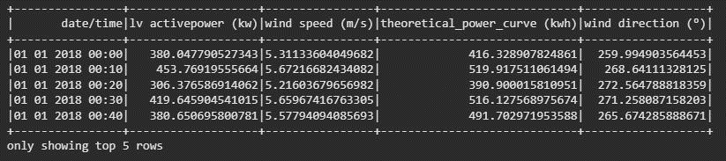
Glimpse of Dataset
No of Rows : 50530
No of Columns: 5

Slide 7

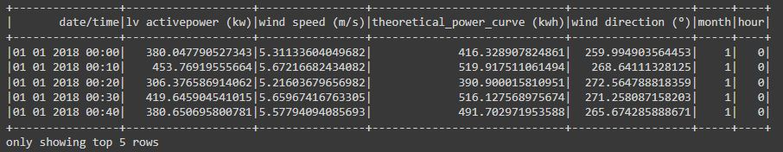
Creating Hour and Month columns

Slide 8
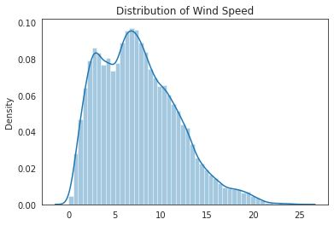
Exploratory Data Analysis
Distribution seems to be mostly normal.
Most wind speed falls between 2 – 7.

Slide 9
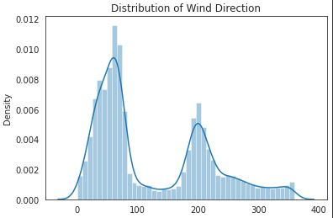
Exploratory Data Analysis
2 peaks indicates that it is a bimodal distribution.
Most of the observations fall in these 2 peaks.

Slide 10
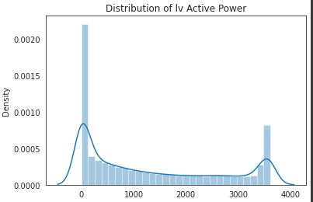
Exploratory Data Analysis
Distribution seems to be right skewed.
At 0 and 3500 most of the data fall in this range.

Slide 11
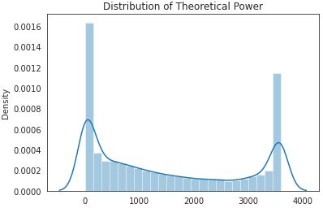
Exploratory Data Analysis
Distribution seems to be right skewed.
At 0 and 3500 most of the data fall in this range.

Slide 12
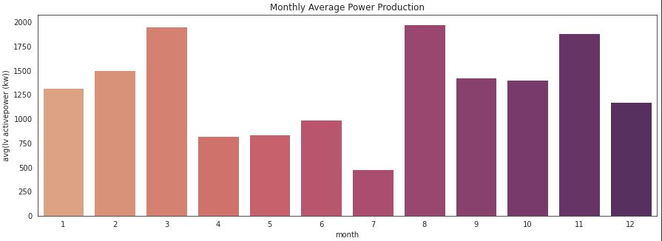
Average power production by month
In March, August and November, the average power production is higher.
In April, June, July and August is lower.

Slide 13
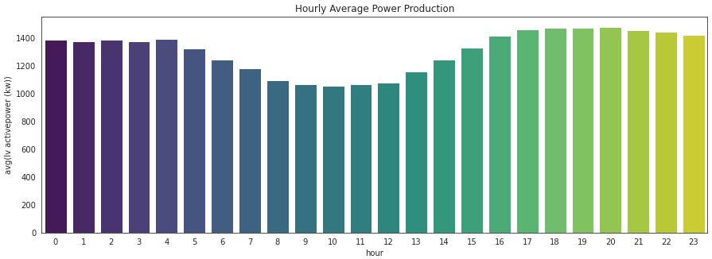
Average power production by hour
The average power production daily decays after 04:00 and start to increase after 12:00 and is higher between 16:00 and 24:00.

Slide 14
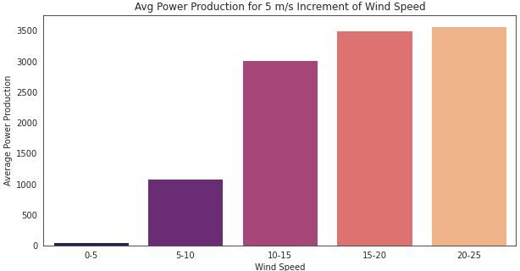
Relation between the wind speed and power production by increasing wind speed by 5m/s
The power production reaches near a maximum level after the wind speed reaches 15 m/s.

Slide 15
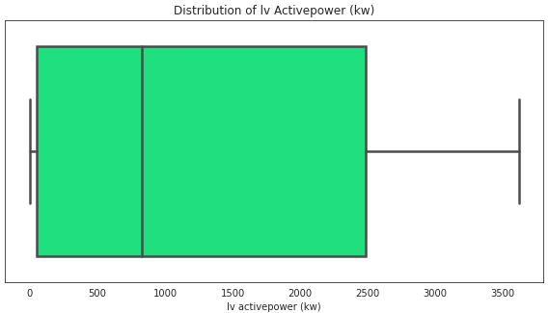
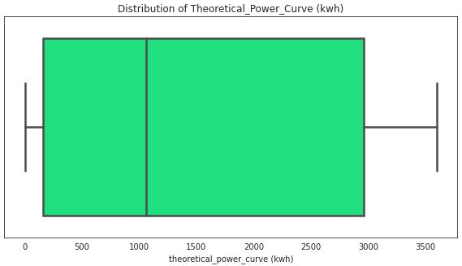
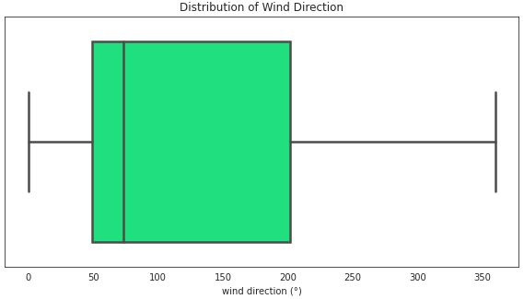
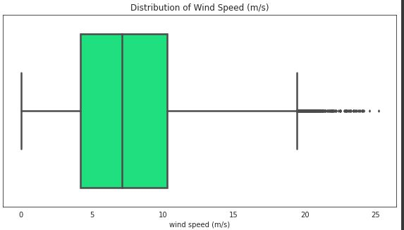
Box Plot
There are some outliers for Wind Speed.
Others don’t have any outliers.

Slide 16
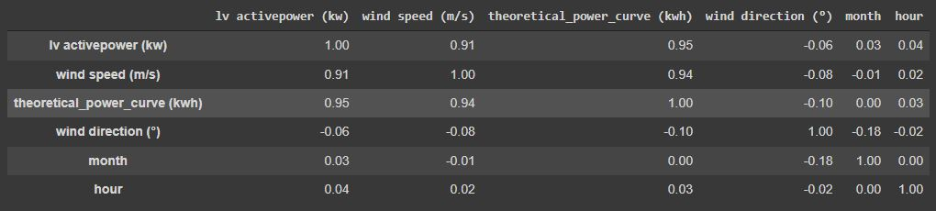
Correlation among the variables
Wind speed and power production is correlated.

Slide 17
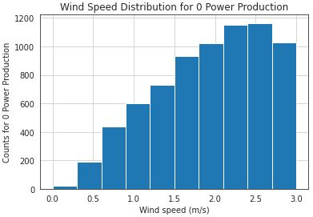
Wind Speed distribution for zero Power
Theoretical power curve has a limit of 3 m/s wind speed.
There is no power output if the wind speed is less than 3 m/s.

Slide 18
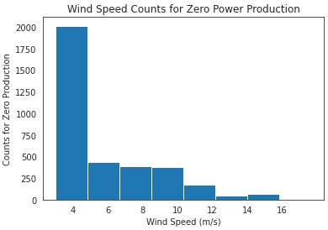
Wind Speed counts for zero power production
Theoretically, the wind speed barrier should be 4 m/s. However, there have been instances where no power is produced while the wind speed is higher.

Slide 19
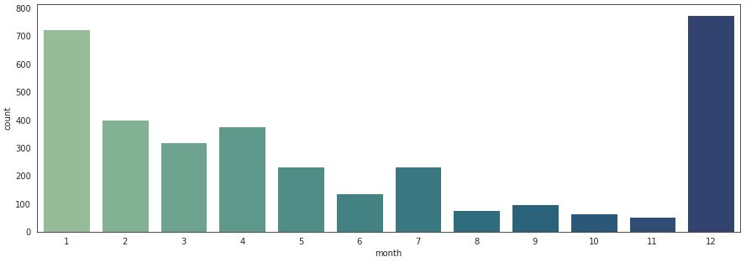
Monthly distribution for zero power production
The wind turbine normally does not produce in the months of December and January.

Slide 20

Preprocessing
Removing 3497 observations where windspeed is > 3 m/s but power production is zero as the reason for this observation is totally unknown.

Slide 21
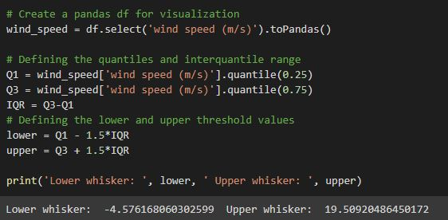
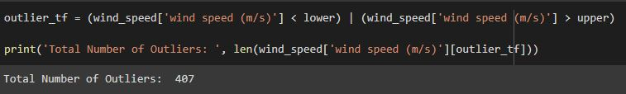
Preprocessing
Calculating Upper and Lower whisker for Wind Speed.
Finding total no of outliers for Wind Speed.

Slide 22

Preprocessing
Treating outliers.
Replace all values higher than 19.50 with 19

Slide 23
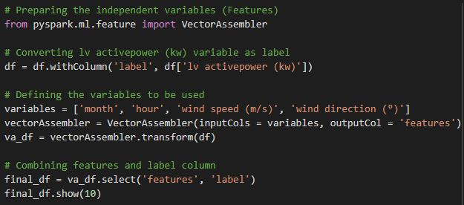
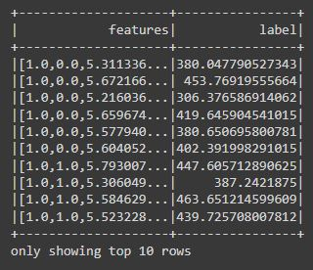
Preprocessing
Vector assembler is used to combine numerous columns into a vector column, which was then produced as a single feature column.
All of the necessary columns have inputs.

Slide 24
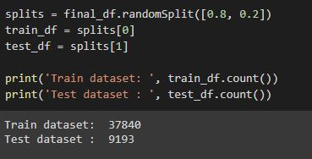
Model Preparation
For machine learning model creation and verification, divide the data into training and test datasets.
Train dataset has 37840 rows.
Test dataset has 9193 rows of data.

Slide 25
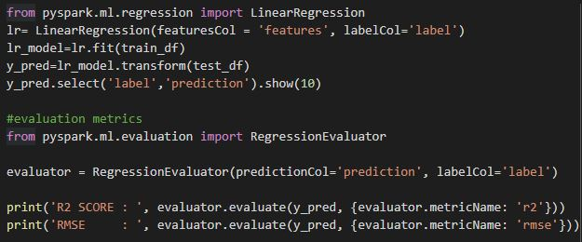

Model Building
For implementing the model from pyspark ml regression model imported the Linear Regression.
Created an instance of that with mentioning the feature columns , label columns and model type.
Fit the model into the train data and performed prediction with test data.
R2 Score and RMSE obtained as 0.8885 and 435.26 respectively.

Slide 26
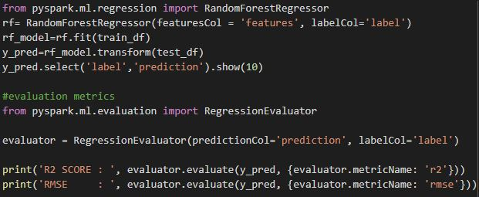

Model Building
In this case another model was built which is Random Forest Regressor.
In this model r2 score and RMSE obtained as 0.9690 and 229.35 respectively.
This model is performing better than the Linear Regression model.

Slide 27

Conclusions
From the Exploratory Data Analysis, we could generate insight from the data - how each of the features are related to the target.
From the evaluation of two models that Random Forest Regressor performed better than Linear Regression.
R2 Score and RMSE scores are 0.96 and 229.35 respectively for Random Forest Regressor.
Though this model is performing better but Deep Learning models can be more useful to obtain the correlations between meteorological features and power generation.

Slide 28


