Slide 1
YANG by Example
v1.0 (2015-10-05)

Slide 2
Overview and Objectives
This presentation uses an example to walk through all main features in the YANG data modeling language.
Our example uses standard and draft-standard YANG modules for static MPLS LSPs with the goal of creating valid configuration
After this presentation, you should be able to:
Identify and describe common elements of a YANG model
Examine a YANG model and create a valid configuration instance
Notes:
Worked with some professional learning development people for this presentation
They suggested trying a use-case driven process where we would walk through something that the audience knew about, and learn along the way
So this is not a slide-version of the YANG RFC – going back and reading the RFC is the next step from here

Slide 3
YANG Models Used
IETF Standard Track YANG Models:
RFC 6991 Common YANG Data Types ietf-yang-types@2013-07-15.yang
RFC 7277 IP Management ietf-ip@2014-06-16.yang
RFC 7224 IANA Interface Type iana-if-type@2014-05-08.yang
RFC 7223 Interface Management ietf-interfaces@2014-05-08.yang
Draft YANG Models:
OpenConfig MPLS LSP Model

Slide 4
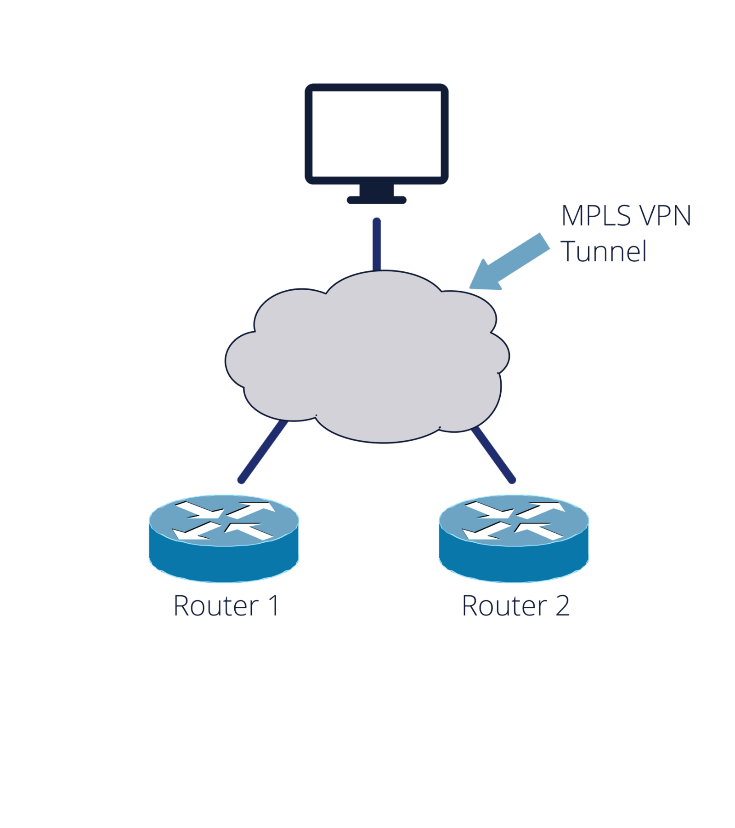
Our Use Case – MPLS VPN Configuration
Tasks:
Enable interfaces on routers
Assign IPv6 addresses to interfaces
Configure Static MPLS LSPs
Router 1:
eth0: 2001:db8:c18:1::3/128
Router 2:
eth0: 2001:db8:c18:1::2/128

Slide 5
Task #1: Enabling the Interfaces
We start with the Interface Management Model
Examine model for YANG features:
Structure
Configuration and operational data
Built-in and customer data types
Conditional features
Abstract identities
Nodes references

Slide 6

Interface Management Model Structure
RW
interfaces
RO
interfaces
string
name
Interfaces-state
string
name
interface
identityref
type
interface
vang:date-and-time
last-change
boolean
enabled
interface-state-ref
Higher-layer-if*
enumeration
Link-up-down- trap-enable?
Two top-level containers:
interfaces
One entry per configured interface
Contains all configuration per interface
interfaces-state
One entry per interface on the device
Contains all operational state per interface
Notes:
Start by talking about the general structure, we will get to the YANG soon
Two top level containers representing the configuration and operational state of an interface respectively
This design is the result

Slide 7

The Interfaces List
“eth0”
name
ethernetCsmacd
type
true
enabled
enabled
Link-up-down-trap-enable?
interfaces
interfaces
string
string
name
“eth0”
“Eth1”
name
identityref
type
“Eth1”
ethernetCsmacd
type
boolean
enabled
“eth0”
true
enabled
enumeration
link-up-down-
trap-enable
enabled
Link-up-down-trap-enable?
“Eth3”
name
ethernetCsmacd
type
false
enabled
disabled
Link-up-down-trap-enable?
The Model
Example Instance data

Slide 8
The Module Header
RFC 7223 Interface Management
Header Information
module ietf-interfaces {
namespace "urn:ietf:params:xml:ns:yang:ietf-interfaces";
prefix if;
import ietf-yang-types {
prefix yang;
}
organization
"IETF NETMOD (NETCONF Data Modeling Language) Working
Group";
contact
"WG Web: <http://tools.ietf.org/wg/netmod/>
WG List: <mailto:netmod@ietf.org>
...
description
"This module contains a collection of YANG definitions for
managing network interfaces.
...
revision 2014-05-08 {
description
"Initial revision.";
reference
"RFC 7223: A YANG Data Model for Interface Management";
}
Imports and Include
Type Definitions
Configuration and Operational
Data Declarations
Action (RPC) & Notification Declarations
Notes:
So, let’s dive into YANG
The module name is informally expected to be globally unique, and also forms part of the filename along with the revision string
The namespace is described to be globally unique, and the value is a URI, may be a IANA managed URN, like in this example or e.g. a URL
The revision statement uniquely versions the module using a date format.
There are specific rules about which types of changes may be done to a module such that a version bump is not requires

Slide 9
Defining a Container
Container statement:
Defines an interior data node in the schema tree
One argument - identifier
No value, but has a list of child nodes in the data tree
interfaces
container interfaces {
description
"Interface configuration parameters.”
...
}

Slide 10
Defining a List
interfaces
List statement:
Defines an interior data node in the schema tree.
Single argument - identifier,
Represents a collection of entries –each entry consists of one or more nodes
RW
RO
interface
Interface-state
container interfaces {
...
list interface {
key “name”;
description
“The list of configured interfaces on the device.“;
}
container interfaces-state {
config false;
list interface {
key “name”;
description
“Data nodes for the operational
state of interfaces.”
}
}
config false – Data under interfaces-state is read-only
Config (RW) and State (RO) clearly separated in this model

Slide 11
Defining Leaves
The Model
A leaf is defined by an identifier and has a type
RW
interface
list interface {
key “name”;
description “...”;
leaf name {
type string;
description
“The name of the interface“
}
}
name
string
interface
identifier
name
An Instance of the Model
Leaf name serves as list key
The type is string
interface
“eth0”
“eth0”
“eth1”
“eth1”
“eth2”
“eth2”

Slide 12
YANG Data Types
YANG has a set of built-in types, similar to those of many programming languages
Use pattern , range, and length statements to restrict values
type string {
length "0..4"; pattern "[0-9a-fA-F]*";
}
binary
bits
boolean
decimal64
empty
enumeration
identityref
instance-identifier
int8, int16, int32, int64
leafref
string
uint8, uint16, uint32, uint64
union

Slide 13
Leaf Types - Boolean
Leaf enabled with boolean value true or false
This is where the interface can be enabled and disabled
The Model
RW
interface
list interface{
key “name”;
description “...”;
leaf name {...}
leaf enabled {
type boolean;
default "true";
description
"This leaf contains the configured,
desired state of the interface.”
}
}
name
string
name
enabled
boolean
An Instance of the Model
name
“eth0”
enabled
true
interface
name
“Eth1”
“eth0”
enabled
true
“Eth1”
“eth0”
name
“eth0”
enabled
true

Slide 14
Leaf Types - Enumeration
Leaf link-up-down-trap-enable may take value enabled or disabled
The Model
RW
interface
name
string
name
list interface{
key “name”;
leaf name {...}
leaf enabled {...}
leaf link-up-down-trap-enable {
if-feature if-mib;
type enumeration {
enum enabled {value 1;}
enum disabled {value 2;}
}
description
"Controls whether linkUp/Down SNMP notifications should be generated”;
}
}
enabled
boolean
link-up-down-
trap-enable?
enumeration
Switch order on graphic

Slide 15
Defining new types
New types can be defined using the typedef statement
typedef percent {
type uint8 {
range "0 .. 100";
}
description "Percentage";
}
leaf completed {
type percent;
}
RFC 6991: Common YANG Data Types
ietf-inet-types (ipv4- and ipv6-addresses, domain-name, etc)
ietf-yang-types (counters, gauges, date-and-time, etc)

Slide 16
Conditional Leaves - Features
feature if-mib {
description
"This feature indicates that the
device implements the IF-MIB.";
reference
"RFC 2863: The Interfaces Group MIB";
}
...
list interface{
key “name”;
leaf name {...}
leaf enabled {...}
leaf link-up-down-trap-enable {
if-feature if-mib;
type enumeration {
enum enabled {value 1;}
enum disabled {value 2;}
}
description
"Controls whether linkUp/Down SNMP notifications should be generated”;
}
}
The feature statement is used to mark parts of the model as conditional
The if-feature statement makes the parent statement conditional
This leaf is a part of our model only If the if-mib feature is supported in the server

Slide 17
Abstract Types - Identityref
identity interface-type {
description
"Base identity from which specific interface types are derived.";
}
leaf type {
type identityref {
base interface-type;
}
mandatory true;
description
"The type of the interface....";
reference
"RFC 2863: The Interfaces Group MIB –
ifType";
}
The Model
RW
interface
name
string
name
type
identityref
An Instance of the Model
name
“eth0”
type
ethernetCsmacd
interface
name
“Eth1”
“eth0”
type
ethernetCsmacd
“Eth1”
“eth0”
name
“eth0”
type
ethernetCsmacd

Slide 18

The Instance Data in XML
Instance
interface
“eth0”
name
interface
true
enabled
XML Representation
<interfaces>
<interface>
<name>eth0</name>
<enabled>true</enabled>
</interface>
</interfaces
Router 1:
eth0: 2001:db8:c18:1::3/128
Router 2:
eth0: 2001:db8:c18:1::2/128

Slide 19
Inspecting the Interfaces State Tree
RO
+--ro interfaces-state
+--ro interface* [name]
+--ro name string
+--ro type identityref
+--ro admin-status enumeration
+--ro oper-status enumeration
+--ro last-change? yang:date-and-time
+--ro if-index int32
+--ro phys-address? yang:phys-address
+--ro higher-layer-if* interface-state-ref
+--ro lower-layer-if* interface-state-ref
+--ro speed? yang:gauge64
+--ro statistics
+--ro discontinuity-time yang:date-and-time
+--ro in-octets? yang:counter64
+--ro in-unicast-pkts? yang:counter64
+--ro in-broadcast-pkts? yang:counter64
+--ro in-multicast-pkts? yang:counter64
+--ro in-discards? yang:counter32
+--ro in-errors? yang:counter32
+--ro in-unknown-protos? yang:counter32
…
Interfaces-state
string
name
vang:date-and-time
last-change
interface-state-ref
Higher-layer-if*
Each entry in the interfaces-state list is a container representing the state of an interface
Notes:
Before we head towards the next task, let’s look at some of the data definitions in the interfaces-state tree
First, let’s look at

Slide 20
Imports and Includes
...
import ietf-yang-types {
prefix yang;
}
...
YANG structures data models into modules and submodules.
The import statement makes definitions from one module available inside another module or submodule
The include statement is used to make content from a submodule available to that submodule’s parent module, or to another submodule of that parent module.
Notes:
Importing data makes the data definitions in the external module available in the local module using a namespace prefix
Including a submodule is a way of splitting large modules into smaller files – each representing a submodule
A submodule declaratively belongs-to a specific module, so can’t be reused by others
This example will use imports, but not submodules
The import statement value is the module name declared in the header of the imported module

Slide 21
Example Import
ietf-yang-types.yang
typedef date-and-time {
type string {
pattern '\d{4}-\d{2}-\d{2}T\d{2}:\d{2}:\d{2}(\.\d+)?'
+ '(Z|[\+\-]\d{2}:\d{2})';
}
description
"The date-and-time type is a profile of the ISO 8601 standard for representation of dates and times using the …
import ietf-yang-types {
prefix yang;
}
...
leaf last-change {
type yang:date-and-time;
description
"The time the interface entered its current operational
state. If the current state was entered prior to the
last re-initialization of the local network management
subsystem, then this node is not present.";
reference
"RFC 2863: The Interfaces Group MIB - ifLastChange";
}
Notes:
Importing data makes the data definitions in the external module available in the local module using a namespace prefix
Including a submodule is a way of splitting large modules into smaller files – each representing a submodule
A submodule declaratively belongs-to a specific module, so can’t be reused by others
This example will use imports, but not submodules
The import statement value is the module name declared in the header of the imported module

Slide 22

Example derived type
Model
Instance
“eth0”
Interfaces-state
RO
Interfaces-state
2015-05-19T16:39:57-08:00
string
name
interface
vang:date-and-time
last-change
interface
“Eth1”
interface
interface
2015-05-19T16:39:57-08:00
interface
interface
interface
“eth0”
2015-05-19T16:39:57-08:00
typedef date-and-time {
type string {
pattern '\d{4}\d{2}\d{2}T\d{2}:\d{2}:\d{2}
(\.\d+)?'+ '(Z|[\+\-]\d{2}:\d{2})';
}
2015-05-19T16:39:57-08:00

Slide 23
Referencing Another Leaf - leafref
Use leafref to reference a particular leaf instance in the data tree
RO
typedef interface-state-ref {
type leafref {
path "/if:interfaces-state/if:interface/if:name";
}
...
}
leaf-list lower-layer-if {
type interface-state-ref;
…
}
interfaces-state
string
name
interface
vang:date-and-time
last-change
interface-state-ref
higher-layer-if*
RO
name
“eth0”
interfaces-state
2015-05-19T16:39:57-08:00
last-change
“eth0”
“vlan0”
“vlan0”
name
2015-05-19T16:39:57-08:00
last-change
“eth0”
higher-layer-if*

Slide 24
Task #2: Assigning an IPv6 Address
ietf-interfaces.yang
interface
string
name
identityref
type
boolean
enabled
To assign IP address we need to augment ietf-interfaces.yang with ietf-ip.yang
enumeration
Link-up-down-trap-enable?
ietf-ip.yang
boolean
enabled?
IPv6
address
inet:ipv6-address-no-zone
ip
uint8
prefix-length

Slide 25
Augmenting the Interface Definition
ietf-ip.yang
import ietf-interfaces {
prefix if;
}
…
augment "/if:interfaces/if:interface" {
description
"Parameters for configuring IP on interfaces...";
container ipv6 {
presence
"Enables IPv6 unless the ’enabled’ leaf
(which defaults to ’true’) is set to ’false’";
description
"Parameters for the IPv6 address family.";
}
}
interface
IPv6

Slide 26
The IPv6 Model
IPv6
boolean
enabled?
address
inet:ipv6-address-no-zone
ip
container ipv6 {
leaf enabled {
type boolean;
default true;
description "Controls whether IPv6 is enabled or disabled...";
}
list address {
key "ip";
description "list of configured IPv6 addresses on interface.";
leaf ip {
type inet:ipv6-address-no-zone;
description "The IPv6 address on the interface.";
}
leaf prefix-length {
type uint8 { range "0..128"; }
mandatory true;
description "The length of the subnet prefix.";
}
}
)
uint8
prefix-length

Slide 27
The Instance Data in XML
interfaces
interface
“eth0”
name
“eth0”
true
enabled
IPv6
boolean
2001:0db8:c18:1::3
ip
address
2001:0db8:c18:1::3
128
prefix-length
<interfaces>
<interface>
<name>eth0</name>
<enabled>true</enabled>
<ipv6>
<enabled>true</enabled>
<address>
<ip>2001:0db8:c18:1::2</ip>
<prefix-length>128</prefix-length>
</address>
</ipv6>
</interface>
</interfaces
Router #1
Router #2
<interfaces>
<interface>
<name>eth0</name>
<enabled>true</enabled>
<ipv6>
<enabled>true</enabled>
<address>
<ip>2001:0db8:c18:1::3</ip>
<prefix-length>128</prefix-length>
</address>
</ipv6>
</interface>
</interfaces

Slide 28
Task #3: Configure LSPs
mpls
lsps
Container static-lsps will hold our configuration
Please note the uses statement below
static-lsps
RW
label-switched-path
name
next-hop
ingress
incoming label
push-label
egress
next-hop
container mpls {
presence "top-level container for MPLS config and state";
...
container lsps {
description "LSP definitions and configuration";
container static-lsps {
description "statically configured LSPs, without dynamic signaling";
uses static-lsp-main;
}
}
}
incoming label
push-label

Slide 29
Groupings
RW
label-switched-
path
name
Groups of nodes can be assembled into reusable collections using the grouping statement.
A grouping defines a set of nodes that are instantiated with the uses statement:
next-hop
“eth0”
ingress
incoming label
“eth0”
push-label
“eth0”
egress
“eth0”
next-hop
incoming label
push-label
grouping static-lsp-main {
list label-switched-path {
key name;
leaf name { type string; }
container ingress { uses static-lsp-common; }
container egress { uses static-lsp-common; }
}
}
grouping static-lsp-common {
leaf next-hop { type inet:ip-address; }
leaf incoming-label { type mplst:mpls-label; }
leaf push-label { type mplst:mpls-label; }
}

Slide 30
The Instance Data in XML
mpls
lsps
static-lsps
label-switched-path
name
name
Incoming-label
name
ingress
100
egress
next-hop
2001:db8:c18:1::2
Router #1
Router #2
<mpls>
<lsps>
<static-lsps>
<label-switched-path>
<name>lsp0</name>
<ingress>
<incoming-label>100</incoming-label>
</ingress>
<egress>
<next-hop>2001:db8:c18:1::2</next-hop>
</egress>
</label-switched-path>
</static-lsps>
s</lsps>
</mpls>
<mpls>
<lsps>
<static-lsps>
<label-switched-path>
<name>lsp0</name>
<ingress>
<incoming-label>100</incoming-label>
</ingress>
<egress>
<next-hop>2001:db8:c18:1::3</next-hop>
</egress>
</label-switched-path>
</static-lsps>
s</lsps>
</mpls>

Slide 31
Summary
You should now be able to:
Identify and describe common elements of a YANG model
Examine a YANG model and create a valid configuration instance

