Slide 1
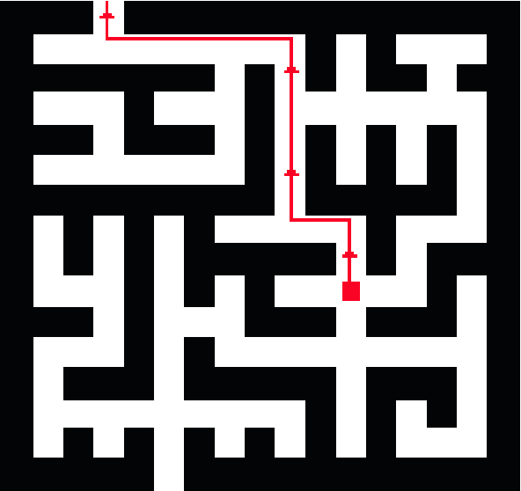
Maze Solver Game An Interactive Puzzle Challenge

Slide 2
Maze Solver Game Course Code : 115 Group Number : 5
Group Members:
1. Arnob Mallik Dhruba
ID : 2512446642
2. Samrin Fatema
ID : 2513373042
3. Sumaya Islam Kotha
ID : 2511242642
4. S.M. Robiul Islam
ID : 2513924642

Slide 3
Introduction
-What is the Maze Solver Game?
- An interactive game where a player or algorithm finds the path from the start point to the exit in a maze.
- Combines logic, problem-solving, and programming techniques.

Slide 4
Objective
-Goal of the Game
- Navigate through a maze efficiently.
- Implement and understand various pathfinding algorithms.
- Enhance critical thinking and teamwork skills.

Slide 5
How It Works
-Game Mechanics
- Players start at a defined point and must find the exit.
- Different mazes present various difficulty levels.
- Algorithms like DFS, BFS, and A* can be used to solve the maze.

Slide 6
Features
- Random maze generation
- Visualized pathfinding process
- Multiple algorithm options
- User-friendly interface

Slide 7



Tools And Techniques
- Language : C
- Version Control : Github

Slide 8
Conclusion
-Outlined the game’s structure, mechanics, and overall design.
-Finalized concept, planned the levels, key challenges.
-Delivering an exciting and interactive game.

Slide 9
Thank You!

