Slide 1
Vectors

Slide 2
Introduction to Vectors
In our day to day life, we come across many queries such as – What is your height? How should a football player hit the ball to give a pass to another player of his team? Observe that a possible answer to the first query may be 1.6 meters, a quantity that involves only one value (magnitude) which is a real number. Such quantities are called scalars. However, an answer to the second query is a quantity (called force) which involves muscular strength (magnitude) and direction (in which another player is positioned). Such quantities are called vectors. In mathematics, physics and engineering, we frequently come across with both types of quantities, namely, scalar quantities such as length, mass, time, distance, speed, area, volume, temperature, work, money, voltage, density, resistance etc. and vector quantities like displacement, velocity, acceleration, force, weight, momentum, electric field intensity etc

Slide 3
Questions
Question 1: What is a scalar quantity? (A) A quantity that involves only one value (magnitude) which is a real number (B) A quantity that involves both magnitude and direction © A quantity that involves only direction
Question 2: What is a vector quantity? (A) A quantity that involves muscular strength (magnitude) and direction (B) A quantity that involves only magnitude © A quantity that involves only direction
Question 3: Which of the following is a scalar quantity? (A) Length (B) Displacement © Velocity
Answers 1A, 2A, 3A

Slide 4
Introduction to Vectors
Vectors are a way of describing movement with math, and they’re used in physics, graphics, machine learning, and many other applications.
In this course, we’ll put vectors to work and use them to solve real problems.
Let's see how vectors can be used to describe moves to a computer.

Slide 5
Definition of a vector
A vector is an object that has both a magnitude and a direction. Geometrically, we can picture a vector as a directed line segment, whose length is the magnitude of the vector and with an arrow indicating the direction. The direction of the vector is from its tail to its head. Two vectors are the same if they have the same magnitude and direction. This means that if we take a vector and translate it to a new position (without rotating it), then the vector we obtain at the end of this process is the same vector we had in the beginning.
Two examples of vectors are those that represent force and velocity. Both force and velocity are in a particular direction. The magnitude of the vector would indicate the strength of the force or the speed associated with the velocity.

Slide 6
A vector has a horizontal part and a vertical part, called components.
In this case, the vector v⃗=(3,2) has a horizontal component of 3 and a vertical component of 2.
Components can be negative, too.

Slide 7
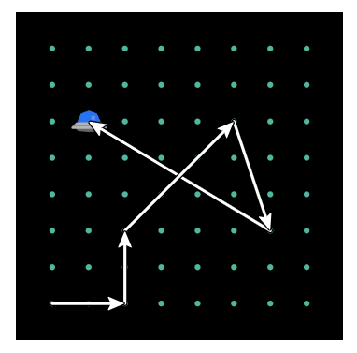
Vector Example

