Slide 1
Elementary Modern Physics

Slide 2
Introduction
New era in the development of modem physics (i.e., wave mechanics) started with the revolutionary idea of Max Planck, which states that electromagnetic radiation may be considered as a stream of small energy packets called photons. Wave mechanics deals with the microscopic properties of materials. Before wave mechanics, phenomena such as photoelectric effect, Compton effect, blackbody radiation, atomic spectra, and so on could not be explained. Wave mechanics was able to correctly explain these phenomena. Macroscopic phenomena such as interference, diffraction, and polarisation firmly confirm the wave character of electromagnetic radiation which may have particle nature as well. In other words, electromagnetic radiation has dual character; in certain situation it exhibits properties of wave, while in
others it acts as a particle. In this chapter, we will discuss blackbody radiation spectrum, Planck's hypothesis and radiation law.
Compton's effect, and photoelectric effect in context of old (classical) and modern (quantum) theory. In the same chapter, we will also study the wave-particle duality along with the concept of phase velocity and group velocity, and matter-waves.

Slide 3
Questions
Q1) What is wave mechanics?
(A) A new era in the development of modern physics
(B) The study of electromagnetism
(C) A theory about photons
Q2) What phenomena could not be explained before wave mechanics?
(A) Diffraction
(B) Blackbody radiation
(C) Both diffraction and blackbody radiation
Q3) What does wave particle duality mean?
(A) Electromagnetic radiation can behave like a wave or a particle
(B) Wave mechanics is a combination of two theories
(C) There are two types of wave mechanics

Slide 4
Blackbody
A blackbody is a body which absorbs radiations of all wavelengths incidenting on it. Blackbody neither reflects nor transmits any of the incident radiation, and therefore, appears black. In actual practice, there is no body as a perfect blackbody, but lamp black may be regarded as blackbody because it is able to absorb nearly 99% of the incident radiations. Scientist Ferry suggested a blackbody which consisted of a hollow thick-walled sphere, painted lamp black internally and provided a small circular opening to enter the radiations. In order to prevent the direct reflection from the inner surface, there is the provision of projection in front of the opening of the blackbody. When any radiation enters the blackbody region through the opening, it suffers multiple reflection inside the sphere and is finally absorbed. When the walls of such a cavity are heated to a temperature T, it emits the radiations which fill the cavity and it comes out through the opening of cavity. These radiations are known as blackbody radiations, which are the characteristic of its temperature. Here, it is worth to mention that the thermal radiations and the light radiations are identical, except the difference in their wavelengths.

Slide 5
Questions
Question 1: What is a blackbody?
(A) A hypothetical object that absorbs all electromagnetic radiation
(B) A light source
(C) A type of mirror
Question 2: What is the relationship between a blackbody and blackbody radiation?
(A) A blackbody absorbs all electromagnetic radiation and emits blackbody radiation.
(B) A blackbody reflects all electromagnetic radiation and blackbody radiation does not exist.
(C) There is no relationship between a blackbody and blackbody radiation.
Question 3: What is an example of a real-world object that approximates a blackbody?
(A) A diamond
(B) A sheet of white paper
(C) Lamp black

Slide 6
Blackbody Radiation Spectrum
Among the scientists, it was a matter of great interest that how the energy was distributed in the different wavelengths in the spectrum of blackbody radiation. In this regard, the first important affect was made by Stefan and Boltzmann during 1884. According to them, the energy of radiation in unit volume of space due to all the wavelengths in the spectrum is proportional to the fourth power of the absolute temperature of the blackbody. Although this law has been verified experimentally, but it is unable to give any idea about the energy distribution among the different wavelengths of the blackbody radiation. Lummer and Pringsheim investigated the distribution of energy amongst the different wavelengths in the thermal spectrum of a blackbody radiation. The results obtained by Lummer and Pringsheim are shown in Fig. 7.1. Here the graph is drawn between emissive power and wavelength for various temperatures.

Slide 7
Questions
Questions Question 1: Who made the first important affect regarding the energy distribution in blackbody radiation? (A) Stefan and Boltzmann (B) Lummer and Pringsheim © Planck
Question 2: What did Stefan and Boltzmann discover in 1884? (A) The relationship between energy and wavelength (B) The law of energy distribution in unit volume of space © The exact wavelengths of blackbody radiation
Question 3: What did Lummer and Pringsheim investigate? (A) The fourth power of absolute temperature of blackbody (B) The emissive power and wavelength for various temperatures © The color of blackbody radiation

Slide 8
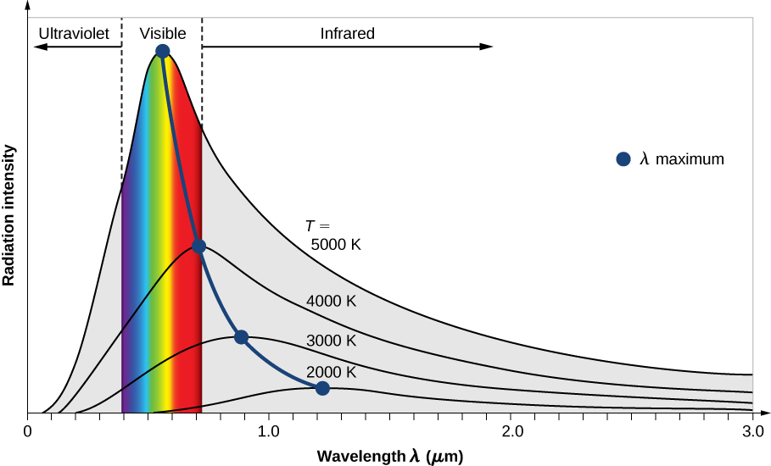
Blackbody Radiation Spectrum

Slide 9
Photoelectric Effect
The emission of electrons from the metal surface when illuminated by light or any other radiation of suitable wavelength or frequency is known as photoelectric effect. The emitted electrons are known as photoelectrons and the current constituted by these electrons is known as photocurrent.

Slide 10
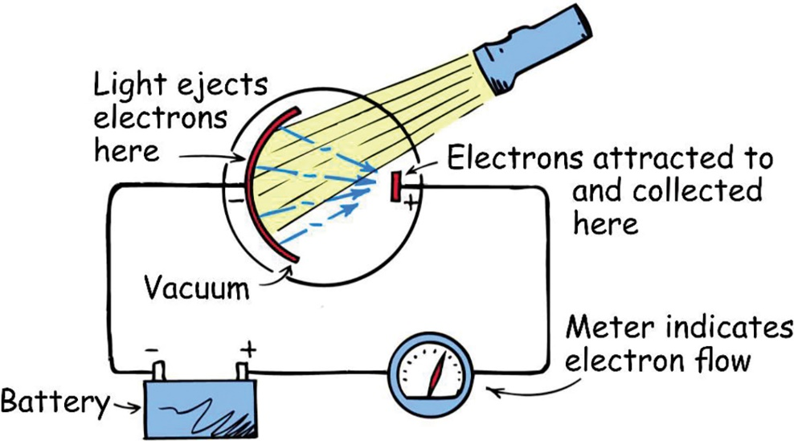
Photoelectric Effect
Here, the two electrode plates are the photosensitive surfaces, which are enclosed in a evacuated quartz bulb. The negative plate is connected to the negative terminal of the battery while positive plate is connected to the positive terminal through a galvanometer G. In the absence of any light, there is no deflection in the galvanometer. But when a beam of radiation is allowed to incident on the negative plate, current starts to flow in the circuit due to which the galvanometer shows deflection.

Slide 11
Course Completed!

