Slide 1
Uncertainty Principle and Quantum Mechanics

Slide 2
Introduction
﻿In classical mechanics, we can simultaneously determine the position and the momentum of a particle. However, this is not the case in quantum mechanics. From de Broglie hypothesis of matter waves, we know that a moving particle may be considered as a group of waves and the particle may be positioned anywhere within the wave packet. This indicates that the position of the particle is uncertain within the limits of a wave packet. This uncertainty is only for microscopic particles; it has no importance for macroscopic particles. In atomic systems, the classical mechanics fails to explain the microscopic sys- tem of particles due to the above said reasons. The uncertainty principle states that the position and the momentum of a microscopic particle cannot be simultaneously measured accurately. The measurement of one quantity introduces a measure of uncertainty into the other. Hence, the classical mechanics, for which position and momentum have definite values at all instants, is not valid for atomic systems.

Slide 3
Introduction
From the concept of de Broglie, we know that a wave is associated with a material particle. Clearly, a mathematical wave equation is required to deal with such waves. Since classical equations (mathematical formulations) were not valid at microscopic level, new equations known as wave mechanics or quantum mechanics were developed by Schrödinger in 1926. In his wave mechanics, Schrödinger assumed wave function ψ(x, y, z, t) as the amplitude of matter waves. Wave function (x, y, z, t) is a complex quantity and is the function of position and time. It gives the idea for the probability of finding a particle in a particular region of space.

Slide 4
Questions
Question 1: What can be simultaneously determined in classical mechanics? (A) The position and momentum of a particle (B) The energy and velocity of a particle © The wavelength and frequency of a particle
Question 2: What is the de Broglie hypothesis of matter waves? (A) A particle in motion is a group of waves (B) A particle has a fixed position within a wave packet © A particle’s momentum is uncertain within limits
Question 3: Why does classical mechanics fail to explain atomic systems? (A) Because of the uncertainty principle for microscopic particles (B) Because particles have definite values at all instants © Because energy is not proportional to the fourth power of temperature

Slide 5
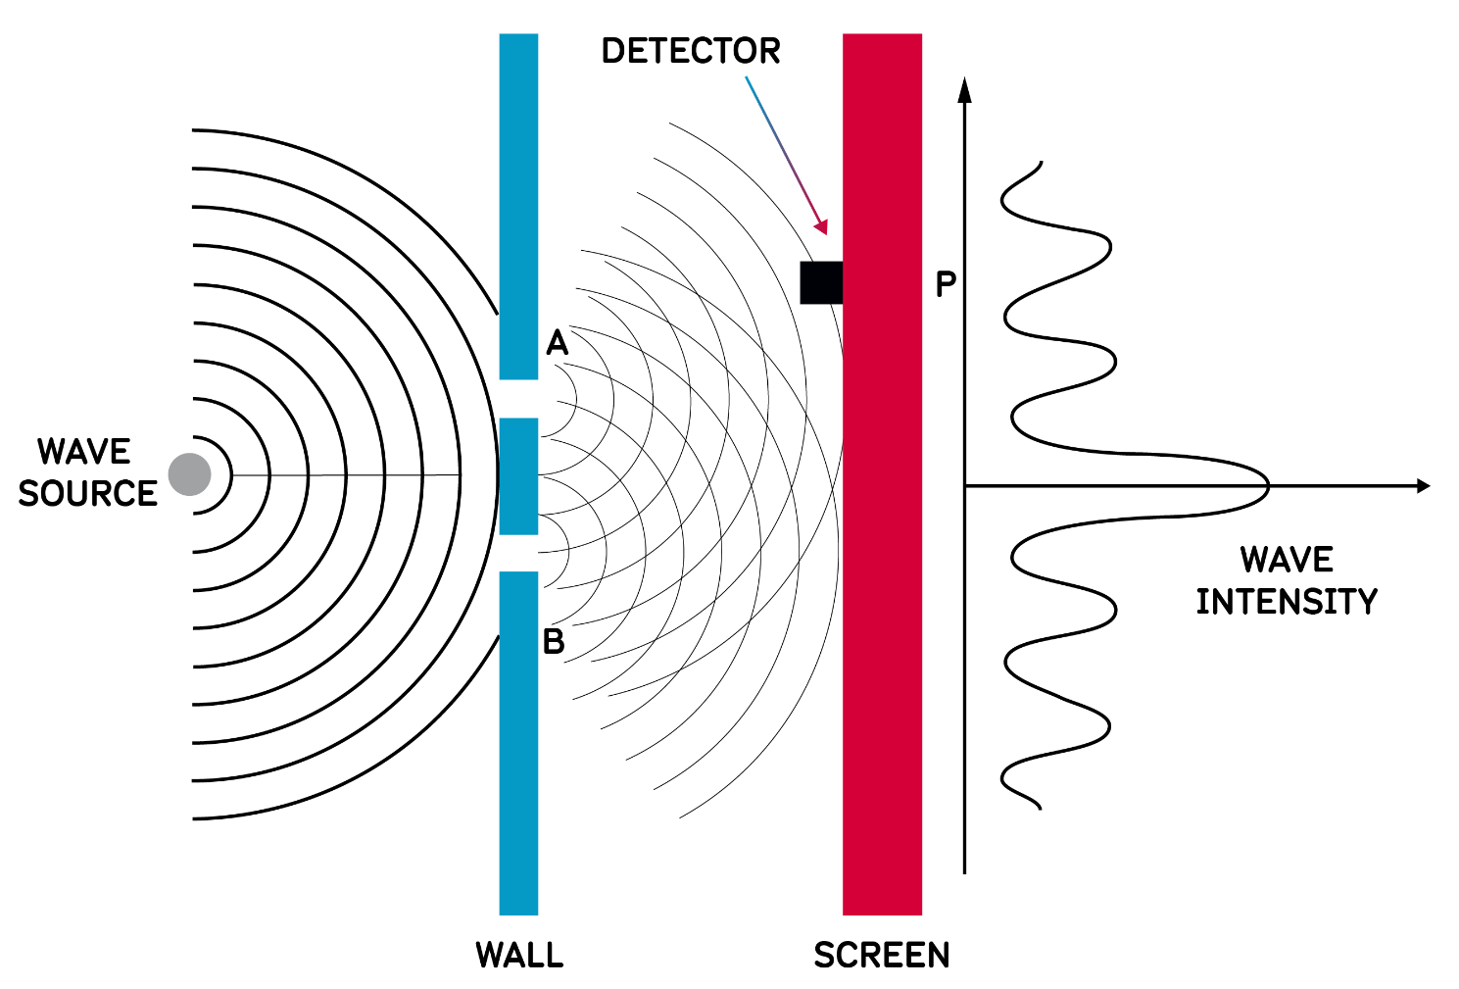
Quantum Wave Interference

Slide 6
Basics of Quantum Mechanics - What is Quantum Mechanics? -
Quantum Mechanics is nothing more but linear algebra and Hilbert spaces
What makes quantum mechanics quantum mechanics is the physical interpretation of the results that are obtained

Slide 7
Basics of Quantum Mechanics
Quantum physicists are interested in all kinds of physical systems (photons, conduction electrons in metals and semiconductors, atoms, etc.). State of these rather diverse systems are represented by the same type of functions ➔ STATE FUNCTIONS.
First postulate of Quantum mechanics:
Every physically-realizable state of the system is described in quantum mechanics by a state function ψ that contains all accessible physical information about the system in that state.
Physically realizable states ➔ states that can be studied in laboratory
Accesible information ➔ the information we can extract from the wavefunction
State function ➔ function of position, momentum, energy that is spatially localized.

Slide 8
Questions
Question 1: What are quantum physicists interested in? (A) The color of photons (B) Physical systems like photons, electrons in metals, and atoms © The taste of metals and semiconductors
Question 2: What does the first postulate of Quantum Mechanics state? (A) Every state of the system is described by a state function that contains all accessible physical information (B) Quantum mechanics is only applicable to particles in motion © State functions are irrelevant in quantum mechanics
Question 3: What are physically realizable states? (A) States that can be studied in a laboratory (B) States that exist only in theory © States that have no physical information

Slide 9
Phase velocity vs group velocity
In the world of waves, we often encounter two distinct velocities: phase velocity and group velocity. While they might seem interchangeable, they represent different aspects of wave behavior.
Phase Velocity (v_p): Imagine a single wave crest or trough. The phase velocity refers to the speed at which this specific point travels through space. It's calculated by dividing the angular frequency (ω) of the wave by its wavenumber (k).
Equation: v_p = ω / k
Group Velocity (v_g): In reality, waves often travel in groups, called wave packets. The group velocity signifies the speed at which the overall envelope of this wave packet propagates. It's particularly relevant for understanding information or energy transfer in waves.
Equation: v_g = dω / dk

Slide 10
Phase velocity vs group velocity
The Relationship: The relationship between phase and group velocity depends on the medium and the wave's properties. In a non-dispersive medium (where wave speed doesn't vary with frequency), they are equal. However, in dispersive mediums (like light in a prism), the phase and group velocities can differ.
Imagine this: Picture a group of children riding bikes at different speeds. The phase velocity would be like the speed of the fastest child, while the group velocity would represent the speed at which the entire group progresses together.

Slide 11
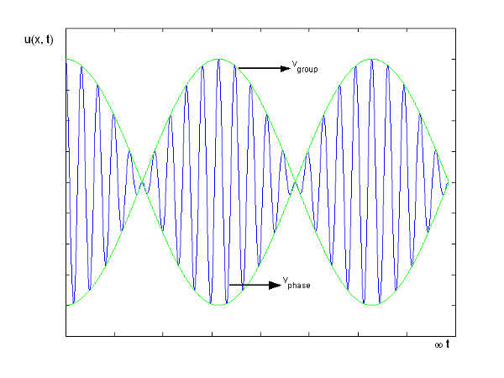
Phase velocity vs group velocity

