Slide 1

DAAD Dataset-International Programmes in Germany

Slide 2
Introduction
This analysis explores DAAD university data to identify trends in tuition fees, degree distributions, and course availability in Germany. The goal is to help students make informed decisions when selecting universities.
Source of the data - https://www.kaggle.com/datasets/leonardoferigutti/daad-datasetinternational-programmes-in-Germany.
This Dataset contain the information of the international programmers that people could study in Germany. The website where you can find this information is: https://www2.daad.de/deutschland/studienangebote/international-programmes/en/

Slide 3
Dataset Overview/Data Cleaning Process
• 1,705 university programs analyzed
• 58 features including university name, degree type, language, and tuition fees
• Data sourced from DAAD (German Academic Exchange Service)
• Replaced missing values with NaN
• Checked for inconsistencies in numerical and categorical data
• Filtered and processed relevant features for analysis

Slide 4
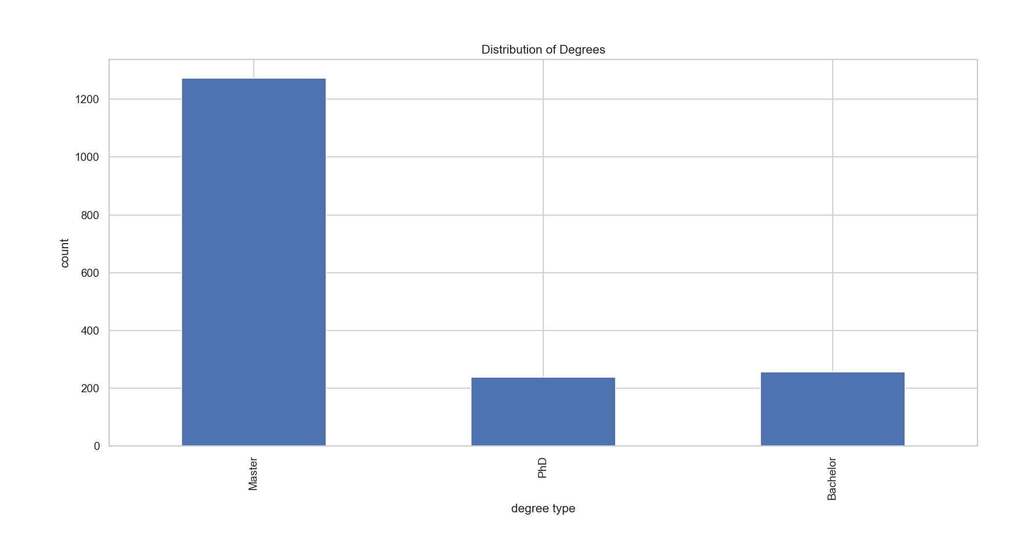
Degree Distribution Analysis
• The dataset includes Bachelor's, Master's, and PhD programs
• Master's programs are the most common
• Visualization: Bar chart showing degree counts

Slide 5
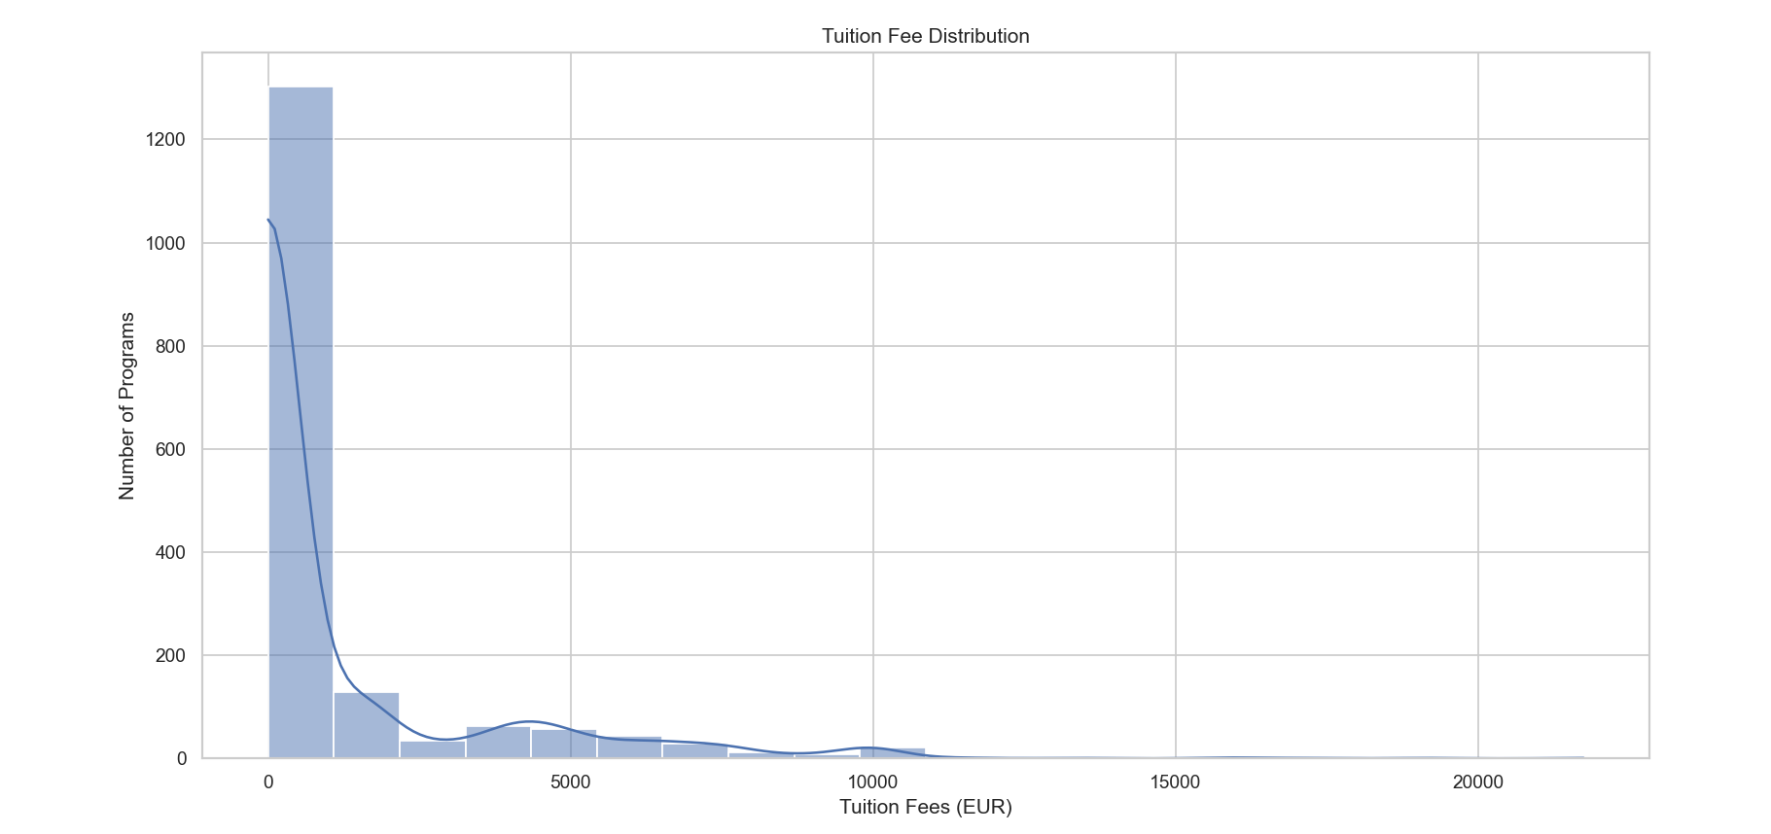
Tuition Fee Analysis
• The average tuition fee per semester is ~1,051 EUR
• Many programs have zero tuition fees
• The highest tuition fee is 21,750 EUR
• Visualization: Histogram of tuition fees

Slide 6
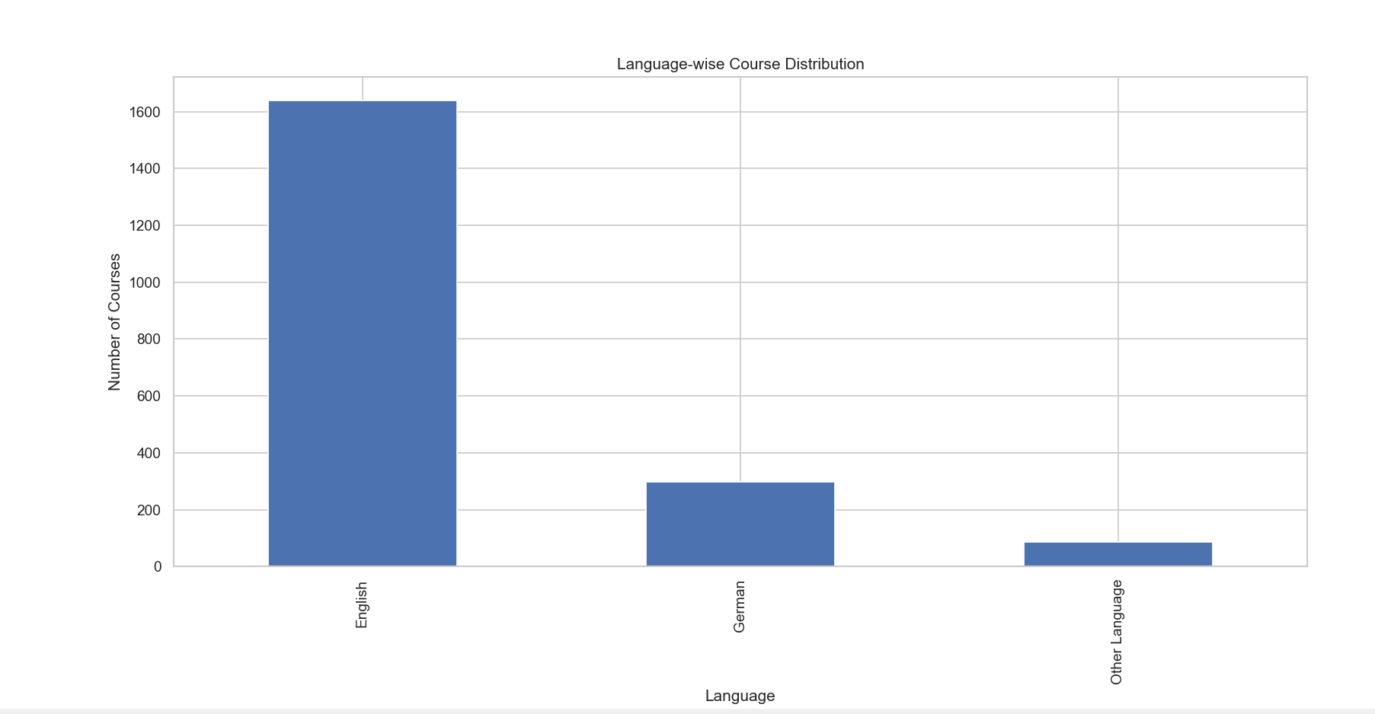
Language-wise Course Distribution
• Courses are mainly offered in English and German
• Some programs are available in other languages
• Visualization: Bar chart showing language distribution

Slide 7
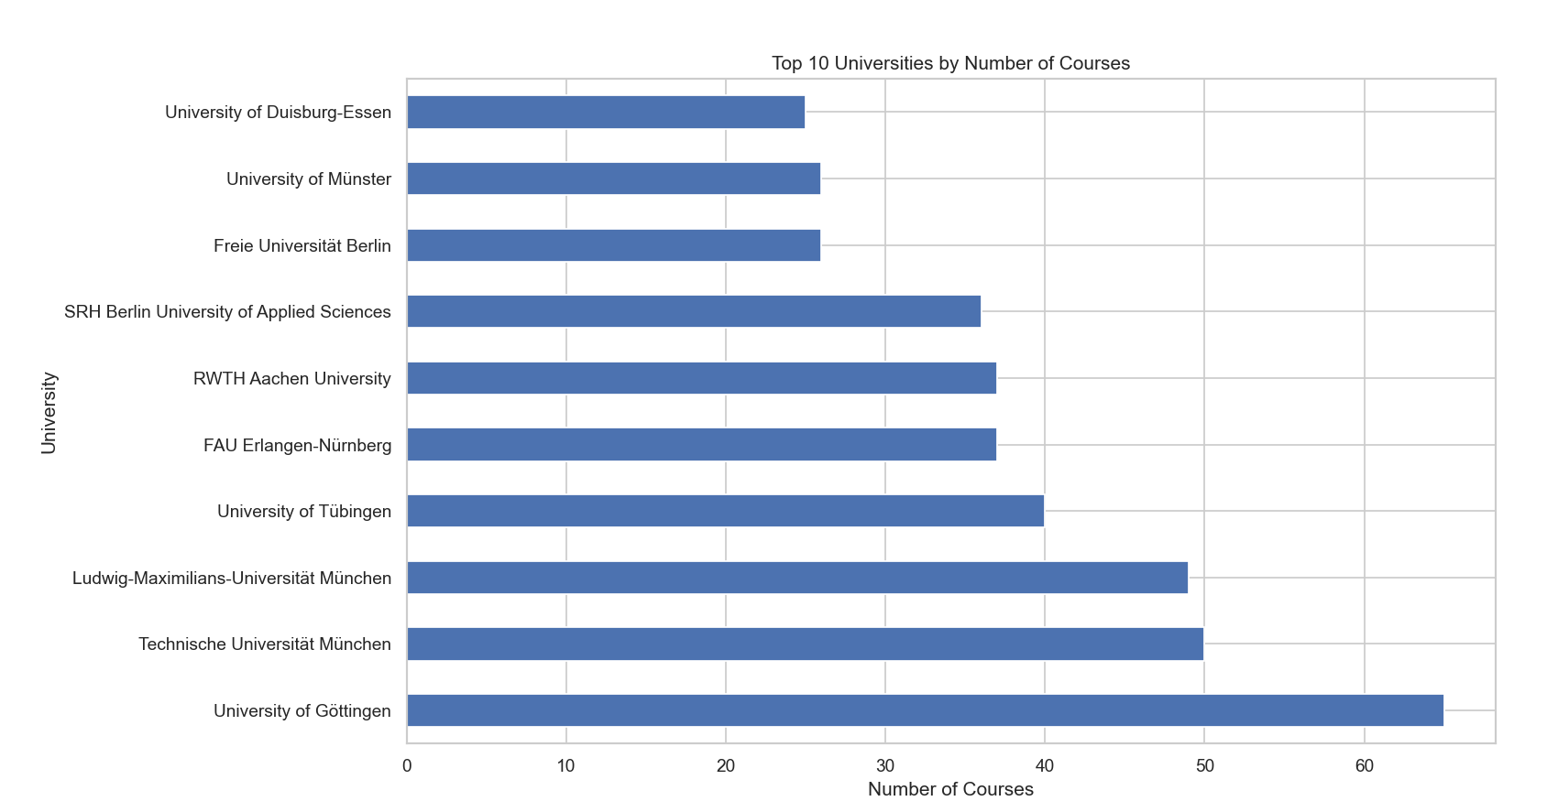
Top Universities by Course Count
• The top universities offer the highest number of programs
• Helps identify the most program-rich institutions
• Visualization: Horizontal bar chart of top universities

Slide 8
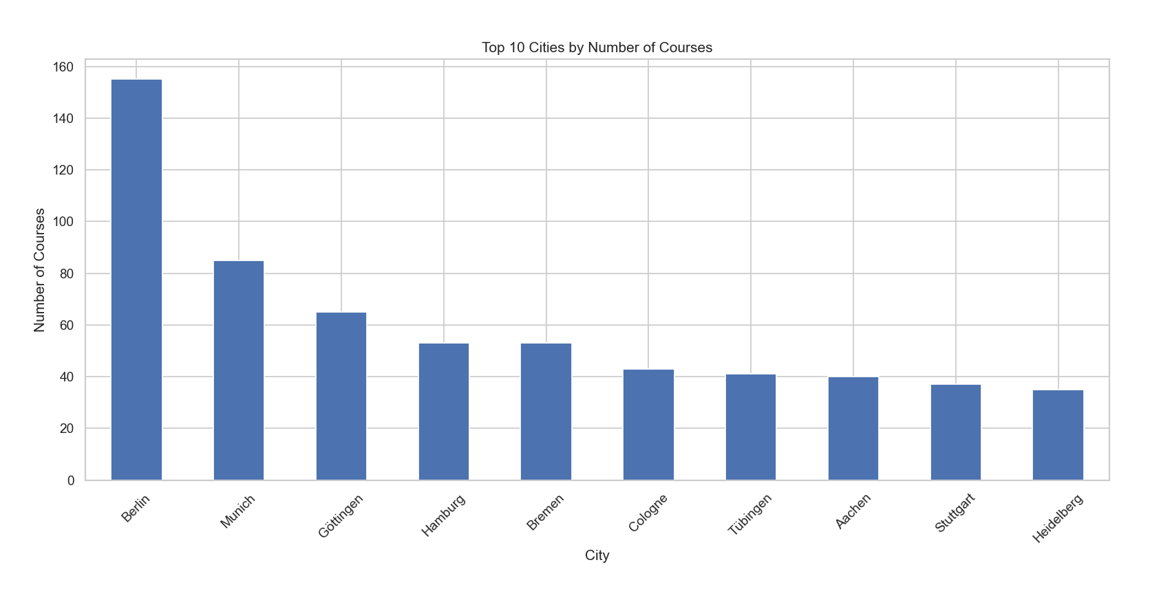
Top Cities by Course Availability
• Some cities have a higher concentration of universities
• Helps understand the geographical spread of programs
• Visualization: Bar chart showing top cities by course count

Slide 9
Application Deadlines
• Programs have different deadlines based on the semester
• Common deadlines occur in January, July, and October

Slide 10
Conclusion & Recommendations
• Germany offers diverse university programs
• Many tuition-free options available
• English and German are the primary languages of instruction
• Students should consider top universities and cities for better opportunities

