Slide 1
Multi-class Brain Tumor Segmentation using Graph Attention Network
Paper ID: DP059
Authors:
Dhrumil Patel, Dhruv Patel, Rudra Saxena, and Thangarajah Akilan
Presenters:
Dhrumil Patel and Dhruv Patel
Next: Presentation Overview

Slide 2
Presentation Overview
Introduction
Literature review
Proposed Solution
Experimental study and results
Conclusion
Next: Introduction – Background and Motivation
Notes:
Introduction
Literature review(Traditional Methods)
Literature review(Advanced Methods/CNN)
Literature review(Advanced Methods/GNN)
Literature review(Dataset Description)
Proposed Solution
Layer-wise schematic of GAT
Equations
Hyperparameters
Experimental study and results
Quantitative analysis
Qualitative analysis-1
Qualitative analysis-2
Conclusion
Acknowledgement
References

Slide 3
Introduction
Background:
Brain tumors can be fatal, significantly impact the quality of life, and fundamentally change the lives of both the patient and their loved ones.
Malignant tumors have a limited chance of surviving, so early detection and diagnosis of brain tumors are essential.
Motivation:
Gliomas are one of the most prevalent forms of brain tumors among all others. Most gliomas are classified as Low-grade gliomas (LGG) and High-grade gliomas (HGG).
A study by the US National Cancer Institute (NCI) found that every year, 18,000 Americans are diagnosed with a glioma brain tumor, most of which pass away within 14 months.
Next: Challenges and Contribution of this Work
Notes:
Since tumor does not discriminate, men, women, and kids of all racial and ethnic origins are impacted. The MRI scans are typically scattered and poorly contrasted because brain tumors can grow anywhere in the brain and vary widely in size, form, and morphology. Therefore, even with human assistance, segmenting MRI brain tumors is still a challenging task. Because brain tumors can be incredibly dangerous, early detection of these disorders is crucial for improving patient care.
As mentioned here over 18k americans are diagnosed with tumor and its very fatal to health.
Neuroimaging using MRI scans is a key component of the diagnosis and treatment of brain tumors, and is used for a variety of purposes including surgical and radiation therapy planning, longitudinal tumor monitoring, treatment response assessment, and predictive analysis.
The challenge of processing entire brain motivated us to employ GAT approach which makes it possible while also improving performance results.
The primary contributions of GAT based approach is gaining higher results and better processing times regards to state of the art results.

Slide 4
Introduction Cont.
Challenges:
Processing of the entire brain.
Applying graph neural network (GNN) on legacy datasets (i.e., non-graphical data).
Contributions:
A computationally efficient and accurate model for brain tumor segmentation as compared to relevant state-of-the-art methods.
Exhaustive experimental analysis on benchmark datasets and thorough comparative analysis.
Next: Literature Review – Traditional Methods
Notes:
A computationally efficient and accurate model for brain tumor segmentation as compared to relevant state-of-the-art methods, and
Exhaustive experimental analysis on benchmark datasets and thorough comparative analysis.

Slide 5
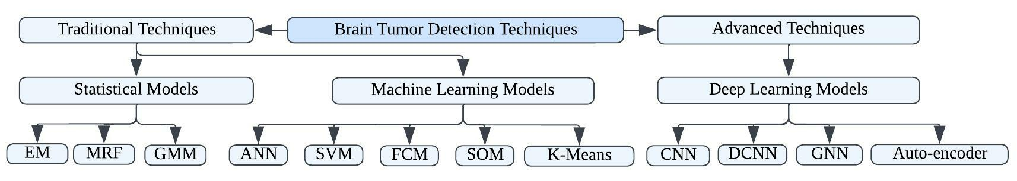
Literature Review
Methodologies for brain tumor detection: ANN- Artificial Neural Network, SVM- Support Vector Machine, FCM-Fuzzy c-means SOM- Self Organized Map, CNN-Convolution Neural Networks, GNN-Graph Neural Networks, DCNN-Deep Convolution Neural Networks, EM- Expectation Maximization MRF-Markov Random Fields, GMM-Gaussian Mixture Model
Traditional Methods:
SVM concept was studied by Shubhangi et al. [5] who combined knowledge-based approaches with multi-spectral analysis.
In 2010, Gopal et al. [6] proposed work on MRI brain tumor detection using fuzzy c-means along with intelligent optimization tools.
Javaid et al. [8] presented a sophisticated fully automated tumor recognition model using kernel-based fuzzy C-means, achieving an accuracy of 98.7%.
Next: Literature Review – Advanced Methods
Notes:
As shown here we started with exploring brain tumor detection techniques which helped us gain more context towards further segmentation techniques used by various studies. Here I will talk more about traditional methods of brain tumor detection.
In first study shows that the method could detect disease and label normal transaxial slices.
Later study shows hybrid approach in which received highly accurate result but it has shortcomings for 3D images as it has never been tested on them, and computational time is higher
Third study uses two different set of groups and optimization techniques but it has only being tested with 42 MRI images, and optimization technique used here is Particle Swarm Optimization.
So far the model by Javaid and team is best performing automated tumor reccognizing model with highest accuracy, sensitivity of 90% and least error rate of 0.2. Only feasible limitation of this model is that only tested MRI images and might not be applicable on any other medical based images.
Javaid et al. [8] came up with an automated tumor recognition model using a kernel-based fuzzy c-means and skull stripping method. They used multiple kernels to extract spatial features for improved clustering and segmentation of tumors.

Slide 6
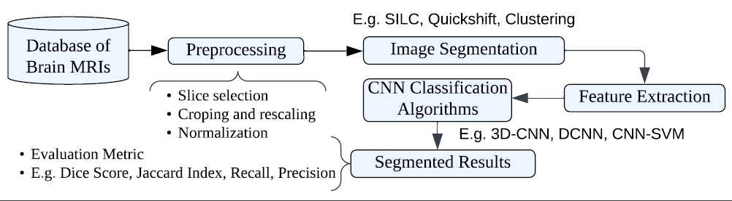
Literature Review Cont.
Advanced methods:
In recent years, deep convolutional neural networks (DCNNs) have shown excellent results in various medical image segmentation tasks.
Longet et al. [9], in 2015, developed a fully convolutional network (FCN) for pixel-level classification.
Following this idea, several DL-based segmentation models have been developed for various applications, including brain tumor segmentation.
Next: Literature Review – GNN
Notes:
Hyeonwoo et al. [16] combined a multi-view representation using multiple simultaneous self-constructing graph (SCG) modules to transform image data into a graph representation.
They used a graph convolutional network (GCN) to learn node features from the generated graphs and applied this integrated model–SCG-GCN for extracting a latent graph pattern from 2-D spatial information and performing segmentation.

Slide 7
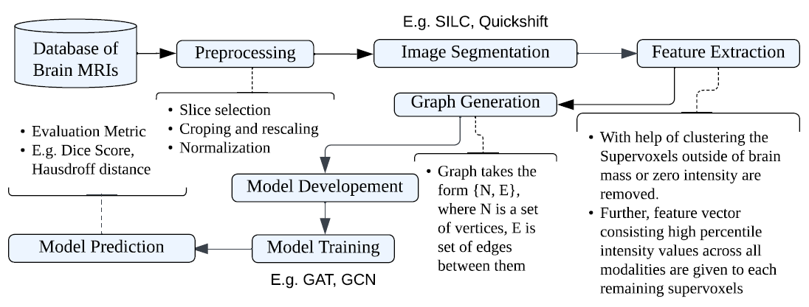
Literature Review Cont.
Graph Neural Network (GNN):
DL-based graph data processing, known as GNN, was first introduced by Gori et al., in 2005 [15].
One of the most advanced techniques, in this category, is the graph attention network (GAT), which was introduced by Yoshua Bengio’s research team, in 2018.
Hyeonwoo et al. [16] combined a multi-view representation using multiple simultaneous self-constructing graph (SCG) modules to transform image data into a graph representation and applied graph convolutional network (GCN) to learn segmentation.
Similarly, Wei et al. [19] proposed a method to determine isocitrate dehydrogenase mutation status in glioma using structural brain networks and GNNs.
Next: Proposed Solution – Flow Diagram
Notes:
These GNN-based models have shown competitive performances when compared to 3d-CNN and 3d-DenseNet-based segmentation approaches. Inspired by the success of graph-based models in segmentation tasks, this work exploits the
attention mechanism of GATs, to improve the performance of GNN-based brain tumor segmentation.
In contrast to earlier approaches, GATs enable simultaneous processing of the entire brain region and explicitly account for both local and global information by combining data from nearby nodes in the region adjacency graph (RAG) of the inputs. As a result, GATs have a rich learning system for feature extraction and reasoning power to capture relationships among the data points efficiently.

Slide 8
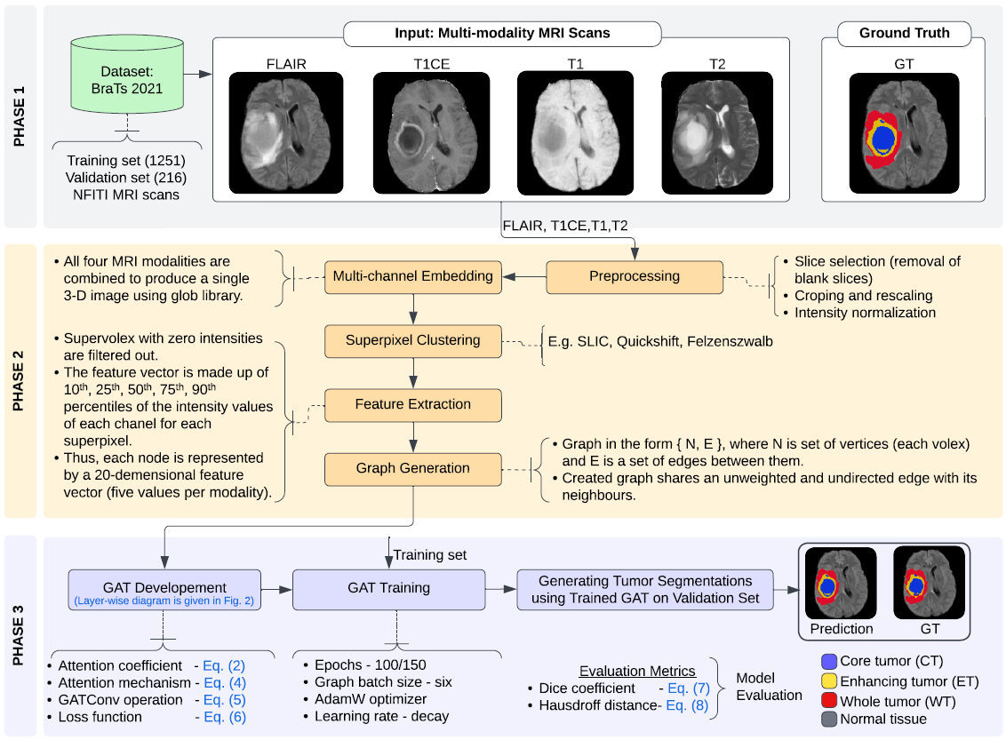
Proposed Solution
Detailed functional flow diagram of the proposed GAT-based MRI brain tumor segmentation framework.
It consists of three abstract phases :
Phase 1: Input
Phase 2: Data curation
Phase 3: Model building and evaluation.
Next: Proposed Solution – Layer-wise Schematic

Slide 9
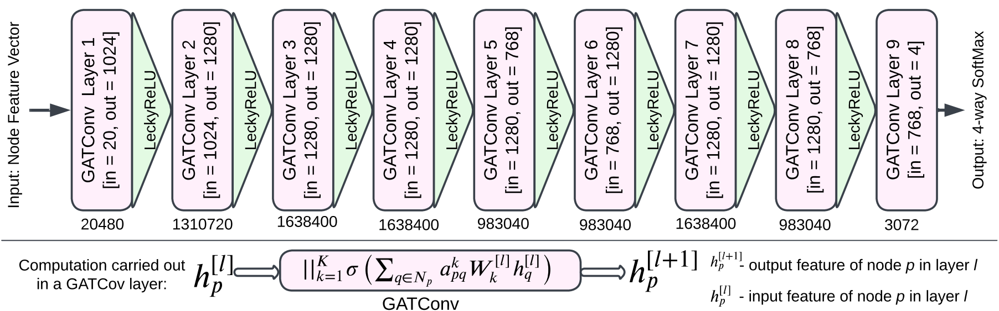
Proposed Solution: Layer-wise Schematic of the GAT
It subsumes ~10 M total number of trainable parameters.
It stacks eight GATConv layers with LeakyReLu activation, and the top layer is formed by a GATConv layer with Softmax activation.
Next: Proposed Solution – Mathematical Formulation
Notes:
K is the number of attention heads set to 4, 5, 5, 5, 3, 5, 5, 3 from layer 1 to layer 8 in the order, where the 5th layer uses residual connections. These are the best settings attained through empirical analysis.
Each GATConv layer computes each node’s output features based on eq (5).
The model uses a negative input slope of 0.2 in the LeakyReLU and applies a multi-head attention mechanism as defined in eq (4).
It is trained using multi-label cross-entropy loss given by Eq. (6).
The values denoted below each layer refer to the trainable parameters of the respective layer.

Slide 10
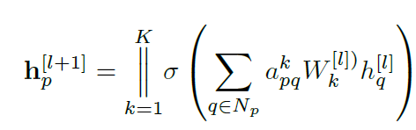

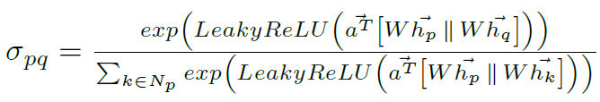

Proposed Solution: The Mathematical Formulation of the GAT
The mathematical formulation of the GATs learning layer :
Attention coefficient e as:
Attention mechanism:
Multi-label cross-entropy loss:
(Eq (5) in the paper)
(Eq (2) in the paper)
(Eq (4) in the paper)
(Eq (6) in the paper)
Next: Proposed Solution – Hyperparameters
Notes:
-> K independent attention mechanisms execute the transformation, and then their features are concatenated, resulting in the following output feature representation.
It indicates the importance of node q to node p, where q is in the neighborhood (Np) of node p, q ∈ Np in the Region Adjacency graph.
-> euv, first common linear transformation that is parameterized by weight matrix. That indicates the importance of node v’s features to node u.
-> We only compute euv for nodes vεNu, where Nu is some neighborhood of node u in the graph. To make coefficients easily comparable across different nodes, we normalize them across all choices of v
using the softmax function.

Slide 11
Proposed Solution: Hyperparameter Setting
The GAT is trained for 300 epochs on mini-batches of 6 graphs.
Note: The training converges between 100 and 150 epochs in different runs depending on the graph mini-batch size.
We used the AdamW optimizer with a weight decay of 0.0001 and exponentially decrease learning rate.
SLIC configuration: k = 15000 and m = 0.5 has the best achievable segmentation accuracy.
The cross-validation phase’s top-performing GAT model comprised 8 layers with 256 neurons each.
Attention heads and Residuals used for the model training are [4, 5, 5, 5, 3, 5, 5, 3] and [False, False, False, False, True, False, False, False], respectively.
Next: Experimental Study – Environment and Evaluation Metrics

Slide 12


Experimental Study and Analysis
Environment:
System specifications: AMD Ryzen 7 4800HS 2.90 GHz processor, a Tesla K80 GPU with 2496 CUDA cores, and 35 GB of DDR5 VRAM on Google Colab, the model was trained and tested.
The per-sample prediction time was 1.7 seconds on the above configurations.
Evaluation Metrics:
Dice score and the 95th percentile of the symmetric Hausdorff distance are two measures used to assess the performance of the models.
(Eq (7) in the paper)
(Eq (8) in the paper)
Next: Experimental Study – Quantitative Analysis
Notes:
The Average prediction time per 10 sample scans is 17 seconds for used environment. Both measures are assessed over the whole tumor, the core tumor, and the active tumor subregions. Dice score evaluates the degree to which predictions and actual segmentations overlap, and Hausdorff distance, on the other hand, measures the degree to which forecasts and actual segmentations differ.
Dice score and the 95th percentile of the symmetric Hausdorff distance are two measures used to assess the performance of the models. Both measures are assessed over the whole tumor, the core tumor, and the active tumor subregions. Dice score evaluates the degree to which predictions and actual segmentations overlap, and Hausdorff distance, on the other hand, measures the degree to which forecasts and actual segmentations differ.
–where T P, F P, and F N are the number of true positives, false positives, and false negatives, respectively. True positive voxels are defined as those correctly assigned as belonging to a specific tumor compartment.

Slide 13
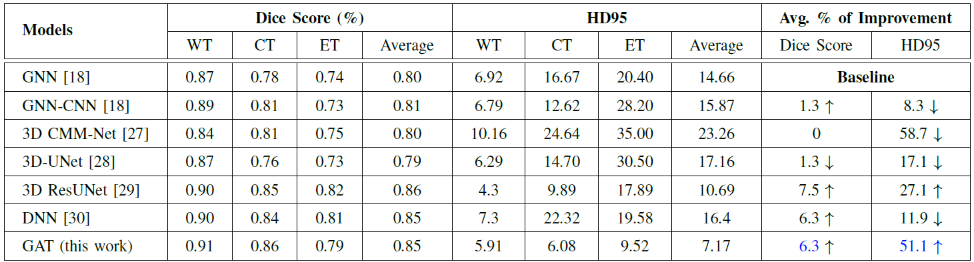
Experimental Study and Analysis: Quantitative Analysis
Performance of various models on the BRATS2021 validation dataset and their % of improvement compared to the baseline model introduced in [18].
Note: Dice coefficient (higher is better), and hd95 (lower is better).
↓ And ↑ stand for ‘+’ and ‘-’ Improvement, respectively. The best performances are inked in blue
Next: Experimental Study – Qualitative Analysis
Notes:
The above table represents the ….”Caption”. The the row in the table represents the performance score for the proposed model “GAT”.

Slide 14
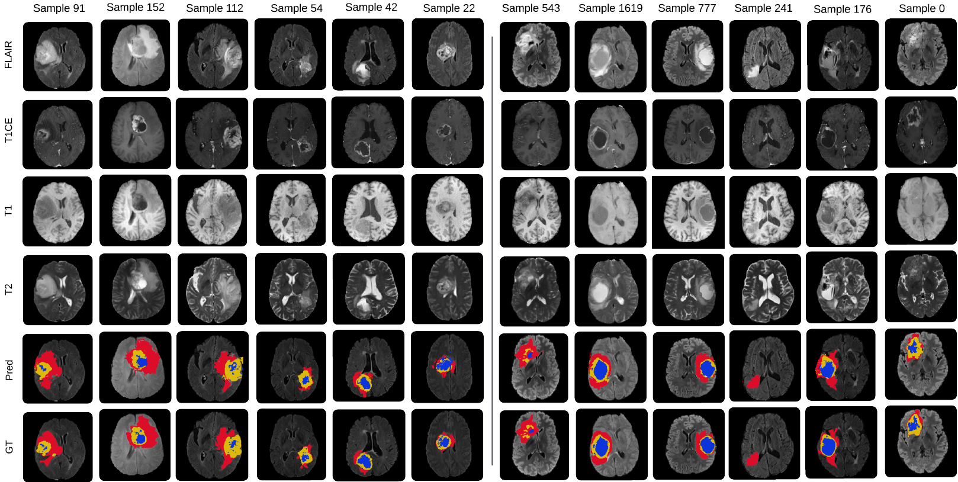
Experimental Study: Qualitative Analysis
(a) BRATS 2020
(a) BRATS 2021
Next: Conclusion
Notes:
The segmentation results obtained utilizing the proposed model.
Rows (R1:R4) represents four input modalities: FLAIR, T1CE, T1 and T2, R5: Predicted result and R6: Ground truth.
Each columns represent samples used for generating segmentation results where Columns (C1:C6) represents the segmentations obtained using BraTS2020 dataset and
Columns (C7:C12) represents the segmentation output for BraTS21 Validation dataset.
3) The segmentation labels are: Red for Edema, Yellow for Enhancing Tumor and Blue for (Necrosis/Non-Enhancing).
This figure summarizes a few qualitative results of the proposed model on BraTS2021 validation dataset.
We also conduct an extended experiment using the BraTS2020 dataset to check the robustness of our model.
Note that the model has not been retrained on BraTS2020, rather the trained model on BraTS2021 is used to predict the tumor segmentation on BraTS2020.
These qualitative results prove that the proposed GAT segments the three types of tumors close to the ground truths.

Slide 15
Conclusion
Exploiting advancement in AI and computer vision for lifesaving medical diagnosis is extremely significant.
In response to that, this work proposes a graph attention-based neural network for effectively segmenting multi-class tumors from multi-modality MRI scans.
Exploiting graph attentional layer that is computationally efficient (does not require expensive matrix operations and is parallelizable across all nodes in the graph).
The exhaustive experimental studies and comparative analysis on the benchmark datasets show that the proposed model can achieve competitive performances.
It shows an overall improvement > 6% and > 50%, respectively in dice score and HD95 evaluation metrics compared to an existing GNN-based baseline model.
Next: Acknowledgment
Notes:
Exploiting advancement in AI and computer vision for lifesaving medical diagnosis is extremely significant.
In response to that, this work proposes a graph attention-based neural network for effectively segmenting multi-class tumors from multi-modality MRI scans.
The exhaustive experimental studies and comparative analysis on the benchmark datasets show that the proposed model can achieve competitive performances.
It shows an overall improvement > 6% and > 50%, respectively in dice score and HD95 evaluation metrics compared to an existing GNN-based baseline model.
These networks use a graph attentional layer that is computationally efficient (does not require expensive matrix operations and is parallelizable across all nodes in the graph), enables (implicitly) assigning different importance to different nodes within a neighborhood while dealing with different-sized neighborhoods, and does not require prior knowledge of the entire graph structure, thus addressing many of the theoretical problems with earlier spectral networks.

Slide 16
Acknowledgment
This work was inspired in part by the pioneering research conducted by various researchers in graph neural networks and MRI segmentation.
Next: References

Slide 17
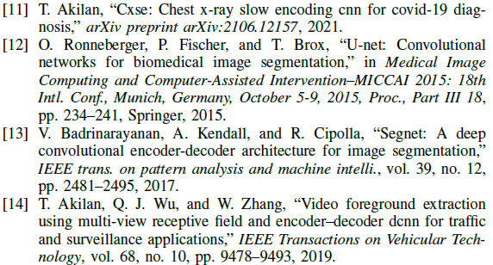
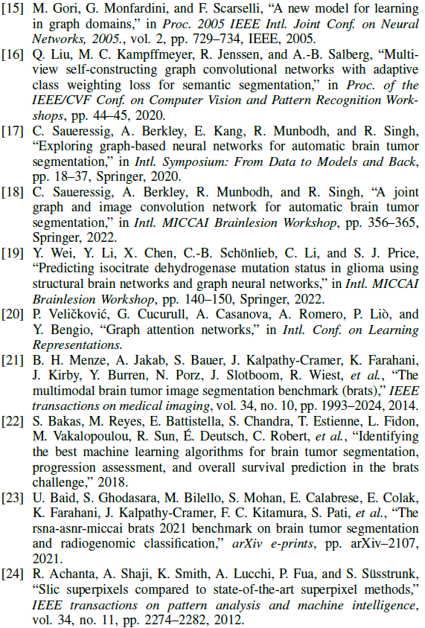
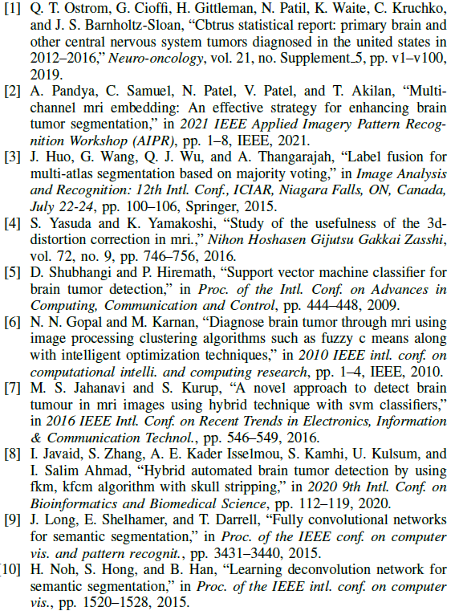
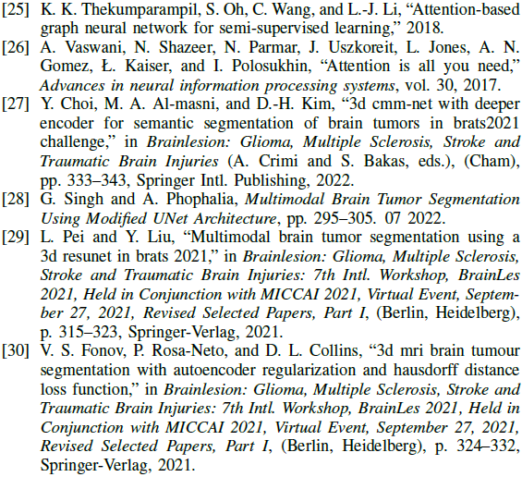
References
Next: Q&A

Slide 18
End of the Presentation
Thank you for attending and listening
Q&A: Please let us know if you have any questions
The End

