Slide 1


Integrated Renewable Energy-Driven Building Automation System for Enhanced Energy Efficiency
Presented by Dhrumil Bhanderi on 28/04/2025
Mr. Hesam Mohammadi
Notes:
Hello, I'm Dhrumil. Thank you, everyone, for coming today. I'm presenting my thesis, “title" research project.
A bit about myself: I have an electrical engineering background. This project is an opportunity to extend my skills and learn more about the field.
I'd like to thank Prof. Hesam for his ongoing support throughout the project and continuing as I complete the thesis.

Slide 2
Project Area
Develop an ML model to schedule appliance and battery storage for cost saving
Real time renewable energy data
Reinforcement Learning
Reward Function
Notes:
The project area focuses on building energy efficiency. Basically, how ML method overcome traditional method gaps to schedule/manage appliance energy by time. Also, it reflects reward function and renew. Source. Reward function used for cost reduction and renew used to reduce carbon footfrints. Explain why reinforcement???

Slide 3
Research Questions
How can models be developed to schedule appliance timing according to energy availability, battery and ToU ?
Can this be solved with ML,
e.g., Reinforcement learning?
Can we implement a software-based solution that improves the data?

Slide 4
Requirements of Tests
15 days Solar Irradiance data
Residential appliance ON/OFF timing
Shiftable, Non Shiftable and Fixed Loads

Slide 5
Location and Experiment
39 Gosford Meander, Ashby WA 6065
31°44'19"S 115°47'43"E
4 people in family
Average 24 to 26 kWh energy usage according to data
HP Pavillion – 15-cs3006tx
Intel(R) Core(TM) i5-1035G1 CPU @ 1.00GHz 1.19 GHz
Tesla PowerWall 2 @ 13.5 kWh

Slide 6
Appliance ON/OFF timing
Loads | Appliance | ON/OFF Time | Notes
Shiftable | Washing Machine | 5 PM to 9 PM | 2 cycles
 | Dishwasher | 9 PM to 10 PM | Everyday
 | Sweeping Robot | 8 AM to 9 AM | Everyday
Non-Shiftable | Lights | 4 AM to 7 AM | 5 lights
 |  | 6 PM to 10 PM | 14–15 lights
 |  | 10 PM to 11 PM | 2 lights
 | TV | 8 PM to 10 PM | Everyday
 | Microwave | 1 hr (no fixed time)
 | Oven | 30 min | 15–20 mins for each person
 | Toaster | 30 min
 | Kettle | 30 min
Fixed | Air Conditioner | 1-2 hrs
 | Fridge | 24/7

Slide 7
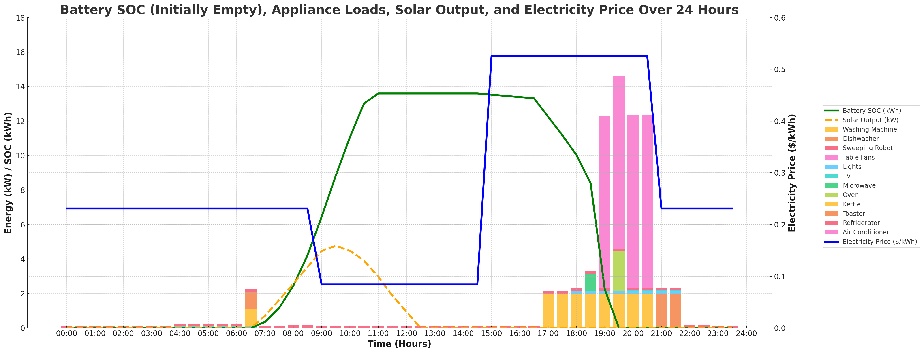
Figure 1: Total Load Profile with Electricity Price, Solar output, Battery

Slide 8
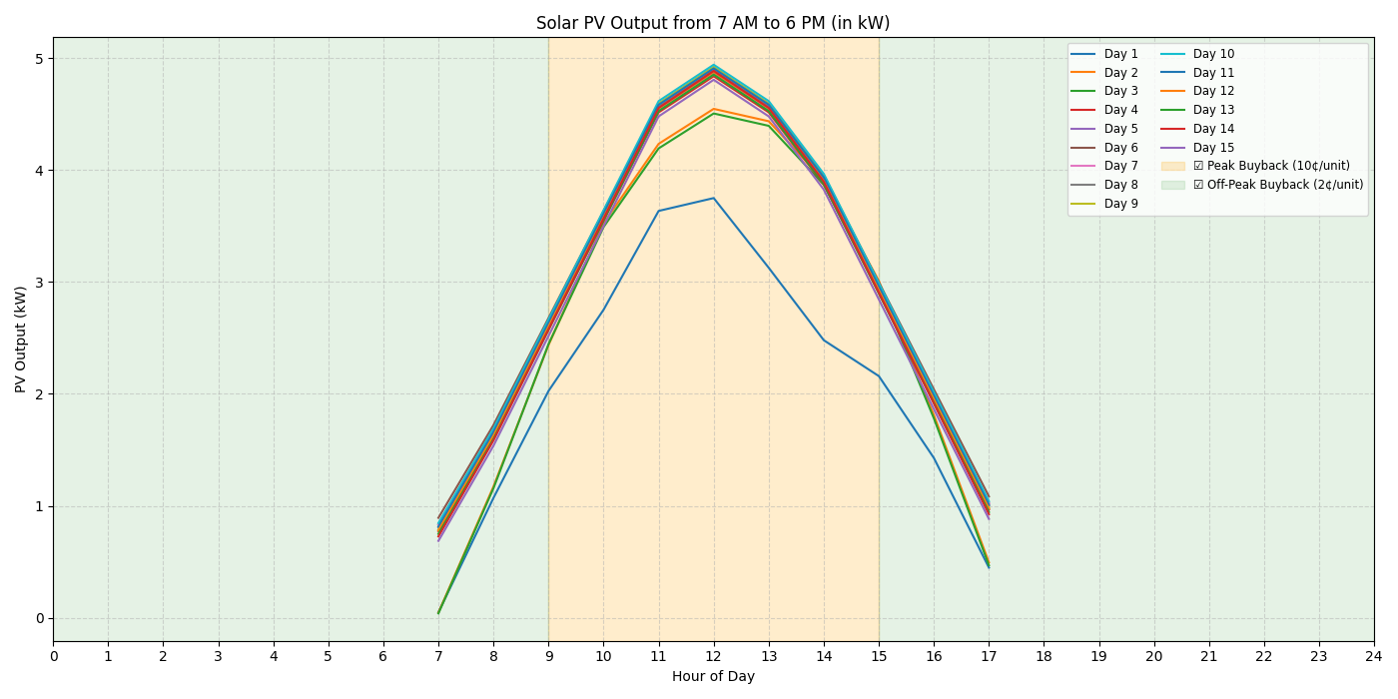

Figure 2: Solar PV output

Slide 9
Limitation of Measured Results
Fixed Schedules
No energy price awareness
No battery storage
No coordination between devices
How to improve?
Adaptive scheduling
Dynamic price response
Flexibility to uncertainty
Battery storage optimization

Slide 10
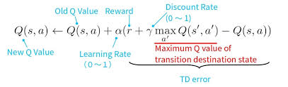
MDP and Q-learning
AGENT
Battery System
Appliance Scheduler
State
Battery SOC
Electricity Price
Loads
AGENT
Battery System
Appliance Scheduler
State
Battery SOC
Electricity Price
Loads
Actions
Charge/Discharge Battery
Change energy source
Rewards
Minimize electricity cost
Actions
Charge/Discharge Battery
Change energy source
https://www.google.com/url?sa=i&url=https%3A%2F%2Fitsudit.medium.com%2Fthe-q-in-q-learning-a-comprehensive-guide-to-this-powerful-

Slide 11
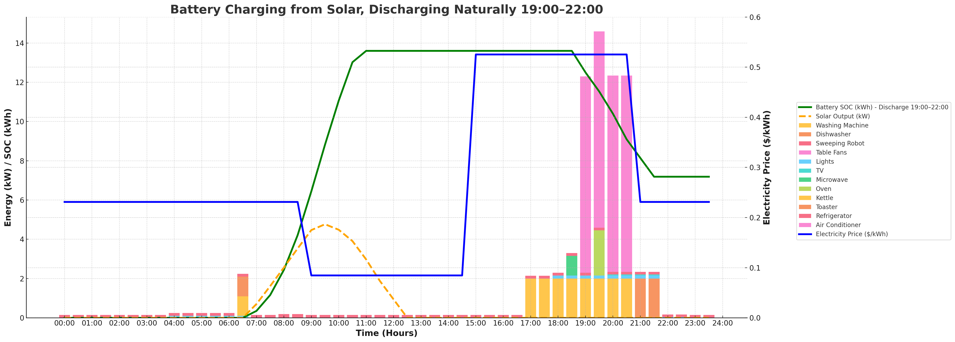
Figure 3: Total Load Profile with Electricity Price, Solar output, Battery After ML implementation
Notes:
boards to increase my sample size.

Slide 12
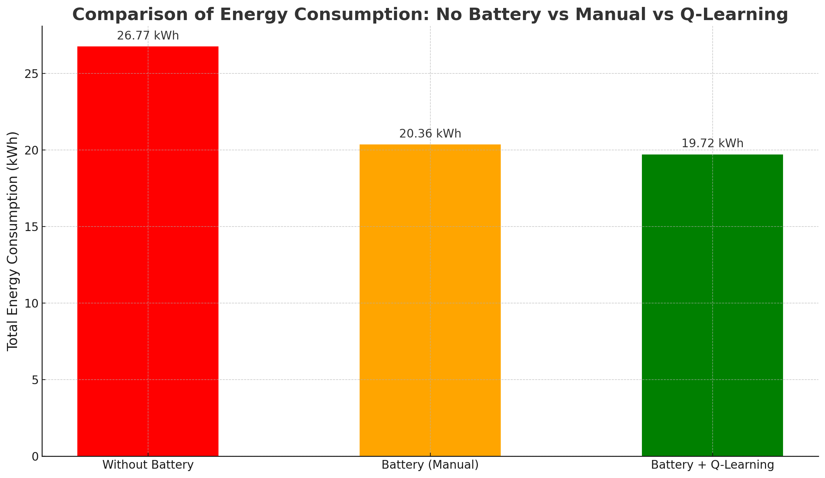
Figure 4: Total Load Profile with Electricity Price, Solar output, Battery After ML implementation
Notes:
Smarter rewards better savings make a suitable and accurate slots to get max savings
Cost table output and kWh
Reduceble load consumption , lighting reduce

Slide 13
Closing Summary
In the scope of the project, I have performed:
A review of literature and python programming
Simulate solar data for further work
Developed an ML model to predict ON/OFF timing of appliances
Done preliminary testing of various loads
Immediate future work will involve:
Improve scheduling graph of Home appliance
Use maximum amount of energy from Solar and Battery
Focus on how to improve reward function

Slide 14
Future Work
Real time data Logs
Add buyback price to save energy and generate revenue
Add comfort zone parameters

Slide 15
Reference List
[1] S. Xiong, D. Liu, Y. Chen, and Y. Zhang, "A deep reinforcement learning approach based energy management strategy for home energy system considering the time-of-use price and real-time control of energy storage system," [Energy Reports]
[2] https://pandas.pydata.org/
[3] https://www.youtube.com/@CodeWithHarry
[4] https://scikit-learn.org/stable/
[5] Hands-On Machine Learning with Scikit-Learn, Keras, and Tensorflow: Concepts, Tools, and Techniques to Build Intelligent Systems by Aurélien Géron (Author)

Slide 16
End of Presentation
Notes:
I'm happy to take any questions you may have

