Slide 1
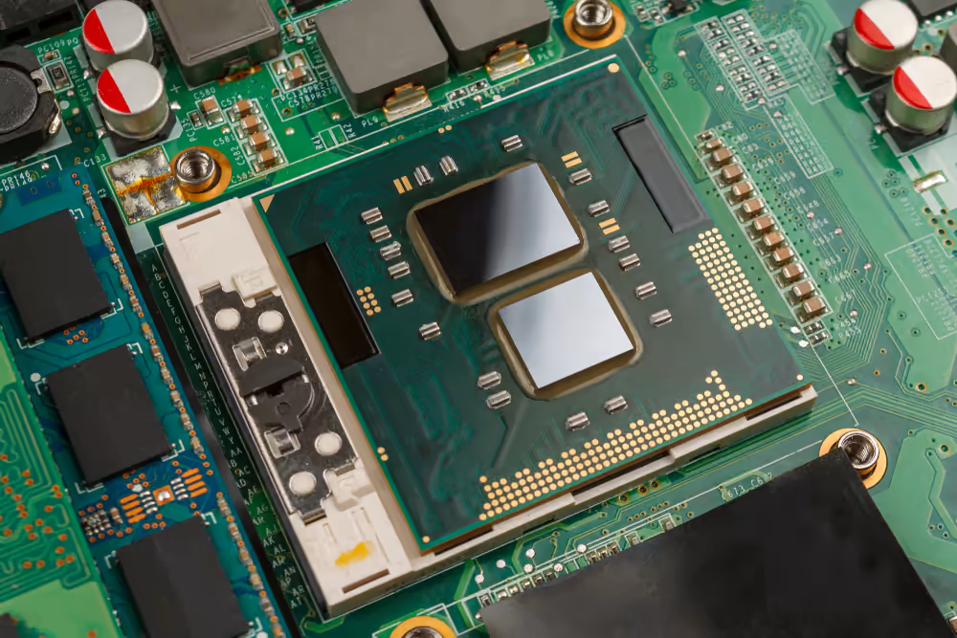
PARALLEL COMPUTING PROJECT
LU-DECOMPOSITION OF A MATRIX USING OPENMP
Presentation By :
NAME - DHRUMIL RAIGAGLA T.Y. I.T.
REG NO - 201080061
PROF - PRATHMESH KADAM

Slide 2
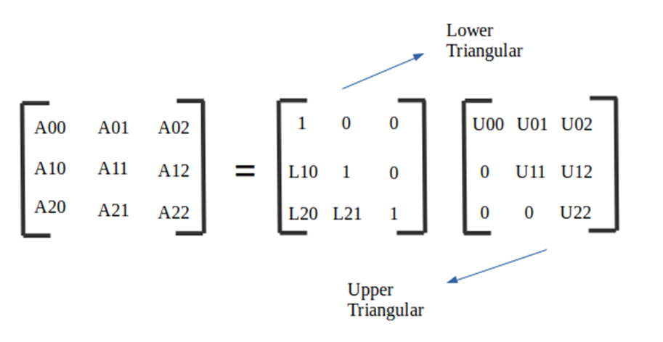
LU - DECOMPOSITION
A nxn square matrix A's LU decomposition is the factorization of A into the product of a lower-triangular nxn matrix L and an upper-triangular nxn matrix U.
L is a lower triangular matrix which has all elements above the main diagonal are 0
U is an upper triangular matrix which has all elements below the main diagonal are 0

Slide 3
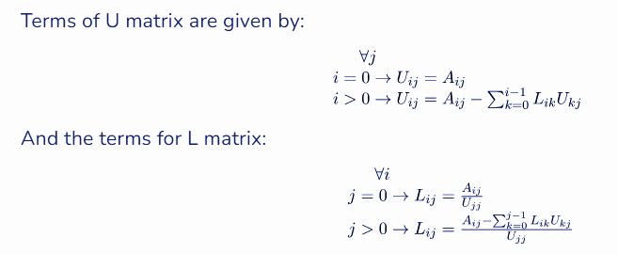
Objective of LU - Decomposition :
Solve a linear equation of the form A*x = B, with A being a matrix, x being a vector, and b being the solution vector.
A can be broken down into matrices L and U. Can solve for y by using L*y = b (forward substitution), and use U*x = y to find x (background substitution)
Reason : L and U can be used to solve for many vectors. (x1,x2,... ,xn)
Approach : Doolittle Algorithm

Slide 4

Sequential Implementation
Precondition -
Matrix A should be square matrix which is diagonal dominant
Implemented sequentially, LU Decomposition consists of 3 nested loops
An outer loop that iterates a number of times equal to the size of the matrix
The inner for loop goes through rows of the matrix and sets the values in the lower matrix.
If the row index lower than the column index, then that cell gets set to 0.
Otherwise, the cell in the L matrix is set by first setting it equal to the same cell in A
The final innermost for loop, iterates through a column in L and a column in the U matrix, doing a dot product and taking the product out of the value in the lower matrix.
Time Complexity : O(N^3)

Slide 5
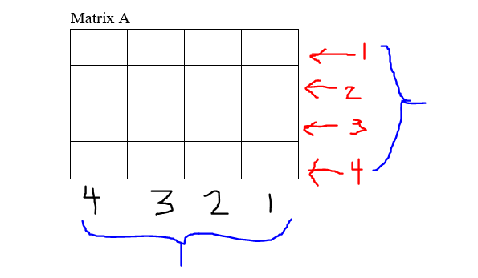
Parallel Implementation using OpenMP
Precondition -
Matrix A should be square matrix which is diagonal dominant
Implemented parallely, LU Decomposition has 2 places for optimization and code parallelization
3 nested loops of the main LU Decomposition function
The initialization function of the matrix A itself
Black part : For each column,
#pragma omp parallel shared(a,l,u)
Red part : For each row
#pragma omp for schedule(static)
Time Complexity : O(N^2)

Slide 6
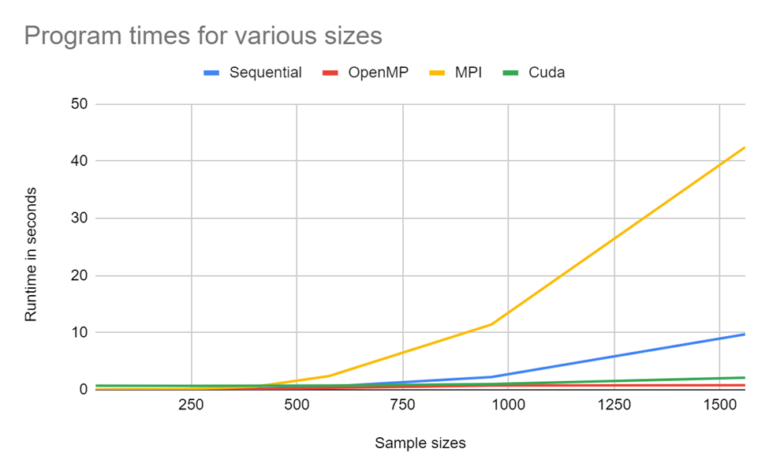
Serial v/s Parallel
Size | T(seq) | T(parallel) | Speed-up
5 | 0.0034 | 0.0008 | 4.25
10 | 0.0225 | 0.00325 | 6.92
100 | 1.578 | 0.136 | 11.602
500 | 154.984 | 5.304 | 29.22
Significant amount of speed up is achieved as matrix size increases
Also, in this case, shared memory parallelism works better than distributed memory parallelism

Slide 7
THANK YOU

