Slide 1
REVIEWSHIELD
AI-powered deceptive review detection engine
Stylometric profiling, RoBERTa transformers, and explainable AI
Presenters: D25DIT095 - DHRUMIL RANA & 24DIT070 - GITANSHU THAKKAR
CLASSIFICATION ACCURACY
89.67%
ROC-AUC
0.9609

Slide 2



THE PROBLEM
Fake reviews sound positive. Their writing gives them away.
Traditional sentiment models miss deceptive reviews.
Language
ReviewShield studies how language is written.
Dissonance
Impact
Text psychology meets sentiment mismatch.
Protect trust, ratings, and purchase decisions.
02

Slide 3



STYLOMETRIC PROFILING
Stylometry turns writing style into signal.
Vocabulary
Structure
Complexity
Type-Token Ratio measures word diversity.
Punctuation frequency and sentence length.
Flesch Reading Ease tests naturalness.
Three compact lenses expose patterns sentiment alone overlooks.
03

Slide 4
SENTIMENT DISSONANCE
Two sentiment engines reveal dissonance.
ENGINE 02
ENGINE 01
RoBERTa
SIGNAL
VADER
Dissonance
Contextual sentiment from CardiffNLP.
Rule-based surface emotion.
Absolute gap between both scores.
Large gaps flag hype without deep context.
−1.0 TO +1.0
CONTEXT
04

Slide 5



A hybrid pipeline connects raw text to risk.
RAW TEXT
40,412
Warehouse
Features · Risk
SQLAlchemy manages warehouse access.
Amazon/e-commerce reviews in PostgreSQL.
ColumnTransformer combines 9 scaled features and 2,000 TF-IDF word n-grams.
Schemas: raw_reviews, engineered_features, system_logs.
05

Slide 6
MODEL BENCHMARK
Logistic Regression leads the benchmark.
Best model balances accuracy, precision, recall, and ranking quality.
MODEL | ACCURACY | PRECISION | RECALL | ROC-AUC
Logistic Regression · BEST MODEL | 89.67% | 90.48% | 88.66% | 0.9609
SGDClassifier · LogLoss | 88.44% | 88.44% | — | 0.9479
Random Forest | 82.89% | 86.97% | — | 0.9132
06

Slide 7
EXPLAINABLE AI
Every prediction can explain itself.
REVIEW TEXT · LIVE HIGHLIGHTS
This product is must buy for every home. The fit felt comfortable and the material held up.
TF-IDF weights become live word highlights.
RED · deceptive triggers like “must buy”
GREEN · genuine customer signal keywords
Contribution weight · deceptive trigger
Tooltips show each word’s contribution weight.
07

Slide 8




INVESTIGATION SURFACE
One Streamlit app, four ways to investigate.
Single scanner
Batch scanner
Real-time score and risk flags.
10k+ rows and CSV export.
Model insights
Database analytics
Benchmarks and coefficient charts.
Live counters and logs.
08

Slide 9
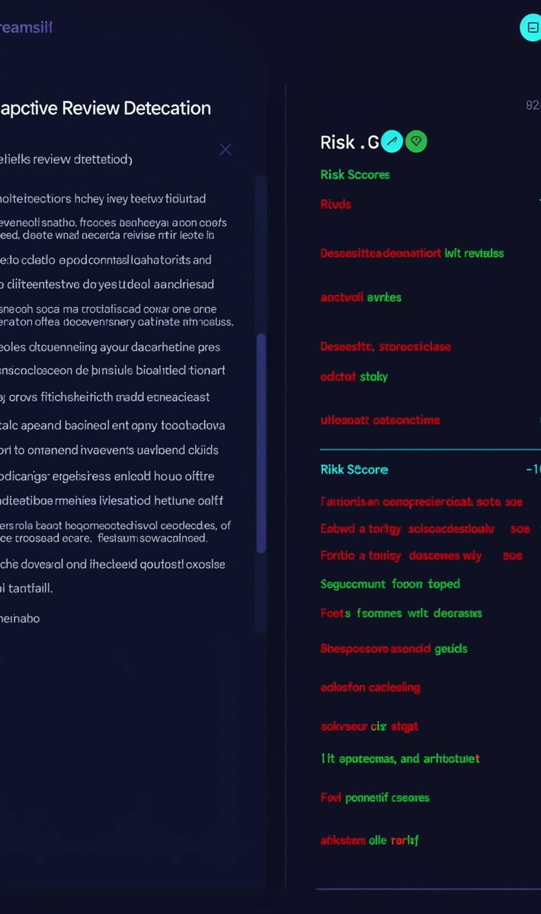
DELIVERED
The core system is already built.
01
02
40,412 reviews
RoBERTa engine
Ingested into PostgreSQL.
Integrated with PyTorch.
03
04
best_model_pipeline.joblib
Streamlit app
Serialized for reuse.
Dark mode with XAI highlighting.
09

Slide 10
NEXT ITERATION
FROM CAPSTONE PROTOTYPE TO PRODUCTION SERVICE.
PHASE 1
PHASE 2
PHASE 3
PHASE 4
FastAPI
Visuals
Audit
Deploy
POST /predict with Swagger.
Word clouds and stylometric radar charts.
Live prediction audit logging.
Docker and AWS/Render deployment.
Q&A · github.com/Dhrumil1435/ReviewShield

