Slide 1
PRAHARI
Zero-Network · Offline · Privacy-Preserving Biometric Authentication
Team Name: Prahari
Team Members: Meher, DHRUMIL

Slide 2
Brief & Problem Statement
THE PROBLEM | PRAHARI's ANSWER
1. Field personnel in remote zones have zero internet access 2. Standard biometric systems require cloud connectivity to authenticate 3. Fraud via printed photos and screen replays goes undetected 4. Existing apps are too heavy (100MB+) for mid-range Android devices 5. Privacy laws (GDPR) prohibit raw biometric storage in plaintext | MobileFaceNet INT8 1.9 MB model, 128-dim embeddings, runs on CPU only Dual liveness (rPPG + geometric) Heartbeat signal + blink/smile/head-turn challenges Zero-knowledge vault AES-256 via Android Keystore - biometrics never in plaintext Offline-first SQLite queue Works at 0 bars; syncs encrypted logs on reconnect React Native cross-platform Android 8+ and iOS 12+ from a single codebase

Slide 3
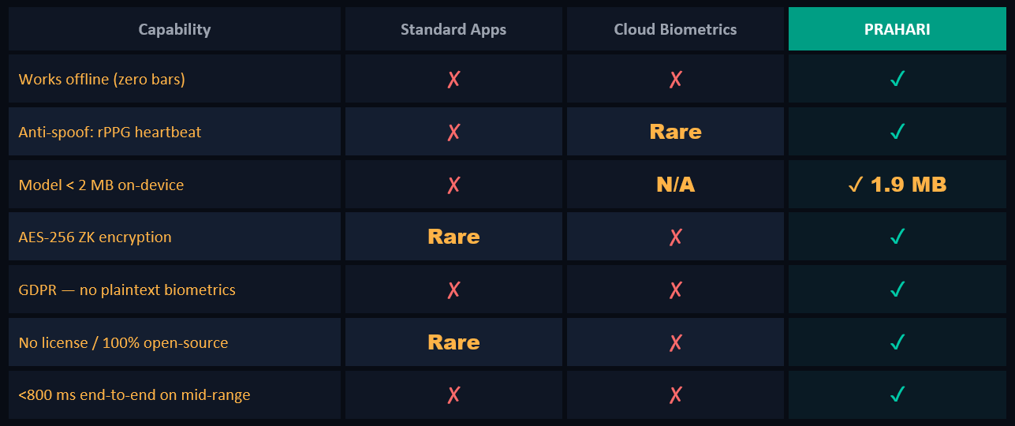
Brief & Problem Statement

Slide 4
5-Layer Security Feature Stack
1
Camera detects periodic skin-colour A caused by blood flow
Photos/screens -> flat signal -> ZERO BPM -> instantly rejected
Goertzel DET: valid range 60-120 BPM at 30 fps
rPPG Heartbeat Liveness
2
468-point Face Mesh: EAR blink . mouth-curve smile . nose-tip head-turn
Threshold: EAR < 0.2 = eyes closed; ≥2 blinks required
Runs in < 100 ms per frame - fully offline
Geometric Liveness (MediaPipe)
3
MobileFaceNet Edge Recognition
INT8 quantised TFLite model: 1.9 MB, 128-dim embeddings
Cosine similarity threshold 0.65 -> >99% accuracy LFW benchmark
< 300 ms inference on Snapdragon 600-class CPU
4
Federated Intelligence Sync
On-device gradient delta learning - model improves with each session
Sync: only encrypted model deltas upload to AWS S3 (never face data)
SQLite purge on S3 ACK confirmation - zero data residue
5
Zero-Knowledge Biometric Vault
Device-unique AES-256 key in Android Keystore / iOS Secure Enclave
Embeddings encrypted before any SQLite write - plaintext never on disk
Verification happens in-memory only - GDPR compliant by design

Slide 5


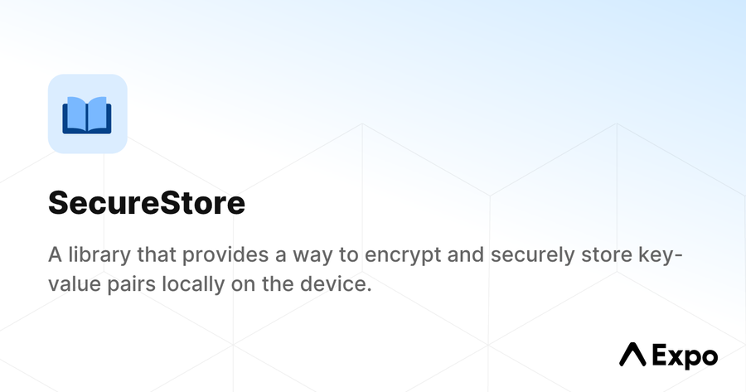




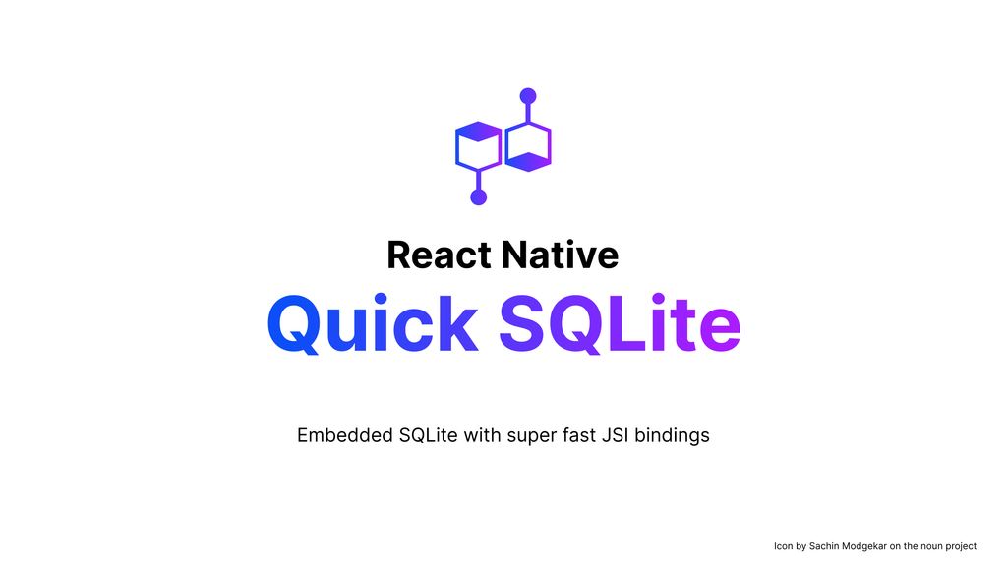
Technology Stack
RUNTIME ARCHITECTURE
Enroll / Verify UI (Expo Router)
Liveness Orchestrator (JS)
rPPG Hook + Geometric Hook
useFaceEngine → TFLite Bridge
MobileFaceNet INT8 · 1.9 MB
AES-256 Vault → SQLite → S3 Sync

Slide 6
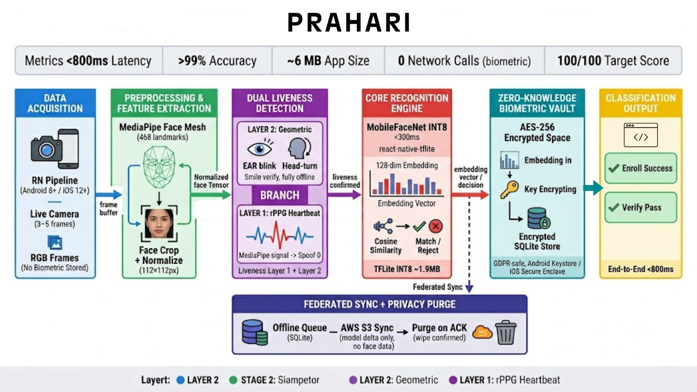
System Pipeline

Slide 7
Brief & Problem Statement

