Slide 1
AI RESUME ANALYZER & JOB MATCHER
A Serverless, Event-Driven Cloud-Native Application on AWS
CSCI 5411 — Advanced Cloud Architecting | Summer 2026
Dhrutiben Narendrabhai Patel
Cognito • API Gateway • Lambda • Step Functions • Textract • DynamoDB • S3 • SNS • EventBridge • CloudWatch • Terraform

Slide 2
THE PROBLEM
Manual Resume Screening Doesn’t Scale
Seconds, not minutes
Recruiters spend roughly 6–8 seconds scanning each resume before deciding to reject or advance it.
OUR SOLUTION
AI-powered, automated, serverless resume scoring.
No objective signal
Screening decisions rely on subjective judgement — there is no consistent, comparable score across candidates.
Instant match scores — 0–100 against any job description, generated in about 90 seconds end-to-end.
Skill gap analysis — matched skills, strengths, gaps, and concrete improvement recommendations.
Ranked candidate lists — recruiters see every applicant for a job pre-sorted by score, highest first.
Silence for candidates
Students who are rejected get no feedback on which skills were missing or how close they were to a match.
Volume breaks the process
A single posting can draw hundreds of resumes — far more than any team can meaningfully review by hand.
AI Resume Analyzer & Job Matcher | CSCI 5411 – Advanced Cloud Architecting
2

Slide 3
SOLUTION OVERVIEW
Two Portals, One Serverless Pipeline
Student Portal
Recruiter Portal
AI Pipeline
Upload a resume against any posted job (or a pasted description). Get an AI match score, skill gaps, strengths, and recommendations in under two minutes.
Post jobs, bulk-upload candidate resumes, and review a ranked leaderboard with score-distribution and top-skills charts.
Amazon Textract extracts resume text; a Hugging Face LLM scores it against the job; results land in DynamoDB and trigger an SNS notification.
Serverless Infrastructure
Security by Design
Full CI/CD
Every compute layer is Lambda or a managed AWS service — zero idle cost, and it scales automatically with load.
Cognito-issued JWTs on every route, role-based access for students vs. recruiters, and Secrets Manager for the one external API key.
GitHub Actions runs the unit test suite on every push; Terraform apply only proceeds once tests pass.
AI Resume Analyzer & Job Matcher | CSCI 5411 – Advanced Cloud Architecting
3

Slide 4
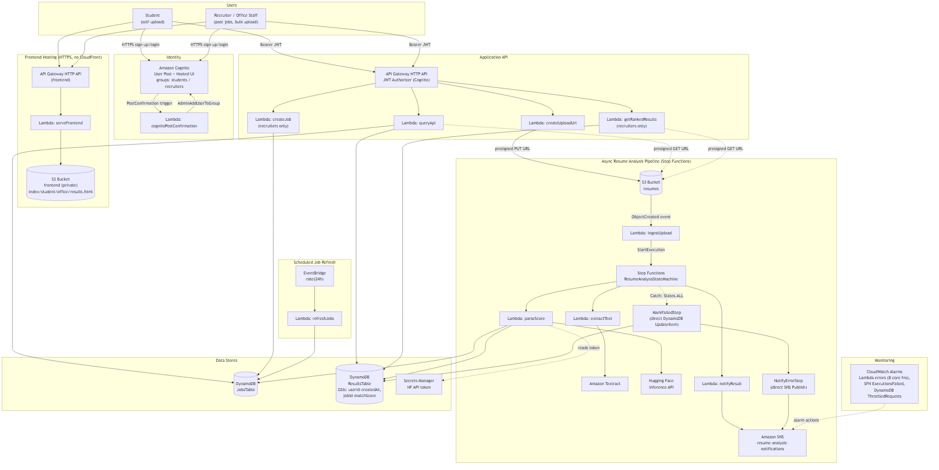
SYSTEM ARCHITECTURE
End-to-End Serverless Design
AI Resume Analyzer & Job Matcher | CSCI 5411 – Advanced Cloud Architecting
4

Slide 5
AWS SERVICES USED
Twelve Managed Services, Zero Servers
Category | Service | Why It’s Here
Compute | AWS Lambda (Node.js 20.x) | Zero idle cost, event-driven, auto-scales
Orchestration | AWS Step Functions | Retry + Catch on every state, visual execution graph
API | API Gateway HTTP API | JWT authorizer; ~70% cheaper than REST API
Storage | Amazon S3 | Resume upload/download, private buckets, lifecycle rules
Database | Amazon DynamoDB (on-demand) | GSIs for pre-sorted queries, zero capacity planning
AI — OCR | Amazon Textract | DetectDocumentText handles multi-column PDF resumes
AI — Scoring | Hugging Face Inference API | LLM scoring (Bedrock unavailable in Learner Lab)
Auth | Amazon Cognito | Self-registration, Hosted UI, student/recruiter groups
Secrets | AWS Secrets Manager | HF API token — never in code or IaC
Messaging | Amazon SNS | Completion + pipeline-error email alerts
Scheduling | Amazon EventBridge | Daily rate(24h) rule refreshes baseline job postings
Monitoring | CloudWatch Alarms | Lambda errors, SFN failures, DynamoDB throttles
AI Resume Analyzer & Job Matcher | CSCI 5411 – Advanced Cloud Architecting
5

Slide 6
STUDENT PORTAL
End-to-End Upload Flow
1
2
3
4
5
Login / Register
Select a Job
Upload Resume
AI Pipeline Runs
View Results
Self-registers or logs in through Cognito; a post-confirmation Lambda assigns the students group, which drives dashboard routing.
Picks from posted jobs or pastes a custom job description to score against.
Browser PUTs the PDF directly to S3 via a presigned URL — no Lambda payload limit. DynamoDB is seeded with status=pending.
S3 event triggers ingestUpload → Step Functions: Textract extracts text → Hugging Face LLM scores it → SNS email sent.
UI polls every 5s. Score (0–100), matched skills, strengths, gaps, and recommendations are displayed, with resume re-download available.
AI Resume Analyzer & Job Matcher | CSCI 5411 – Advanced Cloud Architecting
6

Slide 7
RECRUITER PORTAL
Post, Rank, and Review Candidates
Post Job Openings
Bulk Resume Upload
Create jobs with title, description, required skills, and location — immediately available for student uploads.
Drag-and-drop multiple PDFs; each independently triggers the same AI pipeline via an S3 event.
Ranked Candidate View
Visual Analytics
Candidates sorted by match score via a DynamoDB GSI (jobId-matchScore-index) — no app-level sorting needed.
Score-distribution and top-skills charts (Chart.js), plus stat cards: total, average, top score, strong matches ≥70.
Ownership Enforcement
Resume Download
A recruiter only sees results for jobs they created; the Lambda checks ownerId against the JWT sub and returns 403 otherwise.
Each ranked result includes a presigned S3 GET URL — direct, secure download of the original candidate PDF.
AI Resume Analyzer & Job Matcher | CSCI 5411 – Advanced Cloud Architecting
7

Slide 8
AI ANALYSIS PIPELINE
Step Functions — Retry + Catch on Every State
S3 Upload Trigger
On Any Catch: States.ALL
PutObject event → ingestUpload Lambda → StartExecution
MarkFailedStep — direct DynamoDB UpdateItem sets status=failed (no Lambda).
NotifyErrorStep — direct SNS Publish alerts the operator.
▼
ExtractTextStep
Textract DetectDocumentText extracts raw resume text. Retry: 2x, 2s backoff.
▼
ParseAndScoreStep
Hugging Face LLM scores resume vs. job → matchScore, skills, strengths, gaps, recommendations.
▼
NotifyResultStep
SNS email sent to the candidate with score and summary.
Standard Workflow — every Task state carries its own Retry and Catch block; failures never leave a record stuck in "pending."
AI Resume Analyzer & Job Matcher | CSCI 5411 – Advanced Cloud Architecting
8

Slide 9
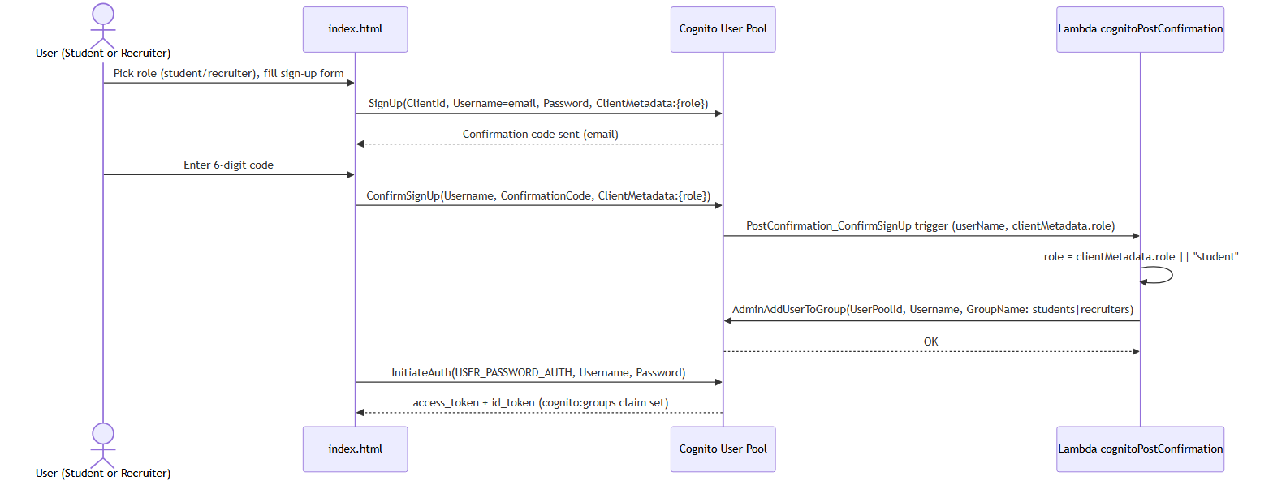
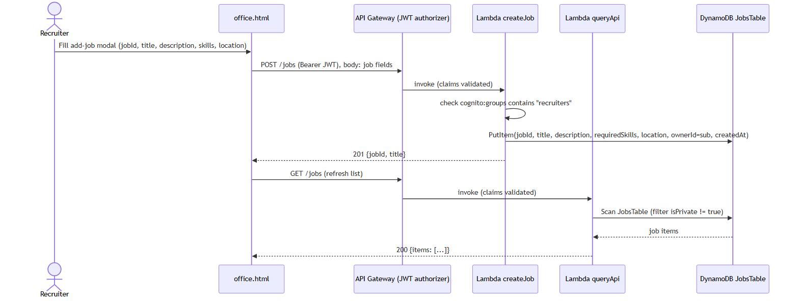
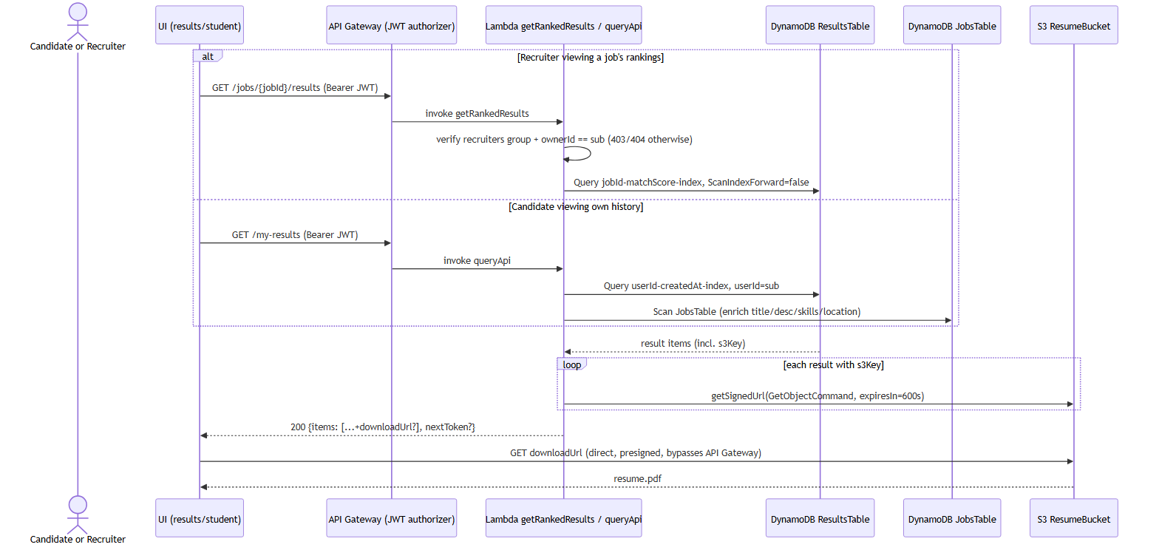
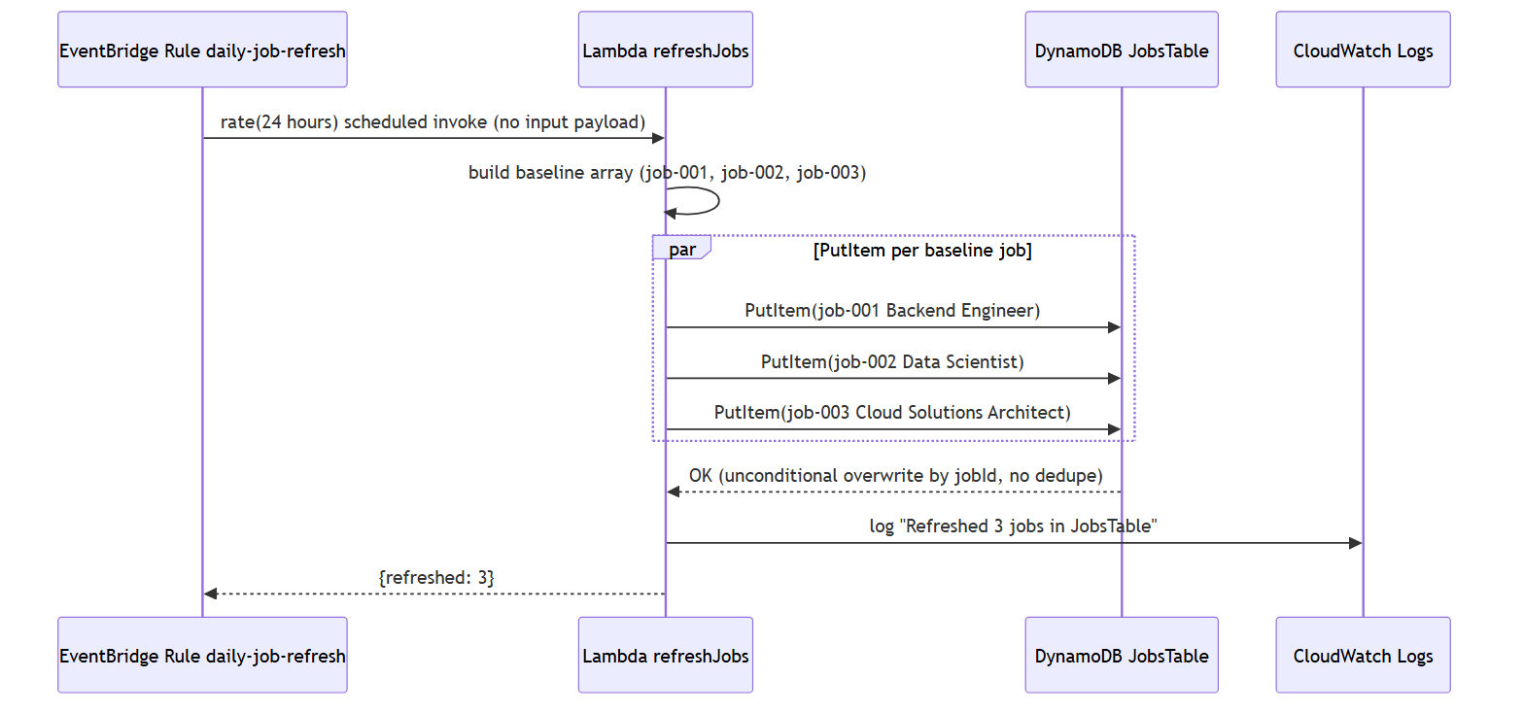
SUPPORTING FLOWS
Registration, Job Posting, Download & Refresh
Self-registration assigns a Cognito group (students/recruiters) via a post-confirmation Lambda — driving all later authorization.
Recruiters create jobs through a JWT-authorized route; the Lambda re-checks the recruiters group before writing to JobsTable.
Resume downloads resolve to a 10-minute presigned S3 GET URL — the file itself never passes through API Gateway or Lambda.
An EventBridge rule invokes refreshJobs every 24 hours to reseed baseline postings, independent of live recruiter-created jobs.
AI Resume Analyzer & Job Matcher | CSCI 5411 – Advanced Cloud Architecting
9

Slide 10
DATA MODEL
DynamoDB — On-Demand, GSI-Driven
ResultsTable
JobsTable
candidateId
PK — Cognito sub or bulk-upload UUID
jobId
PK — recruiter-provided unique ID
resumeId
SK — UUID per upload
title / description
Posting content
userId
Cognito sub of uploader (ownership)
requiredSkills
List of required skills
jobId / jobTitle
Reference + denormalized title
location
Defaults to "Remote"
status
pending | completed | failed
ownerId
Cognito sub of creating recruiter
matchScore
0–100 from the LLM
createdAt
ISO 8601 timestamp
skills / strengths / gaps / recommendations
LLM output arrays
Seeded nightly by refreshJobs (EventBridge, rate(24h)) alongside live recruiter postings.
s3Key
Resume PDF location in S3
createdAt
ISO 8601 timestamp
GSI 1: userId-createdAt-index — student history
GSI 2: jobId-matchScore-index — recruiter ranking
AI Resume Analyzer & Job Matcher | CSCI 5411 – Advanced Cloud Architecting
10

Slide 11
AWS WELL-ARCHITECTED FRAMEWORK
All Six Pillars Addressed
Operational Excellence
Security
Reliability
CloudWatch alarms on every Lambda + Step Functions + DynamoDB; Step Functions ERROR-level logging; CI/CD test gate before every deploy.
Cognito JWT on every route; role-based access (students/recruiters); Secrets Manager for the HF token; security headers on all responses.
Retry (2x) + Catch on every Step Functions state; S3 versioning; DynamoDB on-demand capacity (no throttling); multi-AZ by default.
Performance Efficiency
Cost Optimization
Sustainability
Presigned S3 URLs bypass Lambda for uploads/downloads; DynamoDB GSIs pre-sort results; the analysis pipeline runs fully async.
Serverless end-to-end — zero idle cost; S3 lifecycle rules; API Gateway throttling caps runaway usage.
No always-on servers; scales to zero at zero load; S3 lifecycle deletes stale versions automatically.
AI Resume Analyzer & Job Matcher | CSCI 5411 – Advanced Cloud Architecting
11

Slide 12
CI/CD PIPELINE
GitHub Actions — Every Push to main
Job 1 — Unit Tests
Job 2 — Terraform Apply (needs: test)
▶ Checkout code
▶ Setup Node.js 22
▶ npm ci (install Jest + AWS SDK mocks)
▶ npm test — 71 tests must pass
⛔ FAIL blocks the deploy job entirely
▶ Configure AWS credentials from secrets
▶ npm ci in lambdas/queryApi
▶ terraform init + validate
▶ terraform plan (log changes)
▶ terraform apply -auto-approve
▶ Print live API + frontend outputs
Required secrets: AWS_ACCESS_KEY_ID · AWS_SECRET_ACCESS_KEY · AWS_SESSION_TOKEN · DEMO_USER_PASSWORD · HF_TOKEN
AI Resume Analyzer & Job Matcher | CSCI 5411 – Advanced Cloud Architecting
12

Slide 13
UNIT TESTING
71 Tests Across 6 Lambda Handlers
Test File | Tests | Coverage
createUploadUrl.test.js | 12 | Presigned URL shape, jobId fallback, status seed, S3 key format
createJob.test.js | 11 | 403 non-recruiter, 400 missing fields, 201 success, ownerId from JWT
parseScore.test.js | 13 | JSON extraction, markdown-fence strip, completed write, error paths
getRankedResults.test.js | 14 | 403 auth, 404 job not found, 200 ranked list, download URL, pagination
queryApi.test.js | 12 | GET /jobs, /results, /my-results, 404 unknown route, auth checks
ingestUpload.test.js | 11 | 4-segment key parse, legacy fallback, multi-record, URL decode
Tooling: aws-sdk-client-mock v4 · Jest moduleNameMapper forces every @aws-sdk/* import to the root node_modules · no AWS credentials required to run the suite.
AI Resume Analyzer & Job Matcher | CSCI 5411 – Advanced Cloud Architecting
13

Slide 14
LIMITATIONS & FUTURE WORK
Honest About Learner Lab Constraints
CURRENT LIMITATIONS
FUTURE ENHANCEMENTS
⚠ No per-Lambda IAM roles — LabRole blocks CreateRole; one shared, over-permissioned role.
⚠ No AWS WAF — WAF integration requires a REST API; this project uses an HTTP API.
⚠ External AI API (Hugging Face) — Bedrock is unavailable in the Learner Lab.
⚠ No CloudFront CDN — CreateDistribution is blocked by the LabRole policy.
⚠ No X-Ray tracing — xray:PutTraceSegments is blocked by the LabRole policy.
→ Migrate AI scoring to Amazon Bedrock (Claude 3 Haiku) — remove the external dependency.
→ WebSocket API for real-time notifications, replacing the 5-second polling loop.
→ Resume versioning — track score improvement across multiple uploads.
→ Multi-region active-passive with DynamoDB Global Tables + Route 53 failover.
→ DynamoDB PITR, WAF, and per-Lambda execution roles for production hardening.
AI Resume Analyzer & Job Matcher | CSCI 5411 – Advanced Cloud Architecting
14

Slide 15
KEY ACHIEVEMENTS
By the Numbers
30+
71
6
AWS Resources
Unit Tests
Well-Architected Pillars
Fully provisioned via Terraform — one command deploys everything
All Lambda business logic covered; tests gate every CI deploy
All six AWS Well-Architected Framework pillars addressed
0
<3s
~90s
Idle Cost
Upload Time
AI Analysis
Fully serverless — zero cost when no users are active
Presigned S3 URL bypasses Lambda — direct browser-to-S3 upload
End-to-end: Textract OCR + LLM scoring + DynamoDB write
AI Resume Analyzer & Job Matcher | CSCI 5411 – Advanced Cloud Architecting
15

Slide 16
Thank You
Questions?
LIVE DEMO
https://2ftfx5av88.execute-api.us-east-1.amazonaws.com
GITHUB REPOSITORY
https://github.com/Dhruti832/CloudProject
Dhrutiben Narendrabhai Patel | CSCI 5411 — Advanced Cloud Architecting | Summer 2026
Cognito • API Gateway • Lambda • Step Functions • Textract • DynamoDB • S3 • SNS • EventBridge • Secrets Manager • CloudWatch • Terraform

