Slide 1
An ensemble Deep Neural Net approach for Value at Risk Analysis
Dhruti Contractor
M.Sc in Data Science

Slide 2
BACKGROUND
Equity market is highly volatile and has profound impact on economy. Investors are concerned about their returns before investing. The estimation of Value at Risk (VaR) and similar market risk management measures inform the financial firms with regards to the levels of capital they need to hold to have a buffer against unexpected downturns — market risk.
The Value at Risk was developed as a systematic way to segregate extreme events that are qualitatively studied from everyday price movements, which in turn are dependent on short-term data in specific markets.
Since the Basel Committee on Bank Supervision(BCBS), a primary global standard setter for Regulations of Banks, requires a financial institution to meet capital requirements on the basis of VaR estimates, this measurement has become a basic market risk management tool for financial institutions

Slide 3
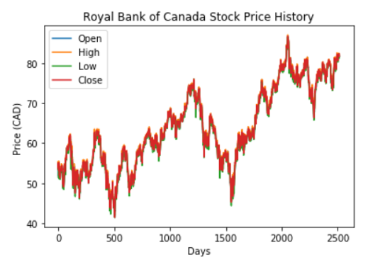
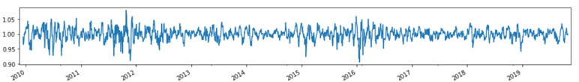
Value at Risk
We have a portfolio of stocks. How Risky is our investment?
We want to model the likelihood of the stock portfolio loses
Problem Statement
Identify the worst case scenario
Current state of art to identify the threshold value
Apply the frame work of Bayesian LSTM
Evaluate the performance.

Slide 4
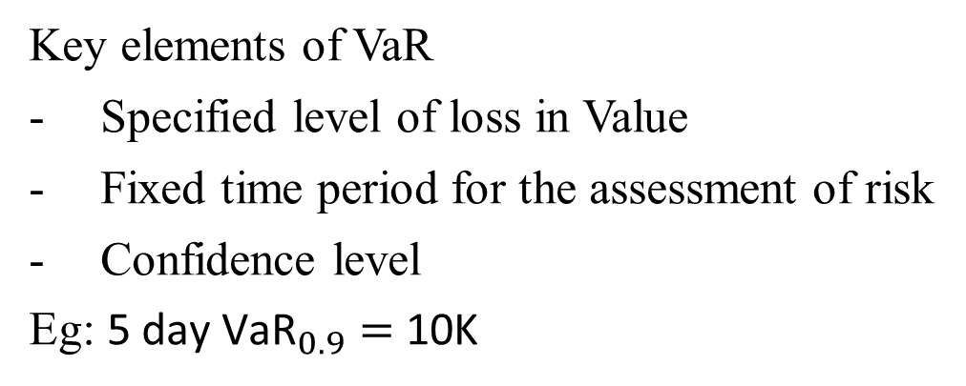
Literature Review
General Techniques
1. Parametric
- Delta-Normal method
- Monte Carlo simulation
2. Non Parametric
- Historical Simulation
Key elements of VaR
Specified level of loss in Value
Fixed time period for the assessment of risk
Confidence level
Eg: ${\text{5 }\text{day} \text{VaR}}_{0.9}=$ 10K
Factors | Portfolio Theory | VaR
Interpretation | Standard Deviation | Maximum Likelihood Loss
Assumptions | Returns are Normally Distributed | Works will various distribution
Application | Limited to Market Risk | credit, liquidity and other risks along with Market

Slide 5
Machine Learning Algorithms
Drawbacks of General techniques
Support Vector Machines
Advantages
Simple Moving Average
Weighted Moving Average
GARCH
Quantile Regressions(Linear and kernel)
Ensemble Approaches

Slide 6
Ensemble With Neural Networks
Extreme Learning Algorithm and GARCH
Random Forest and Deep Neural Network
to decrease variance of model without increasing bias
CNN with sliding window
Bayesian RNN
LSTM

Slide 7
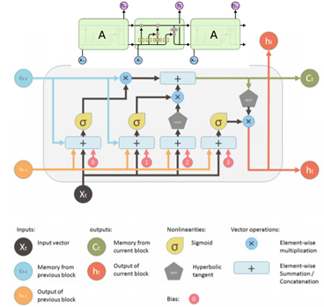
Architecture of LSTM
Decides what to Insert
Decides what to forget
RNN
are network with loops
LSTM
A memory cell that learns long term dependencies
Forget Gate
Input Gate- Decides which values of memory cell to write
Tanh creates a new vector to share with the next state
Tanh maps bits to [-1,+1] range
tanh maps bits to [-1,+1] range
What part of the cell to output?

Slide 8
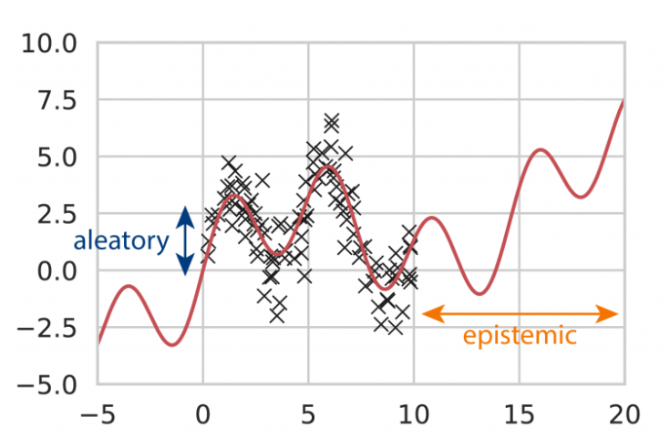
Uncertainty Quantification
Epistemic uncertainty
Due to lack of training data
Aleatory Uncertainty
randomness of the process generating real data
Dropouts
Bayesian Approximation
assigns a prior distribution on parameters

Slide 9
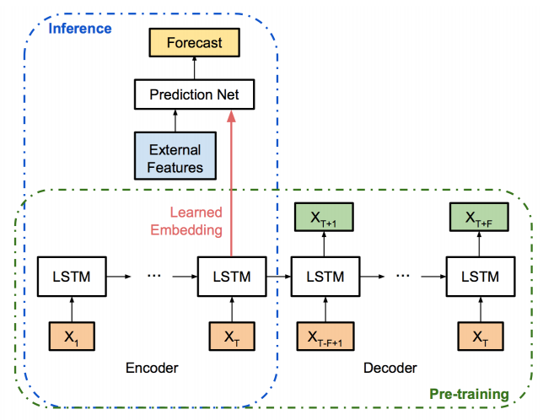
Framework of Bayesian LSTM
2 LSTM layers
Encoder (128)
Decoder(32)
Dropout is applied for both LSTM layers
Predictor Stage:
1 fully-connected output layer
Adam Optimizer applied to training

Slide 10
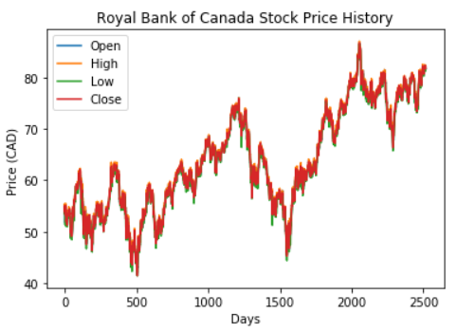
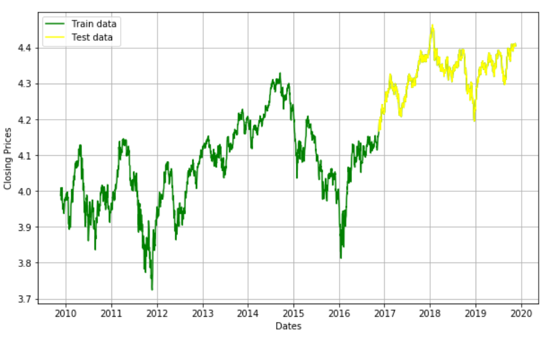
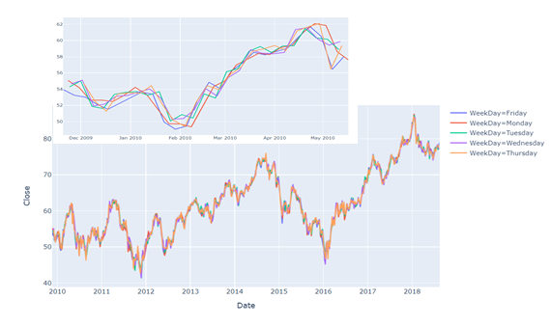
Data Exploration
Pre-process
Feature engineering
2518 records
Split the data into train and test

Slide 11
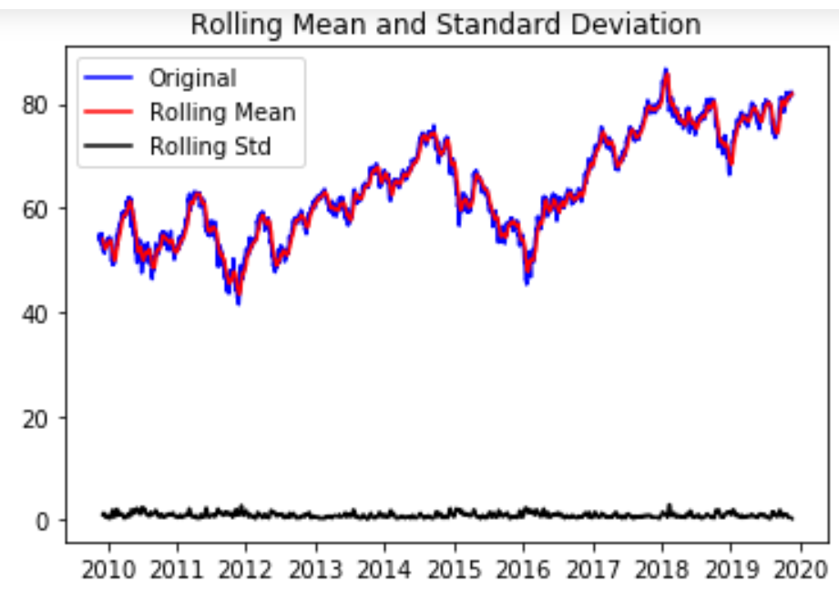
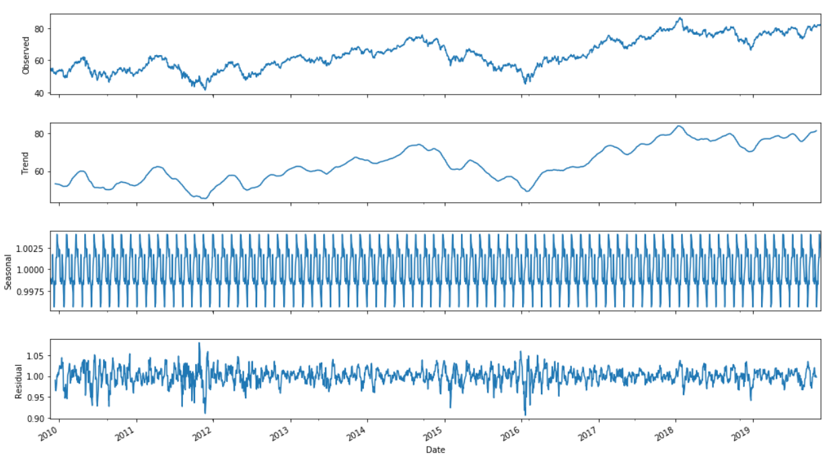
Data Transformation
Test Statistics | -1.442
p-value | 0.561
No of lags used | 0.0
No of observations | 2516
Critical Value(1%) | -3.432
Critical Value(5%) | -2.862
Critical Value(10%) | -2.567

Slide 12
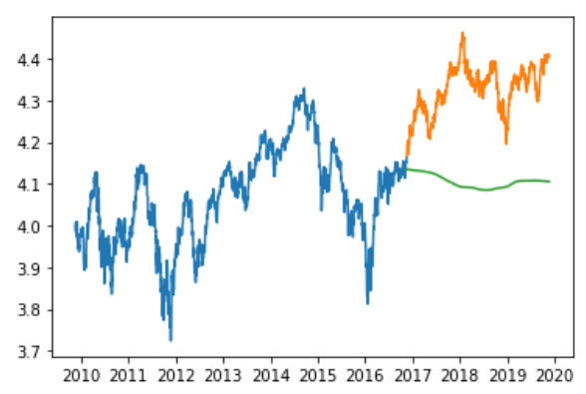
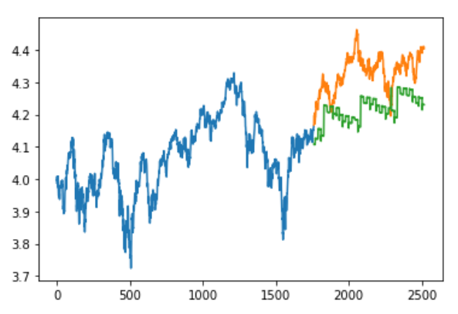
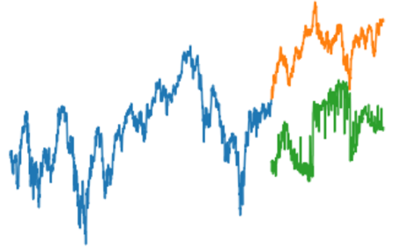
OBSERVATIONS
Moving Average
Linear Regression
KNN
RMSE: 26%
RMSE: 12%
RMSE: 23%

Slide 13
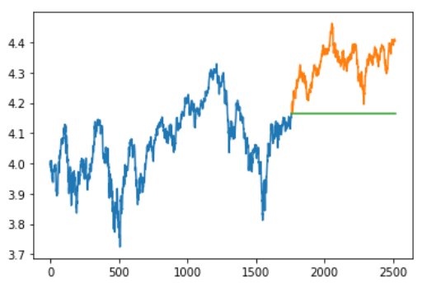
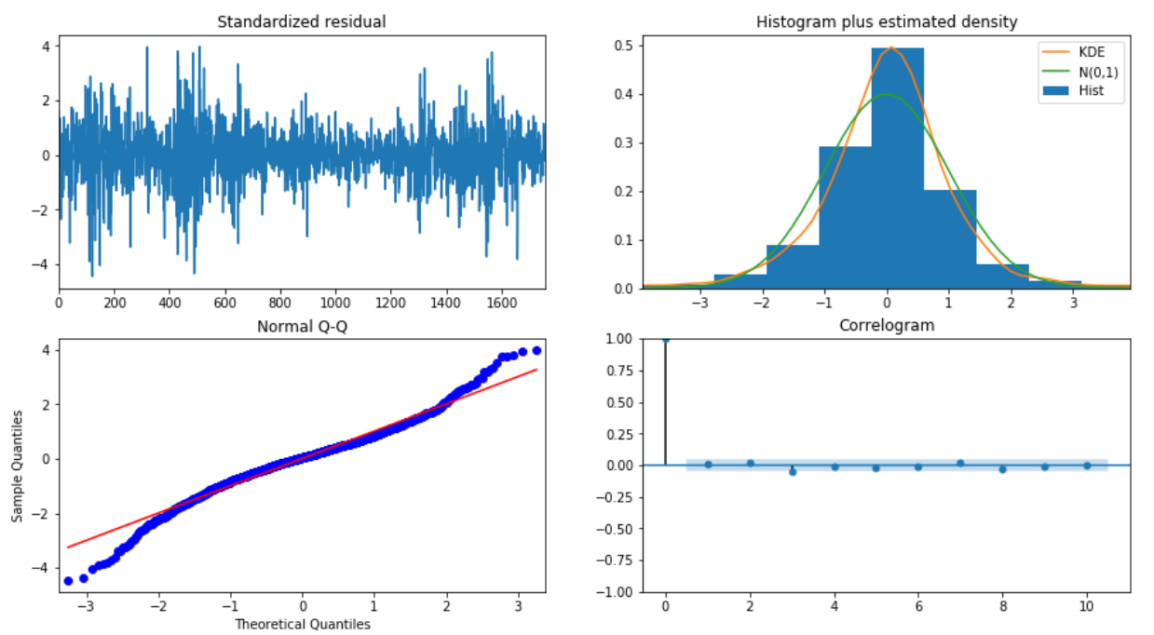
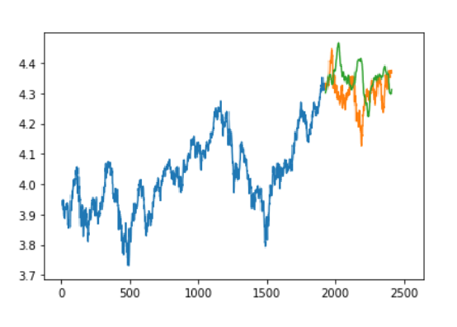
OBSERVATIONS
Auto ARIMA
Residual Plot
RMSE: 17%
LSTM
RMSE: 14%

Slide 14
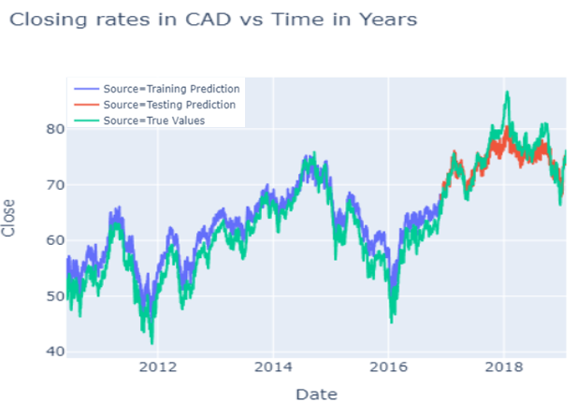
Results
Algorithms | MAPE | MSE | RMSE
Moving Average | 0.24 | 0.05 | 0.23
Linear Regression | 0.26 | 0.015 | 0.12
KNN | 0.06 | 0.071 | 0.26
Auto ARIMA | 0.038 | 0.03 | 0.17
LSTM | 0.03 | 0.02 | 0.14
Bayesian LSTM | 0.0 | 0.0 | 0.025
Bayesian LSTM

Slide 15
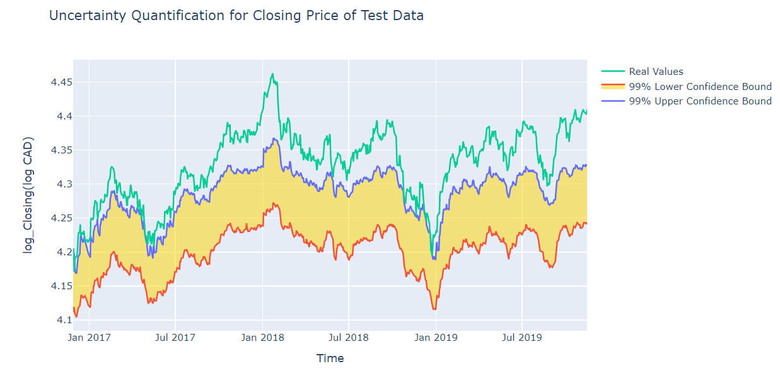
Conclusion and Future Work
The dropout allowed us to obtain model uncertainty out of existing deep learning model
Bayesian NN accounts only for scientific model uncertainty and not statistical uncertainty
Our framework is based on the concept of default hyper-parameter values

