Slide 1
HR ANALYTICS CASE STUDY SUBMISSION
Group Name:
Ishita Aggarwal
Sundaresan V
Dhanilan M
Dhruti Contractor

Slide 2
Background of HR Analytics Case Study
Business Objective
To identify the factors affecting attrition
To Analyse and suggest What change XYZ should make in their workplace to make their employee stay
Data and Strategy
We have different data sourced as below which are provided from XYZ firm.
Data:
employee_survey_data → contains 4410 observations of employee information of firm
Manager_survey_data → contains 4410 observations with job involvement and ratings details
general_data → contains 4410 observation wit employee personal & work details.
In_time → contains in time information of an employee and holiday details of firm.
Out_time →contains out time information of an employee and holiday details of firm
Strategy:
We are going too use predictive analysis of Logistic Regression to solve the business problem, i.e. factors affecting the attrition.

Slide 3
Model – Problem/ Solution
Data understanding
Data Analysis
Model Building
Model Evaluation
Loading HR Analytics Data As is,
Removing Unwanted variables having 0 and NA values
Check for Duplicate in Key column & Merging the Data
Convert Date columns to standard format
Analysis of raw data using Univariate& Multivarite analysis.
•Missing Value Imputation using median
•Dummy variable creation
• Conveting into Categorical & Numeric variables
Use StepAIC and glm to arrive at key factors influencing the attrition
•Identify the model’s
•Accuracy
•Sensitivity
•Specificity
•Use Gain, Lift and KS Stats to predict best model

Slide 4
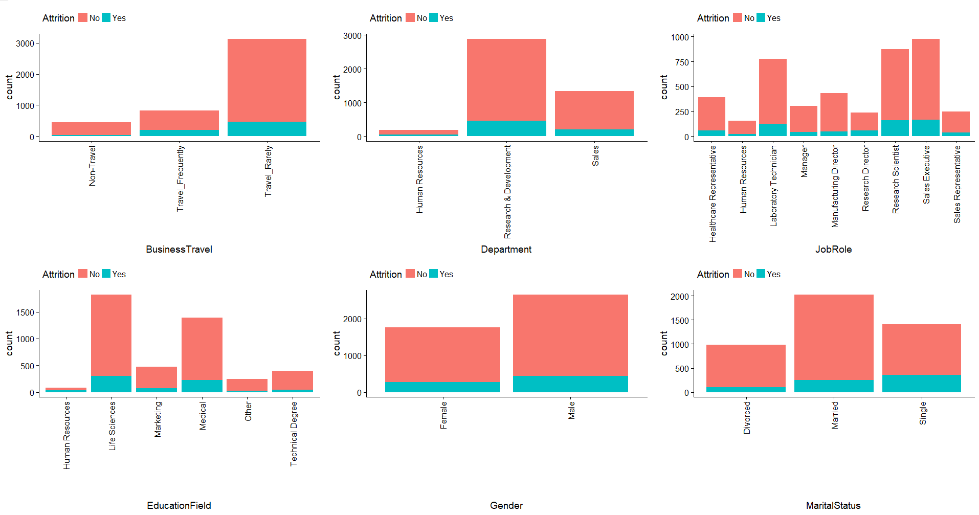
Univariate Analysis on Different Attributes – I (contd)

Slide 5
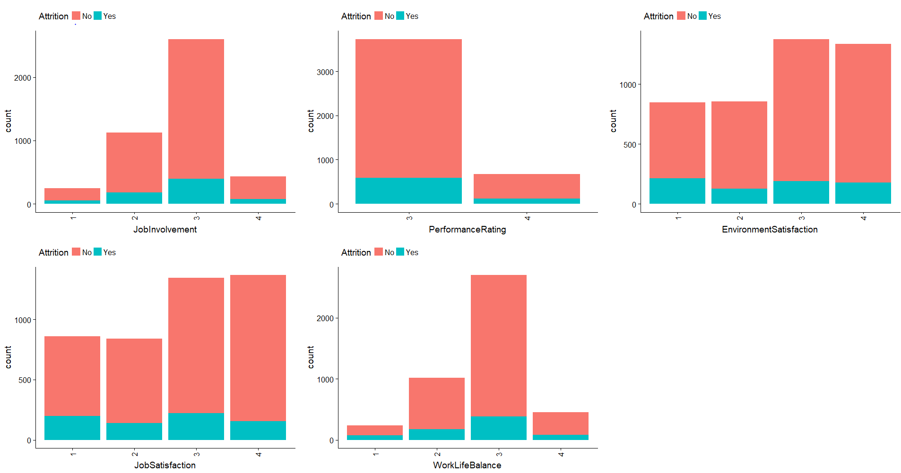
Univariate Analysis on different attributes - II

Slide 6
Summary of Univariate Analysis
Gender & Marital Status
Males have higher attrition rate than females in the company
Attrition rate is higher in Employees who are “Single”.
Education Field
Employees belong to Life sciences and Medical have high attrition Rate.
Business Travel
Employees who are under the category of “Travel_Rarely” have high attrition Rate.
Job Involvement
Employees belong to Job Involvement category of “3” have high attrition Rated
Job Role
Employees belong to category “Research Development” has high attrition rate
Work Life Balance
Employee belong to category of “3” has high attrition rate
Performance Rating
Employees belong to performance rating of “4” have high attrition Rate

Slide 7
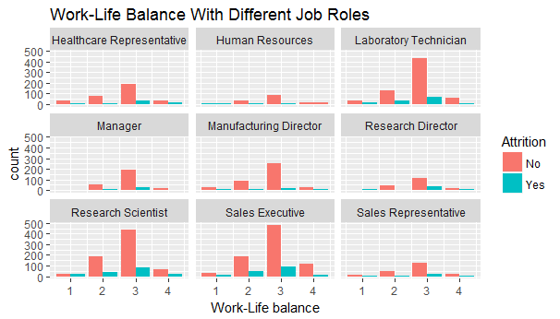
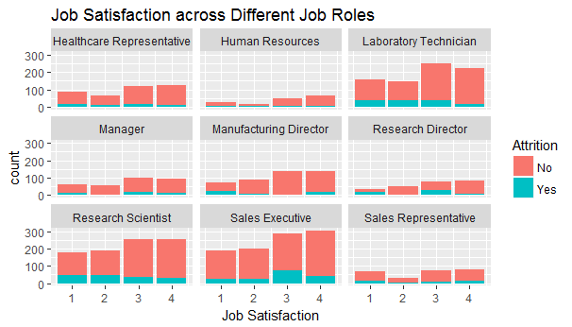
Multivariate Analysis
Attrition Rate is comparatively high for Laboratory Technician, Research Scientist and Sales executive. Despite of Employer providing a balance between personal and professional life, employees with the mentioned job roles are switching to different companies. Interestingly, Employees satisfied with their job are also adding to the attrition and is evident primarily in Roles as Research Director and Sales Executives followed by research Scientists and Lab technican.

Slide 8
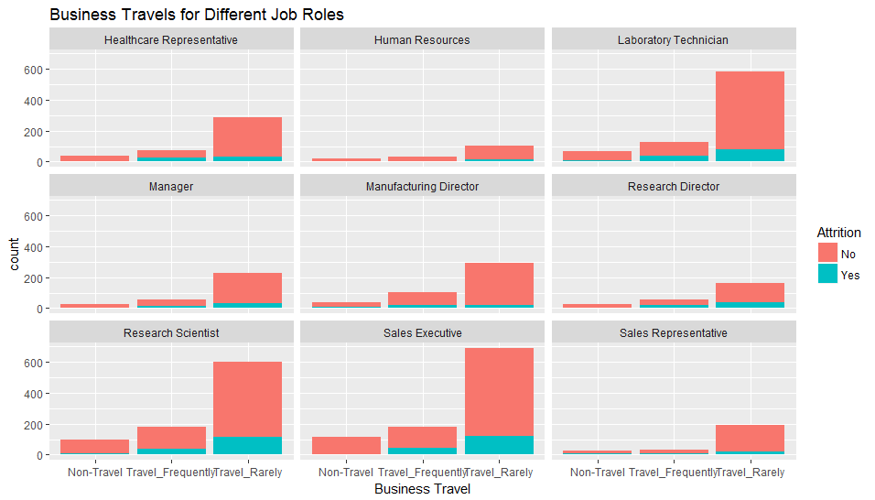
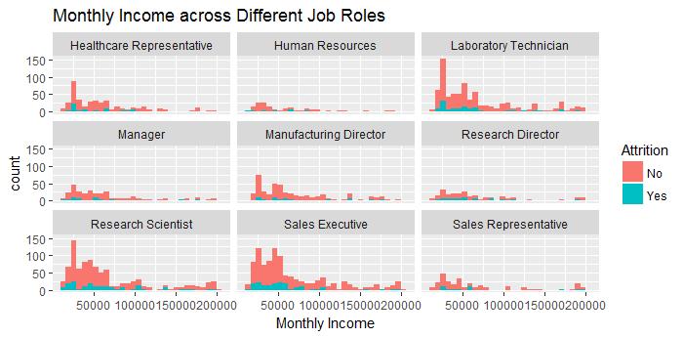
Multi Variate Analysis – II (contd)
It is clearly evident that Business Travel plays a role in retaining employees. Attrition Rate is high across different Job roles as there are rarely any Business Travel.
Employees with Monthly Income of $75000 or less prefer changing the organisation more frequently.

Slide 9
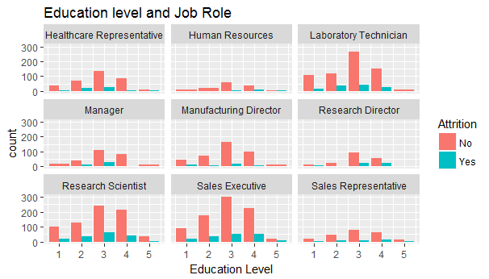
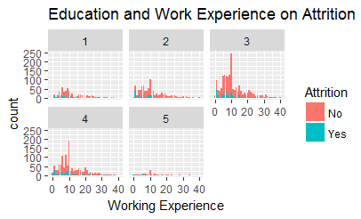
Multi Variate Analysis (Educataion Level/ Work Experience) -- Contd

Slide 10
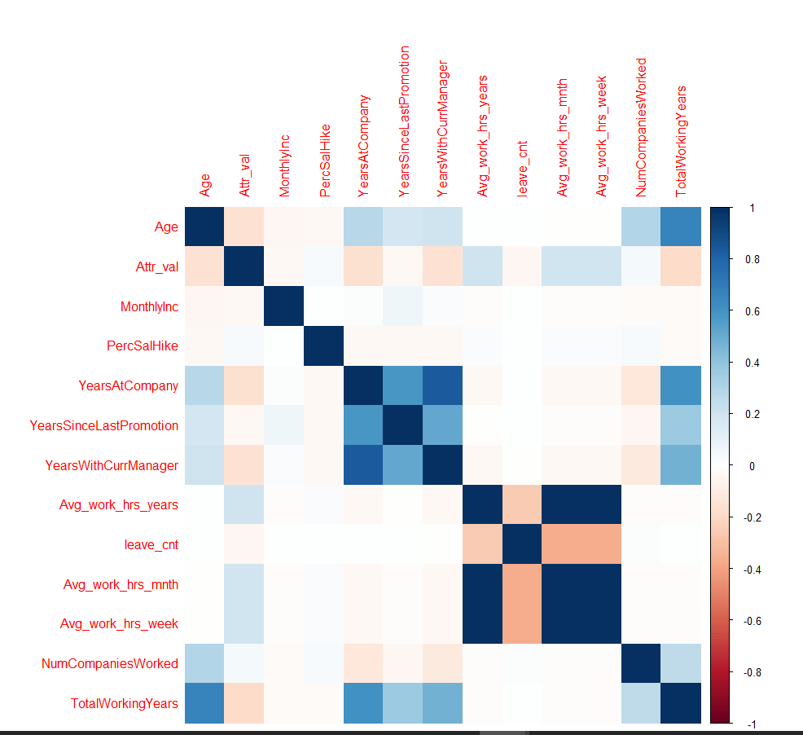
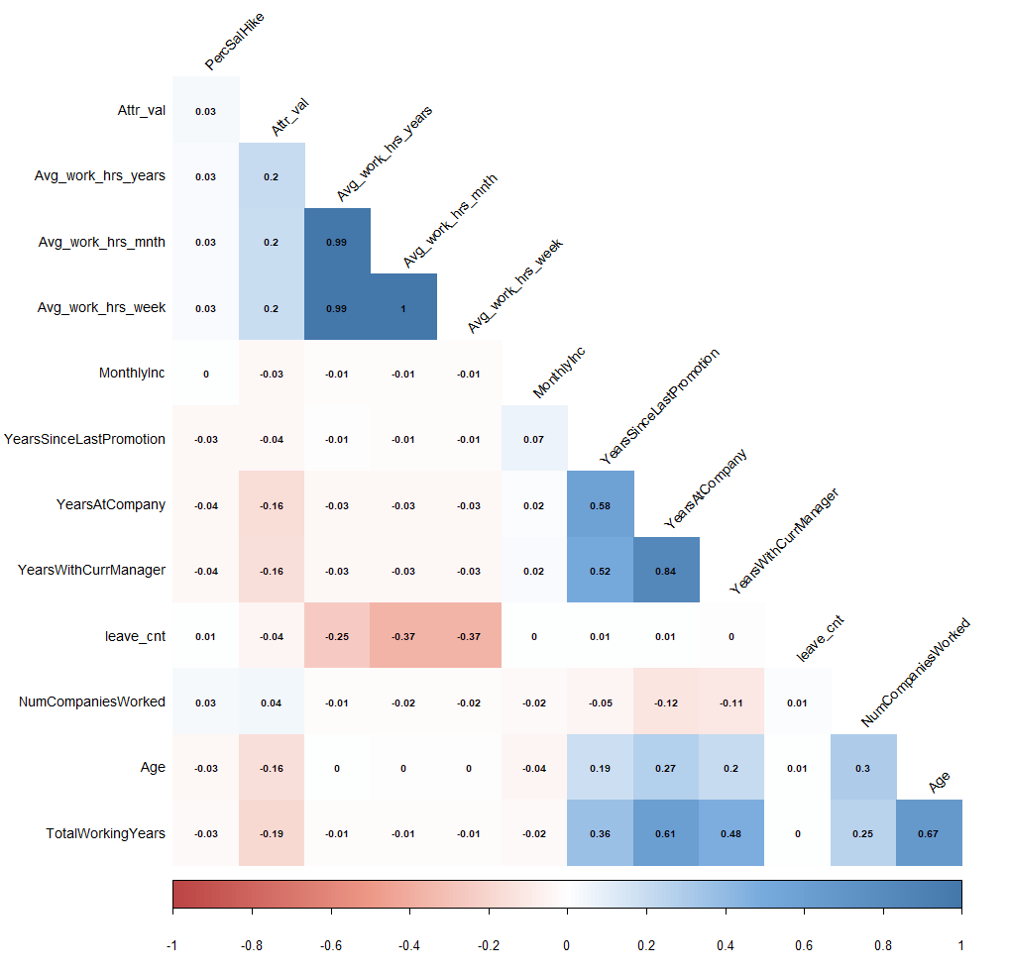
Correlation Matrix

Slide 11
Data Manipulation
Scaling
Performed Scaling different continuous variables
2. Dummy Variables
Introduced dummy variables for all categorical variables
3. Outlier treatment
Performed outlier treatment for below variables
YearsAtCompany
YearswithCurrentManager
YearsSinceLastPromotion
TotalWorkingYears
TrainingTimesLastYear
Derived Variables
Introduced new variables like
Leave_cnt,
Avg_work_hrs_year, avg_work_hr_mnth
Avg_work_hrs_week
Variable Name | NA count | Missing Value Treatment
NumCompaniesWorked | 19 | Replaced NA value with Median
TotalWorkingYears | 9 | Replaced NA value with Median
WorkLifeBalance | 38 | Replaced NA value with Median
JobSatisfaction | 20 | Replaced NA value with Median
EnvironmentSatisfaction | 25 | Replaced NA value with Median

Slide 12
Model Building
Model Building
Training
We used 70% of observations as train serand 30% of data as test
StepAIC is used to improve performance of model by eliminating insignificant variables
Results
Total of 19 models were created to arrive at final model
Using glm model for logistic regression a final dataset of 4410 obs and 59 variables is used for building model.
VIF is used to eliminate variable with high p-value > 0.05
The final model has 16 variables which together impact the attrition rate
Key Variables:

Slide 13
Univariate Analysis on Different Attributes – I (contd)

Slide 14
Univariate Analysis on different attributes - II

Slide 15
Factors affecting Attrition
NumCompaniesWorked
TotalWorkingYears
TrainingTimesLastYear
YearsSinceLastPromotion
YearsWithCurrManager → Being with Same manager for more than 1 years has to be focused
Avg_work_hrs_year → If the average work hours for an employee is more than 9 it has to be focussed
BusinessTravel.xTravel_Frequently
BusinessTravel.xTravel_Rarely
Department.xResearch...Development → Employees belong to reseach department has to be focussed
Department.xSales
MaritalStatus.xSingle → Marital Status as Single turns out to be cause for attrition
EnvironmentSatisfaction.x2
EnvironmentSatisfaction.x3
EnvironmentSatisfaction.x4
JobSatisfaction.x4 → Level 4 signifying poor job satisfaction which turns to be cause
WorkLifeBalance.x3 → Level 3 signifying poor work life balance

Slide 16
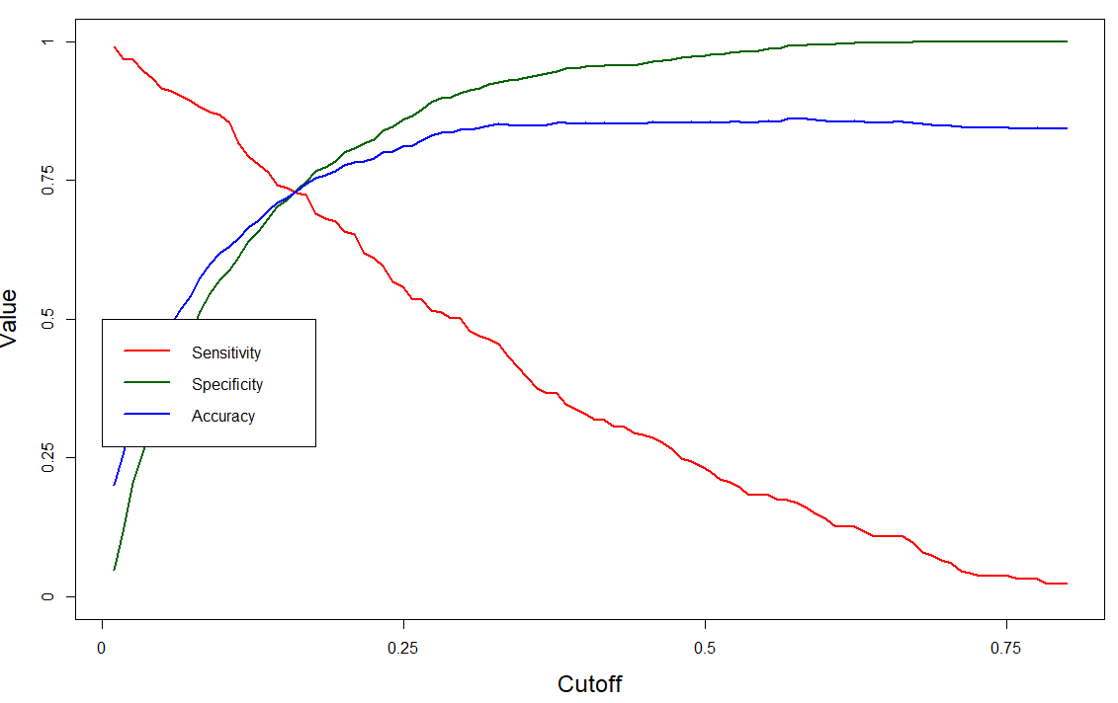
Model Evaluation
Confusion matrix on Probability with 40%
Accuracy -> 0.85
Sensitivity -> 0.32
specificity-> 0.95
It clearly shows Sensitivity is very poor
To overcome low Sensitivity, user defined function created to identify cutoff value
•Optimal probability threshold for best prediction: 0.161
Confusion Matrix at cutoff level of 1.61
•Accuracy : 0.7316
•Sensitivity : 0.7276
•Specificity : 0.7324

Slide 17
Lift Chart/Gain Chart /KS -Plot

Slide 18
Conclusions
Summary:
Conclusion:

Slide 19
Thank You

