Slide 1
Kolmogorov–Arnold Networks
From-scratch implementation, reduced-scale reproduction and ablations
Dhruv · Roll No. 24CS3018 · Deep Learning 2026 · RGIPT
Paper: Liu et al., KAN: Kolmogorov–Arnold Networks, arXiv:2404.19756v5
Notes:
Introduce the paper, what was implemented, and that the deck reports measured numbers only, including the ones that go against the paper.

Slide 2
MLP vs KAN
MLP
KAN
Fixed activation on nodes
Learnable linear weights on edges
MLP(x) = W₂ σ(W₁ x)
Learnable 1-D function on every edge
Nodes only sum their inputs
φ(x) = w_b·silu(x) + w_s·Σ cᵢBᵢ(x)
Paper's claims: faster scaling laws on small compositional tasks, and interpretable edge functions.
Notes:
MLP: fixed activation on nodes, learnable linear weights on edges. KAN: a learnable univariate function on every edge, nodes only sum.

Slide 3
What I built from scratch
1
B-splines
2
KAN layer + network
3
Grid update + extension
Cox–de Boor recursion, checked against SciPy
Eq. 2.5–2.12, paper initialisation
Least-squares refit (Eq. 2.16)
4
Sparsify + prune
5
Symbolic fitting
6
Tasks + baselines
L1 + entropy loss, node pruning (Eq. 2.17–2.21)
c·f(ax+b)+d per edge, SymPy formula
Feynman, Poisson PINN, MNIST, equal-parameter MLPs
20 unit tests pass (1 CUDA test skipped without a GPU)
Notes:
No KAN library used. LBFGS, autograd, lstsq and SymPy come from libraries; everything KAN-specific is my own code, with 20 unit tests passing.

Slide 4
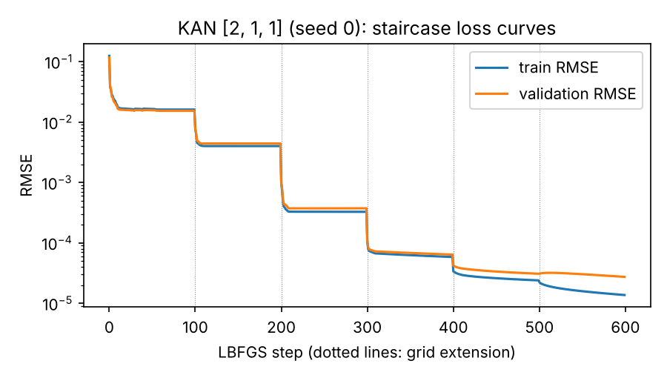
Grid extension
Train at G intervals
Refit a finer spline on G′ intervals to the current one by least squares: the function is preserved
Continue training; repeat for G = 3, 5, 10, 20, 50, 100
Each extension drops the error, then training plateaus (live run).
Notes:
Refit a finer spline to the coarse one so the function is preserved, then keep training. Each dotted line in the plot is an extension.

Slide 5
Experimental setup
Task | f(x,y) = exp(sin πx + y²), x,y ~ U[−1,1]
Data | 1000 train / 1000 val / 10 000 test, float64
KAN | [2,1,1] × 4 seeds, [2,5,1] × 2 seeds; k = 3; G = 3 … 100
MLP | SiLU, depth 2–4, widths 5–50, 4 seeds each
Optimiser | LBFGS: 100 steps per grid; MLP 600 steps (same total)
Selection | Validation RMSE only; test only reported
Differences from the paper: G ≤ 100 (paper: 1000), 100 steps per grid (paper: 200), 4 seeds.
Notes:
Selection of seeds, checkpoints and MLP configs is on validation only; test is only reported. Differences from the paper: G up to 100 not 1000, 100 steps per grid not 200, 4 seeds.

Slide 6
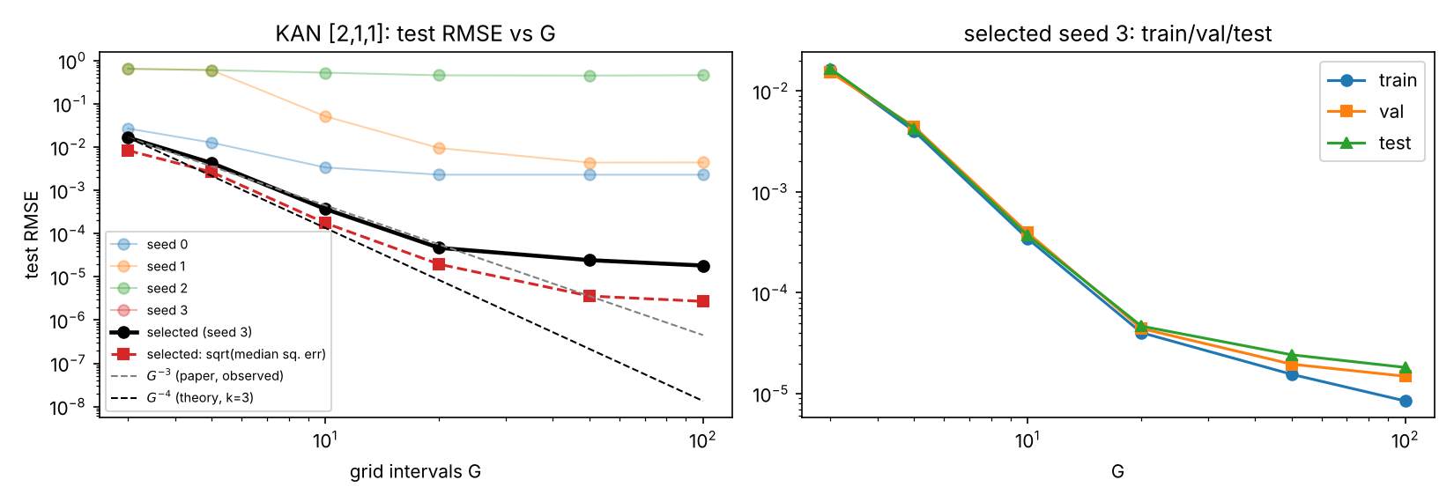
Error vs grid size
3.15
2.02
1 of 4
slope for G ≤ 20 (paper ≈ 3)
slope over G ≤ 100: saturates
seeds reach 1.8×10⁻⁵ at G = 100
Notes:
Slope 3.15 on G up to 20 is a window chosen after seeing the curve. Over the whole range the slope is 2.02 because the error saturates. Only seed 3 reaches ~1e-5.

Slide 7
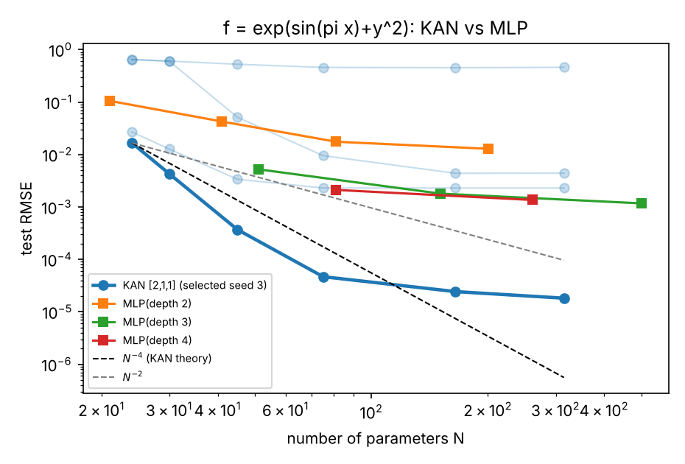
KAN vs MLP, equal parameters
≈ 64×
315-param KAN 1.8×10⁻⁵ vs best MLP (501 params) 1.2×10⁻³
3.4×10⁻³
median KAN at 315 params: worse than the best MLP (1.4×10⁻³)
127–161 s
one KAN run vs 19–28 s for a 600-step MLP (CPU)
Notes:
Best KAN seed (selected on validation) vs best MLP seed per configuration. The median KAN is worse than the best MLP, so the advantage depends on trying several seeds.

Slide 8
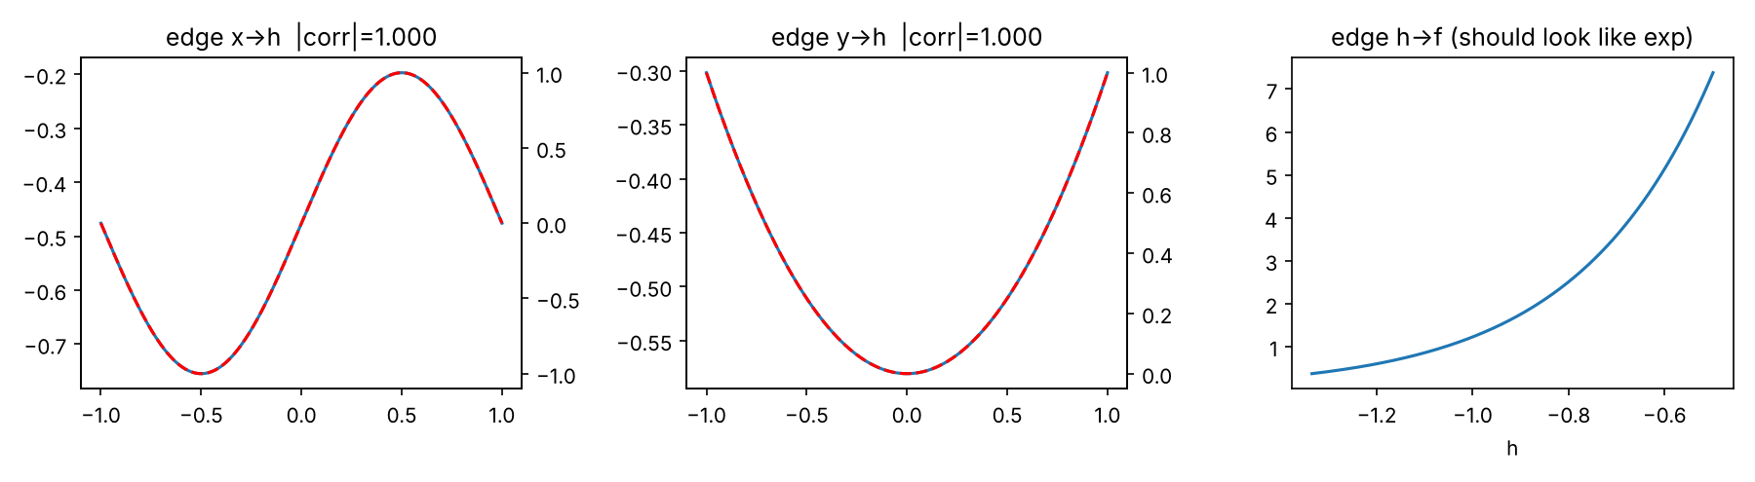
What the KAN learned
First-layer edges recover sin πx and y² (|corr| = 1.000); the output edge is exponential-like, so the compositional structure of f can be read from the splines.
Notes:
Edges of a live-run [2,1,1] KAN. |corr| with sin(pi x) and y^2 is 1.000 on a dense grid; the second layer is exponential-like.

Slide 9
Ablations
A · Grid extension vs from scratch
B · Spline order k
k | slope α | theory | best test RMSE
1 | 1.86 | 2 | 9.8×10⁻⁴
2 | 2.31 | 3 | 1.4×10⁻⁴
3 | 2.46 | 4 | 2.4×10⁻⁵
Higher order lowers the error, as predicted, but slopes fall below k + 1.
Extension helps only for G ≥ 20; at G = 5, 10 a failed first stage is inherited.
Notes:
A: extension only wins at G>=20; at G=5 and 10 from-scratch succeeded more often because a seed failing at G=3 passes its failure down the chain. B: ordering as predicted, slopes below k+1.

Slide 10
Feynman equations
3 of 6
KAN better (I.12.11, I.27.6, I.44.4); 1 tie
20–41×
KAN worse on I.6.2 and II.35.18
0 of 6
target formulas recovered symbolically
Notes:
Human-constructed KAN vs MLP with the same parameter count. Single seed. Symbolic simplification did not recover any target formula; best symbolic RMSE 2.6e-3 on I.27.6.

Slide 11
Poisson PDE and MNIST
Poisson PINN, relative L² error
MNIST test accuracy (%)
9.1×10⁻³ → 6.4×10⁻⁴
KAN as G goes 3 → 20 (240 → 750 params)
MLP wins ≤ 300
e.g. 2.7×10⁻³ vs 9.1×10⁻³ at ≈240 params
KAN best at 750
6.4×10⁻⁴ vs 7.4×10⁻⁴: only 13% better
Teal: KAN, amber: MLP with matched parameters. A KAN epoch is about 4–5× slower.
Notes:
PDE: single seed; KAN stage times are per 100-step stage (524 s in total). MNIST: 10 epochs, one seed, no tuning; the KAN may be under-tuned.

Slide 12
What the evidence supports
Supported
Not supported
Limitations
Staircase loss under grid extension
Power-law decay at small G (slope 3.15)
Tiny KAN beats equal-size MLP on the showcase task (best seed)
Edges expose sin, x², exp
Slope near 4 and wide scaling range
Robustness: only 1 of 4 seeds, median KAN loses
KAN win on MNIST; clear win on PDE
Automatic symbolic recovery
One target for the main study, ≤ 4 seeds
Single seed for Feynman, PDE, MNIST
G ≤ 100, 100 steps per grid
Seed and thread-count dependence
Notes:
Be upfront: the showcase function reproduces qualitatively; beyond it the picture is mixed. Limits: few seeds, G up to 100, own choices where the paper is silent, no statistical tests.

Slide 13
Repository and how to run
src/ KAN code + task modules
tests/ 20 unit tests
notebooks/ KAN_paper_implementation.ipynb
results/ CSV / JSON of every run
figures/ plots used in report and slides
report/ report.tex, report.pdf
No KAN library
all KAN code written from scratch
20 tests
unit tests pass
Measured only
pip install -r requirements.txt
pytest -q
python scripts/make_report_tables.py
every number from saved CSVs
Notes:
Everything in the report is generated from results/*.csv. The notebook runs Part A in about 3 minutes using the saved results.

