Slide 1

Wheel-o-Rent Wheels on the Go, Rent with Flow!
Mentor Name: Dr. Neeraj
Team Members and Enrollment Numbers:
Divyansh Jain E23CSEU1042
Akshat Awasthi E23CSEU1036
Parth Azad E23CSEU1032
Dhruv E23CSEU1031

Slide 2
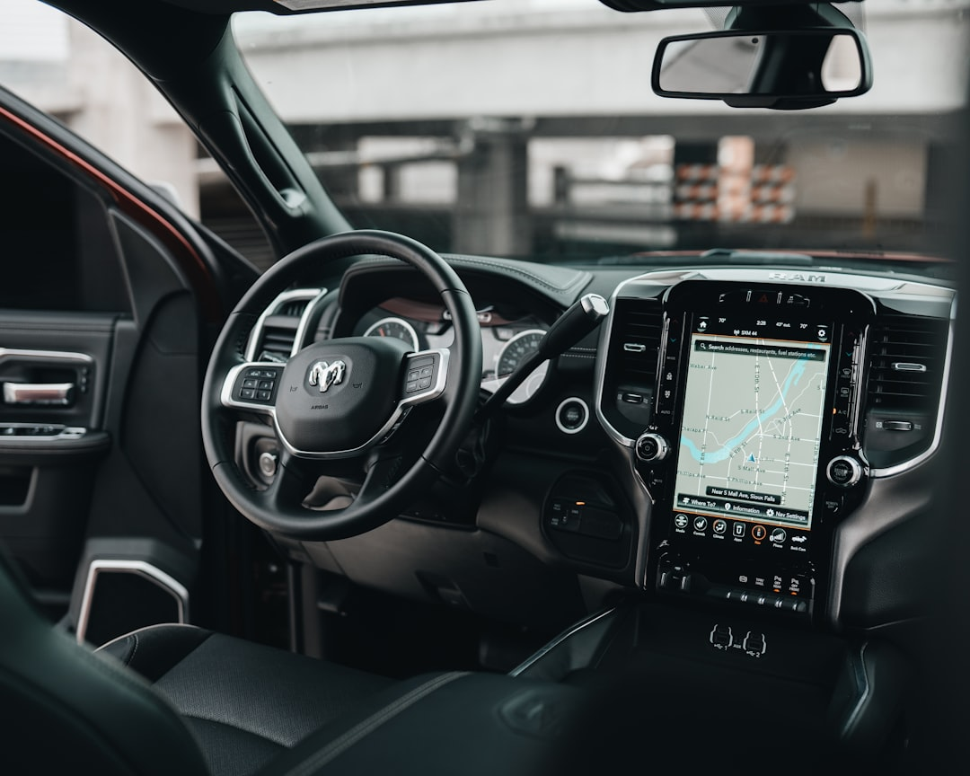

Introduction
Wheel-o-Rent is a web-based platform created to simplify the process of renting two-wheelers and four-wheelers. Whether someone needs a bike for a day or a car for a weekend trip, the platform connects them with verified vehicle owners in just a few clicks. It provides an affordable, quick, and flexible transportation option.

Slide 3

Problem Statement
Students, travelers, and professionals often face challenges in finding affordable and flexible short-term vehicle rentals. Existing options are costly or inconvenient.
Wheel-o-Rent offers a simple digital solution, connecting users with nearby two- and four-wheelers through real-time tracking, clear pricing, and easy booking.

Slide 4


Our Solution
We provide a user-friendly platform that allows users to quickly find, book, and rent nearby two or four wheelers at affordable rates. With real-time availability, secure payments, and location-based search, Wheel-o-Rent makes short-term vehicle rentals easy, transparent, and accessible.

Slide 5
Stakeholders
Vehicle Owners: Can list and manage their vehicles.
Renters/Users: Can find, filter, and book vehicles.

Slide 6
Target Users
College students without personal vehicles
Travelers or tourists needing local transport
Daily commuters looking for affordable options

Slide 7

Key Features
Get the location and filter by type, price, and rating
Secure user login and booking confirmation
Vehicle owner dashboard for listing management
User history and upcoming bookings section

Slide 8


Technology Stack
Frontend: HTML, CSS, JavaScript, React.js
Backend: Node.js, Express.js
Database: MongoDB
Design Tool: Figma ,canva

Slide 9
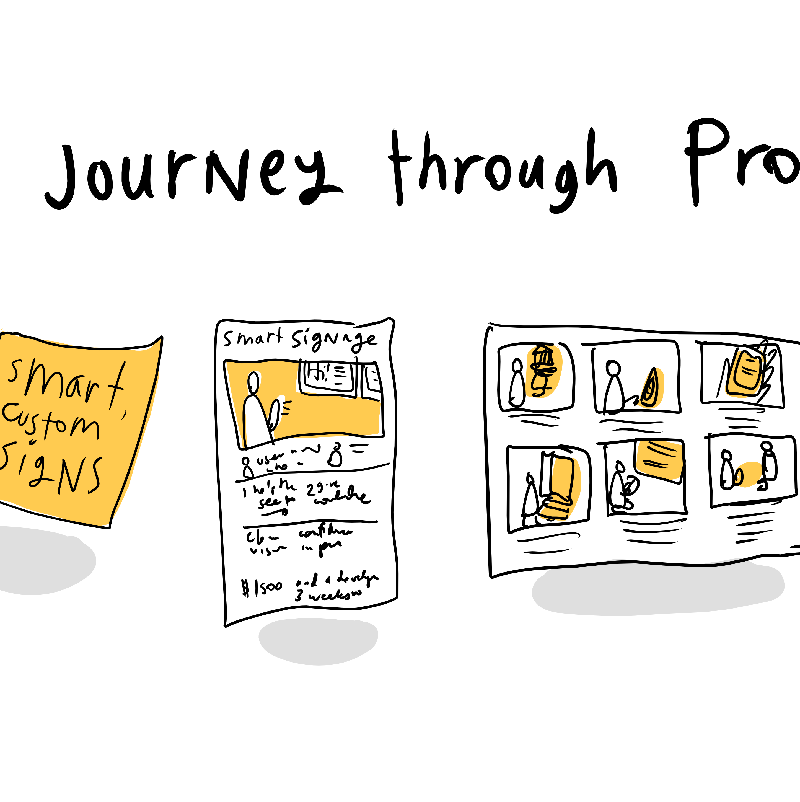
UI/UX Design
We used Figma to create a clean and modern interface. Design choices include simple navigation, consistent color palette, readable fonts, and clear icons. We followed the 6x6 rule to keep the interface clean and understandable.
This Photo by Unknown Author is licensed under CC BY-SA-NC

Slide 10

Team Roles
Divyansh: UI/UX design on Figma and front-end layout development
Akshat Awasthi: Frontend integration and responsive styling
Parth: Backend API development and MongoDB integration
Dhruv: Server configuration and backend route management

Slide 11
Challenges and Learnings
Faced issues with API rate limits and data syncing
Learned better project planning and collaboration
Improved debugging skills and version control (Git)

Slide 12
Future Scope
Launch a mobile app version
Add user ratings and reviews system
Partner with verified rental companies for more inventory
Launch offers and loyalty rewards for frequent users

Slide 13
The End

