Slide 1
Movie Recommendation System
DHRUV SHARMA

Slide 2
Introduction
Project to develop a movie recommendation system based on user preferences.
Helps users discover new and relevant movies.
Domain: Machine Learning, Web Development.

Slide 3
Problem Statement
Users find it difficult to select movies from a large database.
Important to enhance user experience with personalized suggestions.
Target Users: Movie watchers, streaming platform users

Slide 4
Objectives
Build a personalized movie recommendation system.
Utilize collaborative and content-based filtering.
Improve user engagement and satisfaction.

Slide 5
System Requirements
Software: Windows/Linux, Python, Jupyter/VS Code, CSV/SQLite, Scikit-learn, Flask
Hardware: i3 or higher, 4GB+ RAM, 1GB+ Storage

Slide 6
Methodology / Tools Used
Development Model: Agile
Tools: Python,Panda,Numpy, Jupyter, Flask, HTML/CSS
Database: MovieLens CSV, SQLite
Algorithms: Cosine Similarity, TF-IDF, KNN

Slide 7
System Architecture / Flow Diagram
User Input (Ratings/Search) → Data Preprocessing → Recommendation Algorithm → Output
[Insert Architecture or Data Flow Diagram]

Slide 8
Modules Description
User Module: Collects preferences/ratings
Preprocessing Module: Cleans and processes data
Recommendation Module: Applies ML algorithms
Display Module: Shows recommended movies

Slide 9
Screenshots / Demo
Homepage Interface
Movie Search Bar
Recommended Movies List

Slide 10
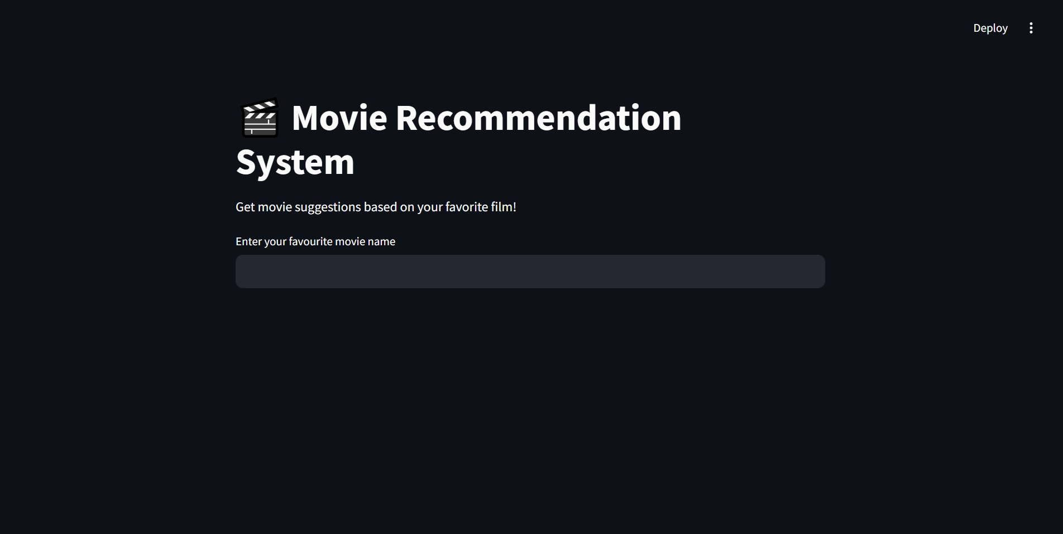

Slide 11
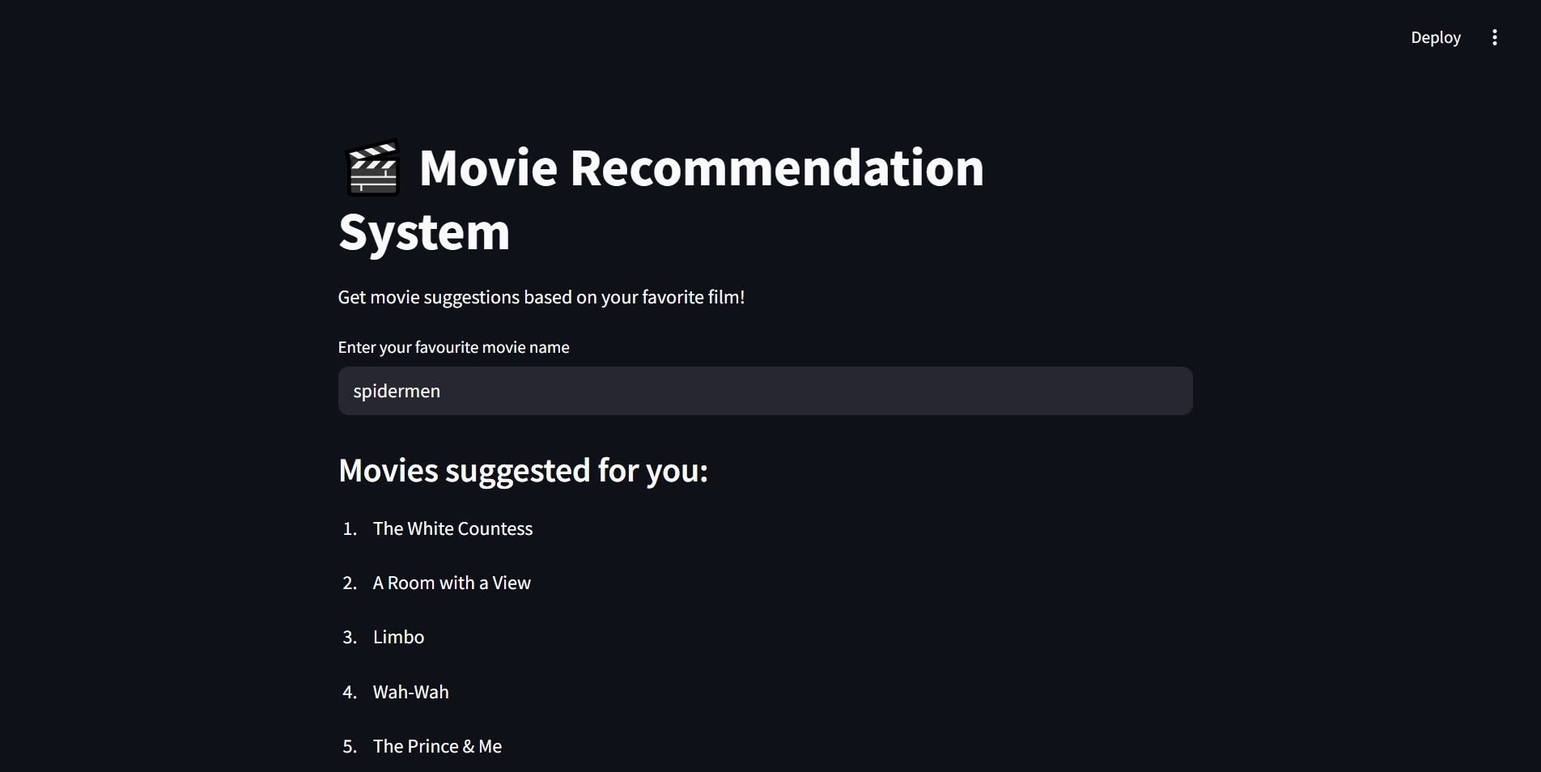

Slide 12
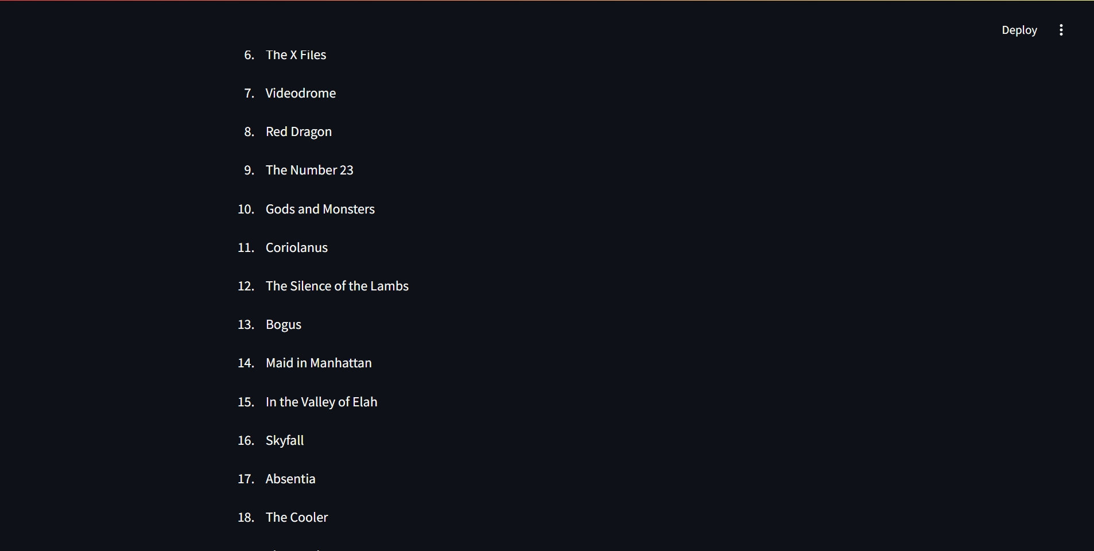

Slide 13
Challenges Faced
Handling large datasets
Cold start problem for new users
UI and backend integration
Solutions: Efficient libraries, fallback suggestions, Flask integration

Slide 14
Future Enhancements
User login and profile history
Include genre and actor preferences
Deploy as full web/mobile app

Slide 15
Conclusion
Developed a functional movie recommendation system.
Learned about ML algorithms and system integration.
Enhances user experience and discovery.

