Slide 1
IT623: Algo and Data Structs
Mergesort
Anish Mathuria
Faculty Block 1, 1105

Slide 2
Mergesort
Idea
  Take the array you would like to sort and divide it in half to create 2 unsorted subarrays
  Next, sort each of the 2 subarrays
  Finally, merge the 2 sorted subarrays into 1 sorted array

Slide 3
Merging Algorithm
Merge
Array A
Array B
Array C
1
13
24
26
2
15
27
38
Actr
Bctr
Cctr
We maintain 3 counters: Actr, Bctr, Cctr

Slide 4
Outline of merging
While both Actr and Bctr did not reach to end of arrays
{
if A[Actr] < B[Bctr] then
C[Cctr] = A[Actr]
Actr++
else
C[Cctr] = B[Bctr]
Bctr++
}
If Actr did not reach end of array A
copy rest of A to C
If B ctr did not reach end of array B
copy rest of B to C

Slide 5
Array A
Array B
Array C
1
13
24
26
2
15
27
38
Actr
Bctr
Cctr
Array A
Array B
Array C
1
13
24
26
2
15
27
38
1
Actr
Bctr
Cctr
1
13
24
26
2
15
27
38
1
2
Actr
Bctr
Cctr

Slide 6
1
13
24
26
2
15
27
38
1
2
13
Actr
Bctr
Cctr
1
13
24
26
2
15
27
38
1
2
13
15
Actr
Bctr
Cctr
1
13
24
26
2
15
27
38
1
2
13
15
24
Actr
Bctr
Cctr

Slide 7
Exhausted
1
13
24
26
2
15
27
38
1
2
13
15
24
26
Actr
Bctr
Cctr
Copy rest of B to C
1
13
24
26
2
15
27
38
1
2
13
15
24
26
27
38
Actr
Bctr
Cctr
Result of merge

Slide 8
Back to Mergesort
Although the merge algorithm produces a sorted array, we have overlooked a very important step
How did we sort the 2 halves before performing the merge algorithm?
We used merge sort!

Slide 9
Mergesort
By continually calling the merge sort algorithm, we eventually get a subarray of size 1
Since an array with only 1 element is clearly sorted, we can back out and merge 2 arrays of size 1

Slide 10
Merge Sort in Action
21
18
14
50
34
68
54
32
43
28
20
21
18
14
50
34
68
54
32
43
28
20
21
18
14
50
34
68
54
32
43
28
20
21
18
14
50
34
68
54
32
43
28
20
21
18
68
54
43
28
14
18
21
34
50
32
54
68
20
28
43
14
18
21
34
50
20
28
32
43
54
68
14
18
20
21
28
32
34
43
50
54
68

Slide 11
Algorithm Merge_Sort(A, lower, upper):
Sort A[lower..upper] in increasing order.
upper >= lower > 0.
{
if (upper > lower)
{
mid := ⎣(lower+upper) / 2⎦
mergesort(A, lower, mid)
mergesort(A, mid+1, upper)
merge(A, lower, mid, upper)
}
}

Slide 12
In-class exercise
Suppose that merge sort is called on the array
What arrays are input to the first four recursive calls of the algorithm (not including the initial call with the entire array)?
4 | 8 | 2 | 1 | 9 | 5 | 7 | 3

Slide 13
Algorithm Merge(A, lower, mid, upper):
Merge A[lower..mid] and A[mid+1..upper], where each is sorted in ascending order.
Use the array Save[lower..upper] as extra storage.
upper > lower > 0; upper >= mid >= lower.
Cctr := lower; Actr := lower; Bctr := mid + 1
while mid >= Actr and upper >= Bctr
if (A[Actr] > A[Bctr])
then Save[Cctr] := A[Bctr]; Bctr := Bctr + 1
else Save[Cctr] := A[Actr], Actr := Actr + 1
Cctr := Cctr + 1
if mid >= Actr
then Save[next..upper] := A[Actr..mid]
else Save[next.upper] := A[Bctr..upper]
A[lower..upper] := Save[lower..upper]

Slide 14
merge operation
What is the worst case?

Slide 15
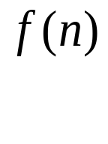
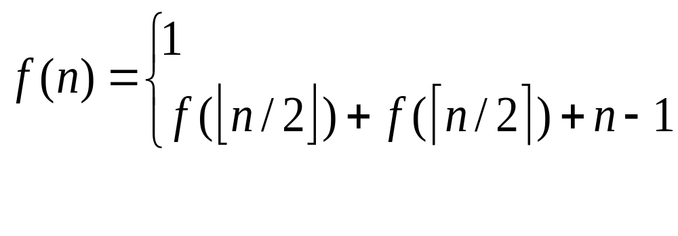
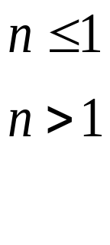
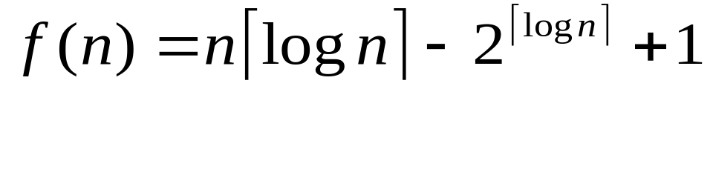
Analysis of merge sort
Let be the worst cost to find x in n sorted things then
Is this recurrence correct?
The solution of the recurrence is

Slide 16
Comparison of sorting algorithms
Selection sort, insertion sort are n² sorts
log n is considerably smaller than n, especially as n gets larger
As the size of our problem grows, the time to run a n² sort will grow much faster than a n log n one

Slide 17
n | log n |  | n log n | n * n
1 | 0.0 |  | 0.0 | 1.0
2 | 1.0 |  | 2.0 | 4.0
5 | 2.3 |  | 11.6 | 25.0
10 | 3.3 |  | 33.2 | 100.0
20 | 4.3 |  | 86.4 | 400.0
50 | 5.6 |  | 282.2 | 2,500.0
100 | 6.6 |  | 664.4 | 10,000.0
200 | 7.6 |  | 1,528.8 | 40,000.0
500 | 9.0 |  | 4,482.9 | 250,000.0
1000 | 10.0 |  | 9,965.8 | 1,000,000.0
5000 | 12.3 |  | 61,438.6 | 25,000,000.0
10000 | 13.3 |  | 132,877.1 | 100,000,000.0
100000 | 16.6 |  | 1,660,964.0 | 10,000,000,000.0

