Slide 1
Creating pipes between processes

Slide 2
What is a Pipe?
Pipes are useful for communication between related processes (e.g. parent and child)
A pipe is implemented as an internal OS buffer
One process writes to the pipe, the other reads from the pipe
  Can read from or write to the pipe like a real file

Slide 3
Opening a pipe
int pipe(int fds[2]);
fd needs to be an array of 2 ints
return value is 0 on success, -1 on error
on success, a new pipe is created
  fds[0] will be the fd for the read end of pipe
  fds[1] will be the fd for the write end of pipe

Slide 4
First pipe example
#define MSGSIZE 16
char *msg1=“hello, world #1”;
char *msg2=“hello, world #2”;
char *msg3=“hello, world #3”;
int main()
{
char inbuf[MSGSIZE];
int p[2], i;
if (pipe(p) < 0)
exit( 1 );
/* continued */
/* write pipe */
write( p[1], msg1, MSGSIZE );
write( p[1], msg2, MSGSIZE );
write( p[1], msg3, MSGSIZE );
for ( i=0; i < 3; i++ )
{
/* read pipe */
read( p[0], inbuf, MSGSIZE );
printf( “%s\n”, inbuf );
}
return 0;
}
pipedemo1.c

Slide 5
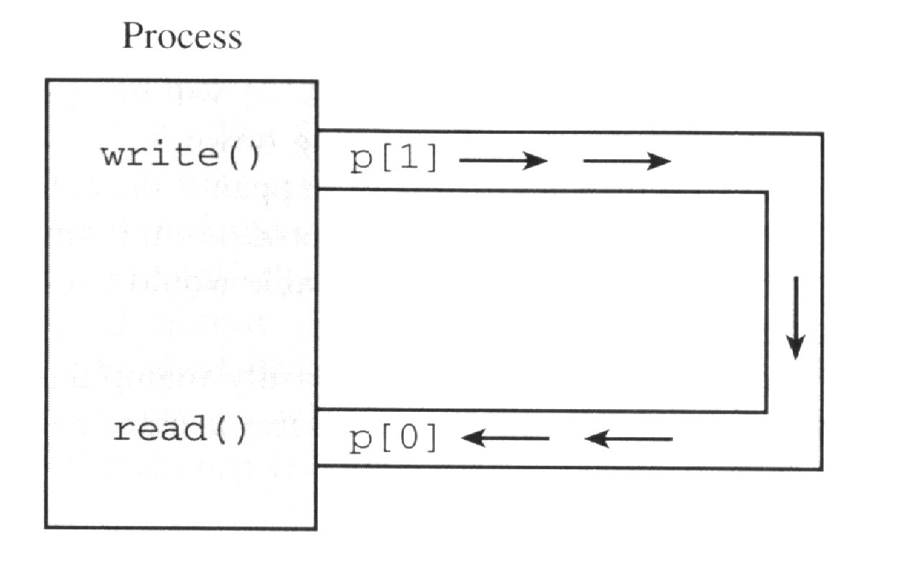
Program execution
Output:
hello, world #1
hello, world #2
hello, world #3

Slide 6
More on pipes
Pipes behave first-in-first-out (FIFO)
  bytes placed in the pipe with write are returned by read in order
  What kind of data structure you might use to implement a pipe?
The size of read and write don’t have to match
  e.g. you can write 512 bytes at a time while reading 1 byte at a time
Pipes are of little use within a single process!

Slide 7
Parent and child sharing a pipe
Recall that file descriptors remain open across a call to fork
If we call fork after creating a pipe, then the parent and child can communicate via the pipe!
parent process
child process
fd[0]
fd[1]
fd[0]
fd[1]
pipe
kernel

Slide 8
Second pipe example
#define MSGSIZE 16
char *msg1=“hello, world #1”;
char *msg2=“hello, world #2”;
char *msg3=“hello, world #3”;
int main()
{
char inbuf[MSGSIZE];
int p[2], pid, nbytes;
if (pipe(p) < 0)
exit( 1 );
/* continued */
if ((pid = fork()) > 0) {
write(p[1], msg1, MSGSIZE);
write(p[1], msg2, MSGSIZE);
write(p[1], msg3, MSGSIZE);
wait(NULL);
}
else {
while ((nbytes =
read(p[0], inbuf, MSGSIZE)) > 0)
printf(“%s\n”, inbuf);
if (nbytes != 0)
exit(2);
printf(“Finished reading\n”);
}
return 0;
}
pipedemo2.c

Slide 9
Program execution
$ a.out
hello world, #1
hello world, #2
hello world, #3
(hangs)
Outcome
  After finishing reading/writing, both parent and child block (instead of terminating)

Slide 10
Rules for reading a pipe
A read call gets as much data as it requests or as much data as the pipe has, whichever is less
If the pipe is empty
  Reads on the pipe will return EOF (return value 0) if no process has the write end open
  If some process has the pipe open for writing, read will block in anticipation of new data

Slide 11
Can you find the bug?
pipedemo2.c illustrates a common programming error
  Neither the parent nor the child closes its write end
  So child never sees EOF!
/* continued */
if ((pid = fork()) > 0) {
write(p[1], msg1, MSGSIZE);
write(p[1], msg2, MSGSIZE);
write(p[1], msg3, MSGSIZE);
wait(NULL);
}
else {
while ((nbytes =
read(p[0], inbuf, MSGSIZE)) > 0)
printf(“%s\n”, inbuf);
if (nbytes != 0)
exit(2);
printf(“Finished reading\n”);
}
return 0;
}

Slide 12
Modified second pipe example
#define MSGSIZE 16
char *msg1=“hello, world #1”;
char *msg2=“hello, world #2”;
char *msg3=“hello, world #3”;
int main()
{
char inbuf[MSGSIZE];
int p[2], pid, nbytes;
if (pipe(p) < 0)
exit( 1 );
/* continued */
if ((pid = fork()) > 0) {
write(p[1], msg1, MSGSIZE);
write(p[1], msg2, MSGSIZE);
write(p[1], msg3, MSGSIZE);
close(p[1]);
wait(NULL);
}
else {
close(p[1]);
while ((nbytes =
read(p[0], inbuf, MSGSIZE)) > 0)
printf(“%s\n”, inbuf);
if (nbytes != 0)
exit(2);
printf(“Finished reading\n”);
}
return 0;
}

Slide 13
In-class Quiz
1: int main ()
2: {
3: int p[2];
4: pipe(p);
5:
6: if (fork()) {
7: close(p[0]);
8: write(p[1],"Please ",7);
9: sleep(1);
10: write(p[1],"fix ",4);
11: sleep(1);
12: write(p[1],"me!!",4);
13: } else {
14: char c[5];
15: while (1) {
16: read(p[0],c,5);
17: write(1,c,5);
18: }
19: }
20: }
The parent sends the words
Please, fix, and me!! to the
child, with small pauses in
between.
What is the output of the
program?
Assume that after each sleep
in the parent the child will
have read all bytes available
in the pipe, before the next
write is executed

Slide 14
Solution
1: int main ()
2: {
3: int p[2];
4: pipe(p);
5:
6: if (fork()) {
7: close(p[0]);
8: write(p[1],"Please ",7);
9: sleep(1);
10: write(p[1],"fix ",4);
11: sleep(1);
12: write(p[1],"me!!",4);
13: } else {
14: char c[5];
15: while (1) {
16: read(p[0],c,5);
17: write(1,c,5);
18: }
19: }
20: }
After 1st read, what is printed?
  Pleas
After 2nd read, what is printed?
  e eas
After 3rd read, what is printed?
  fix s
After 4th read, what is printed?
  me!!s

Slide 15
In-class Quiz
1: int main ()
2: {
3: int p[2];
4: pipe(p);
5:
6: if (fork()) {
7: close(p[0]);
8: write(p[1],"Please ",7);
9: sleep(1);
10: write(p[1],"fix ",4);
11: sleep(1);
12: write(p[1],"me!!",4);
13: } else {
14: char c[5];
15: while (1) {
16: read(p[0],c,5);
17: write(1,c,5);
18: }
19: }
20: }
Apart from the output, what
else is wrong? Sketch
briefly how to fix it (no actual
code necessary).

Slide 16
Simulating ls | sort
Open file descriptors are kept open (by default) across exec calls
Use exec() to start two processes which share a pipe
Before invoking exec
  standard output of ls is coupled to the write end of the pipe
  standard input of sort is coupled to the read end of the pipe

Slide 17
Write pipe fd + stdout
Connect the write end of a pipe to stdout
dup2(p[1], 1);
stdout
pipe p

Slide 18
Read pipe fd + stdin
Connect the read end of a pipe to stdin
dup2(p[0], 0);
stdin
pipe p

Slide 19
Four stages to ls | sort
1) main creates a pipe
p[0] (read)
main
p[1] (write)
pipe p

Slide 20
Four stages to ls | sort
2) main forks two children. They inherit the pipe’s file descriptors
c1
main
pipe p
c2

Slide 21
Four stages to ls | sort
3) Close the pipe links that are not needed
c1
main
pipe p
c2

Slide 22
Four stages to ls | sort
4) Replace children by programs using exec
sort
main
pipe p
ls

Slide 23
ls | sort
int main()
{
int fds[2];
pipe(fds); /* no error checks */
if (fork() == 0)
{ /* 1st child */
/* fds[0]/stdin --> sort */
dup2(fds[0], 0);
close(fds[1]);
execlp(“sort”, “sort”, NULL);
}
if (fork() == 0)
{ /* 2nd child */
/* ls --> fds[1]/stdout */
dup2(fds[1], 1);
close(fds[0]);
execlp(“ls”, “ls”, NULL);
}
/* parent closes its
links to the pipe */
close(fds[0]);
close(fds[1]);
/* wait for 2 children */
wait(NULL);
wait(NULL);
return 0;
}
pipedemo7.c

Slide 24
TO BE CONTINUED …

Slide 25
Non-blocking I/O with pipes
Sometimes it's convenient to have I/O that doesn't block
Example: Process checking two different pipes
  Don't want a read call to block on one in case of input from the other

Slide 26
Non-blocking I/O with pipes
To specify non-blocking option:
int fd;
…
fcntl(fd, F_SETFL,O_NONBLOCK);
A call to read/write returns -1 if pipe empty/full and sets errno to EAGAIN

Slide 27
Non-blocking read example
Child writes “hello” to parent every 3 seconds
Parent does a non-blocking read each second
pipe p
p[0]
child
hello
parent
p[1]

Slide 28
Non blocking read example
#define MSGSIZE 6
char *msg1=“hello”;
char *msg2=“bye!!”;
int main()
{
int p[2], i;
if (pipe(p) < 0)
exit( 1 );
if (fcntl(p[0], F_SETFL,
O_NONBLOCK) < 0)
exit(2);
/* continued */
switch(fork())
{
case -1: /* error */
exit(3);
case 0:
child_write(p);
break;
default:
parent_read(p);
break;
}
return 0;
}
pipedemo5.c

Slide 29
parent_read
void parent_read(int p[])
{
int nread;
char buf[MSGSIZE];
close(p[1]); /* write link */
while(1)
{
nread = read(p[0], buf, MSGSIZE);
switch(nread)
{
case -1:
if (errno == EAGAIN) {
printf(“(pipe empty)\n”);
sleep(1);
break;
}
else {
perror(“read”);
exit(4);
}
case 0:
printf(“End of conversation\n”);
close(p[0]); /* read link */
exit(0);
default: /* text read */
printf(“MSG=%s\n”, buf);
}
}
}

Slide 30
child_write
void child_write(int p[])
{
int i;
close(p[0]); /* read link */
for (i=0; i<3; i++)
{
write(p[1], msg1, MSGSIZE);
sleep(3);
}
write(p[1], msg2, MSGSIZE);
exit(0);
}

Slide 31
Output
(pipe empty)
MSG=hello
(pipe empty)
(pipe empty)
(pipe empty)
MSG=hello
(pipe empty)
(pipe empty)
(pipe empty)
MSG=hello
(pipe empty)
(pipe empty)
(pipe empty)
MSG=bye!!
End of conversation

Slide 32
Pipe capacity
A pipe can hold a limited number of bytes
Writes fill the pipe and block when the pipe is full
  They block until another process reads enough data at the other end of the pipe and return when all the data given to write have been transmitted
Capacity of a pipe is at least 512 bytes, usually more (system dependent)

Slide 33
Program to find pipe capacity
int count = 0;
void alrm_action(int signo)
{
printf("Write blocked
after %d characters\n", count);
exit(0);
}
int main() {
int p[2];
char c = 'x';
signal(SIGALRM, alrm_action);
if (pipe(p) == -1)
exit(1);
while (1) {
alarm(5);
write(p[1], &c, 1);
++count;
alarm(0);
}
}
pipedemo4.c

Slide 34
Closing pipes
Reading from an empty pipe whose write descriptor is closed returns 0 (indicating EOF)
Writing to a pipe whose read descriptor is closed generates a SIGPIPE signal
demo: sigpipe.c

Slide 35
Output
$ ./sigpipe
About to read from pipe
0 bytes were read with write end closed
About to write to pipe
A SIGPIPE (13) has been caught
-1 bytes were written with read end closed

Slide 36
In-class Quiz
int main() {
char c;
int p[2];
pipe(p);
close(p[0]);
if (fork()) {
while (1) {
sleep(1);
write(p[1], "a", 1);
}
} else {
while (1)
read(p[0], &c, 1);
}
}
Here, the parent ought to send a
stream of a’s, one per second.
When you run the program, you
make the following observations
instead:
the program returns to the
shell almost immediately;
(ii) after a while you see that the
system load is at 100%.
Explain both phenomena.

Slide 37
Atomic writes
Atomic means no other process ever observes it partially done
Concurrent writes execute atomically
  Process 1 sends a 100-byte message
  At the same time, process 2 sends a 100-byte message
  No guarantee about the order, but pipe will receive all of one message followed by all of the other

Slide 38
Non-atomic writes
Writes of up to PIPE_BUF (4096) bytes are atomic
For larger writes there is no such guarantee, data could get confusingly intermingled
writer
hello…
writer
bye…
hebypiz…
reader
writer
pizza…

Slide 39
Non-atomic writes
Demo: pipedemo3.c

