Slide 1

SMART FARM DECISION SUPPORT SYSTEM
THE FARM
TODAY
Kisan Mitra
From fragmented farm data to better decision making:
One decision layer
across four signals.
“What should I do on my farm today?”
WEATHER
Delay irrigation
01
02
03
DATA
INTELLIGENCE
ACTION
CROP HEALTH
Inspect leaves
MARKET
Monitor prices
TEAM CODE: RICR-HIM-1106
FARM PROFILE
Keep context
• Dhruv Bhola • Aditya Singh
• Himani • Avni Jain
01

Slide 2
01 — THE PROBLEM
Farmers have data. The hard part is making the right decision on time.
The challenge is not a lack of information — it is fragmented information that arrives without clear action.
01
Crop choice
04
Crop health
Which crop is best suited to the farm, season, and local conditions?
Is an early symptom a sign of disease or pest damage?
02
Irrigation
05
Market timing
When should the farmer irrigate—or wait for rain?
Should the farmer sell now or wait for a better price?
03
Weather risk
Could upcoming weather threaten the crop or delay operations?
ONE WRONG DECISION CAN COST WATER, YIELD, TIME AND INCOME.

Slide 3
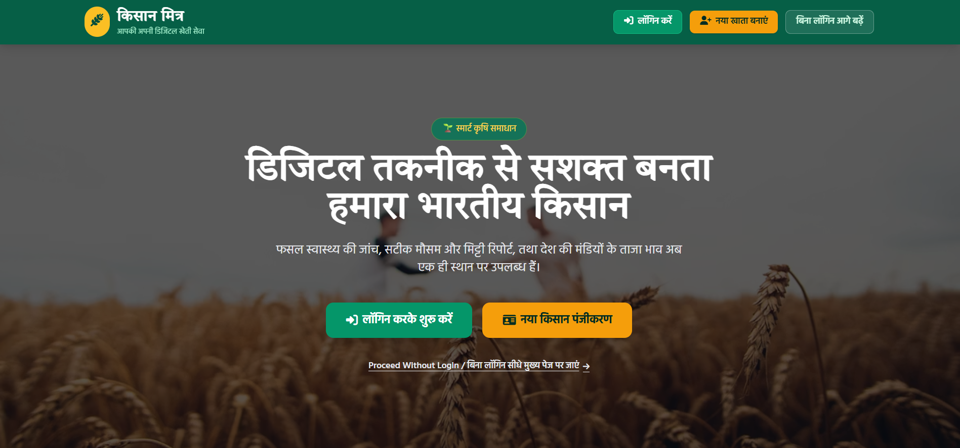
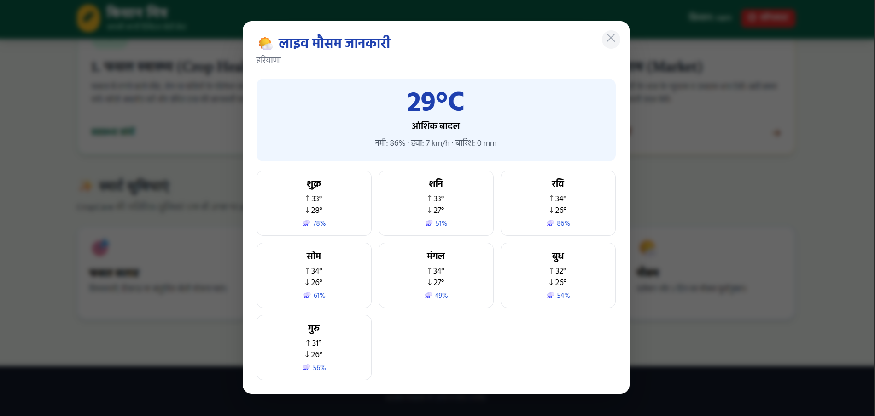
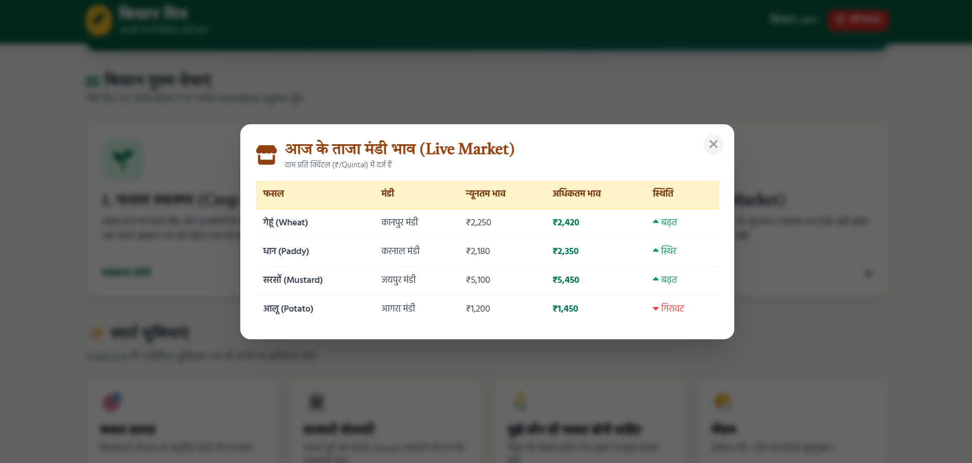
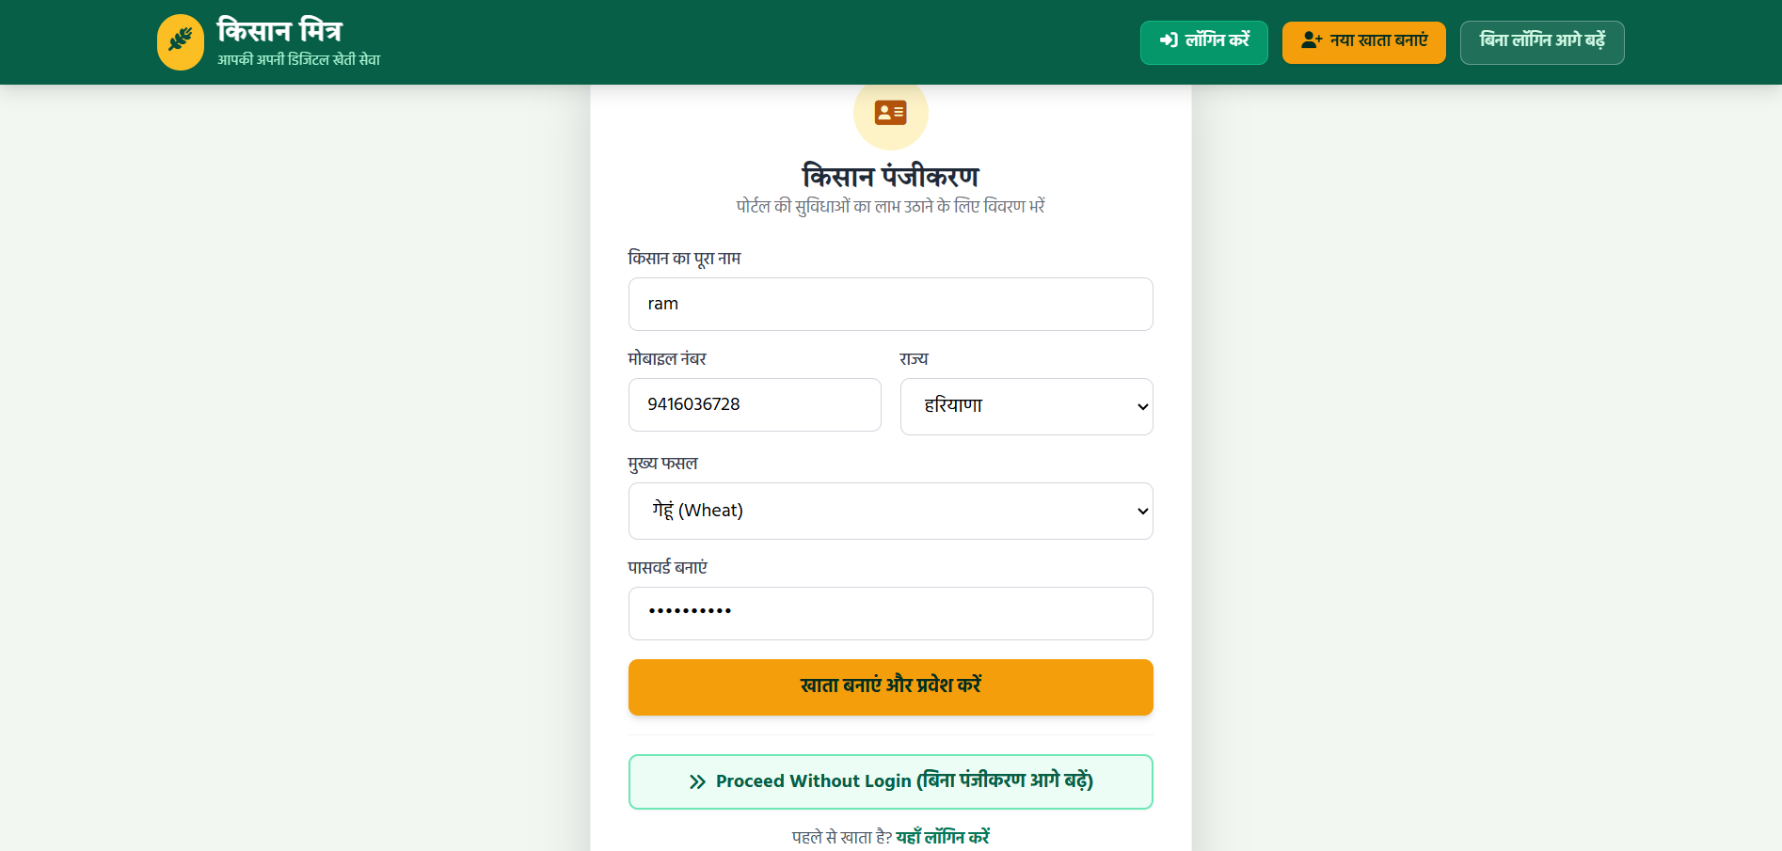
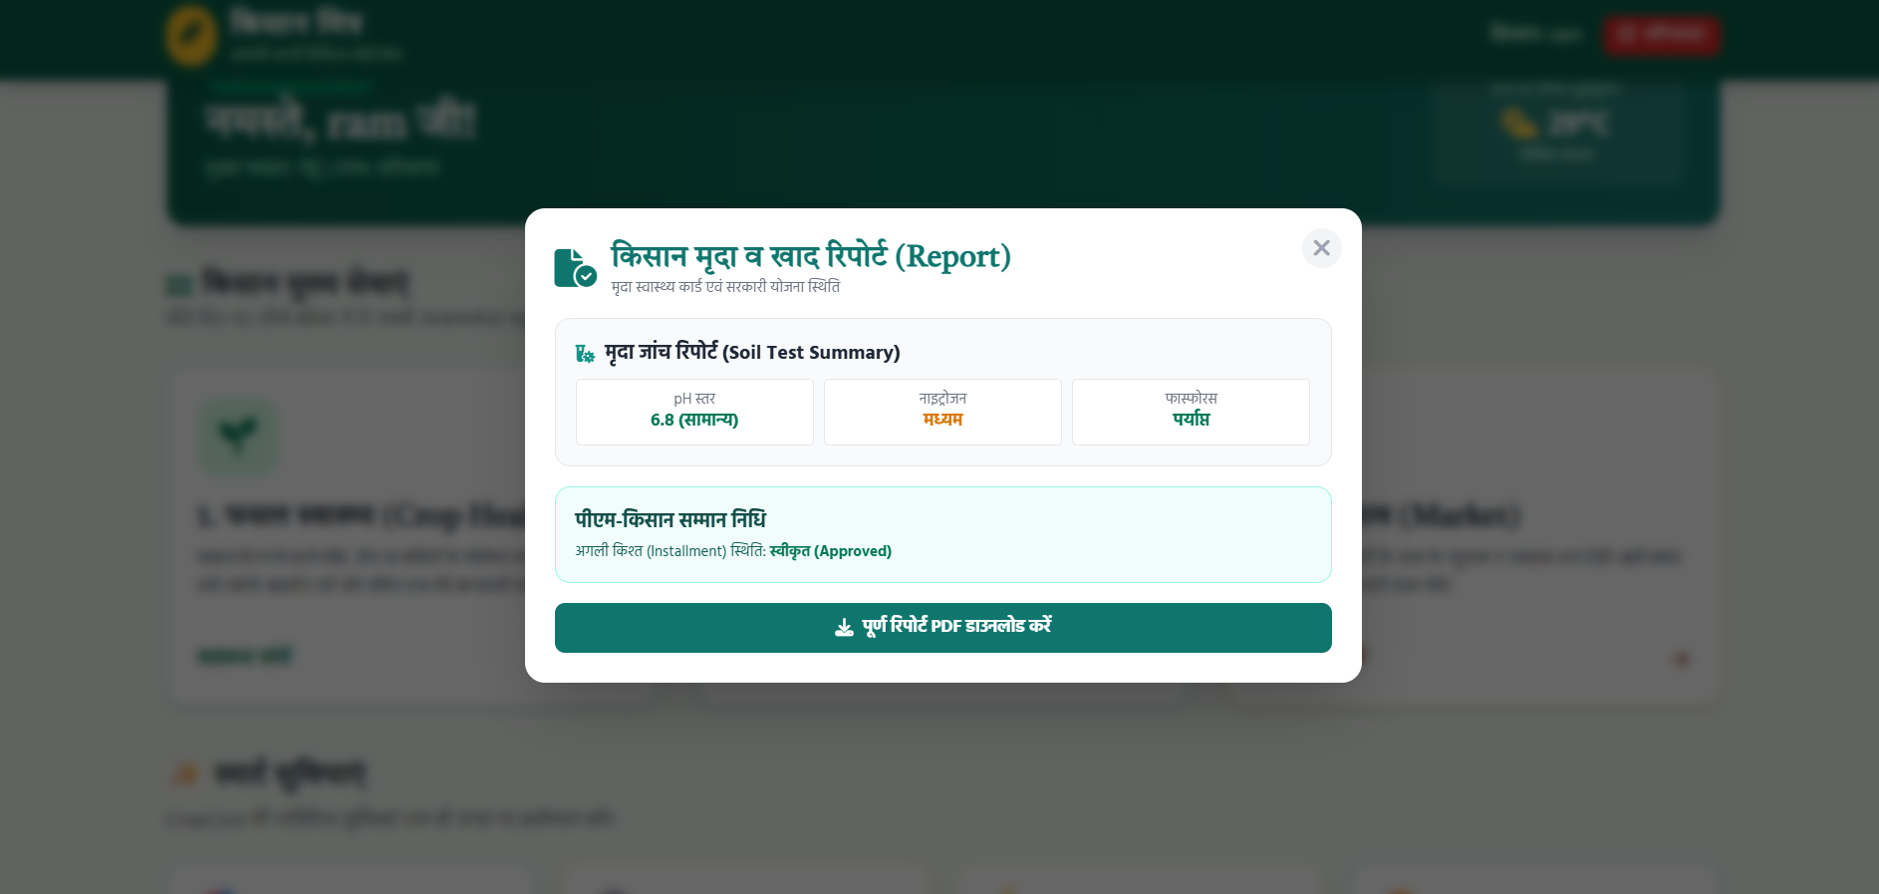
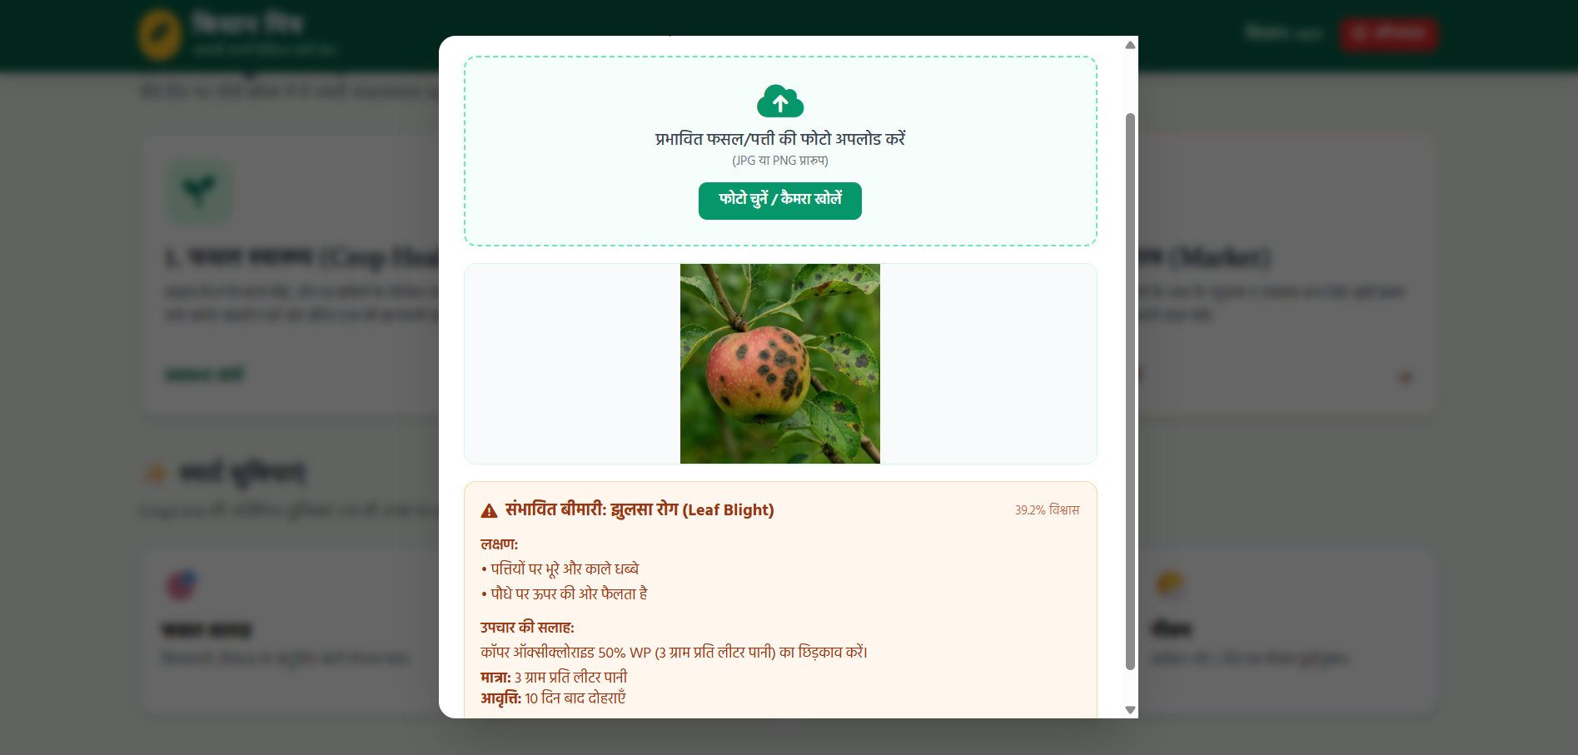
02- Live Website
Our Working Model Screenshots
INSERT SCREENSHOT
FARM DASHBOARD
WEATHER + IRRIGATION
KISAN MITRA • RICR-HIM-1106

Slide 4
03 — THE CORE PRODUCT
One Decision Engine connects the farm’s signals.
The same farm profile gives context to weather, crop health and market information.
1
FARM PROFILE
2
WEATHER
3
CROP HEALTH
4
MARKET
Location • land • soil • crop • growth stage
Rainfall • temperature • humidity • wind • ET
Leaf image • observations • AI screening
Mandi prices • 7-day / 30-day trend
DECISION ENGINE
✓
IRRIGATION
✓
RISK ALERTS
✓
SELL / HOLD
✓
TODAY’S ACTIONS
Delay / irrigate
Low / medium / high
Rising / stable / falling
Prioritized next steps
KISAN MITRA • RICR-HIM-1106
04

Slide 5
04 — CORE PRODUCT
Four modules. One farmer-facing decision layer.
Each feature contributes a signal; the dashboard translates signals into practical next steps.
01
WEATHER + IRRIGATION
02
AI CROP HEALTH
Real weather data → irrigation guidance and risk alerts
Leaf image + observations → possible issue, confidence and severity
→ Don’t irrigate today — rain is expected.
→ Possible fungal issue • 78% confidence
03
MARKET PRICE INSIGHTS
04
UNIFIED DASHBOARD
Relevant crop prices → 7-day / 30-day trend and sell / hold signal
Profile status + alerts + health + market in one place
→ Price trend is rising — monitor before selling.
→ What do I need to act on today?

Slide 6
05 — TECHNOLOGY
Built for rapid development and straightforward deployment.
Tech Stack
FRONTEND
BACKEND
DATA
Next.js
React
Node.js
Express.js
Flask (Python)
MongoDB
UI + routing
Business logic
Persistent storage
APIs
AUTH
STYLING + HOSTING
Open-Meteo
JWT
Tailwind CSS
Netlify
Railway
Weather data
Secure login / sessions
Responsive UI + deployment
FEASIBILITY
Responsive UI • persistent database • external API integration • modular decision engines • deployable full-stack app

Slide 7
06 — DEMO JOURNEY
A farmer can move from setup to action in a few steps.
The demo directly covers the core workflow described in the challenge: profile → weather → crop health → market → action.
01
02
03
04
05
06
SET UP
READ WEATHER
DECIDE
CHECK CROP
CHECK MARKET
ACT
Create account + farm profile
Fetch forecast signals
Irrigation + risk engines
Upload leaf image for screening
View wheat trend
See today’s prioritized actions
TODAY’S FARM ACTIONS
Delay irrigation • Inspect crop health • Monitor wheat prices
One screen. Three signals. One prioritized next step.

Slide 8
07 — IMPACT + FUTURE
Make farming decisions clearer, earlier and more actionable.
The solution targets the decision gap identified in the problem statement — not just the data gap.
WATER
YIELD
INCOME
Better irrigation timing
Earlier crop-risk signals
Better sell / hold context
Less avoidable watering
Faster inspection and response
Use market trends with farm context
FUTURE SCOPE
✓
Crop recommendation engine
✓
Voice + regional languages
✓
Community pest / disease alerts
✓
Fertilizer & resource planning
✓
Yield prediction
✓
Offline-first support
DATA → INTELLIGENCE → ACTION

