Slide 1
Exploratory data analysis of Music Streaming Dataset
- By group 5

Slide 2

Abstract
This study covers the analysis of spotify dataset data related to music streaming.
The dataset was examined using exploratory data analysis and visualization approaches to identify important patterns and trends in the consumption behavior of music.
Preprocessing techniques were used to ensure the data was clean and suitable for analysis.
This analysis extracts insights into the most streamed artists, popular songs, etc.
Also, correlations between song characteristics, streaming platforms, and release trends were examined to provide a comprehensive understanding of music consumption dynamics.

Slide 3
Introduction
Aim of this analysis of the Spotify music is to gain insights of trends and pattern of music consumption.
By analyzing this dataset, we can understand the impact of Spotify streaming platform on this industry and get insights for artists and music enthusiasts.
In this study we get insights like
Most streamed artist
Top streamed songs
Pattern of song release on platform

Slide 4
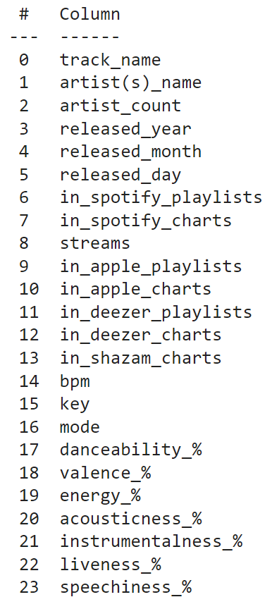
Dataset
This dataset contains a comprehensive list of the most famous songs as listed on Spotify.
The dataset offers a wealth of features beyond what is typically available in similar datasets.
It provides insights into each song's attributes, popularity, and presence on various music platforms.
The dataset includes information such as track name, artist(s) name, release date, Spotify playlists and charts, streaming statistics, Apple Music presence, Deezer presence, Shazam charts, and various audio features.

Slide 5

Preprocessing
Enhancing Data Quality
Enhancing data quality by removing incorrect or corrupted data.
We remove known corrupted data from the dataset.

Slide 6
Preprocessing
Standardizing Data
This step helps to make sure all data is in standardized format.
This lambda function converts all value in ‘stream’ column of the dataset to integers.
This step ensures consistency in the measurements throughout all dataset.

Slide 7
Preprocessing
Handling missing values
This ensures that analytical models are not affected by the missing data in the dataset. Which contributes to more accurate results.
fills missing values with the 0 value.

Slide 8




Methodology
Data Collection
Data Preprocessing
Data Exploration
Visualization Techniques
Obtain the dataset from relevant sources
Tasks such as handling missing values, removing duplicates, and correcting inconsistencies in the dataset
Explore the dataset using statistical summaries and descriptive analytics techniques
Utilize a variety of visualization techniques including scatter plots, bar charts, heatmaps, and pie charts to communicate insights and patterns

Slide 9
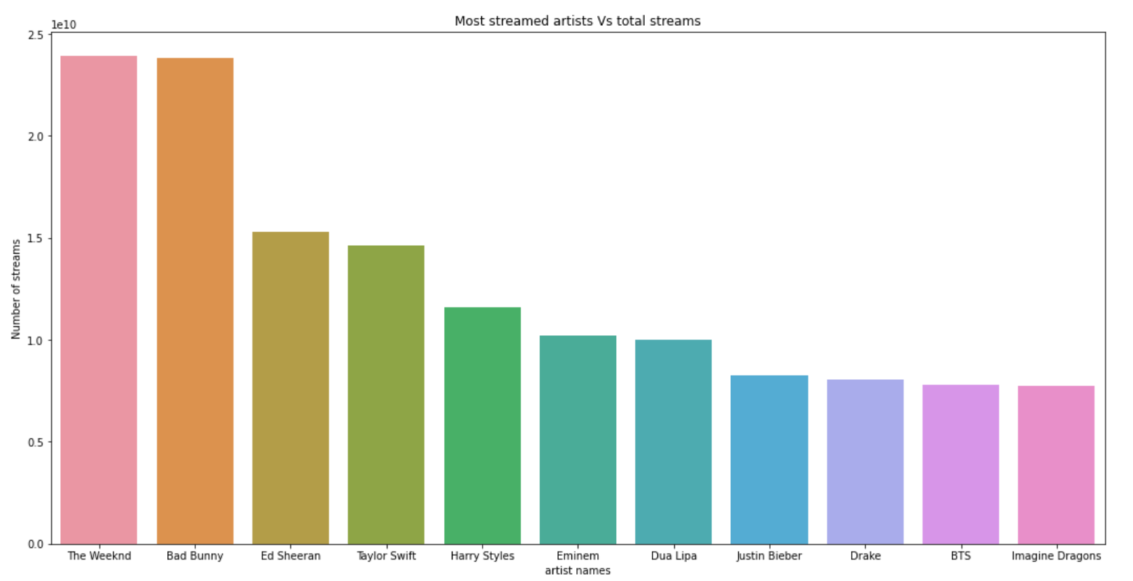
Results
What were the most streamed artists on Spotify in 2023?
Separate artists into separate rows
Use seaborn bar plot for visualization
X axis represents artists and Y axis represents total streams for that artist

Slide 10
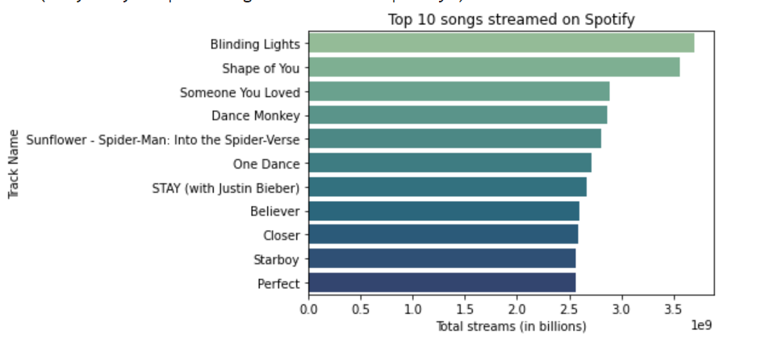
Results
What are top 10 streamed songs on Spotify?
Separate track name and streams into different data frame
Use seaborn bar plot for visualization
X axis represents total streams and Y axis represents track name

Slide 11
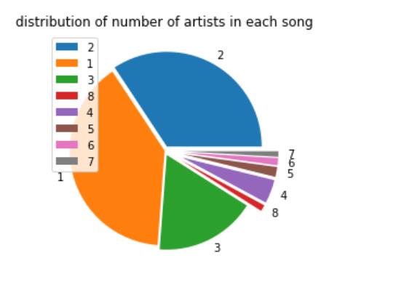
Results
What is the ratio of multiple artists worked on each song ?
Get data for unique artist and get sum of artist for each song
Use pie chart for visualization
Shows distribution of artist in each song

Slide 12
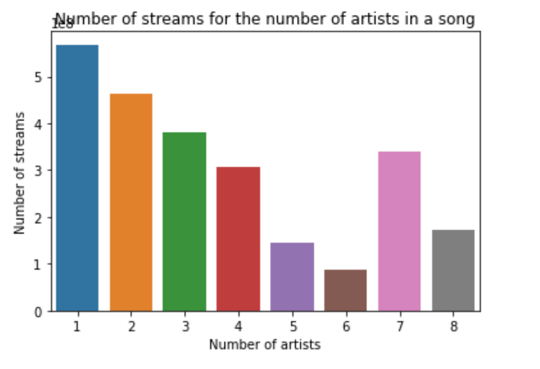
Results
How does the average number of streams based on the number of artists involved in creating a song?
Calculates the average number of streams for song with that particular count of artists
Use bar plot for visualization
X axis represents number of artist and Y axis represents average number of streams

Slide 13
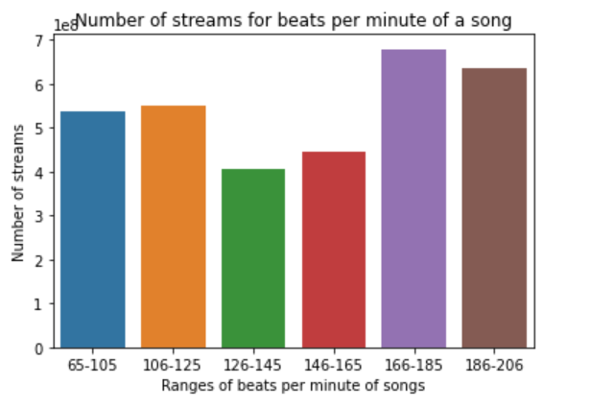
Results
How does the average number of streams vary across different ranges of beats per minute (BPM) in song?
Divide song based on their beats per minute
Calculate average number of streams for song in that range
Use bar plot for visualization
X axis represents beats per minute range and Y axis represents average number of streams for song in each range

Slide 14
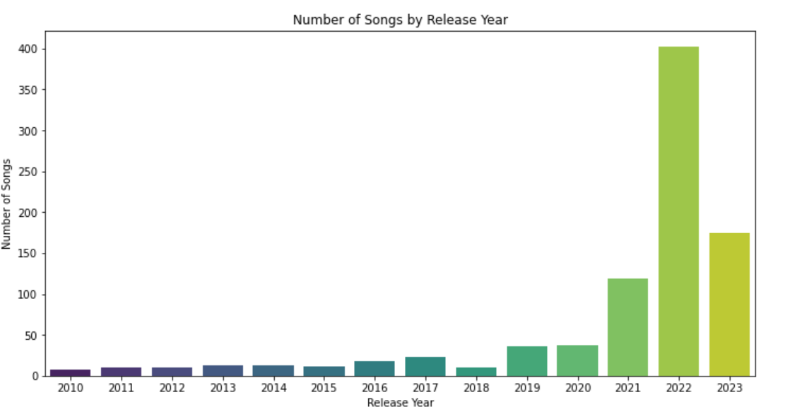
Results
How does the distribution of song released vary across different years?
Calculates the count of song released for each year
Use bar plot for visualization
X axis represents release year and Y axis represents average number of song released

Slide 15
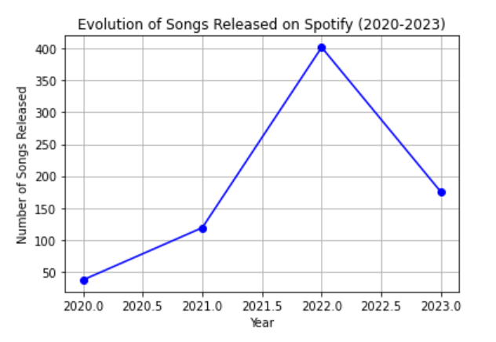
Results
How does the number of songs released on Spotify evolve over the years 2020 to 2023?
Separate songs released between 2020 and 2023
Calculates the count of songs released for each year
Use line plot for visualization
X axis represents year and Y axis represents average number of song released

Slide 16
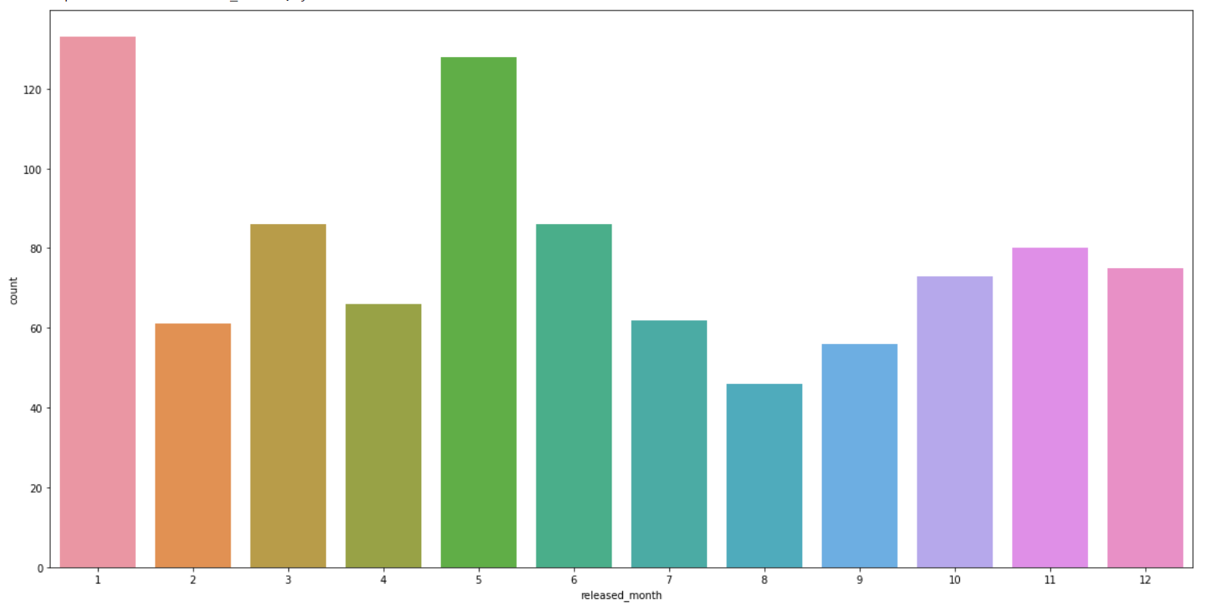
Results
How does the distribution of songs released vary across different months?
Visualize the distribution of songs released each month
Use count plot for visualization
X axis represents month and Y axis represents count of songs released in that month

Slide 17
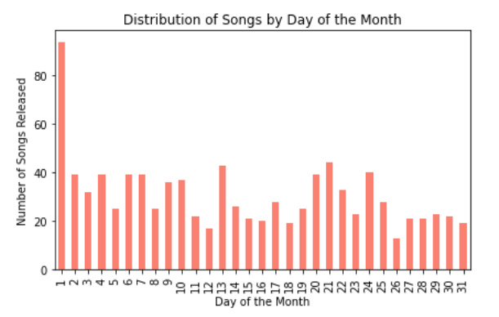
Results
How does the distribution of songs released vary across different days of the month?
groups the data frame by the day of the month on which songs were released
Counts the number of songs released on each day
Use count plot for visualization
X axis represents day and Y axis represents count of songs released

Slide 18
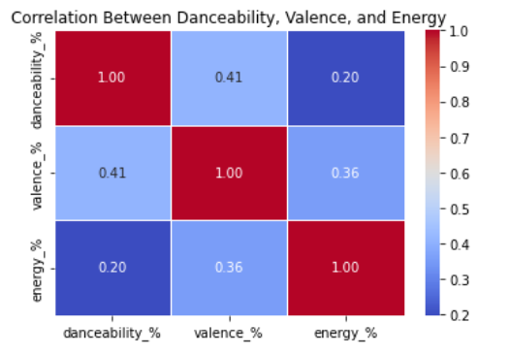
Results
How are the attributes danceability, valence, and energy correlated in song?
Calculates the correlation matrix between the attributes danceability, valence, and energy
Use heatmap to visualization

Slide 19
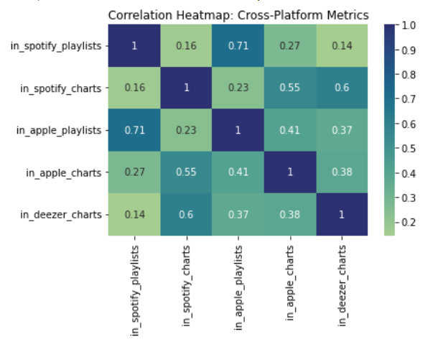
Results
How are different cross-platform indicators correlated in the dataset?
Calculates the correlation matrix between various cross-platform indicators such as being in Spotify playlists, Spotify charts, Apple Music playlists, Apple Music charts, Deezer playlists, Deezer charts, and Shazam charts
Use heatmap to visualization
Each cell represents the correlation coefficient between two indicators

Slide 20
Conclusion
Artists and Song Popularity: Identify the most streamed artists and songs on Spotify in 2023, showcasing the correlation between popular artists and their streaming numbers.
Collaborations and Impact: Analyze the impact of collaborations by studying the distribution of multiple artists on each song and how it correlates with the song's popularity.
Trends Over Time: Show the evolution of song releases and streaming trends over the years, highlighting any significant shifts or patterns.
Seasonal and Temporal Patterns: Explore how song releases vary across different months and days of the month, indicating potential trends related to seasons or specific release strategies.
Musical Attributes and Listener Preferences: Discuss the correlation between musical attributes like danceability, valence, and energy, revealing insights into listener preferences and how these attributes contribute to a song's popularity across platforms.

Slide 21
References
https://github.com/jakevdp/PythonDataScienceHandbook/tree/master/notebooks
https://pandas.pydata.org/docs/user_guide/index.html#user-guide
https://matplotlib.org/stable/tutorials/pyplot.html#sphx-glr-tutorials-pyplot-py
https://seaborn.pydata.org/tutorial.html
https://www.kaggle.com/datasets/nelgiriyewithana/top-spotify-songs-2023
https://stackoverflow.com/questions/69424104/how-to-delete-specific-values-from-a-column-in-a-dataset-python
https://www.geeksforgeeks.org/working-with-missing-data-in-pandas/#

Slide 22
GitHub
Repository
Link for github repo

Slide 23
Thank You

