Slide 1
“Improving Web Automation with DOM Delta Processing and Privacy-Aware LLM Agents”
Major Project – 2
Computer Science & Engineering (Data Science)
—Darji Dhruv S. (24MCD003)
—Mentor: Dr. Parita Oza

Slide 2
Contents
01
07
02
08
03
04
05
06
Introduction
Dataset
Problem Statement
Novelty & Proposed Work
Liturature Review
09
Implementation & Results
Research Gaps
10
Future Work
Objective
11
Conclusion
Existing Solution
12
References

Slide 3
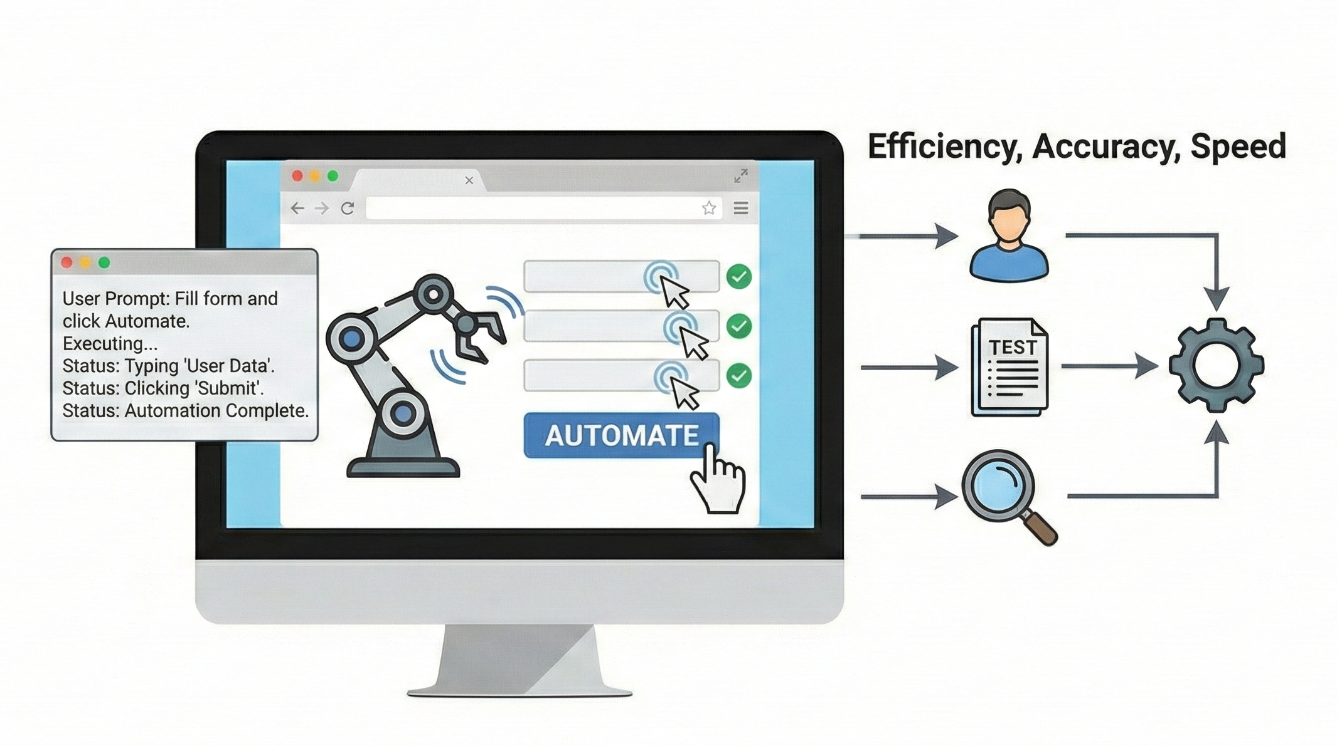
Introduction
GUI automation is a way to automate human interaction such as click, type, scroll, input etc. with user given instruction.
GUI automation accelerates tasks in testing, verification, bug replay, and text-input generation, reducing human effort and improving reliability.
Natural language interfaces allow users to describe tasks (“Order grocery”, “Change Settings”), enabling automatic execution by intelligent agents.
Automation is essential because manual GUI operations are slow, repetitive, error-prone, and difficult to scale.

Slide 4
Problem Statement
Most LLM-based web-agents are based on entire DOM and at every steps uses 10⁴-10⁵ tokens, which is computationally expenses, even as most time important interactive elements are only in updated DOM from last step.
Most element grounding methods are either used cloud-based solution or large models which are not capable to perform without GPUs.
Lack of Privacy and HITL safeguards in web-automations.
A localised, token-efficient, privacy-aware web agent that runs on commodity hardware is still missing.

Slide 5
Literature Review
Year | Title | Key Contribution | Limitations
May, 2025 [ 1 ] | Large Language Model-Brained GUI Agents: A Survey | Systematic , detailed survey of LLM-brained GUI agents: historical evolution, core components, datasets, evaluation metrics, applications. acts as a “cookbook” for building GUI agents. | Identifies open research gaps : robust grounding, benchmarks, long-horizon planning.
Jun, 2025 [ 2 ] | A Survey on (M)LLM-Based GUI Agents | Breaks down modern GUI agents into four components (perception, exploration, planning, interaction) and analyzes technical/evaluation limitations. | Notes methodological limitations in current benchmarks and evaluation practices also highlight for standardization and improved element localization.
Aug, 2025 [ 3 ] | A Survey of WebAgents: Towards Next-Generation AI Agents for Web Automation with Large Foundation Models | Reviews WebAgent architectures, training strategies, and trustworthiness. frames web automation as a productivity/UX problem enabled by LFMs. | Highlights trustworthiness and robustness issues, and the need for better training/regulatory practices for WebAgents.

Slide 6
Literature Review
Year | Title | Key Contribution | Limitations
Feb, 2025 [ 4 ] | GUI Agents with Foundation Models: A Comprehensive Survey | Consolidates recent work using (M)LLMs for GUI tasks. offers taxonomy, datasets review, and unified framework. | Discusses practical gaps like unavailable checkpoints, inconsistent experimental settings, and reproducibility challenges.
Mar, 2024 [ 5 ] | GPT-4V(ision) is a Generalist Web Agent, if Grounded | Shows GPT-4V (multimodal LMM) can act as a generalist web agent when grounded with both screenshot + HTML; introduces SeeAct, evaluates on MIND2WEB (51.1% success with manual grounding). | grounding strategies are imperfect and there’s a significant gap to oracle grounding. SeeAct’s best gains rely on expensive LMMs and manual grounding infrastructure.
Nov, 2024 [ 6 ] | AdaptAgent: Adapting Multimodal Web Agents with Few-Shot Learning from Human Demonstrations | Proposes few-shot adaptation using human demonstrations to improve web agents’ generalization on unseen sites. shows 3.36%–7.21% absolute gains (relative 21%–66%) on benchmarks. | Improvement depends on demonstration selection and model type. few-shot gains vary and do not fully close the generalization gap for proprietary or very different sites.

Slide 7
Literature Review
Year | Title | Key Contribution | Limitations
May, 2025 [ 7 ] | LiteWebAgent: The Open-Source Suite for VLM-Based Web-Agent Applications | Provides an open, modular framework (planning, memory, tree search) plus production demos (serverless backend or Chrome extension) to help researchers build and deploy VLM web agents. | actual performance depends on chosen models and grounding modules.
Aug, 2024 [ 8 ] | OpenWebAgent: An Open Toolkit to Enable Web Agents on Large Language Models | Delivers a modular toolkit with an HTML parser, action generation module, and UI to accelerate building of LLM/LMM web agents; open-source code & plugin. | Toolkit-oriented - does not itself claim new agent performance. Practical utility depends on integration choices and model quality.
Jul, 2025 [ 9 ] | Browsing Like Human: A Multimodal Web Agent with Experiential Fast-and-Slow Thinking (WebExperT) | Proposes a human-like fast/slow planning paradigm and experiential learning (reflecting on failures) to improve decomposition of complex instructions - shows strong results on MIND2WEB. | Added complexity (planning + reflection) may increase compute and implementation complexity.

Slide 8
Literature Review
Year | Title | Key Contribution | Limitations
May, 2025 [ 11 ] | Prune4Web: DOM Tree Pruning Programming for Web Agent | Three-stage Planner→Filter→Grounder; programmatic JS-extractor + chunked LLM judge; 88.28% EA Mind2Web with fine-tuned Qwen2.5VL-3B-Instruct grounder. | Filter is prompt-engineered & LLM-bound. grounder is a 3B VLM and no privacy/HITL layer
2025 [12] | Beyond Pixels: Exploring DOM Downsampling for LLM-Based Web Agents | DOM-diff snapshotting; ~10³-token compression via post-order merging + TextRank | Operates on isolated snapshots; no cross-step reuse
2024 [13] | Agent-E: From Autonomous Web Navigation to Foundational Design Principles in Agentic Systems | Accessibility-tree pruning; MutationObserver for cross-step changes | Converts changes into prompt text — no token reduction

Slide 9
Literature Review
Year | Title | Key Contribution | Limitations
2024 [14] | AutoWebGLM: A Large Language Model-based Web Navigating | HTML pruning by trimming non-actionable nodes, depth-limit | Per-step snapshot only
2023 [15] | A Real-World Webagent With Planning, Long Context Understanding, And Program Synthesis | HTML-specific encoder for long DOM sequences | Each step independent & no delta reuse
2020 [16] | MINILM: Deep Self-Attention Distillation for Task-Agnostic Compression of Pre-Trained Transformers | 22M-param distilled encoder, ms-level CPU inference | Generic encoder, not DOM-aware

Slide 10
Literature Review
Year | Title | Key Contribution | Limitations
2023 [17] | QLORA: Efficient Finetuning of Quantized LLMs | 4-bit nf4 + LoRA — billion-scale fine-tuning on a single consumer GPU | —

Slide 11
Research Gaps
Unreliable Element Grounding
Stateless full-DOM filtering
Current agents struggle with fine-grained visual-to-HTML grounding, causing major failures on real websites [ 4 ] [ 5 ] [ 9 ].
Every existing pruning system (Prune4Web, AutoWebGLM, Agent-E, HTML-T5) re-processes the full DOM each step, even when the page changed marginally. No structural-UID + delta layer is wired into a real filter [ 11 ] [ 13 ] [ 14 ] [ 15 ].
Sub-1B local grounders are under-studied
Privacy and HITL Limitations
Most web agents dependent on GPT-4V or Qwen2.5VL-3B. Also open-weight small models such as 0.5B grounders exist with not having strong number [ 11 ].
Mosts Web-automation tools, do not look for sensitive pages like CAPTCHA, Payment-Gateway, login, or explicit privacy policies at each subtask level [ 1 ] [ 3 ].

Slide 12
Objectives
Build a web automation agent using multimodal which can perform better on some parameter to improve the overall automation process.
Use HTML summarizer which can parse only query related values further we can use that as input to large models.
Add DOM Delta layer for better inference with filter stage with MiniLM based scoring.
Replace closed Qwen2.5-3B grounder with QLORA fine-tuned 0.5B or 0.6B model.
Add Policy HUB and HITL layers with customizable policies and keywords.

Slide 13
Existing Solution
Paper-Title: Prune4Web: DOM Tree Pruning Programming for Web Agent
Three-stage pipeline: Planner (decides sub-task) → Programmatic Element Filter (LLM emits a Python keyword:weight script that a deterministic scorer applies) → Action Grounder (fine-tuned Qwen2.5VL-3B-Instruct).
Reports 88.28% Element Accuracy on Mind2Web test_task with the fine-tuned 3B VLM grounder also filter is having 25 to 50 times DOM-token reduction at the filter stage.
Chosen as base over SeeAct because SeeAct depends on GPT-4V (paid) and could not be reproduced locally while Prune4Web has an local inference capability and a stronger published number.
Source: [ 5 ] [ 11 ]

Slide 14
Dataset: MultiModal-Mind2Web
What is Multimodal-Mind2Web:
It is the multimodal version of Mind2Web, Where each webpage state has both screenshot image + HTML DOM [ 10 ].
Covers 137 websites, spanning 31 top-level domains, with a broad variety of user tasks + interaction patterns [ 10 ].
Consists of over 2,000+ distinct tasks (in the original Mind2Web) with crowdsourced action sequences [ 10 ].
Split / Set | No. of actions / steps | What it means
Train | 7775 actions from 1009 tasks | training pool for learning / experimentation
Test_task | 1339 actions from 177 tasks | tests generalization across tasks within known websites
Test_website | 1019 actions from 142 tasks | tests cross-website generalization
Test_domain | 4060 actions from 694 tasks | tests cross-domain robustness
Source: [ 10 ]

Slide 15
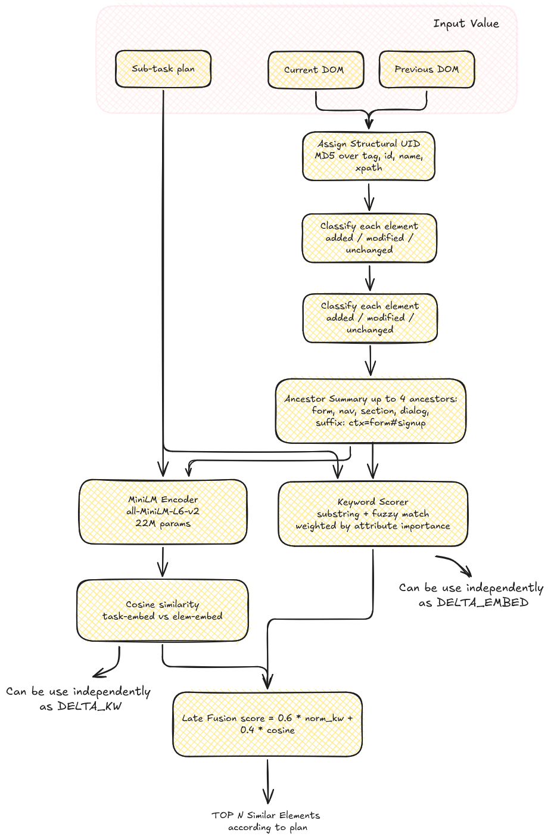
Novelty 1: DOM Delta Processing
Structural UID: tag, id, name, xpath values are stable across re-renders, even when visible text mutates. Same property as Mind2Web's backend_node_id but computed offline from parsed HTML, where no live browser needed.
Ancestor summary: Keep up to 4 semantically meaningful ancestors (form, nav, section, dialog) appended which preserve ancestor summary.
Hybrid score: calculate hybrid score with delta keyword and with delta sentence embeddings from all-MiniLM-L6-v2.
Result: As a result 16–18% Qwen-token reduction at matched Recall@20 across all three test splits.

Slide 16
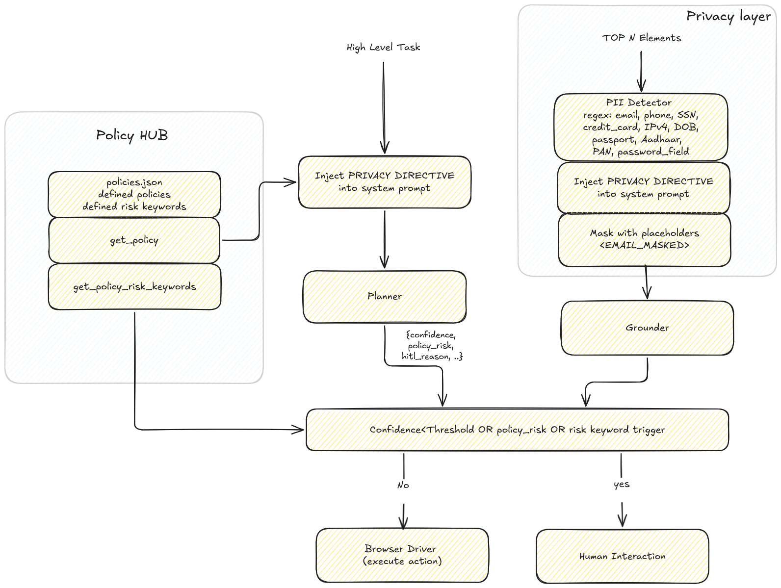
Novelty 2: Policy Hub + Risk-Based HITL
PolicyHub: Contain Policies and risky keywords list, which is customizable and can contain complete policy as well.
LLM JSON output extended with policy_risk (bool), risk_confidence, hitl_reason.
HITL gate fires on any one of three OR-combined triggers: (a) LLM self-flags policy_risk=true, (b) a risk keyword appears in the action text or hitl_reason, (c) risk_confidence falls below a configured threshold.
The gate sits before the grounder, so risky steps further inference can be avoided by the expensive grounder call.
Privacy-Aware LLM wrapper (between Filter and Grounder) runs a regex PII detector such as email, phone, Aadhaar, PAN, password and replaces matches with masking [EMAIL_MASKED] style placeholders. A short privacy directive is injected into the grounder system prompt instructing the model to treat masked tokens as opaque.

Slide 17
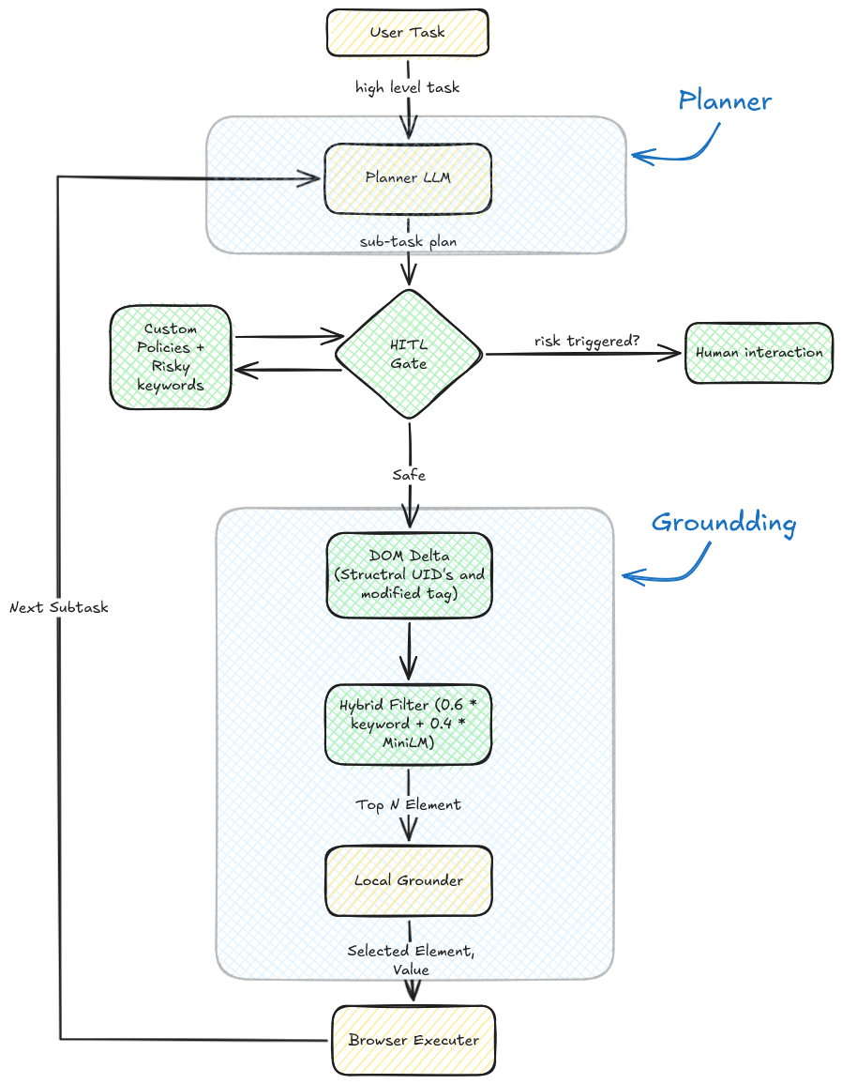
Architecture
Action Generation (LMM): Given the current screenshot + task + history to model which return a textual action and risk scores for action.
Action Grounding: Map textual description to actual DOM element + operation (click / type / select) by small model and with dom delta methodology.
Browser Execution: Use automation (via Playwright / browser engine) to execute the action. Webpage updates and we get new screenshot + DOM.

Slide 18
Improvement
Prune4Web:
at = π(st, T, {a1, a2, ..., at−1})
st+1 = S(at) = {ht+1, it+1}
Where:
at = action at time t
s = site specific input (html + image)
π = Multimodel LLM
T = user defined task
Our’s:
At = π(st, T, {a1, a2, ..., at−1}, pt)
st+1 = S(at) = {ht+1, it+1}
Where:
at = action at time t
s = site specific input (html + image)
π = Multimodel LLM
T = user defined task
pt = Policy rules
At ∈ (at, c, r, hr)
c = confidence c ∈ [0,100],
r ∈ {0,1},
hr = hitl_reason

Slide 19
Improvement - Algorithm
At = π(st, T, {a1, a2, ..., at−1}, pt)
at, c, r, hr = At
matched = compare action plan and policy keywords
if (r>0 or matched or c<confidence){
r = 1 #policy_risk detected
}
if (r == 1) {
HITL value triggered, as wait for human interaction for step
} else {
Executer further steps from grounding
}

Slide 20
Implementation Notes
Our architecture inspired from Prune4Web with some deviations.
Grounder: QLoRA-fine-tuned Qwen2.5-0.5B or Qwen3-0.6B loaded in 4-bit nf4; <1 GB VRAM at inference on RTX 4050 (6 GB).
Fine-tuned on 6,626 Mind2Web examples using the identical grounder prompt as inference — no train/inference drift.
DOM Delta + Privacy wrapper run entirely on-device.

Slide 21
Experiments: Filter-Stage Recall@20
Split | Samples | FULL Recall@20 | DELTA_HYBRID Recall@20 | Δ | Token red.
test_task | 1,257 | 90.30% | 90.07% | −0.23 pp | 17.8%
test_website | 975 | 89.95% | 89.85% | −0.10 pp | 16.4%
test_domain | 3,838 | 86.78% | 87.98% | +1.20 pp | 17.5%
DELTA_HYBRID matches FULL Recall@20 within 0.23 pp on two splits and improves on the largest split, while reducing grounder input tokens by 16–18%.

Slide 22
Experiments: Grounder Element Accuracy
Grounder | Params | test_task EA | Notes
Qwen2.5VL-3B-Instruct (Prune4Web) | 3.0B | 88.28% | Vision-language, paper baseline
Qwen2.5-0.5B + QLoRA (ours) | 0.5B | 85.00% | Text-only, 6× fewer params
Qwen3-0.6B + QLoRA (ours) | 0.6B | 88.00% | Text-only, 5× fewer params, matches paper
200-sample test_domain slice with DOM Delta enabled: Qwen3 reaches 88.00% EA, matching the 3B vision-language baseline within rounding margin while running without a vision encoder.

Slide 23
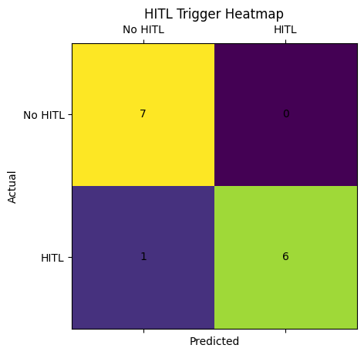
Implementation & Initial Result
*Initial results are computed on 13 live websites (7 required HITL, 6 not required HITL)
Metric | Value
HITL Recall | 85.71%
HITL Precision | 100%
HITL Accuracy | 92.86%
False Positive Rate | 0%
False Negative Rate | 14.29%
The system is able in triggering HITL.
It avoids unnecessary human interruptions (0 false positives),
but misses some high-risk cases (false negatives),
which we aim to improve via expanded risk keywords and site-level overrides.

Slide 24
Future Work
Future work should focus on gathering data for evaluating PolicyHub and privacylayer on large scale.
Even though Recall@20 of FULL and DELTA HYBRID is 1 pp we observed stable 5 to 6 , pp Element Accuracy gap between same QLoRA grounder and 3B model, even though their differs by only on the same 200 test domain samples.
Experiment should try to reorder top-20 block before grounding and to re-measure EA with both grounders. If the gap closes, candidate-order normalisation should be folded back into the DOM Delta layer. if it does not, the grounder is sensitive to the score-induced ordering itself, which would motivate a small preference-tuning around on ordered candidate blocks.

Slide 25
Conclusion
DOM Delta Processing replaces the stateless full-DOM filter with a structural-UID-tracked delta view. hybrid keyword + MiniLM scoring gives 16–18% token reduction at matched or improved Recall@20 across 6,070 Mind2Web test samples.
A QLoRA-fine-tuned Qwen3-0.6B local grounder reaches 88.00% EA, matching the Prune4Web 3B Qwen2.5VL-Instruct baseline (88.28%) within rounding margin while running at 5× fewer parameters, no vision encoder, <1 GB VRAM on a 6 GB RTX 4050.
A PolicyHub + risk-based HITL gate with a regex PII detector and a privacy directive injected into the grounder prompt brings privacy-awareness into the action loop, not bolted on after.
Net result: the Prune4Web pipeline becomes cheaper at the filter stage, safer at the grounder stage, and deployable on consumer hardware without sacrificing element accuracy.

Slide 26
References
[1] C. Zhang, S. He, J. Qian, B. Li, L. Li, S. Qin, Y. Kang, M. Ma, G. Liu, Q. Lin, S. Rajmohan, D. Zhang, and Q. Zhang, “Large language model-brained gui agents: A survey,” 2025.
[2] F. Tang, H. Xu, H. Zhang, S. Chen, X. Wu, Y. Shen, W. Zhang, G. Hou, Z. Tan, Y. Yan, K. Song, J. Shao, W. Lu, J. Xiao, and Y. Zhuang, “A survey on (m)llm-based gui agents,” 2025.
[3] L. Ning, Z. Liang, Z. Jiang, H. Qu, Y. Ding, W. Fan, X. yong Wei, S. Lin, H. Liu, P. S. Yu, and Q. Li, “A survey of webagents: Towards next-generation ai agents for web automation with large foundation models,” 2025.
[4] S. Wang, W. Liu, J. Chen, Y. Zhou, W. Gan, X. Zeng, Y. Che, S. Yu, X. Hao, K. Shao, B. Wang, C. Wu, Y. Wang, R. Tang, and J. Hao, “Gui agents with foundation models: A comprehensive survey,” 2025.
[5] B. Zheng, B. Gou, J. Kil, H. Sun, and Y. Su, “Gpt-4v(ision) is a generalist web agent, if grounded,” 2024.
[6] G. Verma, R. Kaur, N. Srishankar, Z. Zeng, T. Balch, and M. Veloso, “Adaptagent: Adapting multimodal web agents with few-shot learning from human demonstrations,” 2024.

Slide 27
References
[7] D. Zhang, B. Rama, J. Ni, S. He, F. Zhao, K. Chen, A. Chen, and J. Cao, “Litewebagent: The open-source suite for vlm-based web-agent applications,” 2025.
[8] I. L. Iong, X. Liu, Y. Chen, H. Lai, S. Yao, P. Shen, H. Yu, Y. Dong, and J. Tang, “Openwebagent: An open toolkit to enable web agents on large language models,” in Proceedings of the 62nd Annual Meeting of the Association for Computational Linguistics (Volume 3: System Demonstrations), pp. 72–81, 2024.
[9] H. Luo, J. Kuang, W. Liu, Y. Shen, J. Luan, and Y. Deng, “Browsing like human: A multimodal web agent with experiential fast-and-slow thinking,” in Proceedings of the 63rd Annual Meeting of the Association for Computational Linguistics (Volume1: Long Papers), pp. 14232–14251, 2025.
[10] X. Deng, Y. Gu, B. Zheng, S. Chen, S. Stevens, B. Wang, H. Sun, and Y. Su, “Mind2web: Towards a generalist agent for the web,” 2023.
[11] J. Zhang, K. Chen, Z. Lu, E. Zhou, Q. Yu, and J. Zhang, “Prune4web: Dom tree pruning programming for web agent,” 2025.
[12] T. M. Schiepanski and N. Pi¨el, “Beyond pixels: Exploring dom downsampling for llm-based web agents,” 2025.

Slide 28
References
[13] T. Abuelsaad, D. Akkil, P. Dey, A. Jagmohan, A. Vempaty, and R. Kokku, “Agent- e: From autonomous web navigation to foundational design principles in agentic systems,” 2024.
[14] H. Lai, X. Liu, I. L. Iong, S. Yao, Y. Chen, P. Shen, H. Yu, H. Zhang, X. Zhang, Y. Dong, and J. Tang, “Autowebglm: A large language model-based web navigating agent,” 2024.
[15] Gur, Izzeddin, et al. "A real-world webagent with planning, long context understanding, and program synthesis." arXiv preprint arXiv:2307.12856 (2023).
[16] W. Wang, F. Wei, L. Dong, H. Bao, N. Yang, and M. Zhou, “Minilm: Deep self-attention distillation for task-agnostic compression of pre-trained transformers,” 2020.
[17] T. Dettmers, A. Pagnoni, A. Holtzman, and L. Zettlemoyer, “Qlora: Efficient fine- tuning of quantized llms,” 2023.
[18] N. Reimers and I. Gurevych, “Sentence-bert: Sentence embeddings using siamese bert-networks,” 2019.

Slide 29
Thanks!
Do have any questions?

