Slide 1
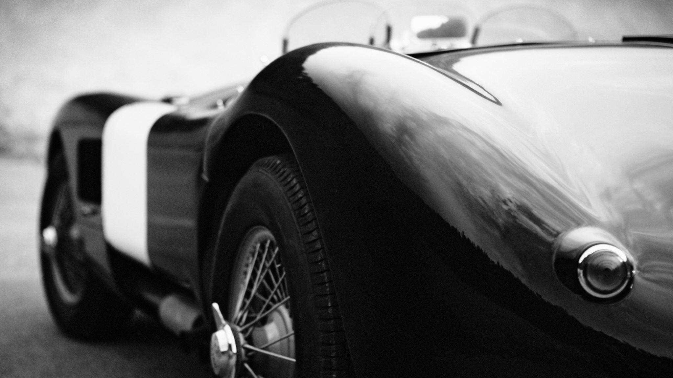
India Automobile Hackathon
Prototype round

Slide 2
4 geeks
Team Members
Dhruv Kumar (Email ID:dhruv.kumar@iitg.ac.in, Contact No. : 7068224644)
Parshva (Email ID: p.shah@iitg.ac.in, Contact No. 9321127974)
Tarannum (Email ID: tarannum9623@gmail.com , Contact No.: 93904 82325)
Vivek Kumar (Email ID: vivek200103117@iitg.ac.in, Contact No. : 8084682815)

Slide 3
Theme
New Digital Transformation through Automobiles in India

Slide 4
Sub Theme
Utilize personal space of pickup truck cars

Slide 5
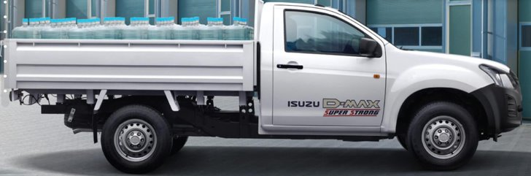
MAIN FOCUS : D-MAX

Slide 6
Ideation
Under this theme, our first need is to create a personal space that is creating a shelter. On each side of the cart, electronically controlled hollow lateral walls will be lifted up with the help of actuators and an electronically mechanized shutter system is used which will act as a roof and it will be initiated only after the two lateral walls are perfectly placed . Shutter curtain’s movement will be constrained with the help of the guide rails attached on the top of lateral walls . Inside each lateral wall, one 270 degree door will be attached which will be controlled manually .

Slide 7
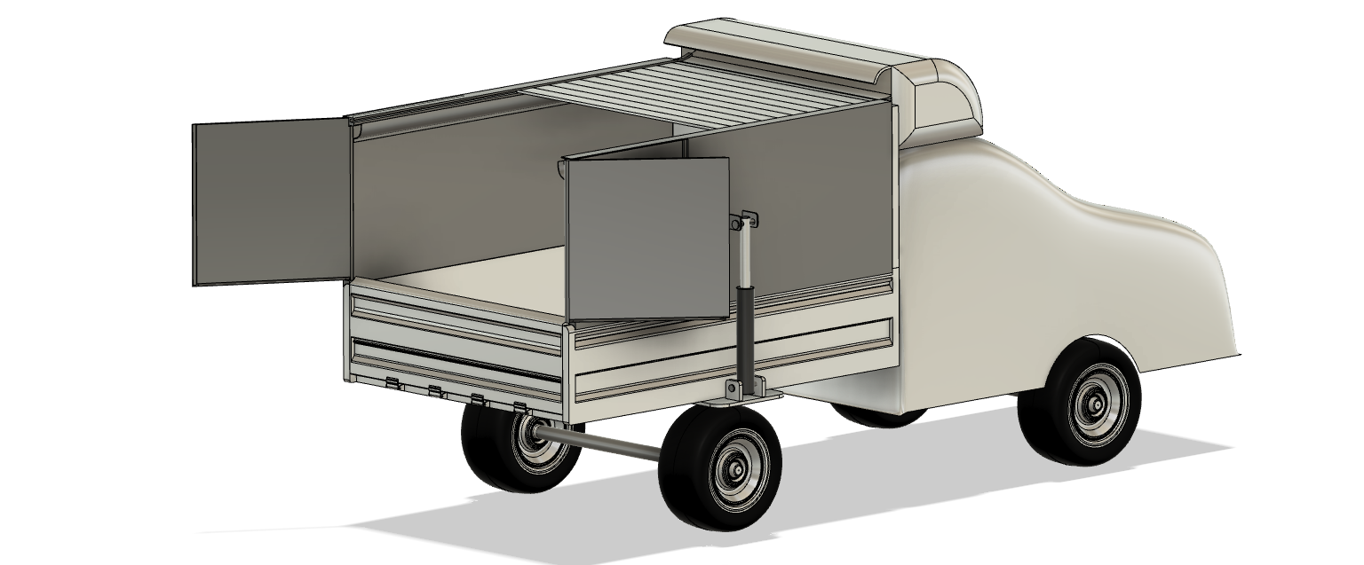
PROTOTYPE

Slide 8
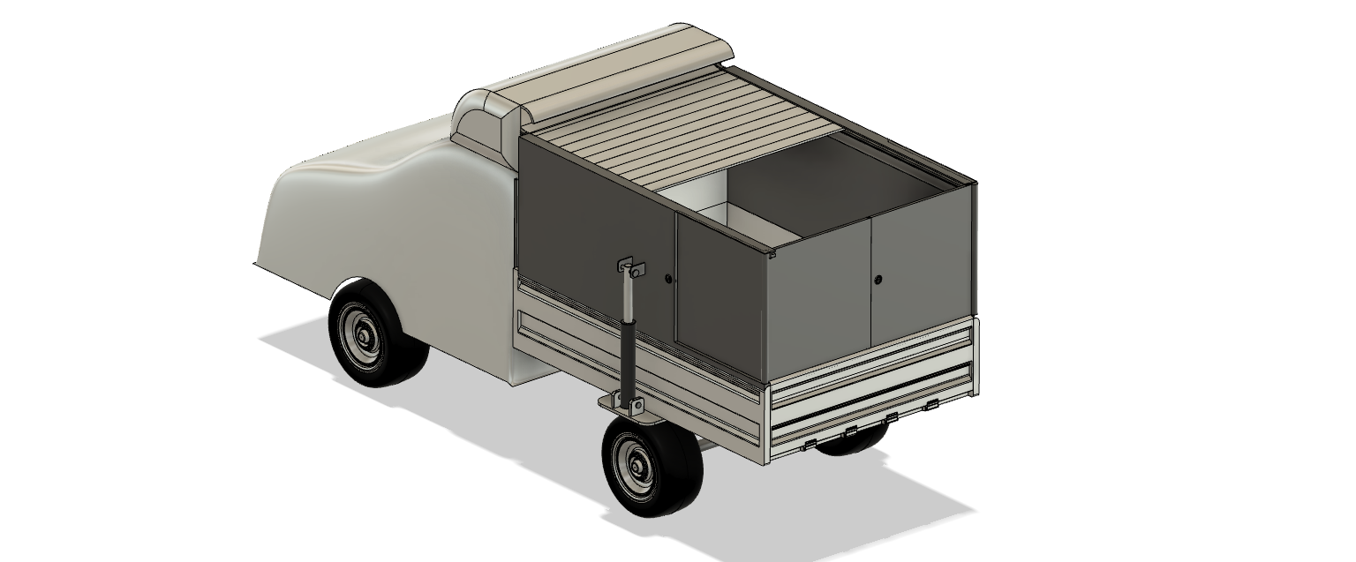

Slide 9
ROOF TOP

Slide 10
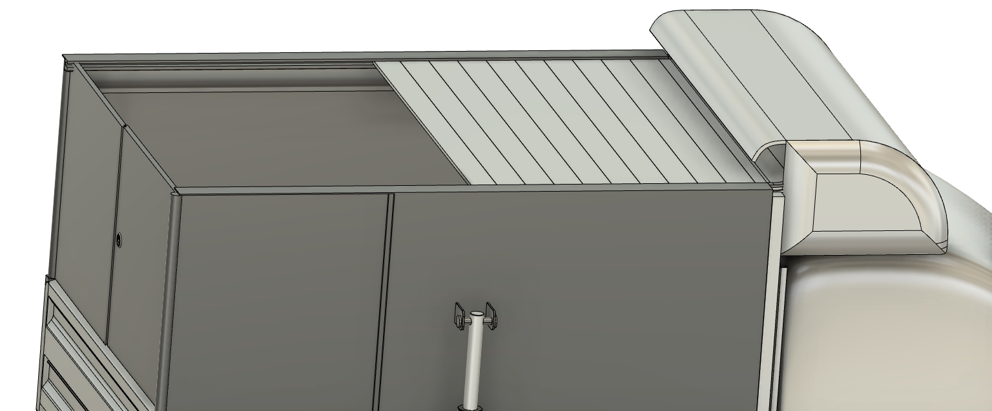

Slide 11
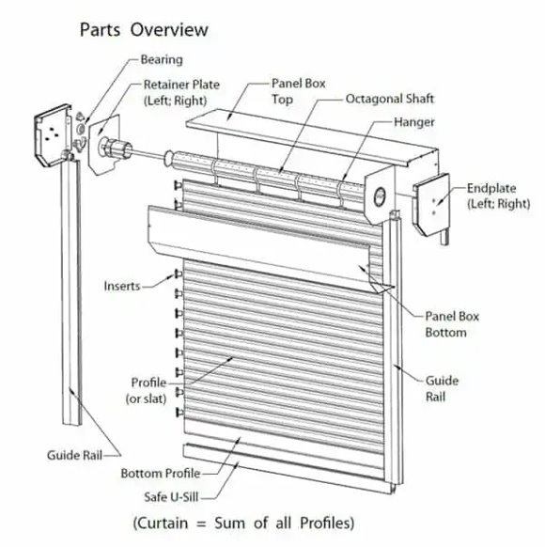
To cover the top, we will use shutter system. Instead of traditional steel curtains, we will use “Aluminium curtains”.

Slide 12
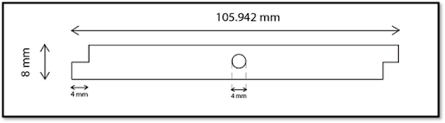
Shape of each curtain

Slide 13
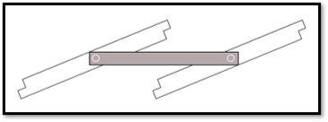
A rod (shown as circle) of Aluminium will pass through curtain about which the curtain can rotate
The two adjacent curtains will be connected via a rectangular metal strip joining the rods present at the center of curtains
ALUMINIUM
STRIP
ALUMINIUM
ROD

Slide 14
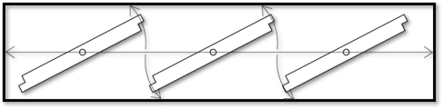
Fabric beneath the curtains
The curtains will rest on a fabric base which will be made of "Hemp"(made of natural fibres).
Maintain sync in between curtain.
Prevent water seepage.
Reduce sound caused due to sliding of curtain.

Slide 15
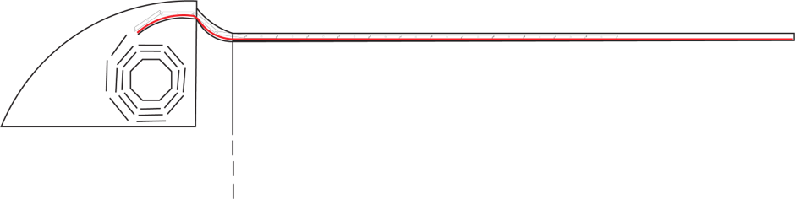
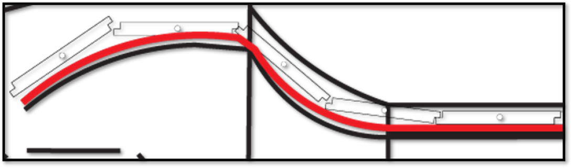
Curtain flow inside guide rail
( Redline is showing base of Hemp fabric that will be connected with the curtains )

Slide 16
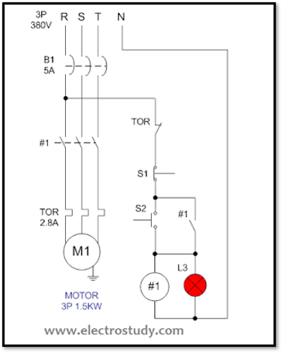
Circuit Diagram for shutter activation
A motor is used to rotate the axle of the shutter, which will start with a button near the driver's seat, which will cause the curtains to fold and unfold.

Slide 17
Parts Required in circuit
B1 | MCB 5A 3 phase
M1 | Motor 1.5kW 380V 3Phase
#1 | Magnetic contactor 220VAC
TOR | Thermal Overload Relay 2.8A
S1 | Push Button Switch (PTB non latching - Stop switch)
S2 | Push Button Switch (PTM non latching - Start switch)
L3 | Pilot lamp 220VAC

Slide 18
Dimension and Specifications
Thickness of Al Sheet​ | 3 mm​
Number of bars required​ | 25​
Width of 1 bar​ | 1860 mm​
Thickness of each bar​ | 15 mm​
Mass of 1 bar​ | 3.64 kg ​
Total mass of shutter​ | 91.10 kg​

Slide 19
LATERAL WALLS

Slide 20
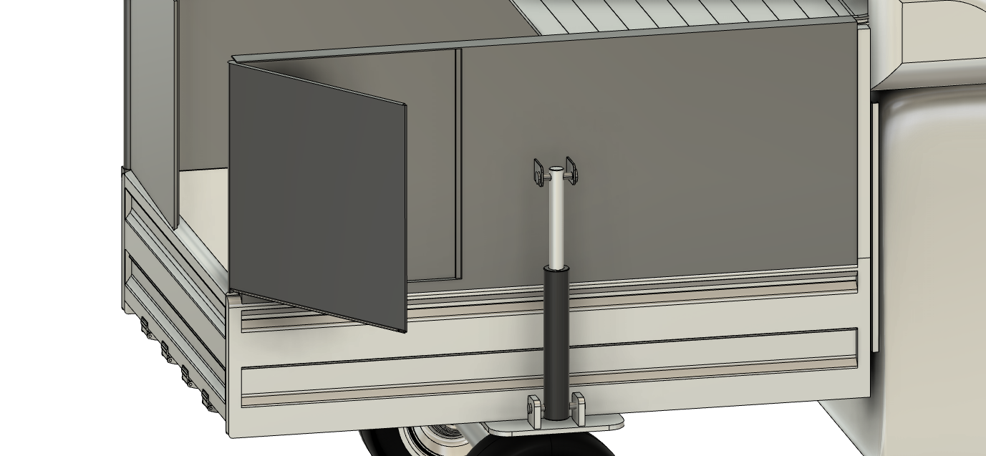

Slide 21
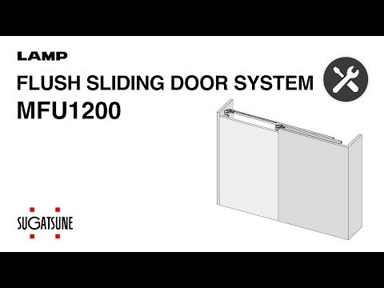
The lateral door will be lifted through this mechanism that is usually used in sliding doors of almirah. ​It will hold the lateral door and will control its movement up and down.​

Slide 22
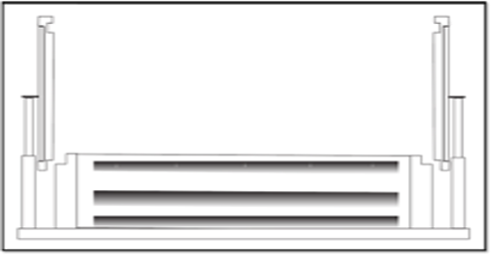
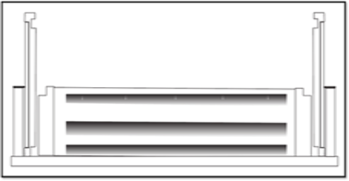
​
Door will be lifted using an electrically controlled linear actuator.​
The actuator and the lateral walls will be attached rigidly.

Slide 23
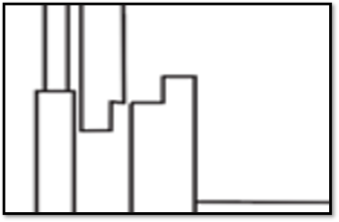
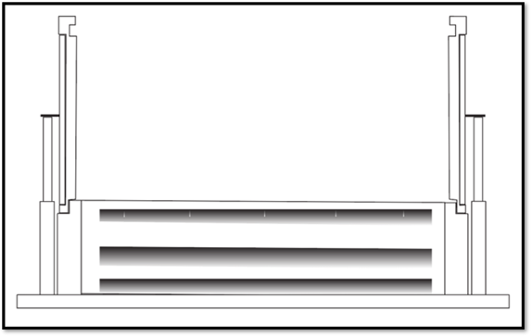
Proper locking of both the walls will be ensured to overcome the torque due to the weight of the lateral walls.​​
​​
The bottom level will be extended to some extent on which this whole mechanism will be kept on.​

Slide 24
Weight of Aluminium Required | 55 Kg
Total Cost of Aluminium | Rs. 6000
Cost of lateral walls :
Cost of actuator :
Total average price : Rs. 10000

Slide 25
BACK DOOR

Slide 26
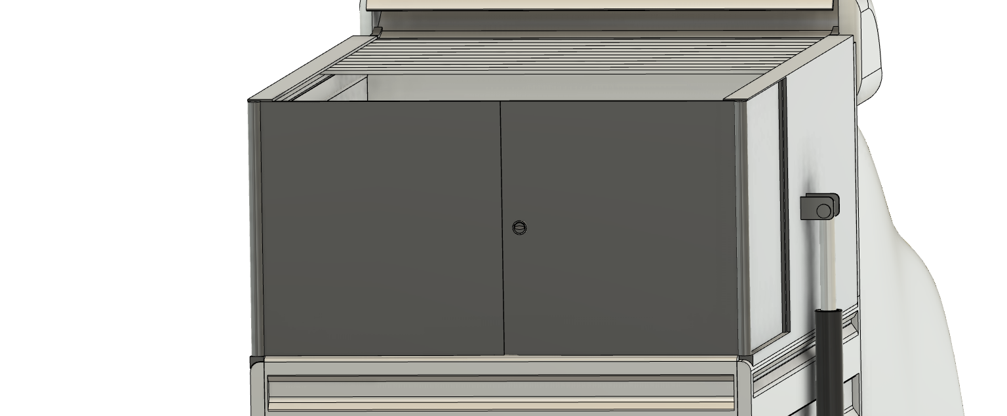

Slide 27
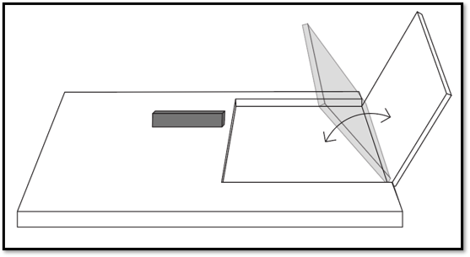
A 270° latch will be used in order to turn the door by 270°.
Back doors will be embedded on the lateral walls.

Slide 28
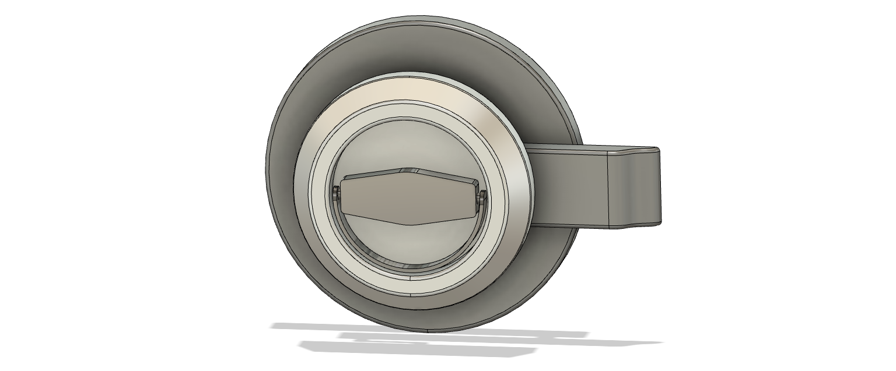
The doors will have deadbolt locks.

Slide 29
S. No. | Domain | Parts | Average Cost
1 | Roof | Motor | 12000
 |  | Al (Curtains + shutter covering) | 15000
 |  | Circuit accessories | 6000
2 | Lateral walls | Actuator *2 | 20000
 |  | Al in Walls | 6500
3 | Back doors | Al in door | 3000
 |  | 270 ° hinge(x4) | 2000
TOTAL |  |  | 64500
COST ANALYSIS
Hence the model can be made space flexible in addition of being cost effective

Slide 30
MARKET ANALYSIS

Slide 31
PURPOSE
LOAD TRANSFER
01
GROCERY AND PHARMACY
02
PERSONALISED SPACE
03

Slide 32
Flexible space utility opens the door for online ordered goods delivery.
It will fulfil the increasing needs of hospital logistics (especially in densely populated areas).
It will increase popularity of D-Max among people who are outdoor enthusiasts, due to its efficient personalized space.
Frozen food delivery will become possible with integration of temperature control system.
New Domains For D-Max Sale

Slide 33
Isuzu has sold over 13,500 vehicles till date in India.
This will increase by manifolds, since other competitors in India don't have such a broad target customer.
Integration of the temperature control system will then contribute more in broadening of the domains. (Then total cost = 64500 + cost of temp. Cooling system).
Flexible space of D-Max at such a low cost will attract more pre-existing target customers.

Slide 34
COMPETITION LANDSCAPE
The Modified D-Max stands stronger among its competitors like:
Mahindra Bolero Camper Pickup
Ashok Leyland Dost
Tata Yodha Pickup

