Slide 1

WINTER PROJECT
ANALYSIS USING SKYVIEW

Slide 2
ASTRONOMICAL OBJECT
M61

Slide 3
SURVEYS USED
Digital Sky Survey (DSS) - Optical Survey
PSPC 2.0 Deg-int survey
Mellinger all sky mosaic: Red survey - Infrared optical region
HI4PI - Radio waves
IRIS 100 - Infrared region
Digital sky 3 red survey
2MASS-K : All sky survey (K-band)
EUVE 83 A: Extreme Ultraviolet Explorer: 83 A
RASS Background 6: ROSAT All-Sky X-ray Background Survey: Band 6

Slide 4
Digital Sky Survey (DSS) - Optical Survey

Slide 5
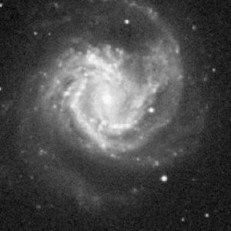
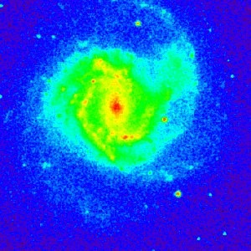
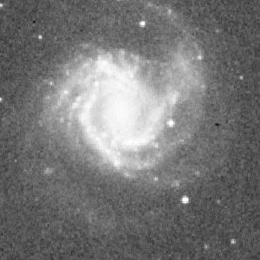
1.) All these pictures of M61 through DSS shows that M61 is a spiral galaxy because of the curve ‘arms’ seems to some out from a central dense region. DSS2 RED shows that center is a typical sphere like, so the galaxy is a TYPICAL SPIRAL GALAXY.
2.) It is clearly a face-on spiral galaxy and have loosely bound arms.
3.) We can see small luminous objects (small maybe because they are very far and can also be bigger than M61) that are emitting photons in visible region. There might be more that are emitting photons in different spectrum region.

Slide 6
PSPC 2.0 Deg-int survey

Slide 7
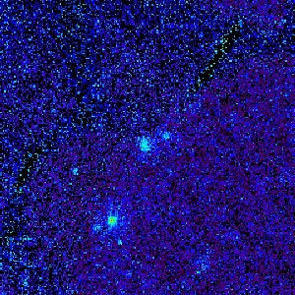
1.)This is an X-Ray spectrum, hence it shows that there are 2 highly energetic dense bodies present.
2.)The one at center must be a black hole as every galaxy has a black hole at its center.
3.)The another one most probably is a star, as Messier 61 is located close to the constellation virgo, so it might be one of the stars of virgo.

Slide 8
3.) Mellinger all sky mosaic: Red survey

Slide 9
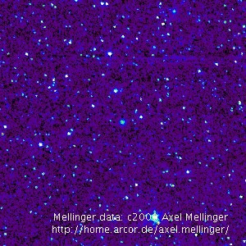
Spectrum is in Infrared region. Hence it shows cooler stars present. These stars might be red giants, red dwarves, red supergiants or brown dwarves

Slide 10
HI4PI - Radio waves

Slide 11
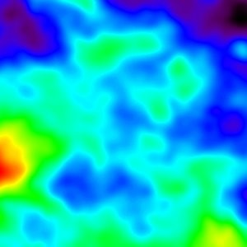
[NOTE:PICTURE IS IN RAINBOW COLOR SCHEME]
HI4PI survey uses radio waves . The yellow region of galaxy signifies presence of neutral hydrogen. So the galaxy have an abundance of neutral hydrogen

Slide 12
IRIS 100 - Infrared region

Slide 13
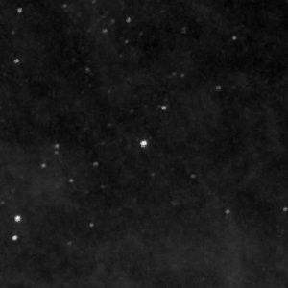
1.) The Iras 100 survey uses infrared region.
2.)The white dots represent cooler stars, and we can observe almost no interstellar gas. So the galaxy have utilized most of its interstellar gas.

Slide 14
2MASS-K : All sky survey (K-band)

Slide 15
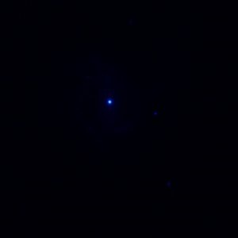
[NOTE:ALL IN BLUE AND WHITE COLOR SCHEME]
2 MASS K is a survey in IR region. The first image is taken in red temperature region and the hot core of galaxy is visible but nothing else. The bright centre shows that the galaxy have an active galactic nucleus(AGN). An active galactic nucleus (AGN) is a compact region at the center of a galaxy that has a much-higher-than-normal luminosity over at least some portion of the electromagnetic spectrum with characteristics indicating that the luminosity is not produced by stars. Such excess non-stellar emission has been observed in the radio, microwave, infrared, optical, ultra-violet, X-ray and gamma ray wavebands. A galaxy hosting an AGN is called an "active galaxy".

Slide 16
EUVE 83 A: Extreme Ultraviolet Explorer: 83 A

Slide 17

From the inverted EUV survey, we can see the galaxy also have a lot of young stars and since very little gas is there , this galaxy might be doing star formation rapidly.

Slide 18
RASS Background 6: ROSAT All-Sky X-ray Background Survey: Band 6

Slide 19
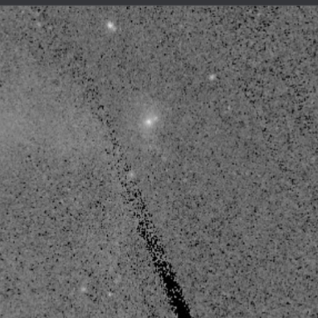
This image has been processed using the Rass Background6 survey of the ROSAT diffuse series. The bright spots which are visible might be Remnants of Supernovae with relatively higher magnitudes.

Slide 20
THE END

