Slide 1


KIDNEY TUMOR DETECTION
Guided by: Dr Ashwin Makwana
PRESENTED BY
20CE117-DHRUV PUVAR
20CE132-NISARG SHAH
20CE134-SHAIL SHAH

Slide 2
1
Introduction
2
History of Kidney Tumor
3
About the project
4
AGENDA
Chronology
5
Proposed model
6
Confusion Matrix
7
Conclusion

Slide 3
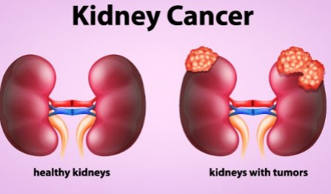
INTRODUCTION
The Kidneys are a pair of bean-shaped organs, each about the size of a fist. They are attached to the upper back wall of the abdomen and protected by the lower rib cage
Kidney tumor (KT) is one of the diseases that have affected our society and is the seventh most common tumor in both men and women worldwide. The early detection of KT has significant benefits in reducing death rates, producing preventive measures that reduce effects, and overcoming the tumor

Slide 4
HISTORY OF KIDNEY TUMOR
Kidney cancer, also known as renal cell carcinoma, is a type of cancer that develops in the cells of the kidneys. The history of kidney cancer dates back to ancient times, although the disease was not recognized as a distinct medical condition until the 19th century.
In the 1980s, new drugs called cytokines were developed that could boost the immune system's ability to fight cancer. More recently, targeted therapies and immunotherapies have emerged as promising treatments for kidney cancer, and ongoing research continues to advance our understanding of this disease.

Slide 5
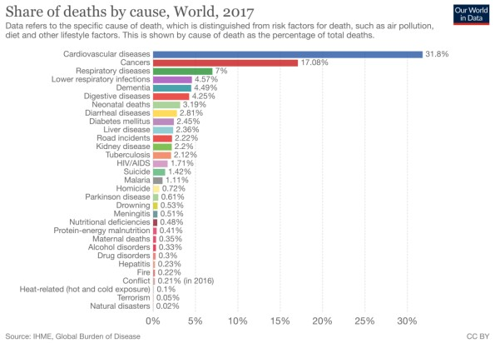

Slide 6
ABOUT THE PROJECT
Objective:
To detect kidney cancer through machine learning model
Goal:
To accurately create machine learning model which can detect kidney cancer accurately.

Slide 7
Project chronology
1
2
Literature review
Dataset collection
Researched previously applied approaches Different approaches
To collect various kidney tumor images from various research paper and Kaggle.
3
4
Creating model
Creating various model for checking accuracy.
Testing
Testing the accuracy and other parameters .

Slide 8

PROPOSED MODEL
1. CNN Model
The model consists of three convolutional layers, followed by a flattening layer, two fully connected layers, and an output layer with a sigmoid activation function.
The input to the model is a 3-channel image with a shape of (256, 256, 3).
The first convolutional layer has 32 filters with a kernel size of (3, 3), followed by a max pooling layer with a pool size of (2, 2) and stride of 2.
The second convolutional layer has 64 filters with a kernel size of (3, 3), followed by another max pooling layer with the same configuration.
The third convolutional layer has 128 filters with a kernel size of (3, 3), followed by the last max pooling layer with the same configuration.

Slide 9
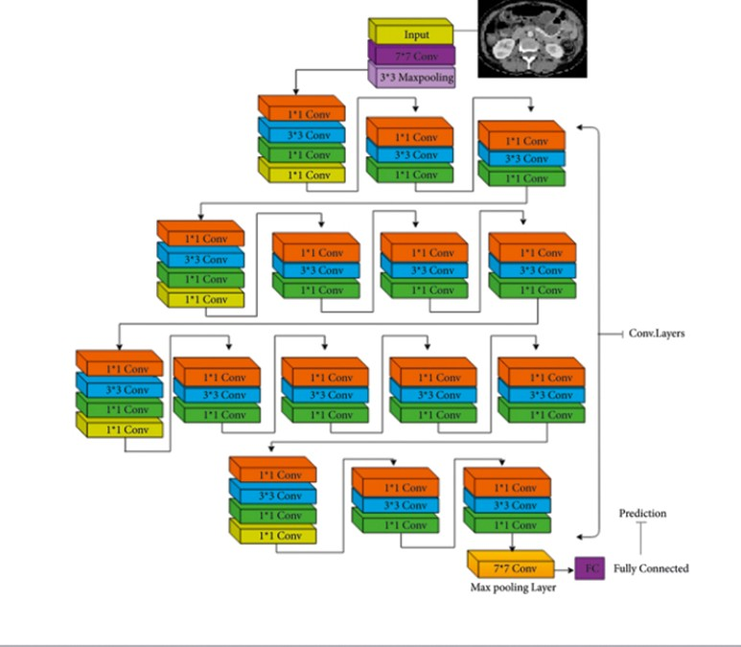

Slide 10
PROPOSED MODEL
2. VGG NET
The layers in the model are as follows:
ZeroPadding2D layer to preserve spatial resolution, Convolution2D layer with 64 filters of size 3x3, MaxPooling 2D layer with a pool size of 2x2 and stride of 2.2, two more sets of convolution2D and MaxPooling2D layers, each with 128 filters.
A Flatten layer to convert the 2D output from the previous layer into a 1D vector, two Dense layers with 128 and 64 units respectively, followed by ReLU activation function and Dropout regularization, and a final Dense layer with 1 unit and a sigmoidal activation function to classify the images.

Slide 11

PROPOSED MODEL
3. SVM(Support Vector Machine)
Flow of execution of the model :
Extract Data(Images) into Normal and Tumour named Folders respectively Initialize two list X and Y for storing all images and their labels respectively Covert the regular list into NumPy array
Convert 3-Dimensional list X into 2-Dimensional.
Splitting the overall data into Train and testing set, respectively. Reinitialize the intensity values in the images from 0-255 to 0-1 (Binary) Creating Support Vector Classifier using SVC library
Fitting the Classifier using train datasets
Predicting Performance metrics for the test dataset

Slide 12
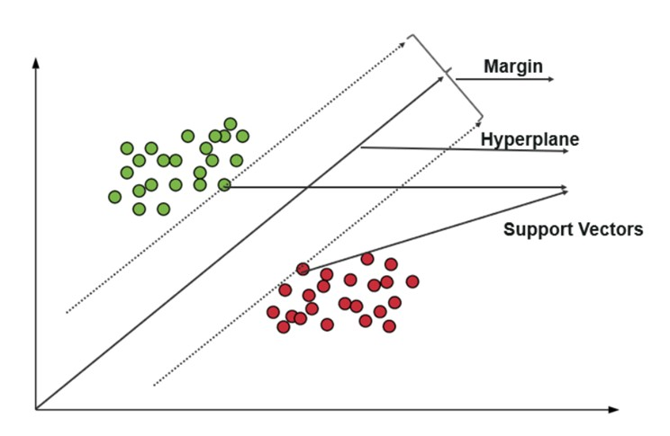

Slide 13
CONFUSION MATRIX
Model Name
CNN
VGG Net SVM
Accuracy
0.998
0.98
0.987
Precision
0.994
1.0
0.992
Recall
1.00
0.998
0.968
F1 Score
0.99
0.999
0.980

Slide 14
CONCLUSION
VGG NET model provides us accuracy of 98% after 5 epochs
SVM model provides accuracy of 98.7%. CNN model provides accuracy of 99.8%.

Slide 15
Thank you

