Slide 1

Genome Sequencing using Graph Traversal Method
-Ayush Ambhorkar
-Mohit Apte
-Abhijeet Bhosale
-Atharva Lonhari

Slide 2
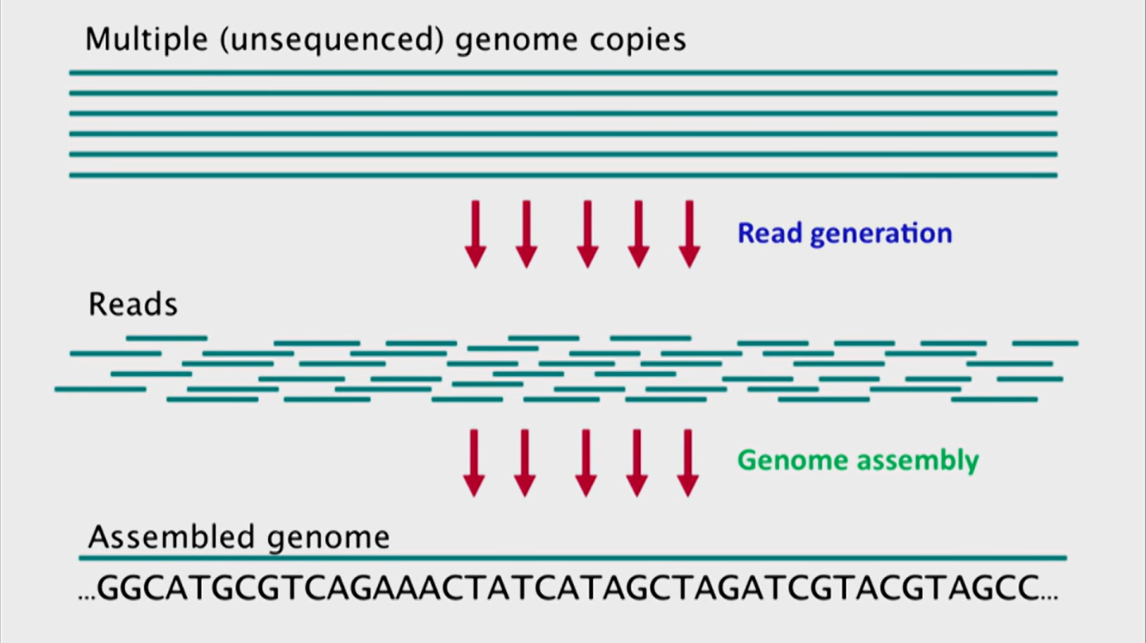
Sequencing a Genome

Slide 3
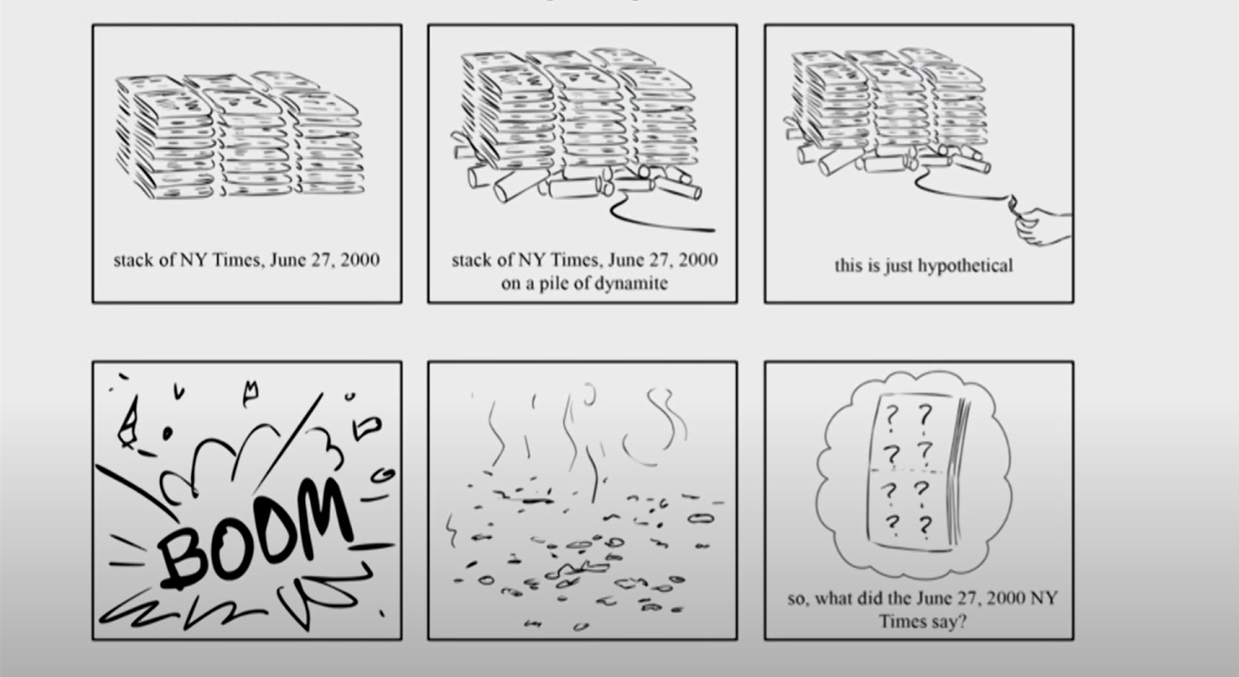
The Exploding Newspaper Problem

Slide 4
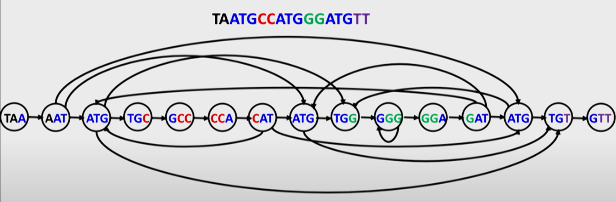
Use of Hamiltonian Graph in Genome Sequencing

Slide 5
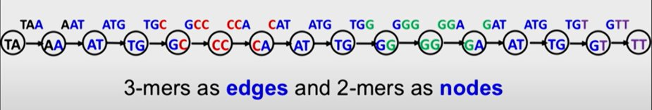
Bits of the Genome Sequence

Slide 6
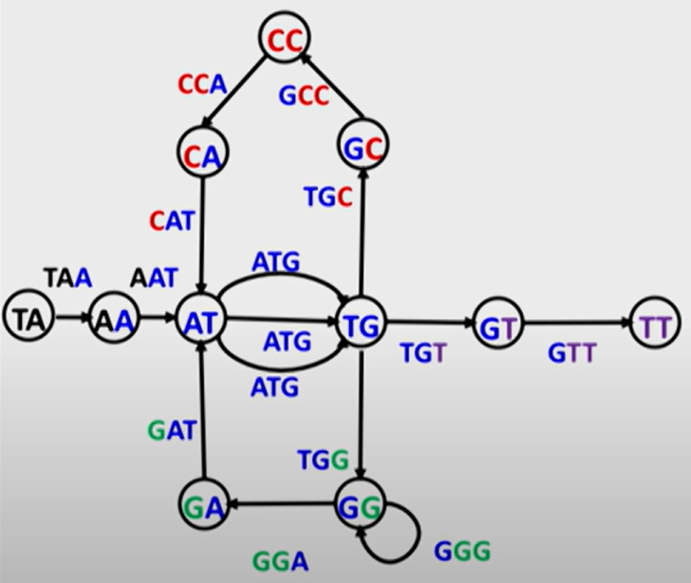
De Bruijn Graph

Slide 7
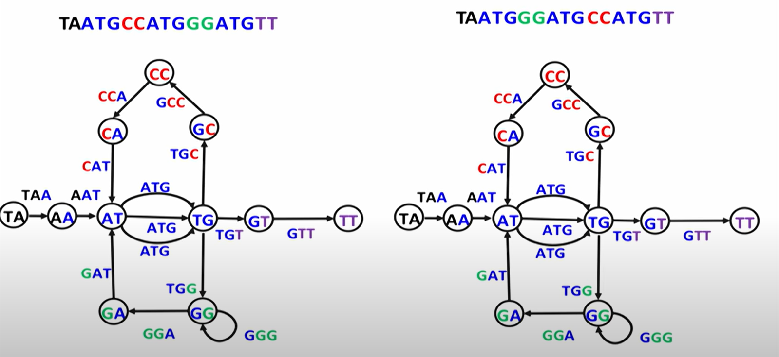
Multiple Euler Paths

Slide 8
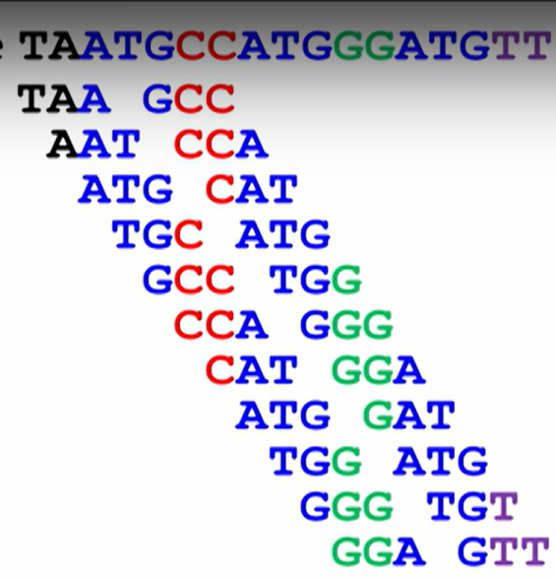
Read Pairs

Slide 9
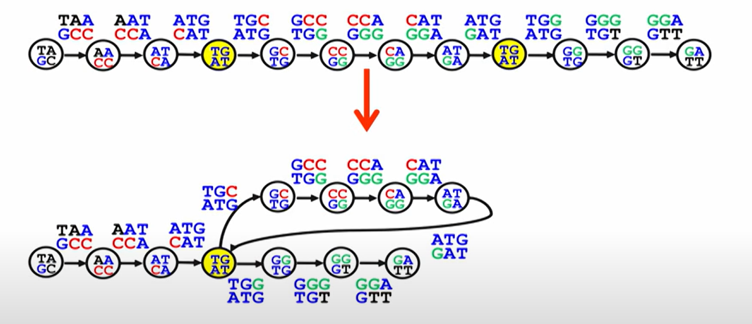
De Bruijn Graph with Read Pairs

Slide 10
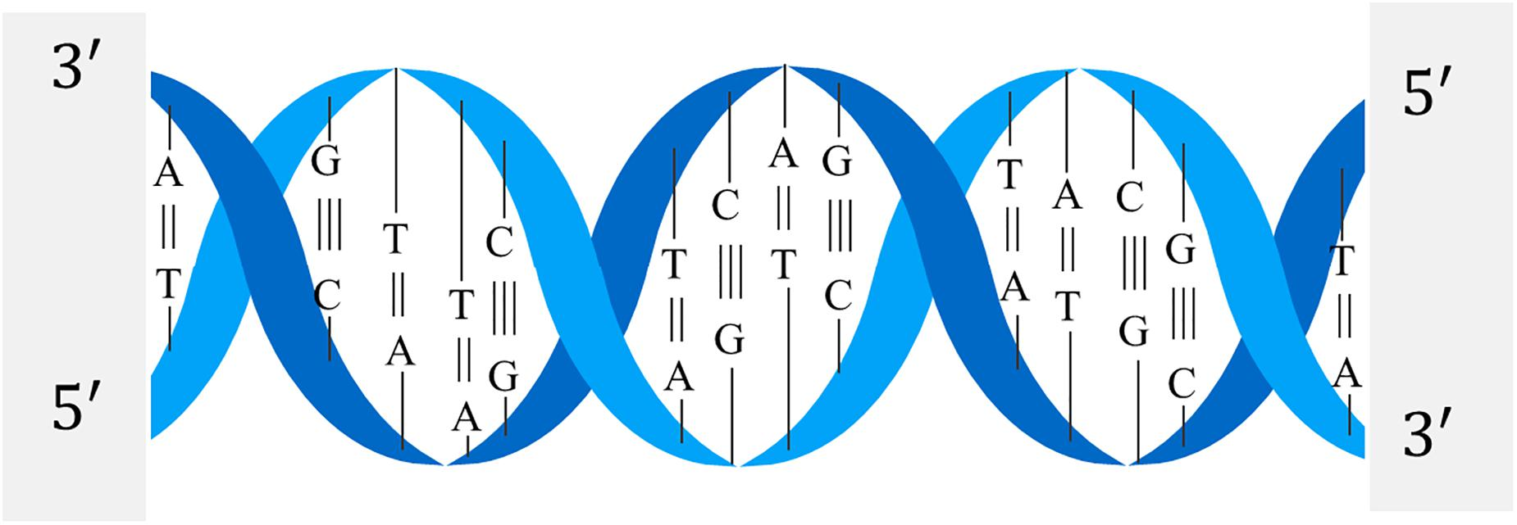
Thank You

