Slide 1

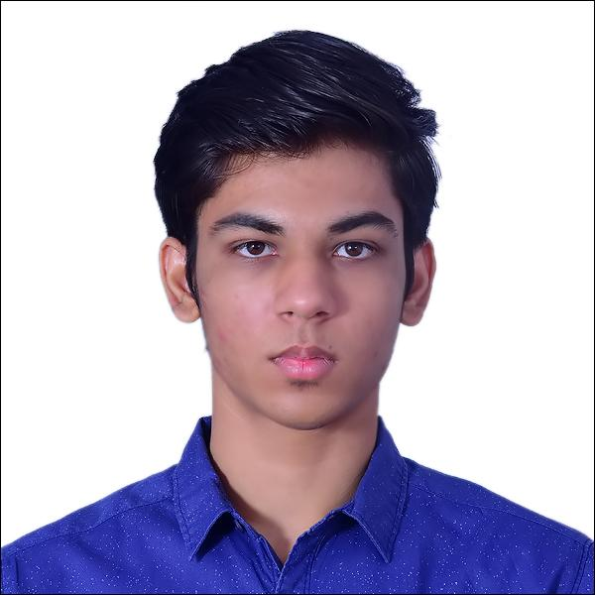
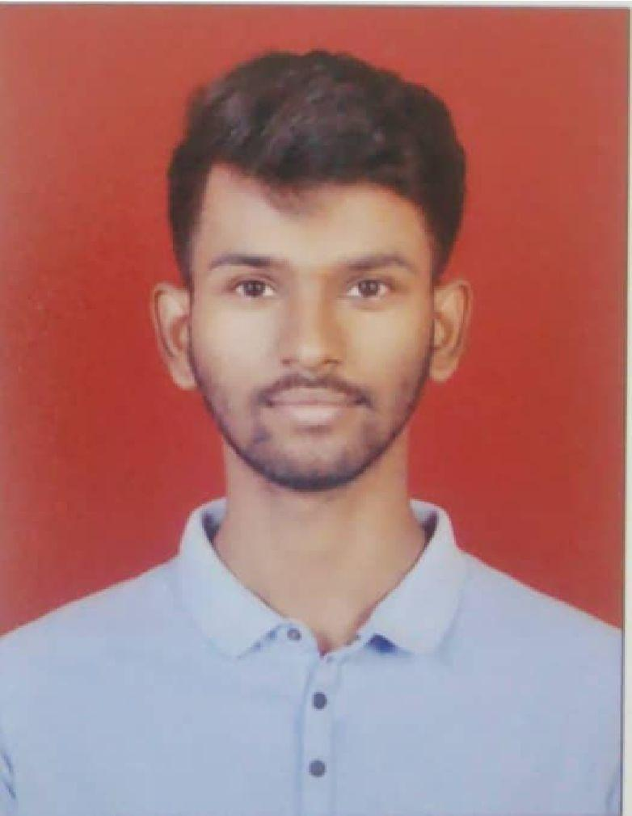
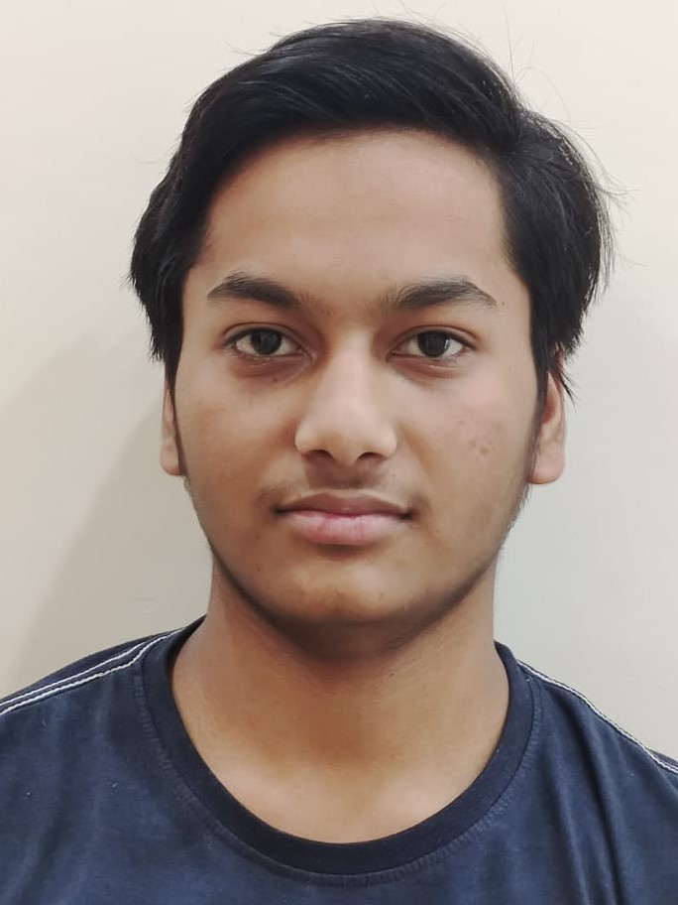
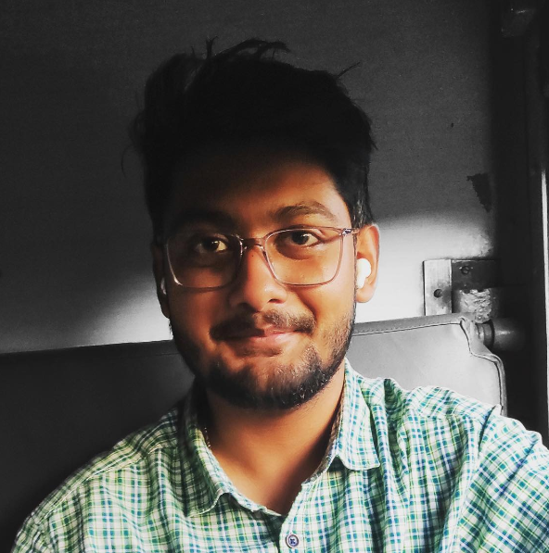
Create Secure Health data exchange solution using blockchain and web3
Author 1
Photo
Author 2
Photo
Author 3
Photo
Author 4
Photo
Dhruv Sahu
Anish Khot
Subham Gupta
Diptanshu Mandal
College Name : SRM Institute of Science and Technology
Location : Kattankulathur, Chennai
College Mentor Name : Dr. Prakash M.

Slide 2
Challenge Statement
Despite being sold to other business entities, patient data owners do not receive any benefits from the data. We need to come up with a system where the patient is the owner of the data and may sell his health information to other users like hospitals and drug development organisations while yet ensuring that nobody else can use it without his or her consent. In 2021, an average of 1.95 healthcare data breaches of 500 or more records were reported each day.
Major Problems concerning the safety and privacy of the individual’s record:-
Illegal trading of data - Patients data are sold to different organization without prior consent of the patient.
Database Breach - Many big private as well as public hospitals database are breached to get sensitive data of patients as they are stored in centralized legacy servers.
Data present in small chunks - Data stored in legacy servers are typically not shared with others due to lack of common format and standards and this also leads to data unavailability.
Data Manipulation - Health records are manipulated and can be presented as facts in order to obtain compensation from an insurance company.

Slide 3
Concept / Solution
Developing a privatized blockchain concluding all users like hospitals, patients, healthcare department and various organization.
Here each user will be given a private key for accessing their data.
Owner will have complete authority on their own data.
Hospital will add the patient’s data on our network and it can be accessed by both parties
Once the data uploaded by hospital cannot be changed. So tampering of data will not be possible.
User data will be stored in encrypted form using state of the art encryption algorithms in database.

Slide 4
Progress / Status / Plan
NFT Marketplace has been completed
NFT Generator is built
IFPS(Backend) server built
Solidity code for NFT Generation almost completed
Future Plan:
Registration/Login creation
Database creation
Buying and selling feature
Report generation and Data population

Slide 5
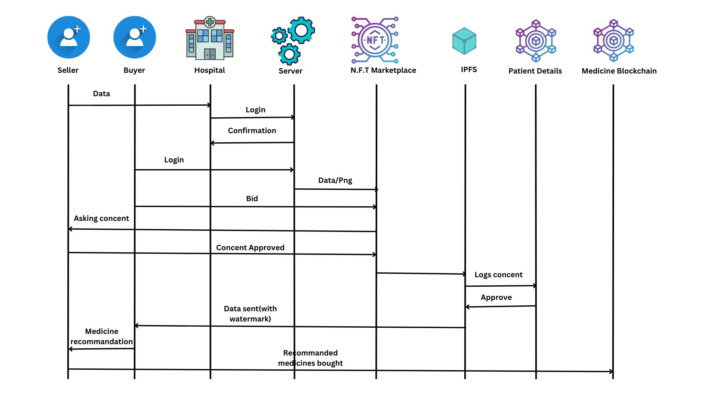
Progress / Status / Plan

Slide 6
Queries to the Mentor
What will be the judging criteria
What should be the MVP
Features Requirement
Display of data in NFT
Display of Report

Slide 7


