Slide 1

Video Games Sales & Engagement Analysis Project
:- By Dhruv Sikarwar
:- By Dhruv Sikarwar

Slide 2
Problem
Goal
Data
Insights
Recommendation
AGENDA

Slide 3
PROBLEM STATEMENT
Analyze and visualize video game sales and engagement data to uncover trends in game popularity, user behavior, and platform performance by merging sales and engagement data.

Slide 4
GOALS
Goal 1: Data Cleaning & Standardization to ensure accurate analysis.
Goal 2 : Design Structured Sql tables to store data.
Goal 3: Develop data-driven recommendations for upcoming Genre & Platform selection.
Goal 4: Design a user friendly dynamic Dashboard.
Main Question:-
Does higher rating leads to higher Revenue Collection ?
Which Genre has collected highest Revenue ?
Which Region has produced higher Revenue ?
Is there a relationship between Ratings and Sales ?

Slide 5
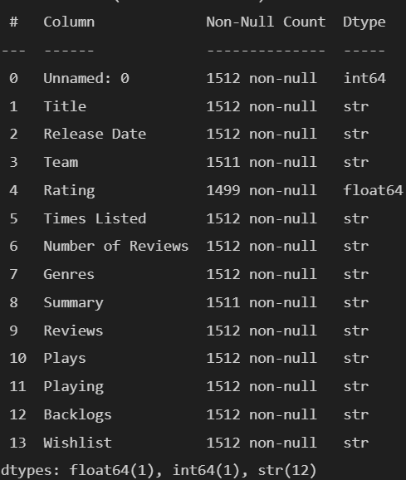
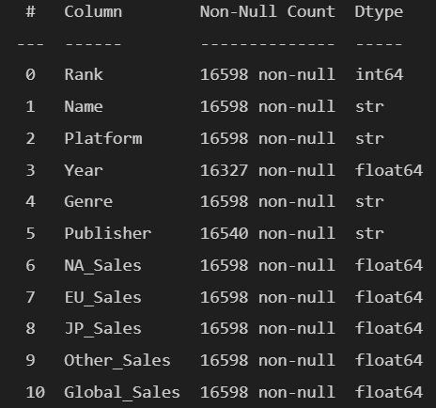
Data : Overview
Game Meta
Game Sales
Data : VG Sales & Engagement Data (1980 -2025).
Source : Kaggle
Size :
Games Meta → 1512 rows & 14 columns.
Games Sales → 16598 rows & 11 columns.
Fields :
Games Meta → Team,Release_Date,Team,Rating etc.
Games Sales → Name ,Platform ,Genre ,Publisher ,Region Sales etc.

Slide 6
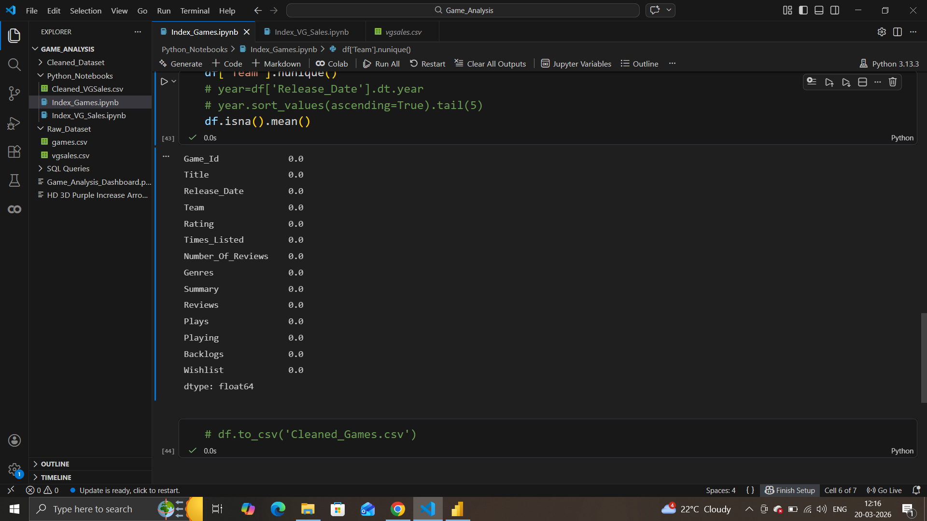
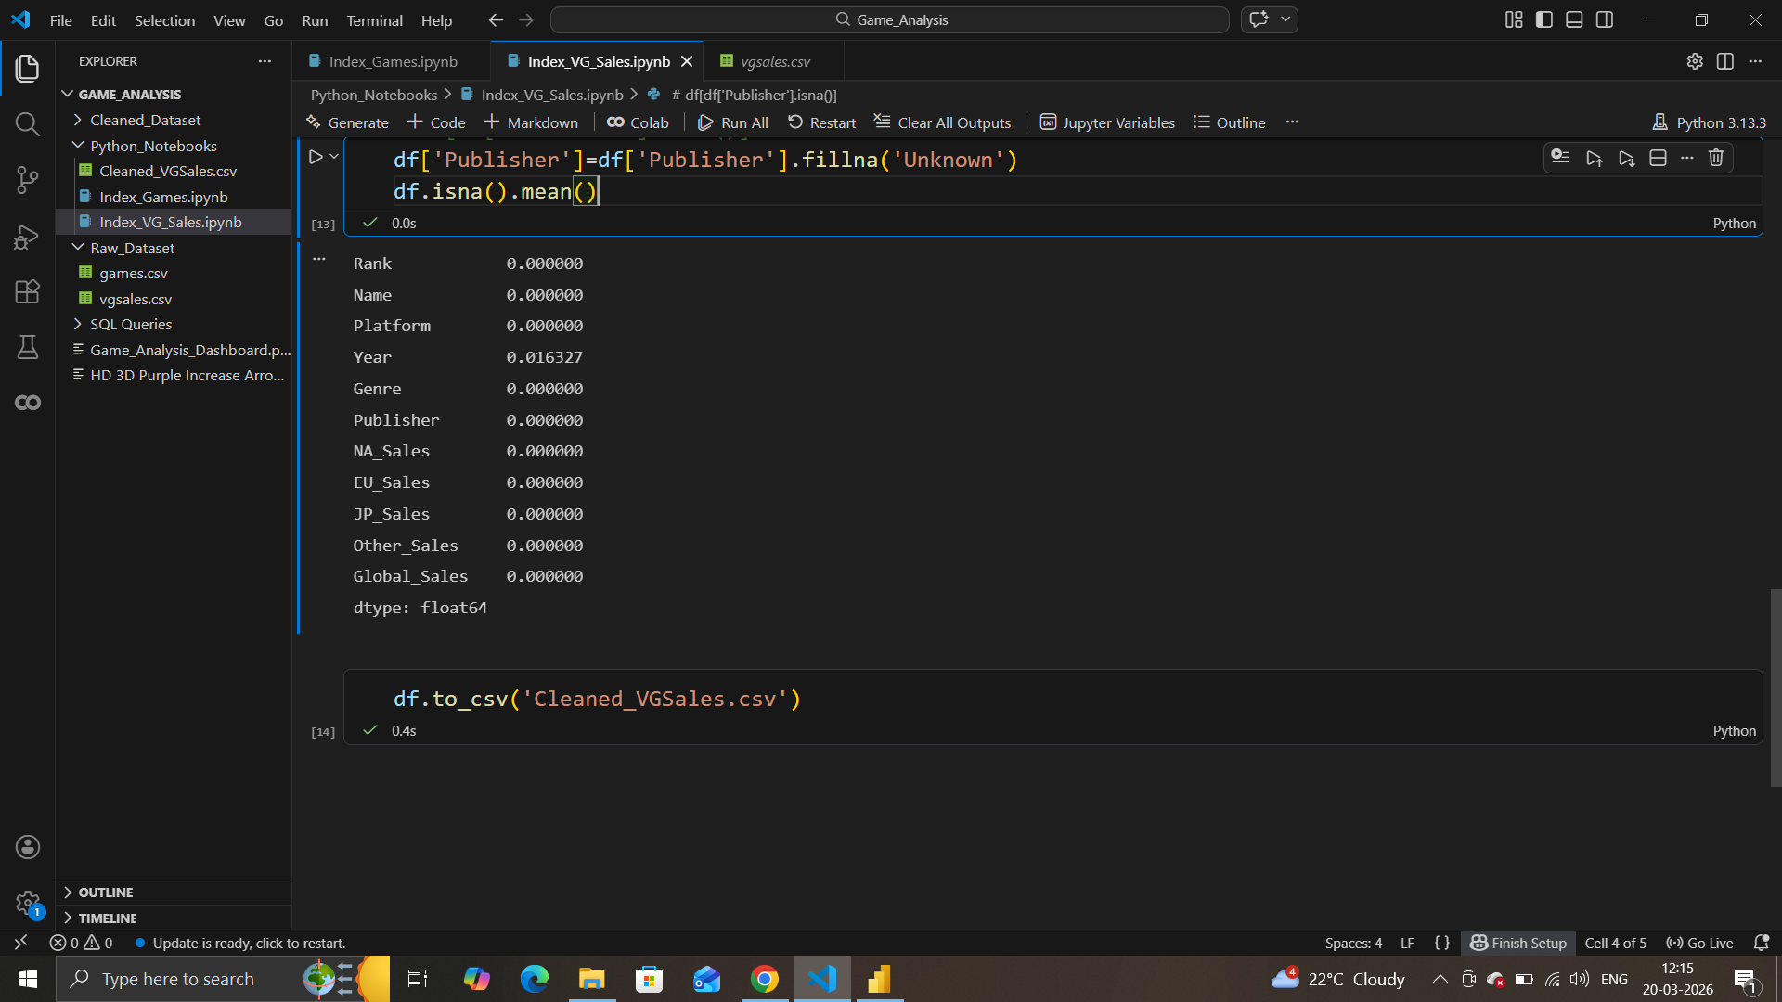
Data : Cleaning
Games Meta :-
Changed Data type of 7 fields (Release Date,Times Listed,Number of Reviews,Plays,Playing,Backlog,Wishlist) for accurate analysis.
Converted the Values of Number of Reviews,Plays,Playing,Backlog,Wishlist by replacing {K,M,comma}.
Exploded Team & Genre Fields by unpivoting them.
Standardized Column names & their records following by removing duplicates.
Replacing null values in Rating with their respective genres average rating.
Games Sales :-
Converted Data type of Year from float to int for better calculated analysis.
Replaced null values from Publisher to ‘Unknown’ .

Slide 7
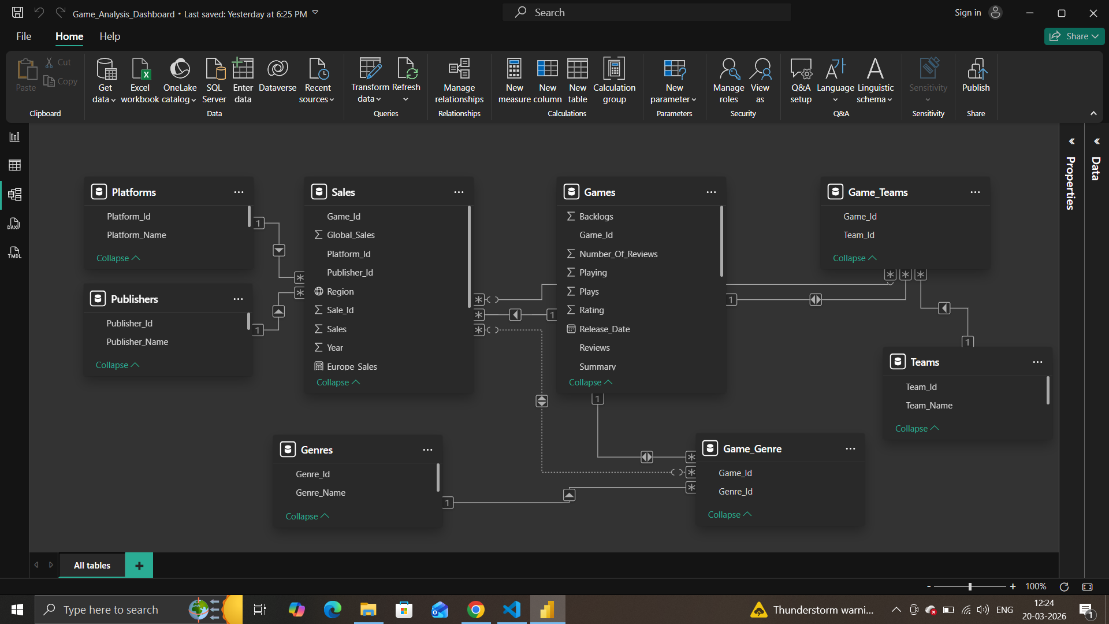
Data : Structuring & Modelling
Created 8 SQL Tables
Fact Tables : Sales,Games.
Dimension Tables : Platforms,Publishers,Genres,Teams,etc.
Inserted cleaned records from Games Meta & Sales Cleaned csvs.
Connected SQL Database to Power bi & made relations between them.

Slide 8
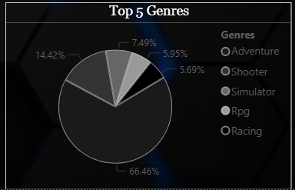
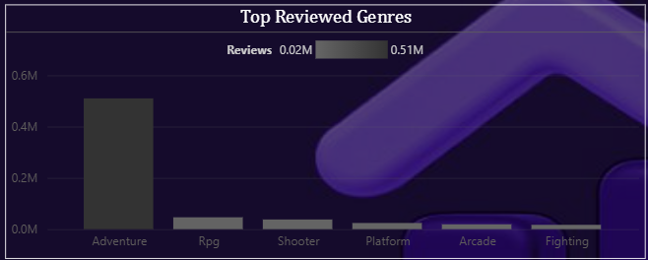
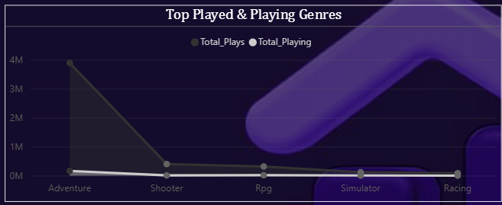
Insights : Genre Term
Adventure stands out as the most successful Genre based on Sales,Regions,feedbacks,active & inactive users.

Slide 9
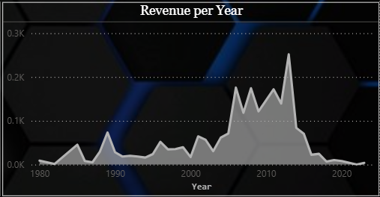
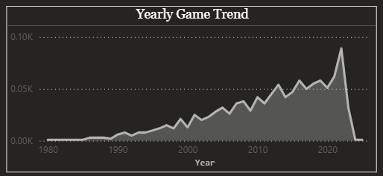
Insights : Yearly Trend
2006 -2013 was the peak time of Sales globally.
After year 2022 the production of games slowed down drastically.

Slide 10
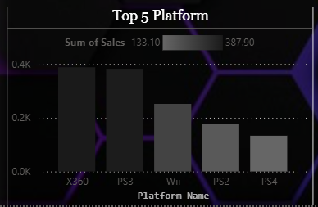
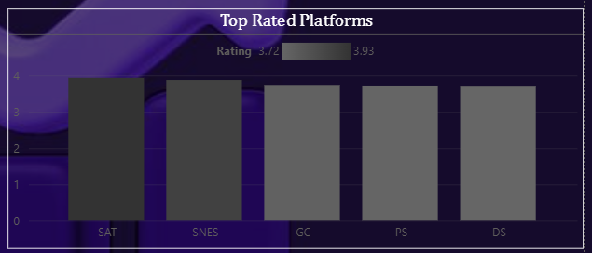
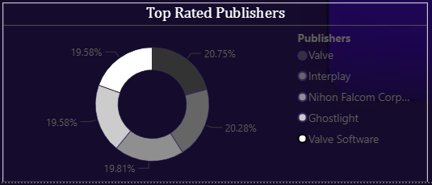
Insights : Publisher & Platform
Publisher :
Nintendo (Sales)
Valve (Rating)
Platform :
X360 & PS3 (Sales)
SAT (Rating)

Slide 11
Recommendation
Company must consider those Budget games which can be accessible on X360 or PS3 Platforms and focus more on Adventure Genre.
Adventure Genre games should make some updates by putting Strategies & Puzzles in their games with a storyline making them good in rating too.
Advertise more in Japan and Europe as they produce less sales.

Slide 12


