Slide 1
DYMUN '26
Wave background colour samples
Orange and gold kept; a third colour added to each

Slide 2
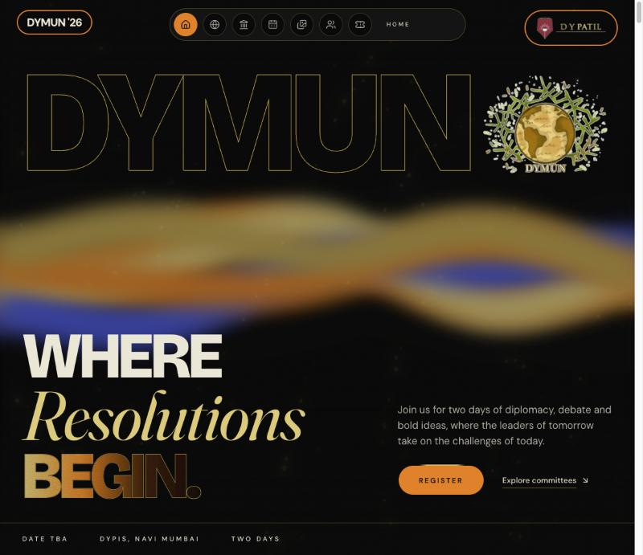
Royal blue

Slide 3
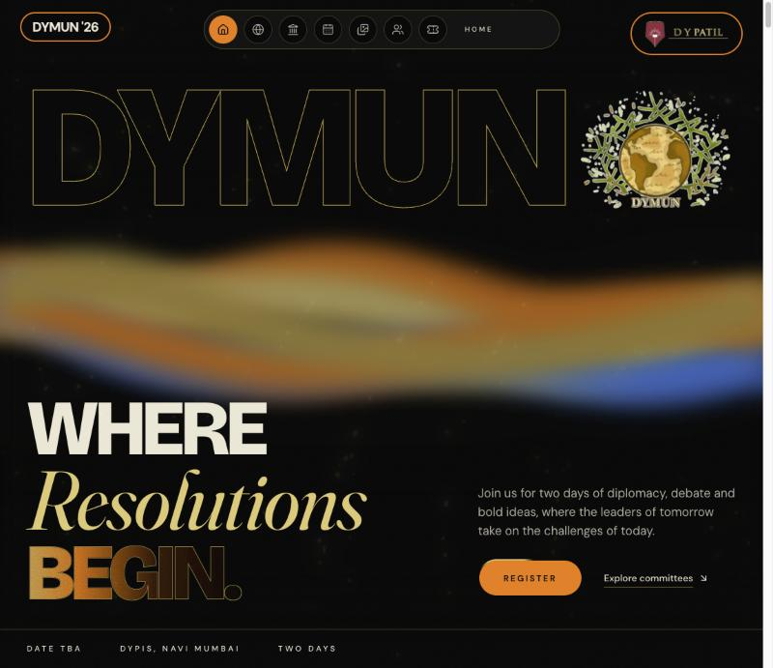
Blue

Slide 4
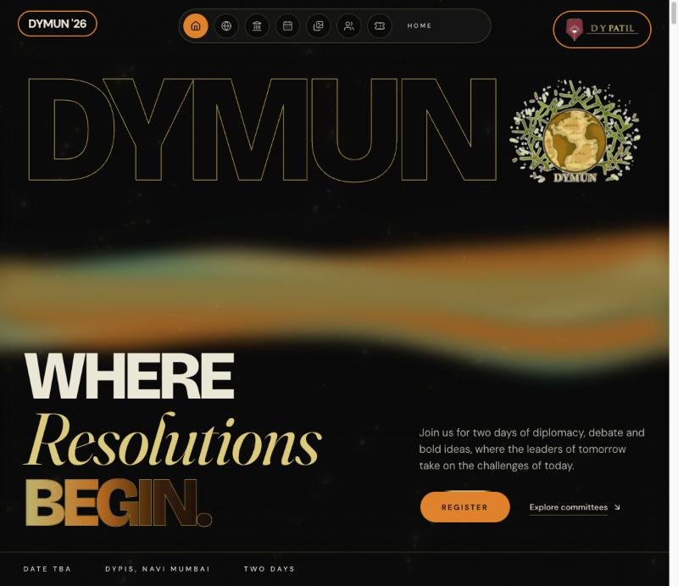
Teal (in the live site)

Slide 5
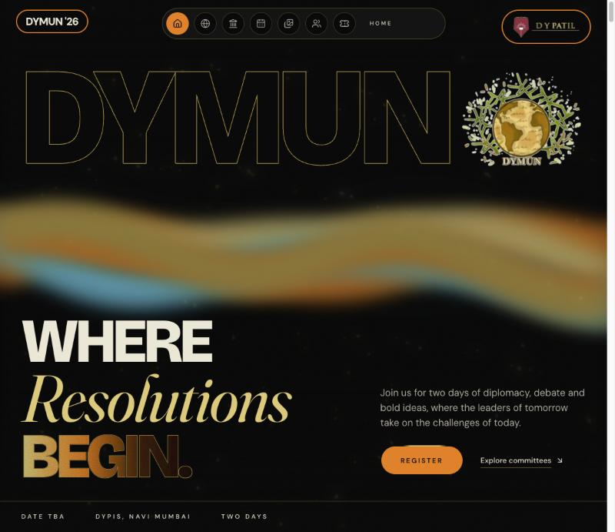
Cyan

Slide 6
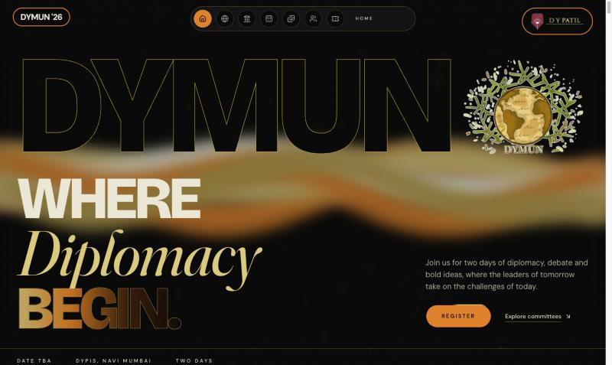
Ivory

Slide 7
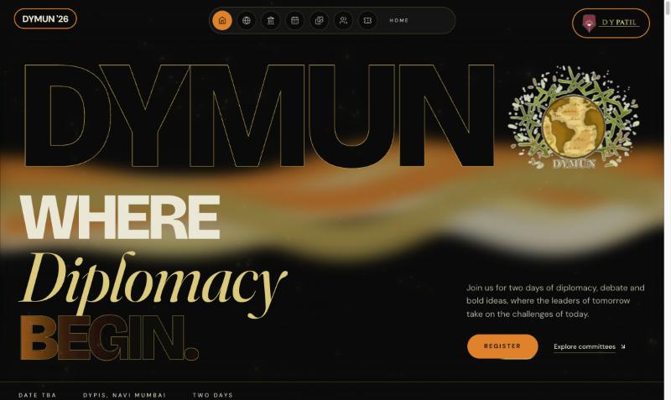
Beige

Slide 8
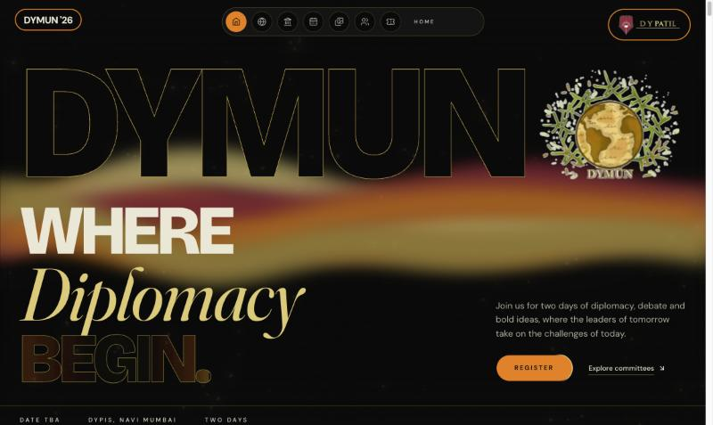
Burgundy

Slide 9
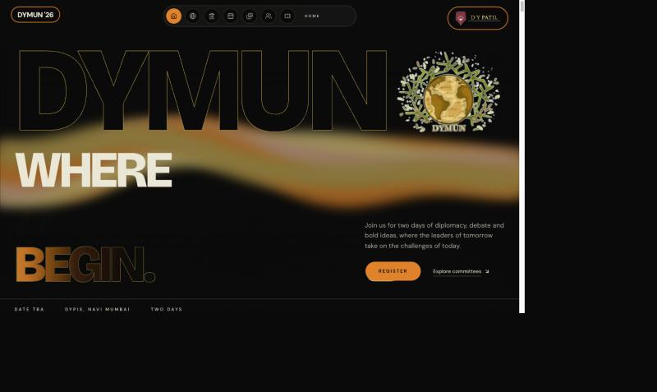
Blush rose

