Slide 1
23MCAC103- ADVANCED OPERATING SYSTEMS
by
Dr.Gobi Natesan

Slide 2
Course Outcome –Unit 2
Apply the Linux commands for manage the files to perform the basic operations of File Systems.

Slide 3
Syllabus- Unit 2
Open Source Operating System:
Linux System: GUIs-Command Line-Virtual Machines-Unix and Linux-Types of Users-Linux Commands- Man Pages-Bash Features- Interpreters- File Specifications File System Commands-File System Structure.

Slide 4
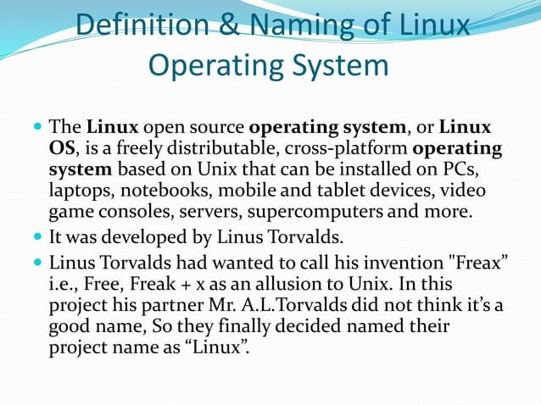

Slide 5
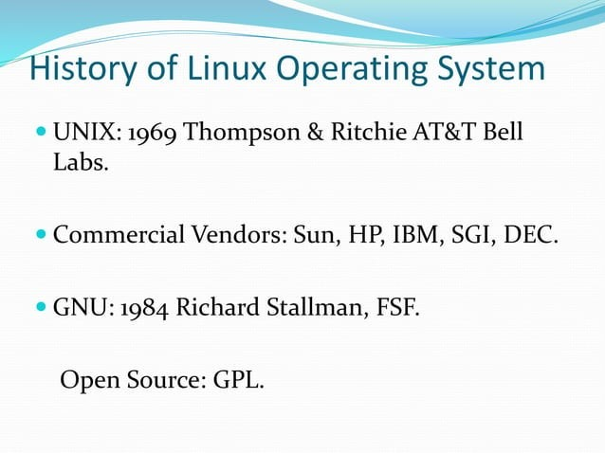

Slide 6
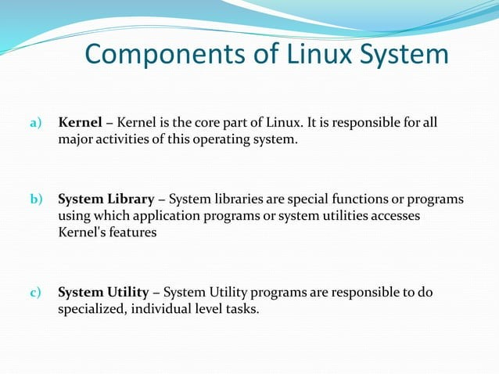

Slide 7
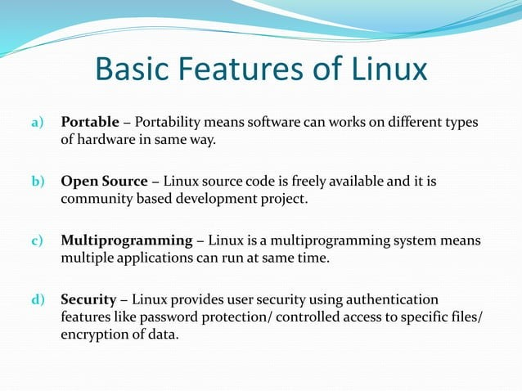

Slide 8
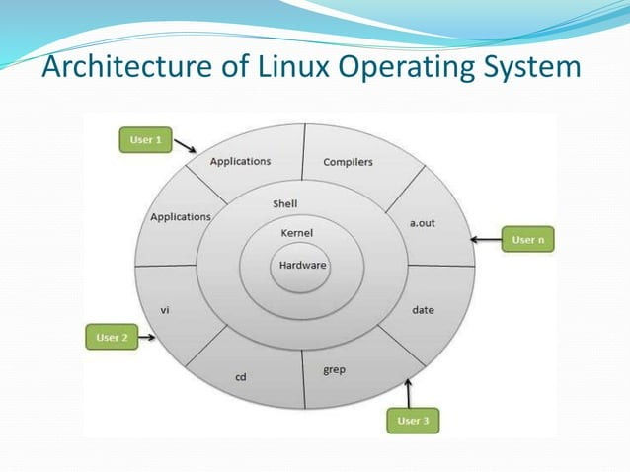

Slide 9
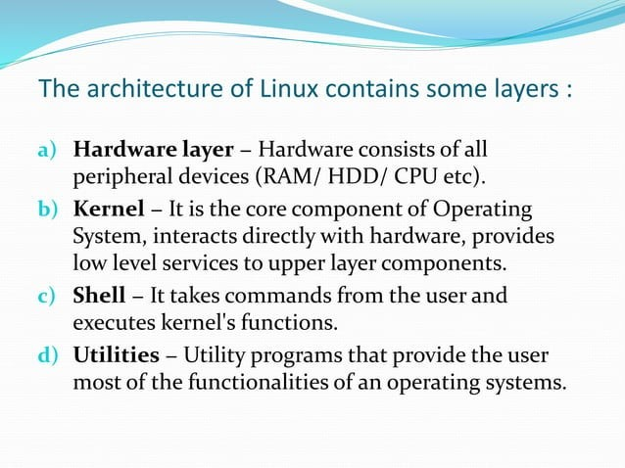

Slide 10
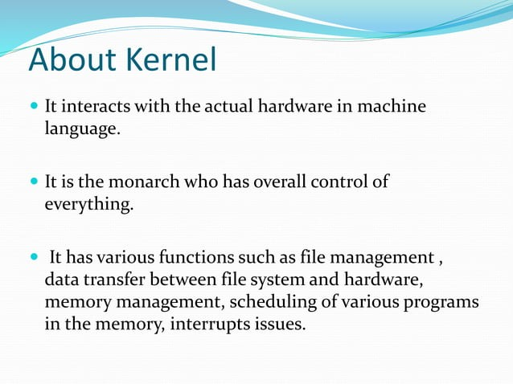

Slide 11
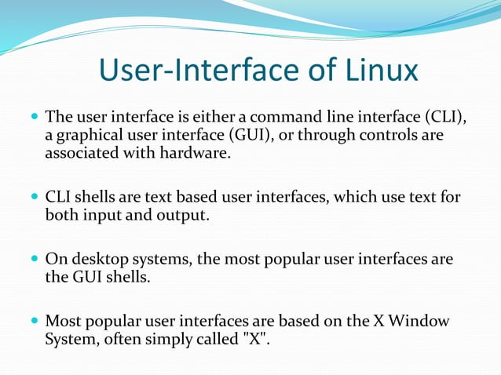

Slide 12
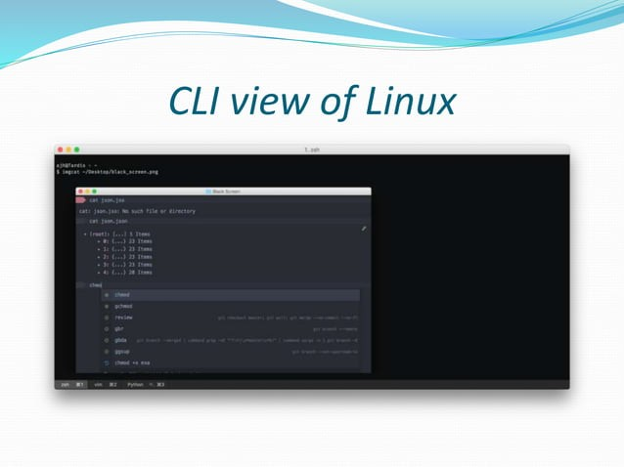

Slide 13
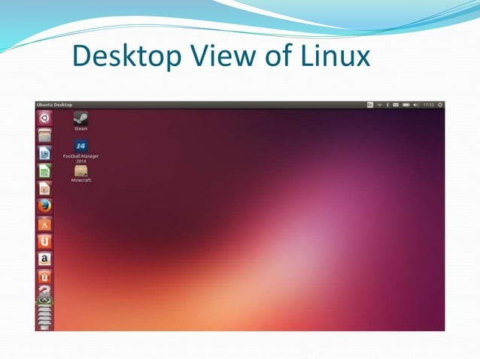

Slide 14
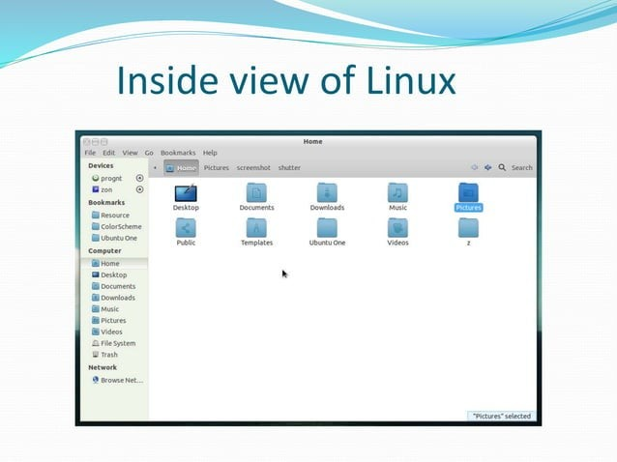

Slide 15
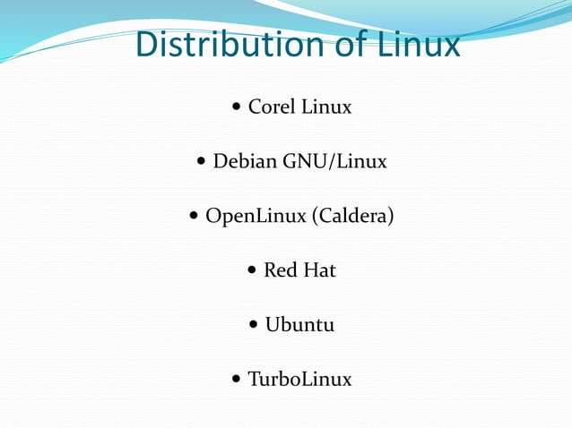

Slide 16
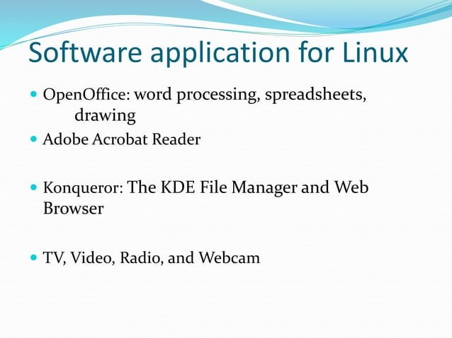

Slide 17
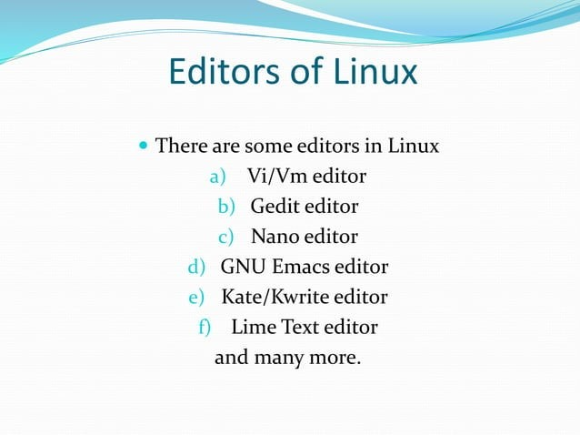

Slide 18
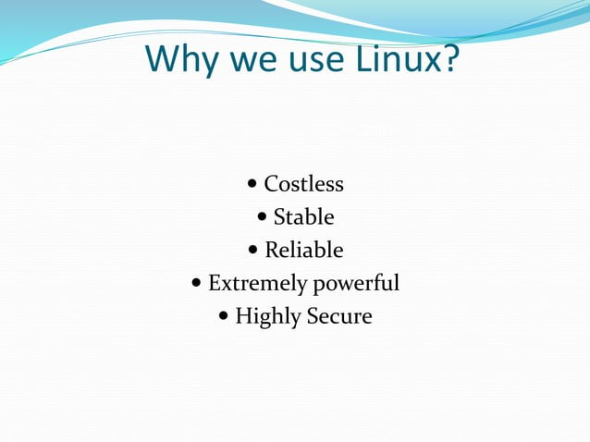

Slide 19
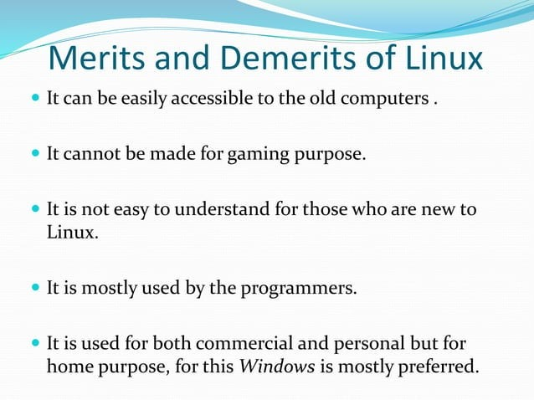

Slide 20
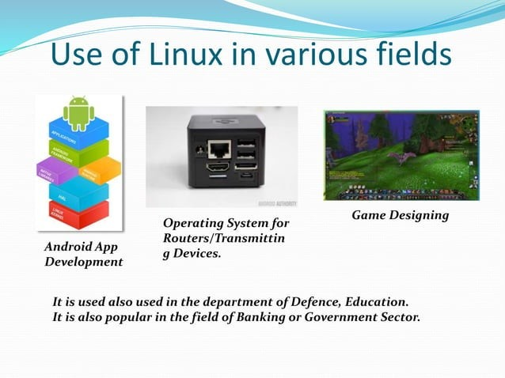

Slide 21
VIRTUAL MACHINES

Slide 22
Virtual Machine
A Virtual Machine is a software that creates a virtualized environment between the computer platform and the end user in which the end user can operate software.

Slide 23
Description
A virtual machine provides an interface identical to the underlying bare hardware.
The operating system creates the illusion of multiple processes, each executing on its own processor with its own (virtual) memory.

Slide 24
Virtualization
Virtualization is an abstraction layer that decouples the physical hardware from the operating system to deliver greater IT resource utilization and flexibility.
It allows multiple virtual machines, with heterogeneous operating systems to run in isolation, side-by-side on the same physical machine.

Slide 25
Virtualization contd..
Each virtual machine has its own set of virtual hardware (e.g., RAM, CPU, NIC, etc.) upon which an operating system and applications are loaded.
The operating system creates the illusion of multiple processes, each executing on its own processor with its own (virtual) memory.

Slide 26
History
Virtualization was first introduced in the 1960s to allow partitioning of large, mainframe hardware.
In the 1990s, researchers began to see how virtualization could solve some of the problems associated with the proliferation of less expensive hardware, including underutilization, escalating management costs and vulnerability.

Slide 27
Virtual Machine Monitor
The host software that provides virtualization is often referred to as a virtual machine monitor (VMM) or hypervisor.
The VMM gives each virtual machine an illusion of a complete computer to itself.

Slide 28
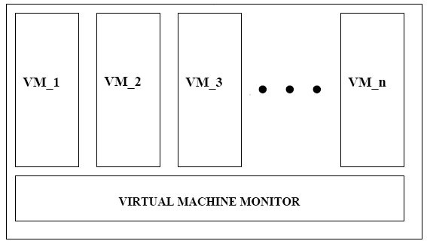

Slide 29
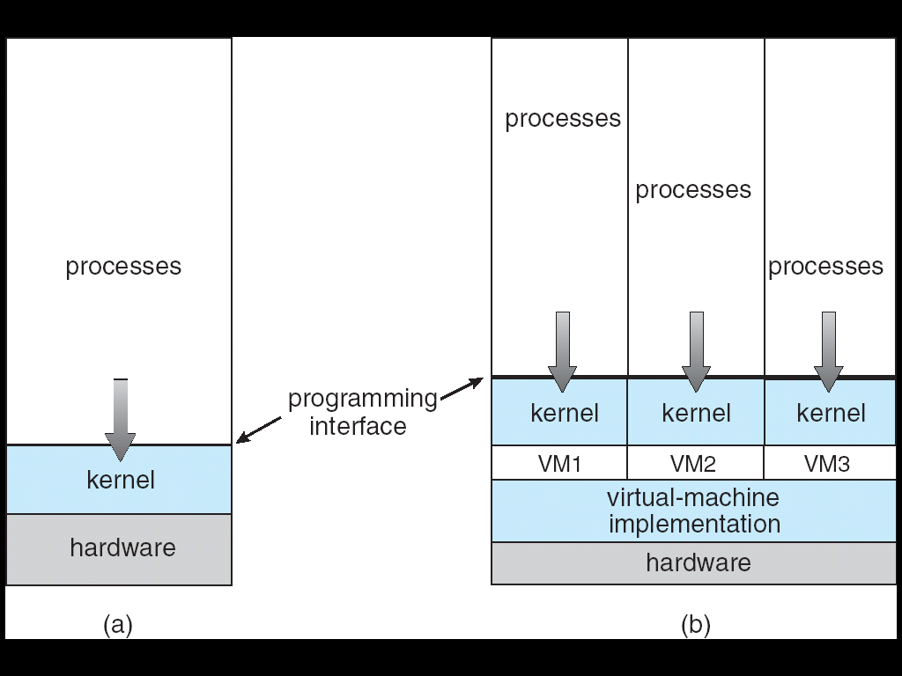
Architecture

Slide 30
Features
Each virtual machine has its own set of virtual hardware (e.g., RAM, CPU, NIC, etc.) upon which an operating system and applications are loaded.
The operating system sees a consistent, normalized set of hardware regardless of the actual physical hardware components.

Slide 31
Benefits
1. Partitioning
- Multiple applications and operating systems can be supported within a single physical system.
- There is no overlap amongst memory as each Virtual Memory has its own memory space.

Slide 32
Benefits
2.Isolation
-Virtual machines are completely isolated from the host machine and other virtual machines. If a virtual machine crashes, all others are unaffected.
-Data does not leak across virtual machines.

Slide 33
Summary
Virtual machines are a number of discrete identical execution environments on a single computer, each of which runs an operating system.
This can allow applications written for one OS to be executed on a machine which runs a different OS which provide a greater level of isolation between processes than is achieved when running multiple processes on the same instance of an OS.

Slide 34
Differences | Linux | Unix
Origins | Linux was developed in the 1990s by Linus Torvalds as a free and open-source alternative to Unix. | Unix was developed in the 1970s at Bell Labs
Introduction | Linux is Open Source, and a large number of programmers work together online and contribute to its development. | Unix was developed by AT&T Labs, different commercial vendors, and non-profit organizations.
Licensing | Linux, on the other hand, is open-source software and can be used freely without any licensing fees. | Unix is a proprietary ary operating system, meaning that it requires a license to use.
Kernels | both have a similar design but are less complex than the Unixhold-upthat kernel. | both have a similar design but larger and more complex than the Linux kernel.
Availability | On the other hand, Linux is widely used on both enterprise and personal computers. | Unix is typically found on enterprise-level servers and workstations and is less commonly used on personal computers.

Slide 35
Accessibility | It is an open-source operating system which is freely accessible to everyone. | It is an operating system which can only be utilized by its copywriters.
Source Code Availability | The source is accessible to the general public. | The source is not accessible to the general public.
Operating System Versions | Some Linux versions are Ubuntu, Debian GNU, Arch Linux, etc. | Some Unix versions are SunOS, Solaris, SCO UNIX, AIX, HP/UX, ULTRIX, etc.
Community Support: | Linux has a large and active community of developers and users who contribute to its development and provide support. | While Unix also has a community, it is generally smaller and more focused on enterprise-level users.

Slide 36
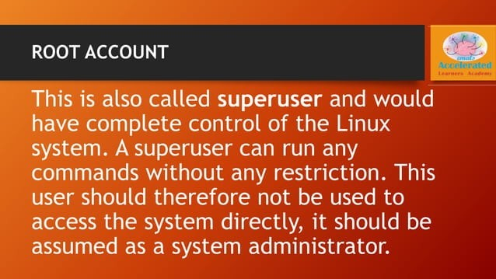

Slide 37
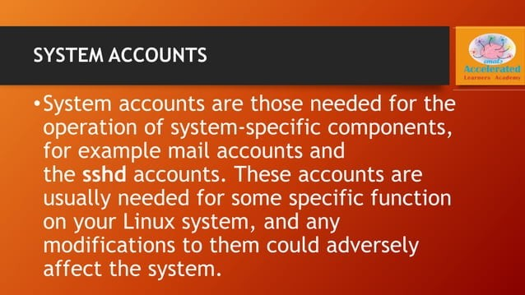

Slide 38
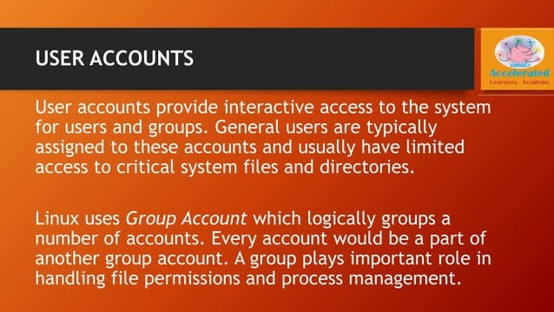

Slide 39
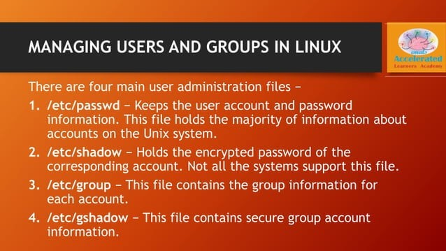

Slide 40
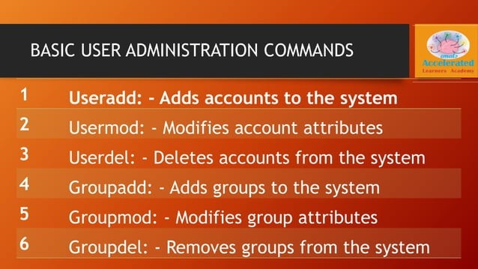

Slide 41
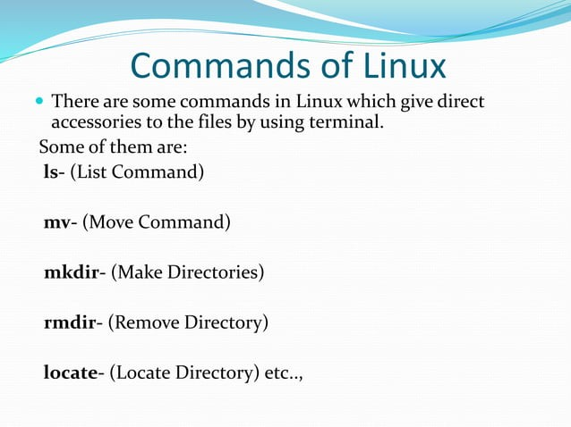

Slide 42
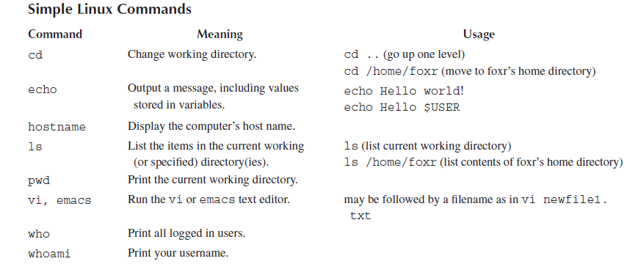
Linux Commands

Slide 43
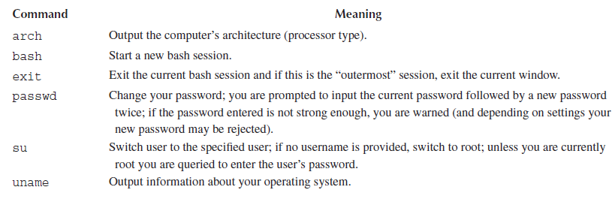
Linux Commands

Slide 44
More About Linux Commands
https://www.javatpoint.com/linux-ls

Slide 45
Man Pages in Linux
Man command expects the name of a Linux command as its argument.
Response of the man command is to display the manual page for that command, called a man page for short.
Man page is displayed within the vi text editor.
Movement and search commands available in vi can be used to move through the man page.
It provides a detailed view of the command which includes NAME, SYNOPSIS, DESCRIPTION, OPTIONS, EXIT STATUS, RETURN VALUES, ERRORS, FILES, VERSIONS, EXAMPLES, AUTHORS and SEE ALSO.

Slide 46
Man Commands Syntax
$man [OPTION]... [COMMAND NAME]...
$ man printf
$ man [SECTION-NUM] [COMMAND NAME]

Slide 47
BASH FEATURES
Linux Bash is also known as 'Bourne-again Shell.‘
It is a command language interpreter for the Linux based system.
It is a replacement of Bourne shell (sh).
Linux/Unix shell allows us to interact with the Linux system through the commands.
Bash is a command language interpreter as well as a programming language. It supports variables, functions, and flow control, like other programming languages. It can also read and execute the commands from a file, which is called a shell script.
To open the terminal, press CTRL+ALT+T keys. Perform some basic operations such as date, cal, ls, and pwd to take a tour with it.

Slide 48
BASH FEATURES
Shell Syntax: The shell syntax contains shell operations, quoting, and comments.
Shell commands: Shell commands are the types of commands that you can execute.
Shell Functions: Shell functions are used to group commands by name.
Redirections: It is a way to manage and control the input and output.
Command execution: It decides how the system will react when we execute a command.
Shell Scripts: It is a text file that has shell commands and executes them when it is used. Bash reads and executes the commands then exits.

Slide 49
INTERPRETERS
An interpreter is a program whose task is to execute instructions. To execute an instruction, the instruction must be converted into an executable form.
parsing the instruction entered on the command line into its component parts and then executing the program that the command is implemented by on the arguments of the rest of the instruction.

Slide 50
INTERPRETERS
Compiler is a program which performs this translation process, converting an entire program into an executable program.
Interpreted approach to programming utilizes an environment in which the programmer enters instructions one at a time.
Each instruction, upon being entered, is parsed, converted into executable code and executed.
Parsing, converting and executing steps are all handled by the interpreter
ls – listing files
ls – l display a detailed list

Slide 51
FILENAME SPECIFICATION
Focus on specifying paths and files as parameters in Linux instructions.
Path is a description of how to reach a particular location in the file space.
Path is required if the specified item is not in the current working directory.
For executable programs, we can omit the path if the directory containing the program is stored in our PATH variable.
Paths can be expressed as absolute and relative.

Slide 52
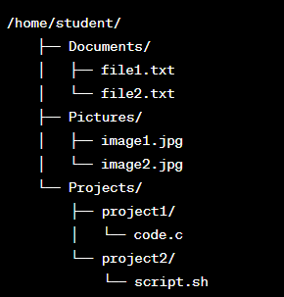

Slide 53
Absolute Path:
An absolute path specifies the exact location of a file or directory from the root directory. It always starts with a forward slash (/).
For example:
Absolute path to file1.txt: /home/student/Documents/file1.txt
Absolute path to script.sh: /home/student/Projects/project2/script.sh
An absolute path always begins at the root level of the file space (/) and specifies each directory from the root level down to the location of interest, separating each directory in the path by a forward slash (/).
Length of an absolute path is determined by the number of directories/ subdirectories that exist between the root level and the target file or directory.

Slide 54
Relative path
A relative path specifies the location of a file or directory relative to the current working directory.
Here are some examples based on different scenarios:
If the current working directory is /home/student/Documents/, the relative path to file2.txt is: file2.txt
If the current working directory is /home/student/Projects/project1/, the relative path to code.c is: code.c
If the current working directory is /home/student/, the relative path to image1.jpg is: Pictures/image1.jpg

Slide 55
INTERPRETERS
my_documents/
|-- documents/
| |-- file1.txt
| |-- file2.txt
| |-- file3.txt
|-- pictures/
| |-- pic1.jpg
| |-- pic2.jpg
|-- notes.txt

Slide 56
INTERPRETERS
ls command is used to list files and directories in a directory.
$ ls my_documents
documents pictures notes.txt
https://bellard.org/jslinux/vm.html?url=alpine-x86.cfg&mem=192

Slide 57
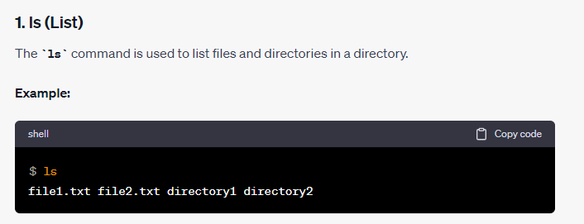
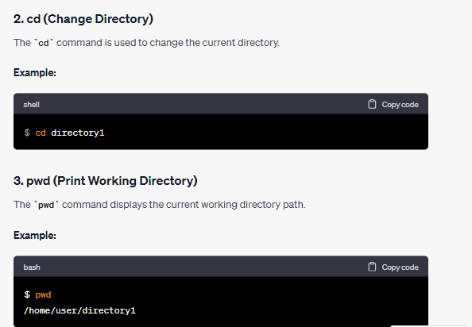

Slide 58
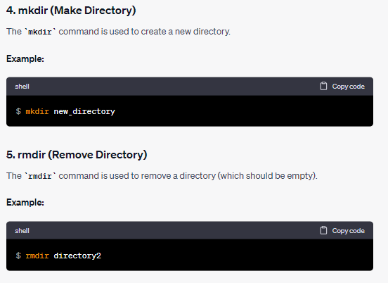

Slide 59
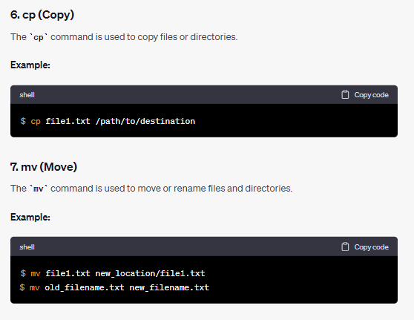

Slide 60
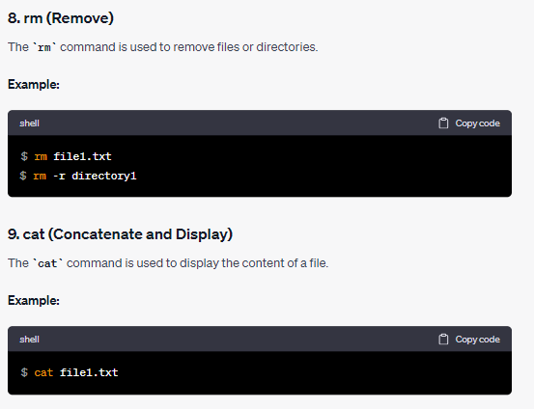

Slide 61
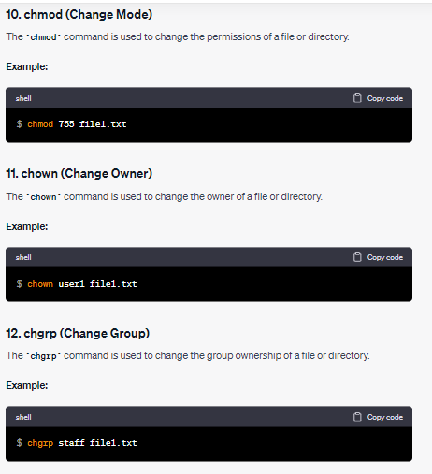

Slide 62
INTERPRETERS
ls command is used to list files and directories in a directory.
$ ls my_documents
documents pictures notes.txt

Slide 63
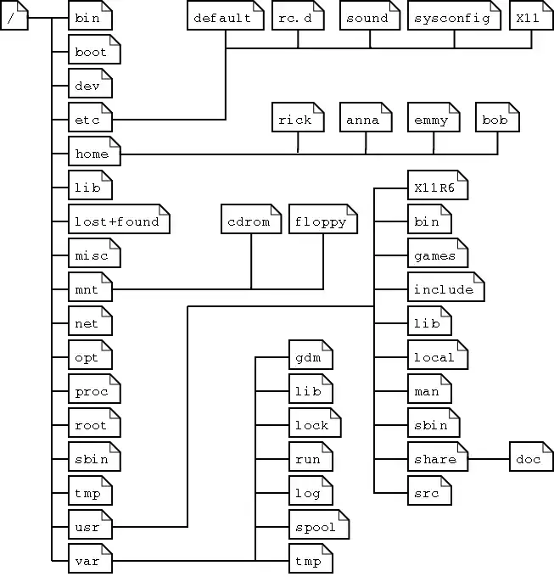
Linux System Structure

Slide 64
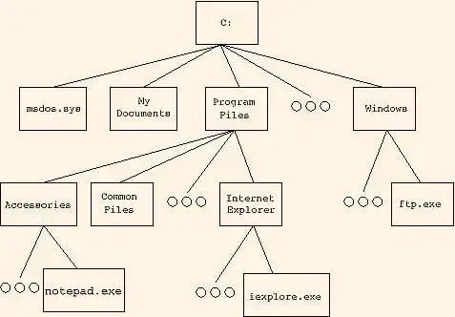
Windows System Structure

Slide 65
Linux System Structure
/ – this is known as “root”, the logical beginning of the Linux file system structure.
/bin –most of your binary files are stored, typically for the Linux terminal commands and core utilities, such as cd (change directory), pwd (print working directory), mv (move), and so on.
/boot – This is where all the needed files for Linux to boot are kept.
/dev – This is where your physical devices are mounted, such as your hard drives, USB drives, optical drives, and so on.
/etc –configuration files are stored.

Slide 66
Linux System Structure
/home – This is where you’ll spend the vast majority of your time because it has all of your personal data.
/lib – This is the location of libraries.
/media – Another place where external devices such as optical drives and USB drives can be mounted.
/mnt – This is basically a placeholder folder used for mounting other folders or drives. Typically this is used for Network locations.
/proc – The “processes” folder where a lot of system information is represented as files.
/root – This is the equivalent to the /home folder specifically for the root user, also called the superuser.

Slide 67
/sbin – Similar to /bin, except that it’s dedicated to certain commands that can only be run by the root user, or the superuser.
/tmp – This is where temporary files are stored, and they are usually deleted upon shutdown, which saves you from having to manually delete them like is required in Windows.
/usr – Contains files and utilities that are shared between users.
/var – This is where variable data is kept, usually system logs but can also include other types of data as well.

Slide 68
Thank You

