Slide 1

1

Slide 2


Slide 3
Programming or Scripting
Linux command line is provided by a program called the shell.
Shell scripting is an important part of process automation in Linux.
Scripting helps you write a sequence of commands in a file and then execute them.
bash is not only an excellent command line shell, but a scripting language in itself.
Shell scripting allows us to use the shell's abilities and to automate a lot of tasks that would otherwise require a lot of commands.
3

Slide 4
Programming or Scripting
(Contd…)
■
Difference between programming and scripting languages:
Programming languages are generally a lot more powerful and a lot faster than scripting languages. Programming languages generally start from source code and are compiled into an executable. This executable is not easily ported into different operating systems.
A scripting language also starts from source code, but is not compiled into an executable. Rather, an interpreter reads the instructions in the source file and executes each instruction. Interpreted programs are generally slower than compiled programs. The main advantage is that you can easily port the source file to any operating system. bash is a scripting language. Other examples of scripting languages are perl, lisp, and tcl.
●
4

Slide 5
Example of a bash program
■
We must know how to use a text editor. There are two major text editors in Linux:
vi, emacs (or xemacs)
So fire up a text editor; for example:
■
●
bash$ vi
and type the following inside it:
#!/bin/bash
echo “Hello World”
The first line tells Linux to use the bash interpreter to run this script. We call it hello.sh. Then, make the script executable:
●
■
bash$ bash$
chmod +x hello.sh
./hello.sh
●
Hello World
The source command
■
5

Slide 6
Variables
■
We can use variables as in any programming languages. Their values are always stored as strings, but there are mathematical operators in the shell language that will convert variables to numbers for calculations.
We have no need to declare a variable, just assigning a value to its reference will create it.
Example:
■
■
#!/bin/bash STR=“Hello World!” echo $STR
Line 2 creates a variable called STR and assigns the string "Hello World!" to it. Then the value of this variable is retrieved by putting the '$' in at the beginning.
●
■
6

Slide 7
Warnings!!!
■
The shell programming language does not type-cast its variables. This means that a variable can hold number data or character data.
count=0 count=Sunday
●
■
Switching the TYPE of a variable can lead to confusion for the writer of the script or someone trying to modify it, so it is recommended to use a variable for only a single TYPE of data in a script.
\ is the bash escape character and it preserves the literal value of the next character that follows.
bash$: ls \*
ls: *: No such file or directory
■
7

Slide 8
The read command
■
The read command allows you to prompt for input and store it in a variable
■

Slide 9
Arithmetic Evaluation
■
The let statement can be used to do mathematical functions:
bash$: bash$: 24 bash$: bash$: 32
let X=10+2*7 echo $X
let Y=X+2*4 echo $Y
■
An arithmetic expression can be evaluated by $[expression] or $ ((expression))
bash$: 143 bash$: bash$: 17589
echo “$((123+20))”
●
VALORE=$[123+20]
echo “$[123*$VALORE]”
●

Slide 10
Arithmetic Evaluation
(Contd…)
■
Available operators: Example:
+, -, /, *, %
■
●
#! /bin/bash
echo -n “Enter the first number: ” ; read x
echo -n “Enter the second number: ”; read y add=$(($x + $y))
sub=$(($x - $y)) mul=$(($x * $y)) div=$(($x / $y))
mod=$(($x % $y))
# print out the answers: echo “Sum: $add”
echo “Difference: $sub” echo “Product: $mul”
echo “Quotient: $div” echo “Remainder: $mod”

Slide 11
Conditional Statements
■
Conditionals let us decide whether to perform an action or not. This decision is taken by evaluating an expression. The most basic form is:
if [expression]; then statements
elif [expression]; then
statements
else
statements
fi
the elif (else if) and else sections are optional
●

Slide 12
Simple IF
if [ expression ]
then
statement
fi

Slide 13
Simple IF-ELSE
if [ expression ]
then
statement1
else
statement2
fi

Slide 14
Else If ladder
if [ expression1 ]
then
statement1
statement2
.
.
elif [ expression2 ]
then
statement3
statement4
.
.
else
statement5
fi

Slide 15
Nested if
if [ expression1 ]
then
statement1
statement2
.
else
if [ expression2 ]
then
statement3
.
fi
fi

Slide 16
case in
Pattern 1) Statement 1;;
Pattern n) Statement n;;
esac

Slide 17
#Initializing two variables
a=10
b=20
#Check whether they are equal
if [ $a == $b ]
then
echo "a is equal to b"
fi
#Check whether they are not equal
if [ $a != $b ]
then
echo "a is not equal to b"
fi

Slide 18
#!/bin/bash
echo -n "Enter a number: "
read number
if [ $number -eq 0 ]
then
echo "You entered zero. Zero is an even number."
elif [ $(($number % 2)) -eq 0 ]
then
echo "You entered $number. It is an even number."
else
echo "You entered $number. It is an odd number."
fi

Slide 19
#Initializing two variables
a=20
b=20
if [ $a == $b ]
then
#If they are equal then print this
echo "a is equal to b"
else
#else print this
echo "a is not equal to b"
fi

Slide 20
CARS="bmw"
#Pass the variable in string
case "$CARS" in
#case 1
"mercedes") echo "Headquarters - Affalterbach, Germany" ;;
#case 2
"audi") echo "Headquarters - Ingolstadt, Germany" ;;
#case 3
"bmw") echo "Headquarters - Chennai, Tamil Nadu, India" ;;
esac

Slide 21
Looping Statements
while statement
for statement
until statement
To alter the flow of loop statements, two commands are used they are,
break
continue

Slide 22
while <condition> do <command 1> <command 2> <etc> done

Slide 23
for <var> in <value1 value2 ... valuen> do <command 1> <command 2> <etc> done

Slide 24
until <condition> do <command 1> <command 2> <etc> done

Slide 25
a=0
# -lt is less than operator
#Iterate the loop until a less than 10
while [ $a -lt 10 ]
do
# Print the values
echo $a
# increment the value
a=`expr $a + 1`
done

Slide 26
#Start of for loop
for a in 1 2 3 4 5 6 7 8 9 10
do
# if a is equal to 5 break the loop
if [ $a == 5 ]
then
break
fi
# Print the value
echo "Iteration no $a"
done

Slide 27
for a in 1 2 3 4 5 6 7 8 9 10
do
# if a = 5 then continue the loop and
# don't move to line 8
if [ $a == 5 ]
then
continue
fi
echo "Iteration no $a"
done

Slide 28
a=0
# -gt is greater than operator
#Iterate the loop until a is greater than 10
until [ $a -gt 10 ]
do
# Print the values
echo $a
# increment the value
a=`expr $a + 1`
done

Slide 29
COLORS="red green blue"
# the for loop continues until it reads all the values from the COLORS
for COLOR in $COLORS
do
echo "COLOR: $COLOR"
done

Slide 30
The test command
■
This command is provided to specify the control statement or condition
■
It can perform several types of tests like numeric test, string test and file test

Slide 31
Expressions
■
An expression can be: String comparison, Numeric comparison, File operators and Logical operators
String Comparisons:
■
●
=
!=
-n
-z
compare if two strings are equal compare if two strings are not equal
evaluate if string length is greater than zero evaluate if string length is equal to zero
●
●
●
■
Examples:
●
[ s1 = s2 ] [ s1 != s2 ] [ s1 ]
[ -n s1 ]
[ -z s2 ]
(true if s1 same as s2, else false) (true if s1 not same as s2, else false) (true if s1 is not empty, else false)
(true if s1 has a length greater then 0, else false) (true if s2 has a length of 0, otherwise false)
●
●
●
●

Slide 32
Expressions
(Contd…)
■
Number Comparisons:
●
-eq
-ge
-le
-ne
-gt
-lt
compare if two numbers are equal
compare if one number is greater than or equal to a number compare if one number is less than or equal to a number compare if two numbers are not equal
compare if one number is greater than another number compare if one number is less than another number
●
●
●
●
●
■
Examples:
●
[ n1 -eq n2 ]
[ n1 -ge n2 ]
[ n1 -le n2 ]
[ n1 -ne n2 ]
[ n1 -gt n2 ]
(true if n1 same as n2, else false)
(true if n1greater then or equal to n2, else false) (true if n1 less then or equal to n2, else false) (true if n1 is not same as n2, else false)
(true if n1 greater then n2, else false)
●
●
●
●
●
[ n1 -lt n2 ] (true if n1 less then n2, else false)

Slide 33
Example of test command
clear echo
echo –n “Enter a number: “ read num
if test $num -eq 0 then
echo “The number entered by you is zero”
elif test $num -lt 0 then
echo “The number entered by you is negative”
else
echo “The number entered by you is positive”
fi

Slide 34
Without the test command
■
Instead of specifying test command explicitly whenever we want to check for condition, the condition can be enclosed in square brackets
Example is given on the next slide ➔ ➔
■

Slide 35
Example (without using test)
clear echo
echo -n "Enter a number: " read num
if [ num -eq 0 ] then
echo "The number entered [ num -lt 0 ]
echo "The number entered echo "The number entered
by you is zero"
elif then
by you is negative"
else
by you is positive"
fi

Slide 36
Some more examples
#!/bin/bash
clear echo
echo -n "Enter two names: " read name1
read name2
if [ $name1 = $name2 ] then
echo "The names entered by you are the same"
else
echo "The names are different"
fi

Slide 37
Expressions
(Contd…)
■
Files operators:
-d
-f
-e
-r
check if path given is a directory check if path given is a file check if file name exists
check if read permission is set for file or directory
check if a file has a length greater than 0
check if write permission is set for a file or directory
check if execute permission is set for a file or directory
●
●
●
-s
-w
●
●
●
-x

Slide 38
Expressions
(Contd…)
■
Examples:
●
[ -d fname ]
[ -f fname ]
[ -e fname ]
[ -s fname ]
(true if fname is a directory, otherwise false) (true if fname is a file, otherwise false)
(true if fname exists, otherwise false)
(true if fname length is greater then 0, else false)
(true if fname has the read permission, else false)
(true if fname has the write permission, else false)
(true if fname has the execute permission, else false)
●
●
●
●
[ -r fname ]
●
[ -w fname ]
●
[ -x fname ]

Slide 39
read -p 'Enter a : ' a
read -p 'Enter b : ' b
if(($a == "true" && $b == "true" ))
then
echo Both are true.
else
echo Both are not true.
fi
if(($a == "true" || $b == "true" ))
then
echo Atleast one of them is true.
else
echo None of them is true.
fi
if(( ! $a == "true" ))
then
echo "a" was initially false.
else
echo "a" was initially true.
fi

Slide 40
#!/bin/bash
#reading data from the user
read -p 'Enter a : ' a
read -p 'Enter b : ' b
bitwiseAND=$(( a&b ))
echo Bitwise AND of a and b is $bitwiseAND
bitwiseOR=$(( a|b ))
echo Bitwise OR of a and b is $bitwiseOR
bitwiseXOR=$(( a^b ))
echo Bitwise XOR of a and b is $bitwiseXOR
bitiwiseComplement=$(( ~a ))
echo Bitwise Compliment of a is $bitiwiseComplement
leftshift=$(( a<<1 ))
echo Left Shift of a is $leftshift
rightshift=$(( b>>1 ))
echo Right Shift of b is $rightshift

Slide 41
Expressions
(Contd…)
Logical operators:
! negate (NOT) a logical expression
-a logically AND two logical expressions
-o logically OR two logical expressions
●
●

Slide 42
Example
#!/bin/bash
echo -n “Enter a number 1 < x < 10:” read num
if [ “$num” -gt 1 –a “$num” -lt 10 ]; then
echo “$num*$num=$(($num*$num))” else
echo “Wrong insertion !”
fi

Slide 43
Expressions
(Contd…)
Logical operators:
&& logically AND two logical expressions
|| logically OR two logical expressions
●
●

Slide 44
Expressions
(Contd…)
#!/bin/bash
echo -n "Enter a number 1 < x < 10: " read num
if [ “$num” -gt 1 ] && [ “$num” -lt 10 ]; then
echo “$num*$num=$(($num*$num))” else
echo “Wrong insertion !”
fi

Slide 45
Iteration Statements
■
The for structure is used when you are looping through a range of variables.
for var in list do
statements done
■

Slide 46
while <condition> do <command 1> <command 2> <etc> done

Slide 47
for <var> in <value1 value2 ... valuen> do <command 1> <command 2> <etc> done

Slide 48
until <condition> do <command 1> <command 2> <etc> done

Slide 49
#Start of for loop
for a in 1 2 3 4 5 6 7 8 9 10
do
# if a is equal to 5 break the loop
if [ $a == 5 ]
then
break
fi
# Print the value
echo "Iteration no $a"
done

Slide 50
for a in 1 2 3 4 5 6 7 8 9 10
do
# if a = 5 then continue the loop and
# don't move to line 8
if [ $a == 5 ]
then
continue
fi
echo "Iteration no $a"
done

Slide 51
a=0
# -lt is less than operator
#Iterate the loop until a less than 10
while [ $a -lt 10 ]
do
# Print the values
echo $a
# increment the value
a=`expr $a + 1`
done

Slide 52
a=0
# -gt is greater than operator
#Iterate the loop until a is greater than 10
until [ $a -gt 10 ]
do
# Print the values
echo $a
# increment the value
a=`expr $a + 1`
done

Slide 53
COLORS="red green blue"
# the for loop continues until it reads all the values from the COLORS
for COLOR in $COLORS
do
echo "COLOR: $COLOR"
done

Slide 54
Examples
■
statements are executed with var set to each value in the
list
#!/bin/bash let sum=0
for num in 1 2 3 4 5 do
let “sum = $sum + $num” done
echo $sum

Slide 55
Some more examples
#!/bin/bash
for x in paper pencil pen; do
echo “The value of variable x is: $x” sleep 1
done

Slide 56
Some more examples
(Contd…)
If the list part is left off, var is set to each parameter passed to the script ($1, $2, $3,…)
#!/bin/bash for x
do
echo “The value of variable x is: $x” sleep 1
done
OUTPUT:
./file.sh alpha beta
The value of variable x is: alpha The value of variable x is: beta

Slide 57
Functions
■
Functions make scripts easier to maintain. Basically it breaks up the program into smaller pieces. A function performs an action defined by you, and it can return a value if you wish.
#!/bin/bash hello()
{
echo “You are in function hello()”
}
echo “Calling function hello()…” hello
echo “You are now out of function hello()”

Slide 58
What does this script do?
#!/bin/bash function check() { if [ -e “$PWD/$1" ] then
return 0 else
return 1
fi
}
(Contd…)
echo “Enter the name of the file: ” ; read x if check $x
then
echo “$x exists!” else
echo “$x does not exists!”
fi

Slide 59
Reading from a file
clear echo
echo -n "Enter the name of a file: " read file_name
exec < $file_name while read line
do
echo $line done
echo

Slide 60
Shell Keywords
echo | read | set | unset
readonly | shift | export | if
else | fi | while | do
done | for | until | case
esac | break | continue | exit
return | tap | wait | eval
exec | ulimit | umask

Slide 61
Arrays- Declaration
ARRAY=(apple banana cherry date fig)
------------------------------------------------
ARRAY=()
------------------------------------------------
ARRAY=([0]=apple [2]=cherry [4]=fig)
------------------------------------------------
ARRAY[0]=apple
ARRAY[1]=banana
ARRAY[2]=cherry
ARRAY[3]=date
ARRAY[4]=fig
------------------------------------------------
----------------------------------------------
declare –a ARRAY=(apple banana cherry date fig)

Slide 62
ARRAYS IN SHELL PROGRAMMING

Slide 63
Declaring and initializing arrays
# Declare an array
declare -a fruits
# Initialize an array
fruits=("apple" "banana" "orange")
# Alternative initialization
fruits=(
"apple"
"banana"
"orange"
)

Slide 64
Accessing array elements
echo ${fruits[0]} # Output: apple
echo ${fruits[1]} # Output: banana
echo ${fruits[@]} # Output: apple banana orange
echo ${#fruits[@]} # Output: 3 (number of elements)

Slide 65
Adding elements to an array
fruits+=("grape")
fruits[4]="mango"

Slide 66
Iterating over array elements
for fruit in "${fruits[@]}"; do
echo "I like $fruit"
done

Slide 67
Slicing arrays
echo ${fruits[@]:1:2} # Output: banana orange

Slide 68
Associative arrays
declare -A capital_cities
capital_cities[France]="Paris"
capital_cities[Germany]="Berlin"
capital_cities[Italy]="Rome"
echo ${capital_cities[France]} # Output: Paris

Slide 69
Array operations
# Copy an array
new_fruits=("${fruits[@]}")
# Remove an element (3rd element)
unset fruits[2]
# Clear the entire array
unset fruits

Slide 70
Using arrays with command substitution
files=($(ls *.txt))
for file in "${files[@]}"; do
echo "Processing $file"
done

Slide 71
Array of numbers and basic arithmetic
numbers=(1 2 3 4 5)
sum=0
for num in "${numbers[@]}"; do
sum=$((sum + num))
done
echo "Sum: $sum" # Output: Sum: 15

Slide 73
STRING MANIPULATIONS IN SHELL

Slide 74
String Length
To get the length of a string, you can use the ${#variable} syntax.
string="Hello, World!"
echo ${#string} # Output: 13

Slide 75
String Concatenation
concatenate strings by simply placing them next to each other or using the += operator.
str1="Hello"
str2="World"
result="$str1 $str2"
echo $result # Output: Hello World
str1+=" there"
echo $str1 # Output: Hello there

Slide 76
Substring Extraction
To extract a portion of a string, use ${string:start_position:length}.
string="Hello, World!"
echo ${string:7:5} # Output: World
echo ${string:7} # Output: World! (omitting length extracts to the end)

Slide 77
String Replacement
To replace parts of a string, use ${string/pattern/replacement}.
string="The quick brown fox"
echo ${string/quick/slow} # Output: The slow brown fox
# Replace all occurrences
echo ${string//o/0} # Output: The quick br0wn f0x
# Replace at the beginning
echo ${string/#The/A} # Output: A quick brown fox
# Replace at the end
echo ${string/%fox/dog} # Output: The quick brown dog

Slide 78
String Trimming
To remove characters from the beginning or end of a string
string=" Hello, World! “
echo "${string##*( )}"
# Output: Hello, World! (left trim)
echo "${string%%*( )}"
# Output: Hello, World! (right trim)
echo "${string##*( )}" | sed 's/[[:space:]]*$//'
# Output: Hello, World! (trim both sides)

Slide 79
Converting Case
Bash doesn't have built-in functions for case conversion, but you can use tr:
string="Hello, World!“
echo "$string" | tr '[:lower:]' '[:upper:]'
# Output: HELLO, WORLD!
echo "$string" | tr '[:upper:]' '[:lower:]'
# Output: hello, world!

Slide 80
String Comparison
Compare strings using operators like = (equal) and != (not equal) in conditional statements.
str1="hello"
str2="world"
if [ "$str1" = "$str2" ]; then
echo "Strings are equal"
else
echo "Strings are not equal"
fi
# Output: Strings are not equal

Slide 81
String Contains
To check if a string contains a substring.
string="Hello, World!"
if [[ $string == *"World"* ]]; then
echo "String contains 'World'"
fi
# Output: String contains 'World'

Slide 82
String Splitting
can split a string into an array using IFS (Internal Field Separator):
string="apple,banana,cherry"
IFS=',' read -ra ADDR <<< "$string"
for i in "${ADDR[@]}"; do
echo "$i"
done
# Output:
# apple
# banana
# cherry

Slide 83
Advanced Pattern Matching and Replacement
#!/bin/bash
# Sample text
text="The quick brown fox jumps over the lazy dog. The FOX is quick!"
# Replace 'quick' with 'slow', case-insensitive, all occurrences
echo "${text//[Qq][Uu][Ii][Cc][Kk]/slow}"
# Replace the first word that starts with 'f' or 'F' and ends with 'x' or 'X'
echo "${text/[fF][a-zA-Z]*[xX]/cat}"
# Remove all words of 3 letters or less
echo "$text" | sed 's/\b[a-zA-Z]\{1,3\}\b//g'
# Output:
# The slow brown fox jumps over the lazy dog. The FOX is slow!
# The quick brown cat jumps over the lazy dog. The FOX is quick!
# quick brown jumps over lazy dog. FOX quick!

Slide 84
Date and Time Manipulation
#!/bin/bash
# Current date and time
now=$(date +"%Y-%m-%d %H:%M:%S")
echo "Current date and time: $now"
# Date 30 days from now
future_date=$(date -d "+30 days" +"%Y-%m-%d")
echo "Date 30 days from now: $future_date"
# Convert timestamp to human-readable format
timestamp=1609459200
readable_date=$(date -d @$timestamp +"%Y-%m-%d %H:%M:%S")
echo "Converted timestamp: $readable_date"
# Calculate time difference
start_date="2023-01-01 00:00:00"
end_date="2023-12-31 23:59:59"
difference=$(( $(date -d "$end_date" +%s) - $(date -d "$start_date" +%s) ))
echo "Time difference: $((difference / 86400)) days"
# Output:
# Current date and time: 2023-05-15 10:30:45
# Date 30 days from now: 2023-06-14
# Converted timestamp: 2021-01-01 00:00:00
# Time difference: 364 days

Slide 85
Pattern matching in shell programming
Basic Wildcards
* Matches any sequence of characters (except leading .)
? Matches any single character
[abc] Matches any one character listed in brackets
[!abc] or [^abc] Matches any one character NOT listed in brackets
[a-z] Matches any one character in the given range

Slide 86
Examples
# List all .txt files
ls *.txt
# List files with single character before .txt
ls ?.txt
# List files starting with either a, b, or c
ls [abc]*
# List files NOT starting with vowels
ls [!aeiou]*
# Match files with numbers
ls [0-9]*

Slide 87
Basic Function Syntax
# Method 1
function_name() {
commands
}
# Method 2
function function_name {
commands
}
# Example of a simple function
hello() {
echo "Hello, World!"
}

Slide 88
Functions with Parameters
# $1, $2, etc. represent positional parameters
greet() {
echo "Hello, $1!"
echo "Age: $2"
}
# Call: greet "John" "25"
# $# gives number of parameters
# $* or $@ gives all parameters
check_params() {
echo "Number of parameters: $#"
echo "All parameters: $*"
echo "Parameter list: $@"
}

Slide 89
Return Values
# Using return (0-255 only)
is_number() {
if [[ $1 =~ ^[0-9]+$ ]]; then
return 0 # Success
else
return 1 # Failure
fi
}
# Using echo for string return
get_date() {
echo $(date +%Y-%m-%d)
}
# Usage: today=$(get_date)

Slide 90
Local Variables
calculate() {
local result # Local variable
result=$(($1 + $2))
echo $result
}
# Variable scope example
demo_scope() {
local local_var="I'm local"
global_var="I'm global"
echo "Inside function: $local_var"
}

Slide 91
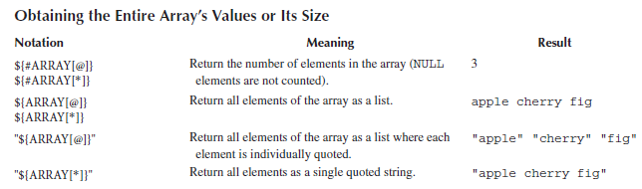

Slide 92
Arrays- Declaration
for item in ${ARRAY[@]}
do
echo $item
done
for (( i=0; i<${#ARRAY[@]}; i++ ))
do
echo ${ARRAY[i]}
done

Slide 93
Accessing Array Elements
myArray[element]="Hey Ninjas"
echo ${myArray[element]}
Hey Ninjas

Slide 94
myArray=(1 2 3 4 5)
echo ${myArray[2]}
3

Slide 95
Reading Array Elements
[@] symbol is used to print all the elements at the same time.
myArray=(1 2 3 4 5 6 7 8)
for i in ${myArray[@]}
do
echo $i
done

Slide 96
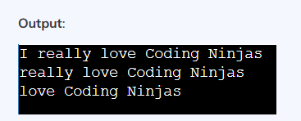
echo ${arrrayName[whichElement]:startingIndex}
myArray=(I really love Coding Ninjas)
echo ${myArray[@]:0}
echo ${myArray[@]:1}
echo ${myArray[@]:2}
echo ${myArray[0]:1}

Slide 97
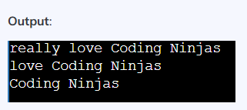
echo ${arrayName[whichElement]:startingIndex:countElement}
myArray=(I really love Coding Ninjas)
echo ${myArray[@]:1:4}
echo ${myArray[@]:2:3}
echo ${myArray[@]:3:4}
echo ${myArray[0]:1:3}

Slide 98
Counting the Number of Elements
myArray=(1 2 3 4 5)
echo ${#myArray[@]}
Output:
5

Slide 99
Delete a Single Array Element
myArray=(1 2 3 4 5 6 7 8)
printf "Array before delete:\n"
for i in ${myArray[@]}
do
echo $i
done
unset myArray[2]
printf "Array after delete:\n"
for i in ${myArray[@]}
do
echo $i
done

Slide 100
Array before delete:
1
2
3
4
5
6
7
8
Array after delete:
1
2
4
5
6
7
8

Slide 101
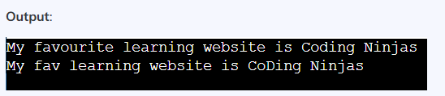
Search and Replace Array Element
echo ${arrayName[@]//character/replacement}
myArr=(My fav learning website is Coding Ninjas)
echo ${myArr[@]//fav/favourite} #changing a complete element
echo ${myArr[@]//d/D} #changing a character in an element

Slide 102
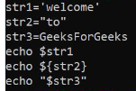
String Manipulation in Shell Scripting
Syntax:
VariableName='value'
echo $VariableName
VariableName="value"
echo ${VariableName}
VariableName=value
echo "$VariableName"

Slide 103
Read Only variable declaration
$ declare -r VAR1='Hello world'

Slide 104
print length of string inside Bash Shell
variableName=value
echo ${#variablename}
Eg:
Str=GodIsGreat
Echo ${#str}
10

Slide 105
Concatenate strings inside Bash Shell using variables
var=${var1}${var2}${var3}
Or
var=$var1$var2$var3
Or
var="$var1""$var2""$var3"

Slide 106
Following will insert "**" between the strings
var=${var1}**${var2}**${var3}
or
var=$var1**$var2**$var3
or
var="$var1"**"$var2"**"$var3"

Slide 107
Following concatenate the strings using space:
var=${var1} ${var2} ${var3}
or
var="$var1" "$var2" "$var3"
or
echo ${var1} ${var2} ${var3}

Slide 108
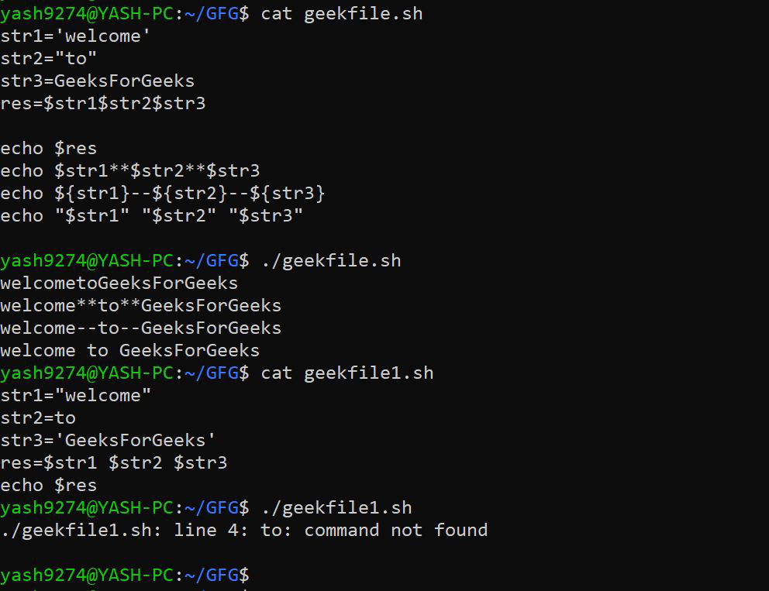

Slide 109
Concatenate strings inside Bash Shell using an array:
To create an array:
arr=("value1" value2 $value3)
To print an array:
echo ${arr[@]}
To print length of an array:
echo ${#arr[@]}
Using indices (index starts from 0):
echo ${arr[index]}
Note: echo ${arr} is the same as echo ${arr[0]}

Slide 110
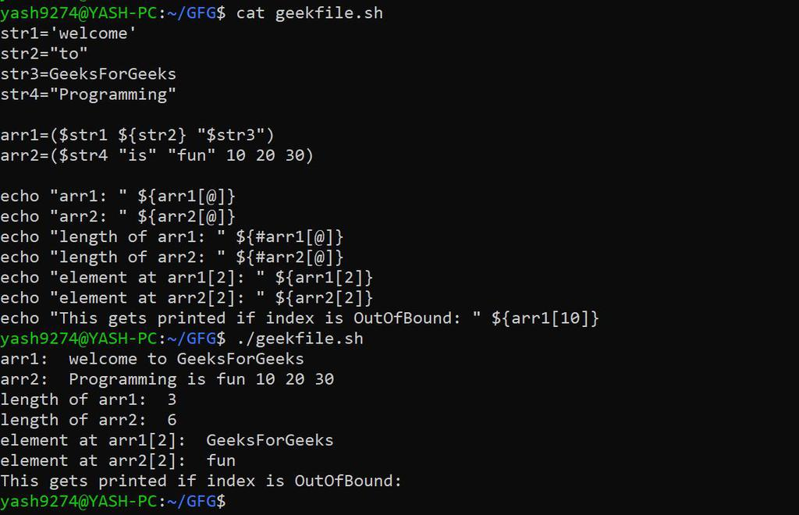

Slide 111
Extract a substring from a string
${string:position} --> returns a substring starting from $position till end
${string:position:length} --> returns a substring of $length characters starting from $position.
Note:
$length and $position must be always greater than or equal to zero.
If the $position is less than 0, it will print the complete string.
If the $length is less than 0, it will raise an error and will not execute.

Slide 112
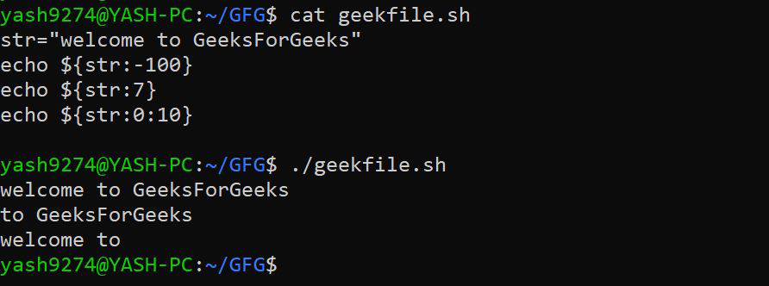

Slide 113
Substring matching:
In Bash, the shortest and longest possible match of a substring can be found and deleted from either front or back.
Syntax:
To delete the shortest substring match from front of $string:
${string#substring}
To delete the shortest substring match from back of $string:
${string%substring}
To delete the longest substring match from front of $string:
${string##substring}
To delete the shortest substring match from back of $string of $string:
${string%%substring}

Slide 114
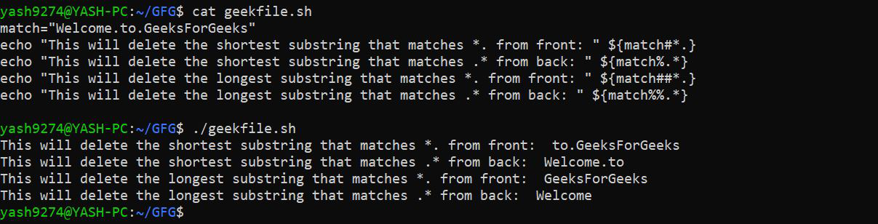

Slide 115
In the above example:
The first echo statement substring ‘*.‘ matches the characters ending with a dot, and # deletes the shortest match of the substring from the front of the string, so it strips the substring ‘Welcome.‘.
The second echo statement substring ‘.*‘ matches the substring starting with a dot and ending with characters, and % deletes the shortest match of the substring from the back of the string, so it strips the substring ‘.GeeksForGeeks‘
The third echo statement substring ‘*.‘ matches the characters ending with a dot, and ## deletes the longest match of the substring from the front of the string, so it strips the substring ‘Welcome.to.‘
The fourth echo statement substring ‘.*‘ matches the substring starting with a dot and ending with characters, and %% deletes the longest match of the substring from the back of the string, so it strips the substring ‘.to.GeeksForGeeks‘.

Slide 116
Shell Functions
Function is a collection of statements that execute a specified task.
Its main goal is to break down a complicated procedure into simpler subroutines that can subsequently be used to accomplish the more complex routine.
Functions are popular:
Assist with code reuse.
Enhance the program’s readability.
Modularize the software.
Allow for easy maintenance.

Slide 117
Basic structure of a function in shell scripting looks as follows:
function_name(){
// body of the function
}

Slide 119
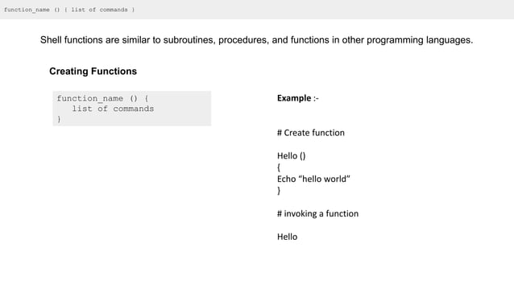

Slide 120
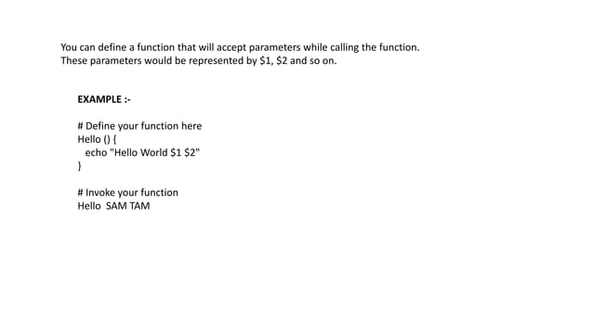

Slide 121
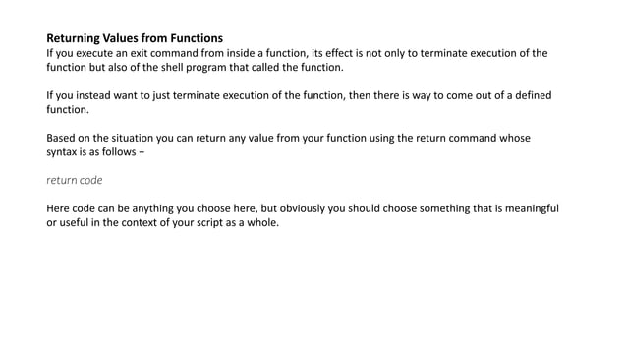

Slide 122
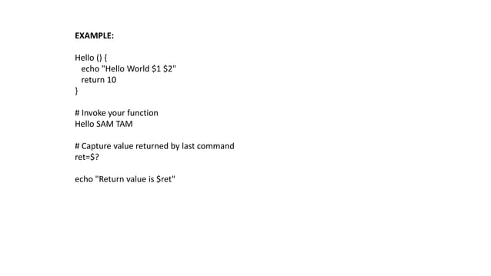

Slide 123
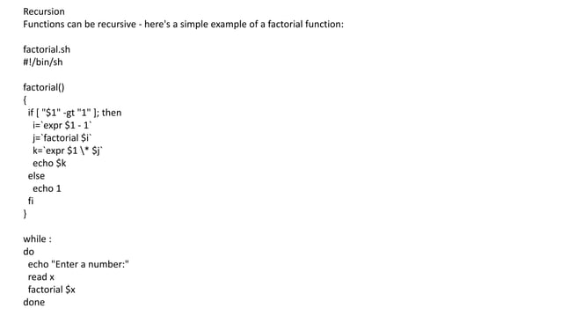

Slide 124
Creating Accounts and Groups- Managing Users and Groups-Passwords

Slide 125
Computer is used by many people it is usually necessary to differentiate between the users, for example, so that their private files can be kept private.
An account is all the files, resources, and information belonging to one user.

Slide 126
Types of user account
Root account: This is also called super user and would have complete and unfettered control of the system. A super user can run any commands without any restriction. This user should be assumed as a system administrator.
System accounts: System accounts are those needed for the operation of system specific components for example mail accounts and the sshd accounts. These accounts are usually needed for some specific function on your system, and any modifications to them could adversely affect the system.
User accounts: User accounts provide interactive access to the system for users and groups of users. General users are typically assigned to these accounts and usually have limited access to critical system files and directories.

Slide 127
Managing Users and Groups
/etc/passwd − Keeps the user account and password information. This file holds the majority of information about accounts on the Unix/Linux system.
/etc/shadow − Holds the encrypted password of the corresponding account. Not all the systems support this file.
/etc/group − This file contains the group information for each account.
/etc/gshadow − This file contains secure group account information.

Slide 128
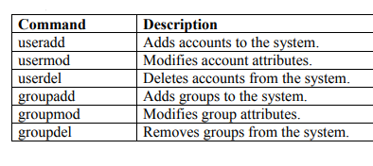
Following are commands available on the majority of Linux systems to create and manage accounts and groups:

Slide 129
useradd
useradd [options] username
sudo useradd johndoe
sudo useradd -m -d /home/janedoe -s /bin/bash janedoe
Common options:
-m: Create the user's home directory
-d: Specify the home directory
-s: Specify the login shell
-G: Add the user to additional groups

Slide 130
usermod
usermod [options] username
sudo usermod -d /newhome/johndoe johndoe
sudo usermod -aG sudo,developers janedoe
Common options:
-d: Change the home directory
-s: Change the login shell
-l: Change the username
-G: Set supplementary groups
-aG: Add to supplementary groups without removing from existing ones

Slide 131
userdel
userdel [options] username
sudo userdel johndoe
sudo userdel -r janedoe
Common options:
-r: Remove the user's home directory and mail spool

Slide 132
groupadd
groupadd [options] group_name
sudo groupadd developers
sudo groupadd -g 1500 project_team

Slide 133
groupmod
groupmod [options] group_name
sudo groupmod -n new_developers developers
sudo groupmod -g 2000 project_team

Slide 134
groupdel
groupdel group_name
sudo groupdel project_team

Slide 135
getent group
To view existing groups on the system.

Slide 136
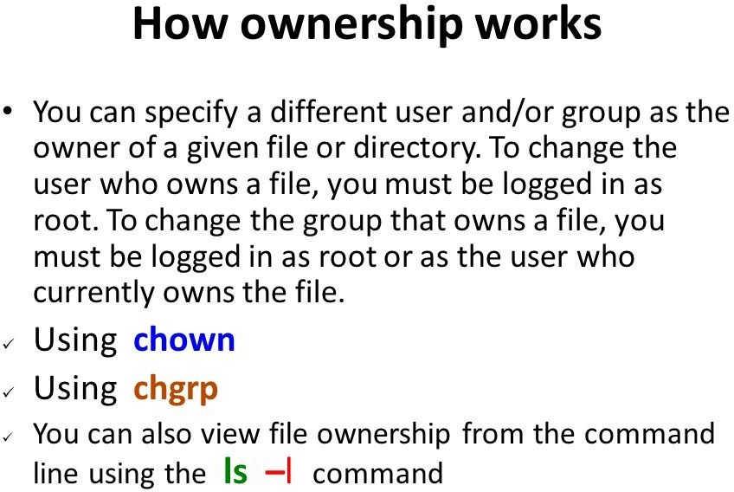

Slide 137
chown
chown command in Linux is used to change the ownership of files and directories.
chown [OPTIONS] USER[:GROUP] FILE(s)
Where:
USER is the new owner's username
GROUP (optional) is the new group
FILE(s) are the target files or directories

Slide 138
chown john file.txt
chown john:users file.txt
chown -R alice:staff /home/project
chown 1000:1000 file.txt
chown :developers file.txt

Slide 139
chgrp
chgrp command in Linux is used to change the group ownership of files and directories.
chgrp [OPTIONS] GROUP FILE(S)
Change the group of a single file:
chgrp developers myfile.txt
Change the group of multiple files:
chgrp staff file1.txt file2.txt file3.txt

Slide 140
Recursively change group ownership of a directory and its contents
chgrp -R project_team /path/to/project/
Change group ownership using a numeric group ID
chgrp 1001 document.pdf
Change group and display what's being changed:
chgrp -v marketing report.docx

Slide 141
Change group only if it matches a specific group:
chgrp --from=oldgroup newgroup shared_file.txt
Change group and preserve root directory group:
chgrp --preserve-root team /some/directory

Slide 142
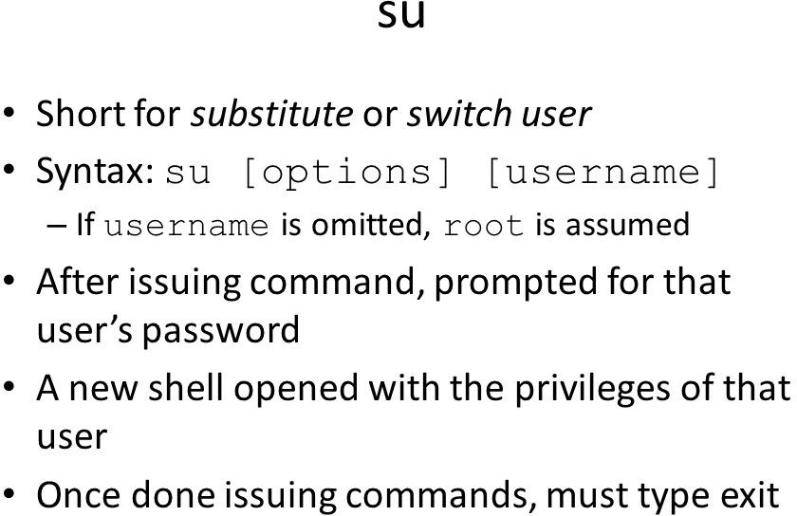

Slide 143
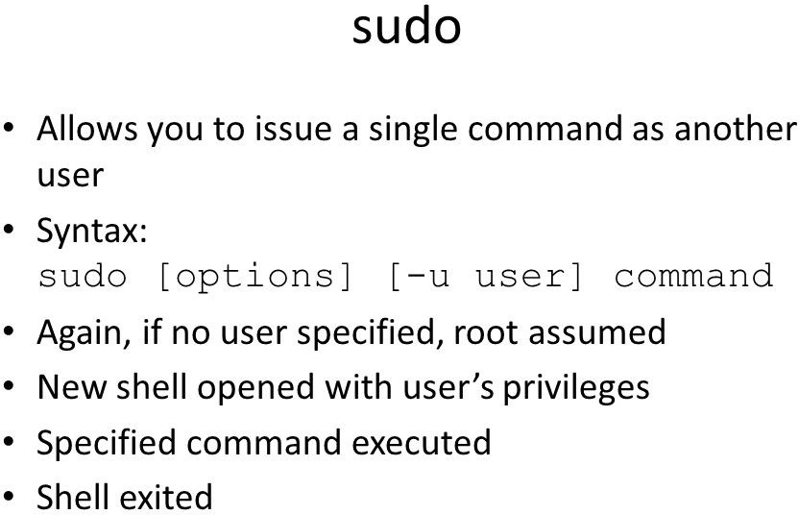

Slide 144
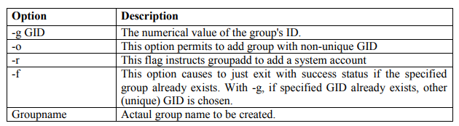
Create a Group
All the default groups would be system account specific groups and it is not recommended to use them for ordinary accounts.
Syntax: sudo groupadd [-g gid [-o]] [-r] [-f] groupname
groupadd IMCAGEN

Slide 145
Modify a Group
To modify a group, use the groupmod syntax:
$groupmod –n newgroupname oldgroupame

Slide 146
Delete a Group
To delete an existing group, all you need are the groupdel command and the group name. To delete the ‘networking’ group, the command is:
$goupdel IMCAGEN

Slide 147
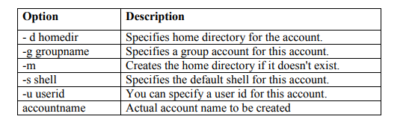
Create an Account
$ sudo useradd -d homedir -g groupname -m -s shell -u userid accountname
$ useradd -d /home/gobi -g developers -s /bin/ksh gobi

Slide 148
creates an account gobi, setting its home directory to /home/gobi and the group as developers. This user would have Korn Shell assigned to it.

Slide 149
Once an account is created you can set its password using the passwd command as follows:
$ passwd gobi
Changing password for user gobi
New UNIX password:
Retype new UNIX password:
passwd: all authentication tokens updated successfully.

Slide 150
Modify an Account
usermod command enables you to make changes to an existing account from the command line. It uses the same arguments as the useradd command, plus the -l argument, which allows you to change the account name.
$ usermod -d /home/ram -m -l gobi ram

Slide 151
Delete an Account
userdel command can be used to delete an existing user. This is a very dangerous command if not used with caution.
There is only one argument or option available for the command .r, for removing the account's home directory and mail file.
$ userdel -r ram

Slide 152
Changing user properties
There are a few commands for changing various properties of an account (i.e., the relevant field in /etc/passwd):
chfn: to change the full name field.
chsh: to change the login shell.
passwd: to change the password.
super−user may use these commands to change the properties of any account.
Normal users can only change the properties of their own account.

Slide 153
/etc/passwd and other informative files
Username
Previously this was where the user's password was stored.
Numeric user id.
Numeric group id.
Full name or other description of account.
Home directory.
Login shell (program to run at login)

Slide 154
passwd
Changes a user's password.
passwd [options] [LOGIN]
passwd command changes passwords for user accounts.
A normal user may only change the password for his or her own account, while the superuser may change the password for any account.
passwd also changes the account or associated password validity period.

Slide 155
passwd : Change your own password.
passwd username : Change the password for the user named username.

Slide 156
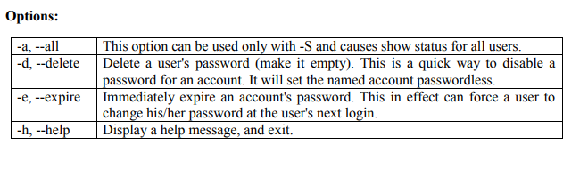
General guideline-Password
passwords should consist of 6 to 8 characters including one or more characters from each of the following sets:
lower case letters
digits 0 through 9
punctuation marks

Slide 157
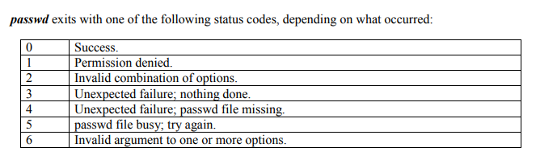

Slide 158
Set Password Expiry Date for an user using chage option -M
Root user (system administrators) can set the password expiry date for any user
# chage -M number-of-days username
sudo chage –M 30 gobi

Slide 159
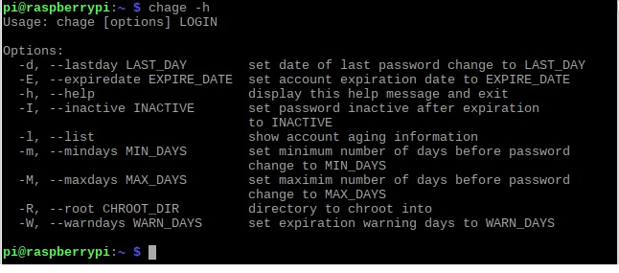

Slide 160
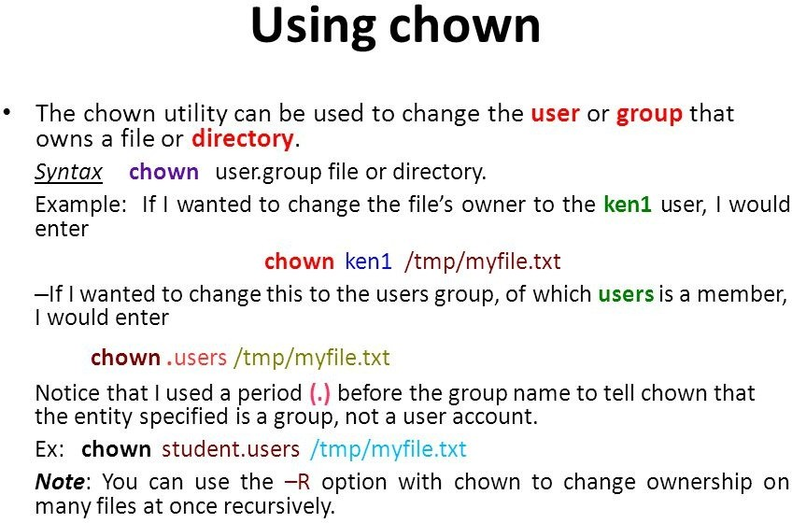

Slide 161
