Slide 1
Unit -IV
Prepared by
Dr.N.Gobi

Slide 2
Syllabus- Unit IV
Linux Process Management:
Forms of Process Management-Starting, Pausing, and Resuming Processes-Monitoring Processes-Managing Linux Processes-Linux Applications: Text EditorsLatex-Email Programs- Network Software- Regular Expressions: Grep-Sed-Awk.

Slide 3
Introduction
Process is a running program.
Program is static whereas Process is dynamic which changes its states over time.
In Linux, processes can be started from the GUI or the command line or by other running processes.
Whenever a process runs, the Linux kernel keeps track of it through a process ID (PID).
Linux kernel is loaded and running, the first process it launches is called system[PID is 1].
systemd is responsible for starting the run-time environment and then monitoring the environment while in use.

Slide 4
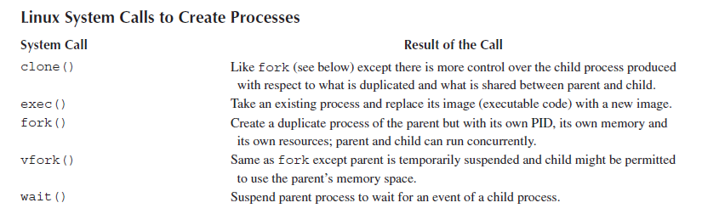
In Linux, a process can only be created by another process (with the exception of systemd). We refer to the creating process as the parent and the created process as the child.

Slide 5
fork is best for independent processes.
vfork is faster than fork for processes that immediately exec.
exec is for transforming a process into a new program.
clone is ideal for creating threads with controlled resource sharing.

Slide 6
FORMS OF PROCESS MANAGEMENT
Consider that a program is a piece of software. It contains code and has memory space reserved for data storage.
Most of this storage is dedicated to variables that are declared and used in the program.
Program exists in one of two states: the original source code and the executable code. In either case, the program is a static entity.

Slide 7
Process is an active entity.
As the process executes, the values it stores in memory (variables) change.
As the process executes, it may request resources from the operating system which it then holds, uses and returns to the operating system.
CPU stores information about the running process via its registers.
Program Counter (PC) stores the address of the next instruction to fetch from memory while the Instruction register (IR) stores the current instruction.

Slide 8
Results of the most recent operation are indicated using status flags in the Status Flag (SF) register .
A run-time stack is maintained for this process, indicating subroutine invocation and parameter passing. The top of the stack is pointed to by the Stack Pointer (SP).

Slide 9
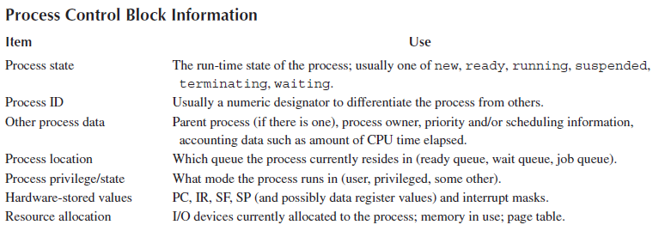

Slide 10
Process Management.
Handling the startup and termination of, scheduling and movement of, and interprocess communication of processes.

Slide 11
Single-process execution
single tasking, the operating system starts a process and then the CPU’s attention is entirely held by that one running process.
CPU executes this one process until either the process terminates or requests some operation by the operating system.
Among them, the user is limited to running one task at a time and so there is no way to switch back and forth between multiple tasks.
if the process has to perform some time-consuming input or output, the CPU remains idle while the input/output (I/O) takes place.

Slide 13
Batch Processing
Batch processing is much like single tasking .Batch processing, the computer is shared among multiple users such that users can submit processes to run at any time.
Scheduling may be performed by some offline system
Job may run any time from immediately to hours or days later, the job cannot be expected to run interactively.
Scheduling algorithm can be used to schedule the processes.

Slide 14
Concurrent processing
One of the great inefficiencies of both single tasking and batch processing is that of I/O.
One process/job may wait for the i/o – time consuming if read from magnetic tapes.
Idea of switching from a waiting process to a process ready for execution leads us to an improved form of process management called multiprogramming.
In multiprogramming, the CPU executes a single process, but if that process needs to perform time-consuming I/O then that process is set aside and another process is executed.
Concurrent Processing- By switching between processes in this way, it appears to the user that the computer is executing multiple processes at a time
Context switching plays a major role.

Slide 15
For context switching, OS follows
Pre-emptive
Non-Preemptive
Time sharing

Slide 16
Interrupt handling
Process of interrupting the CPU as an interrupt and the process of requesting an interrupt as an interrupt request (IRQ).
IRQ may originate from hardware or software. For hardware, the IRQ is carried over a reserved line on the bus connecting the hardware device to the CPU (or to an interrupt controller device). For software, an IRQ is submitted as an interrupt signal.
Upon receiving an interrupt request, the CPU finishes the current fetch-execute cycle and then decides how to respond to the interrupt request.
For every type of interrupt, the operating system contains an interrupt handler.
Each interrupt handler is a piece of code written to handle a specific type of interrupting situation.

Slide 17
STARTING, PAUSING AND RESUMING PROCESSES
Depending on the version of Linux and the GUI being used, there are menu selections and icons.
Parent process making the request might be the GUI, Bash, another running application or a part of the operating system (e.g., a service).
kernel’s process manager creates the process and prepares it for execution.
When a process is launched by the user, the process runs under access rights based on its Effective User ID (EUID) and Effective Group ID (EGID).

Slide 18
Launching processes from the command line
Launching processes from within a shell is accomplished by specifying the program name. → Absolute path or relative path.

Slide 19
Suspending and resuming processes from the command line
Run as many processes in the background.
A terminal window can only have one process running in the foreground at a time.
Foreground process is the one that provides interaction with the user, whether to receive user input or to output information to the window, or both.
Jobs command responds with all of the active jobs in the terminal window. These are processes that have been started from the command line but have not yet terminated.

Slide 20
A process may be in a stopped state. This means that the process has been running but is currently suspended.
User can resume a suspended process. In doing so, we specify whether to resume the process in the foreground or in the background.
In order to stop a running, foreground process, type control+z in the terminal window

Slide 21
MONITORING PROCESSES
Operating system can run multiple processes efficiently with little or no user intervention.
Several different tools available to monitor processes and system resources.
Primary GUI tool is called the System Monitor.
Launching System Monitor from the GUI has changed.
Two different versions of the System Monitor, one for Gnome and one for KDE (an alternative GUI desktop).

Slide 22
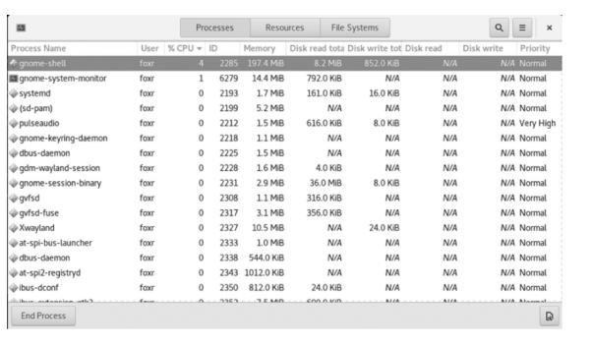
Gnome

Slide 23
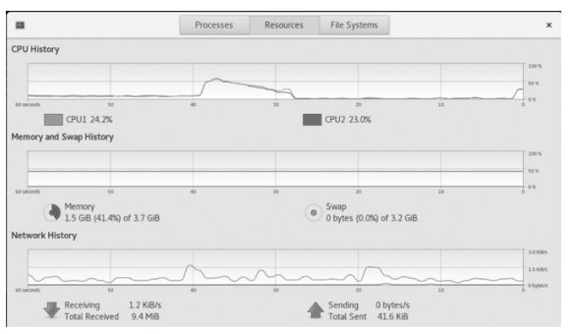
Resources tab provides a summary of CPU, memory/swap space and network utilization over time (the last minute).

Slide 24
File Systems tab displays statistics about the file system.

Slide 25
Command-Line Monitoring Tools
System Monitor provides a convenient way to view system usage and control running processes, we might be more interested in exploring system usage from the command line for two reasons.
similar to the idea of opening multiple windows to run multiple processes that we explored in the last section, using the System Monitor takes more resources than command-line programs.
information we can get from the System Monitor is not as comprehensive as what can be found from some of the command-line programs. So, we turn to two of the primarily monitoring tools: top and ps

Slide 26
top program
top program is launched from the command line but unlike most of the commands we have viewed, this command fills the terminal window with its output and remains running.
top is an interactive program that updates its output in a specified refresh rate and changes its appearance based on input keystrokes.
Default refresh rate is 3 seconds.

Slide 27
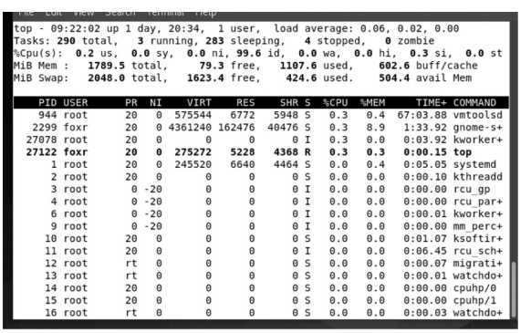

Slide 28
ps command
ps command provides a detailed examination of the running processes as a snapshot.
Unlike top, it is not interactive. It displays the information and exits.

Slide 29
MANAGING PROCESS PRIORITY
Linux runs processes and threads together by switching off between them.
Because of the speed and power of modern processors, the user is typically unaware of the time elapsing as the processor moves from one process to another and back.
processor moves through the processes in the ready queue and back to the first in under a millisecond (thousandths of a second).

Slide 30
A process is a standalone entity; it has its own code, data and status information.
Thread, some-times called a lightweight process, shares its code and data (or at least some data) with other threads.
Threads are, in essence, portions of a process.
Linux executes processes and threads using multitasking and multithreading.
Linux command batch, for instance, forces a process to run in batch mode.
A batch process is one that does not interact with the user. Therefore, any batch process must be provided its input at the time the process is launched.

Slide 31
In Linux, a process’ priority is established by setting its niceness value. Niceness refers to how nice a process is with respect to other processes.
With a higher niceness value, a process will offer some of its CPU time to other processes.
Higher the niceness value, the less CPU time it will take when it is that process’ turn, and thus higher niceness means lower priority.
https://www.geeksforgeeks.org/priority-of-process-in-linux-nice-value/

Slide 32
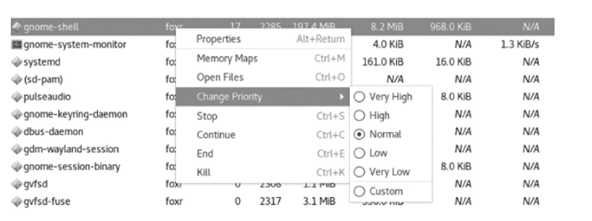
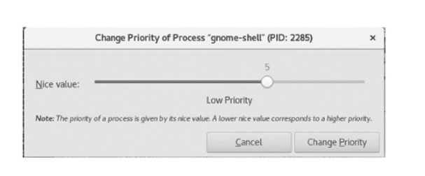

Slide 33
Regular Expressions
Linux Regular Expressions are special characters which help search data and matching complex patterns.
Regular expressions are shortened as ‘regexp’ or ‘regex’.
They are used in many Linux programs like grep, bash, rename, sed, etc.

Slide 34
Basic Regular expressions
Symbol Descriptions
. replaces any character
^ matches start of string
$ matches end of string
* matches up zero or more times the preceding character
\ Represent special characters
() Groups regular expressions
? Matches up exactly one character

Slide 35
Syntax:
cat sample | grep string

Slide 36
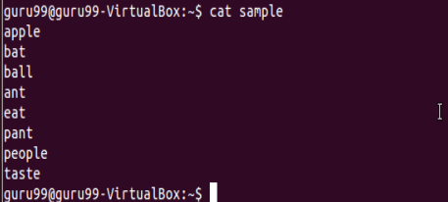

Slide 37
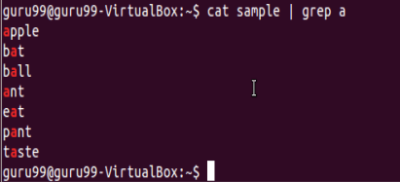


Slide 38
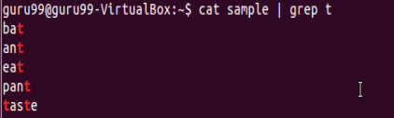
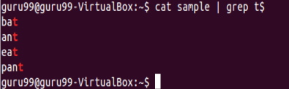

Slide 39
Interval Regular expressions
These expressions tell us about the number of occurrences of a character in a string.
Expression | Description
{n} | Matches the preceding character appearing ‘n’ times exactly
{n,m} | Matches the preceding character appearing ‘n’ times but not more than m
{n, } | Matches the preceding character only when it appears ‘n’ times or more

Slide 40

Filter out all lines that contain character ‘p’

Slide 41

Check that the character ‘p’ appears exactly 2 times in a string one after the other.
need to add -E with these regular expressions.

Slide 42
Extended regular expressions
regular expressions contain combinations of more than one expression.
Expression | Description
\+ | Matches one or more occurrence of the previous character
\? | Matches zero or one occurrence of the previous character

Slide 43
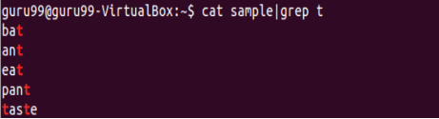

Filter out lines where character ‘a’ precedes character ‘t’

Slide 44
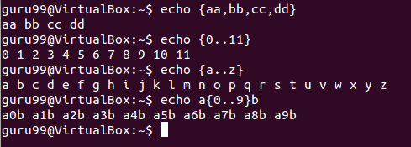
Brace expansion
Brace expansion is either a sequence or a comma separated list of items inside curly braces “{}”.
Starting and ending items in a sequence are separated by two periods “..”.

Slide 45
Matching Control
‘-i’
Ignores case.
‘-v’
Inverts the matching. When used, grep will print out lines that do not match the pattern
‘-e pattern’
Pattern is the pattern. This can be used to specify multiple patterns, or if the pattern starts with a ‘-’. A line only has to contain one of the patterns to be matched.

Slide 46
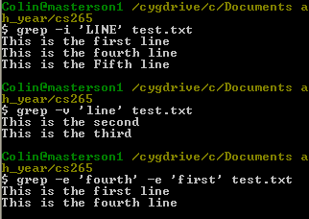
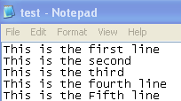
Examples using ‘-i’, ’-v’, and ‘-e’
The file below was used for these examples

Slide 47
General Output Control
‘-c’
Suppress normal output and instead print out a count of matching lines for each input file
‘-l’
Suppress normal output and print the name of each file that contains at least one match
‘-L’
Suppress normal output. Print the name of each file that does not contain any matches
Note: both the ‘-l’ and ‘-L’ options will stop searching a file once a match is found

Slide 48
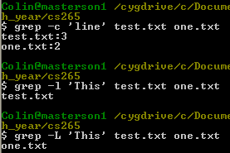
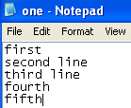
Examples using ‘-c’, ’-l’, and ‘-L’
Two files were used and specified below

Slide 49
Output Line Prefix Control
‘-n’
Prefixes each line of output with the line number from the input file the match was found on
‘-H’
Prefix each line of output with the input file name that the match was found in
‘-T’
Makes sure that the actual line content (or whatever content comes after the ‘-T’) lands on a tab stop

Slide 50
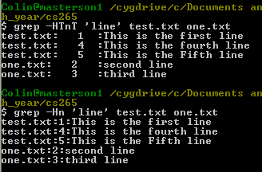
Examples using ‘-H’, ’-n’, and ‘-T’
Two files were used and specified below

Slide 51
Context Line Control
‘-A num’
Print num lines of trailing context after matching lines
‘-B num’
Print num lines of leading context before matching lines
‘-C num’ or ‘-num’
Print num lines of leading and trailing output context

Slide 52
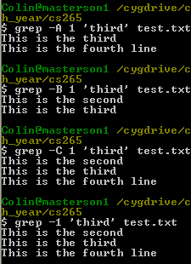
Examples using ‘-A’, ’-B’, and ‘-C’
The file below was used for these examples

Slide 53
Special Characters
‘.’ The period ‘.’ matches any single character.
‘?’ The preceding item is optional and will be matched at most once.
‘*’ The preceding item will be matched zero or more times.
‘+’ The preceding item will be matched one or more times.
‘{n}’ The preceding item is matched exactly n times.
‘{n,}’ The preceding item is matched n or more times.
‘{,m}’ The preceding item is matched at most m times.
‘{n,m}’ The preceding item is matched at least n times, but not more than m times.

Slide 54
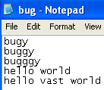
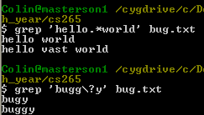
Examples using ‘.’, ‘*’, and ‘?’

Slide 55
Basic vs Extended Regular Expressions
‘-G’
Interpret pattern as basic regular expression (BRE). This is the default.
‘-E’
Interpret pattern as extended regular expression (ERE)
When using basic regular expression some special characters (like ‘?’ in the previous example) loose their special meaning and must have a ‘\’, the escape character, before them
When using ERE, the escape character is unnecessary

Slide 56
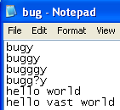
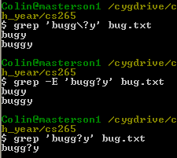
BRE and ERE Difference
Note that without the ‘\’ in the BRE call (example 3), the ‘?’ is seen as a normal character

Slide 57
Bracket Expressions
A bracket expression is a list of characters enclosed by ‘[‘ and ‘]’. It matches any single character in the list
However, if the first character in the list is ‘^’, it matches any character not in the list
A range can be done by using ‘-’ in a bracket expression
[0-5] is the same as [012345]
Some ranges are pre-defined in character classes
[:digit:] is the same as 0123456789
When using grep, the class name (including brackets) must be contained within another set of brackets

Slide 58
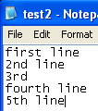
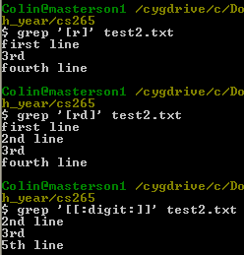
Bracket Expression Example

Slide 59
àwk
awk is a programmable, pattern-matching, and processing tool available in UNIX.
It works equally well with text and numbers.
It derives its name from the first letter of the last name of its three authors namely Alfred V. Aho, Peter J. Weinberger and Brian W. Kernighan.

Slide 60
Simple awk Filtering
awk is not just a command, but a programming language too.
awk utility is a pattern scanning and processing language.
It searches one or more files to see if they contain lines that match specified patterns and then perform associated actions, such as writing the line to the standard output or incrementing a counter each time it finds a match.

Slide 61
AWK Operations:
(a) Scans a file line by line (b) Splits each input line into fields (c) Compares input line/fields to pattern (d) Performs action(s) on matched lines

Slide 62
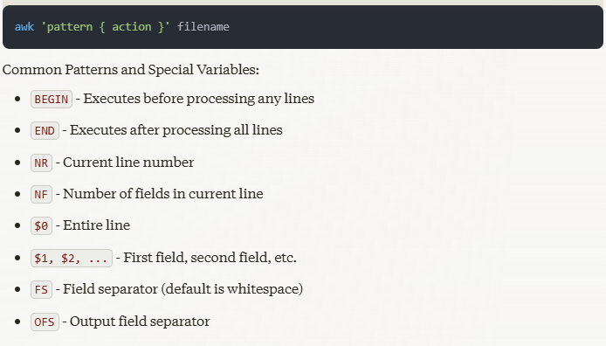

Slide 63
NR: NR command keeps a current count of the number of input records.
NF: NF command keeps a count of the number of fields within the current input record.
FS: FS command contains the field separator character which is used to divide fields on the input line→ default is “white space”, meaning space and tab characters.
RS: RS command stores the current record separator character.
OFS: OFS command stores the output field separator, which separates the fields when Awk prints them.
ORS: ORS command stores the output record separator, which separates the output lines when Awk prints them.

Slide 64
$cat > employee.txt
ajay manager account 45000
sunil clerk account 25000
varun manager sales 50000
amit manager account 47000
tarun peon sales 15000
deepak clerk sales 23000
sunil peon sales 13000
satvik director purchase 80000

Slide 65
Print the lines which match the given pattern. awk '{print}' employee.txt
ajay manager account 45000
sunil clerk account 25000
varun manager sales 50000
amit manager account 47000
tarun peon sales 15000
deepak clerk sales 23000
sunil peon sales 13000
satvik director purchase 80000

Slide 66
awk '/manager/ {print}' employee.txt
ajay manager account 45000
varun manager sales 50000
amit manager account 47000

Slide 67
# Print entire file
awk '{print}' file.txt
# or
awk '{print $0}' file.txt
# Print first column
awk '{print $1}' file.txt
# Print first and second columns
awk '{print $1, $2}' file.txt
# Print last column
awk '{print $NF}' file.txt
# Print second-to-last column
awk '{print $(NF-1)}' file.txt

Slide 68
# Print line numbers
awk '{print NR, $0}' file.txt
# Print line numbers for non-empty lines
awk 'NF {print NR, $0}' file.txt
# Print line numbers and first column
awk '{print NR ":", $1}' file.txt

Slide 69
# Print lines containing "pattern"
awk '/pattern/' file.txt
# Print lines NOT containing "pattern"
awk '!/pattern/' file.txt
# Print lines longer than 80 characters
awk 'length($0) > 80' file.txt
# Print lines with more than 5 fields
awk 'NF > 5' file.txt

Slide 70
# Print number of fields in each line
awk '{print NF}' file.txt
# Print lines with field count
awk '{print NF "fields:", $0}' file.txt
# Print first and last fields
awk '{print $1, $NF}' file.txt
# Swap first and second fields
awk '{print $2, $1}' file.txt

Slide 71
# Sum first column
awk '{sum += $1} END {print sum}' file.txt
# Average of first column
awk '{sum += $1} END {print sum/NR}' file.txt
# Count lines
awk 'END {print NR}' file.txt
# Count non-empty lines
awk 'NF {count++} END {print count}' file.txt

Slide 72
# Use comma as separator
awk -F',' '{print $1}' file.csv
# Use colon as separator
awk -F':' '{print $1}' /etc/passwd
# Multiple character separator
awk -F'[ ,]' '{print $1}' file.txt # Space or comma
# Change output separator
awk 'BEGIN {OFS=","} {print $1, $2}' file.txt

Slide 73
# Print first 10 lines
awk 'NR <= 10' file.txt
# Print lines 5 through 10
awk 'NR >= 5 && NR <= 10' file.txt
# Print odd numbered lines
awk 'NR % 2 == 1' file.txt
# Print even numbered lines
awk 'NR % 2 == 0' file.txt

Slide 74
# Format numbers with spacing
awk '{printf "%5d %s\n", NR, $0}' file.txt
# Add zeros before numbers
awk '{printf "%03d %s\n", NR, $0}' file.txt
# Format as table
awk '{printf "%-20s %s\n", $1, $2}' file.txt
# Add dashes between fields
awk '{print $1 "-" $2}' file.txt

Slide 75
Print lines where first field > 100
awk '$1 > 100' file.txt

Slide 76
# Sum values in third column
awk '{sum += $3} END {print sum}' file.txt

Slide 77
# Use comma as separator
awk -F',' '{print $1}' file.csv

Slide 78
Add line numbers
awk '{print NR ") " $0}' file.txt

Slide 79
Filter with multiple conditions
# Print lines where $1 > 100 and $2 contains "test"
awk '$1 > 100 && $2 ~ /test/' file.txt

Slide 80
# Average of second column
awk '{sum += $2} END {print "Average = " sum/NR}' file.txt

Slide 81
Formatted Output
# Format as CSV
awk 'BEGIN {OFS=","} {print $1, $2, $3}' file.txt

Slide 82
Splitting a Line Into Fields
awk '{print $1,$4}' employee.txt
ajay 45000
sunil 25000
varun 50000
amit 47000
tarun 15000
deepak 23000
sunil 13000
satvik 80000

Slide 83
Built-In Variables In Awk
Awk’s built-in variables include the field variables—$1, $2, $3, and so on ($0 is the entire line) — that break a line of text into individual words or pieces called fields.

Slide 84
$ awk '{print NR,$0}' employee.txt
1 ajay manager account 45000
2 sunil clerk account 25000
3 varun manager sales 50000
4 amit manager account 47000
5 tarun peon sales 15000
6 deepak clerk sales 23000
7 sunil peon sales 13000
8 satvik director purchase 80000

Slide 85
Use of NF built-in variables (Display Last Field)
$ awk '{print $1,$NF}' employee.txt
ajay 45000
sunil 25000
varun 50000
amit 47000
tarun 15000
deepak 23000
sunil 13000
satvik 80000

Slide 86
awk 'NR==3, NR==6 {print NR,$0}' employee.txt
3 varun manager sales 50000
4 amit manager account 47000
5 tarun peon sales 15000
6 deepak clerk sales 23000

Slide 87
SED command
SED command in UNIX stands for stream editor and it can perform lots of functions on file like searching, find and replace, insertion or deletion.
SED is a powerful text stream editor.
Can do insertion, deletion, search and replace(substitution).
SED command in unix supports regular expression which allows it perform complex pattern matching.
sed OPTIONS... [SCRIPT] [INPUTFILE...]

Slide 88
$cat > geekfile.txt
unix is great os. unix is opensource. unix is free os.
learn operating system.
unix linux which one you choose.
unix is easy to learn.unix is a multiuser os.Learn unix .
unix is a powerful.

Slide 89
Replacing or substituting string
$sed 's/unix/linux/' geekfile.txt
linux is great os. unix is opensource.unix is free os.
learn operating system.
linux linux which one you choose.
linux is easy to learn.unix is a multiuser os.Learn unix .unix is a powerful.
“s” specifies the substitution operation.
“/” are delimiters.

Slide 90
Replacing all the occurrence of the pattern in a line
$sed 's/unix/linux/g' geekfile.txt
linux is great os. linux is opensource. linux is free os.
learn operating system.
linux linux which one you choose.
linux is easy to learn.linux is a multiuser os.Learn linux .linux is a powerful.

Slide 91
Replacing from nth occurrence to all occurrences in a line
$sed 's/unix/linux/3g' geekfile.txt
unix is great os. unix is opensource. linux is free os.
learn operating system.
unix linux which one you choose.
unix is easy to learn.unix is a multiuser os.Learn linux .linux is a powerful.

Slide 92
Parenthesize first character of each word
$ echo "Welcome To The Geek Stuff" | sed 's/\(\b[A-Z]\)/\(\1\)/g‘
(W)elcome (T)o (T)he (G)eek (S)tuff

Slide 93
Replacing string on a specific line number
$sed '3 s/unix/linux/' geekfile.txt
unix is great os. unix is opensource. unix is free os.
learn operating system.
linux linux which one you choose.
unix is easy to learn.unix is a multiuser os.Learn unix .unix is a powerful.

Slide 94
Duplicating the replaced line with /p flag
/p print flag prints the replaced line twice on the terminal. If a line does not have the search pattern and is not replaced, then the /p prints that line only once.
linux is great os. unix is opensource. unix is free os.
linux is great os. unix is opensource. unix is free os.
learn operating system.
linux linux which one you choose.
linux linux which one you choose.
linux is easy to learn.unix is a multiuser os.Learn unix .unix is a powerful.
linux is easy to learn.unix is a multiuser os.Learn unix .unix is a powerful.

Slide 95
Printing only the replaced lines :
$sed -n 's/unix/linux/p' geekfile.txt
linux is great os. unix is opensource. unix is free os.
linux linux which one you choose.
linux is easy to learn.unix is a multiuser os.Learn unix .unix is a powerful.

Slide 96
Replacing string on a range of lines :
$sed '1,3 s/unix/linux/' geekfile.txt
linux is great os. unix is opensource. unix is free os.
learn operating system.
linux linux which one you choose.
unix is easy to learn.unix is a multiuser os.Learn unix .unix is a powerful.

Slide 97
$sed '2,$ s/unix/linux/' geekfile.txt
unix is great os. unix is opensource. unix is free os.
learn operating system.
linux linux which one you choose.
linux is easy to learn.unix is a multiuser os.Learn unix .unix is a powerful

Slide 98
Deleting lines from a particular file
To Delete a particular line say n in this example
Syntax:
$ sed 'nd' filename.txt
Example:
$ sed '5d' filename.txt

Slide 99
To Delete a last line
$ sed '$d' filename.txt
To Delete from nth to last line
$ sed '3,6d' filename.txt
To Delete pattern matching line
$ sed '/abc/d' filename.txt

Slide 100
cat a.txt
life isn't meant to be easy, life is meant to be lived.
Try to learn & understand something new everyday in life.
Respect everyone & most important love everyone.
Don’t hesitate to ask for love & don’t hesitate to show love too.
Life is too short to be shy.
In life, experience will help you differentiating right from wrong.

Slide 101
Insert one blank line after each line : sed G a.txt
To insert two blank lines :sed 'G;G' a.txt
Insert 5 spaces to the left of every lines : sed 's/^/ /' a.txt

