Slide 1
SUMMER INTERNSHIP PROJECT
Universal Real-Time Event
Ingestion and Observability Platform
A Prototype for Unified, Format-Agnostic, Multi-Source Real-Time Data Monitoring
Dhruv Rathore
Roll No. 23052240 · KIIT University, CSE (3rd Year)
Summer Trainee, ISTRAC Lucknow, ISRO
Guide: Shri Anant Madhukar
Notes:
Good morning. My name is Dhruv Rathore, and over the past six weeks at ISTRAC Lucknow I designed and built a prototype platform that can ingest, parse, and monitor data from any source in real time, without knowing the format of that data in advance. I'll walk you through the problem, the architecture, what I built, and where this goes next.

Slide 2
Problem Statement
1
Heterogeneous Sources
Ground station operations generate continuous data from network equipment, applications, and custom systems
2
No Common Format
Each source speaks differently — structured, semi-structured, and unstructured data, all at once
3
No Unified View
No single platform exists to ingest, normalize, and visualize this data together in real time
4
Doesn't Scale
Operators need one consistent view — rebuilding integrations for every new source isn't sustainable
Dhruv Rathore · 23052240 · ISTRAC Lucknow
2 / 28
Notes:
At a ground station, data comes from many directions at once — network equipment, application logs, system telemetry, custom protocols. The challenge isn't collecting one type of data well. It's collecting any type of data, without rebuilding the system every time a new source appears.

Slide 3
Project Objective
The brief: build a system that accepts ANY data, from ANY source, without assuming the format in advance.
INGEST
NORMALIZE
VISUALIZE
Accept raw data from any source — HTTP, Kafka, and beyond
Convert heterogeneous input into one consistent, queryable schema
Provide a live dashboard for real-time operational visibility
Dhruv Rathore · 23052240 · ISTRAC Lucknow
3 / 28
Notes:
The brief I was given was direct: build something that can take in any kind of data and make sense of it live, without assuming what that data looks like ahead of time. That single constraint — any format — is what shaped every architectural decision after this point.

Slide 4
Scope of Work
Delivered in This Phase
Planned for Next Phase
Complete ingestion pipeline (HTTP + Kafka)
Dynamic, format-agnostic parsing engine
Universal event normalization layer
Live real-time dashboard
Persistent multi-database storage
JWT authentication + API keys
Production hardening and security audit
Formal load testing at scale
Multi-region / Kubernetes deployment
Additional parsers (CSV, XML, Syslog)
Alert engine and notification delivery
Dhruv Rathore · 23052240 · ISTRAC Lucknow
4 / 28
Notes:
Given the six-week window, I scoped this deliberately as a complete, working prototype rather than a partially-built production system. Every layer you'll see actually runs end to end.

Slide 5
Why This Architecture
The Wrong Approach
The Approach Used Here
CiscoParser.ts
FortinetParser.ts
JuniperParser.ts
...one new file per source, forever
Receiver → Decoder → Parser Engine
→ Normalizer → Storage → Dashboard
One generic pipeline. New sources are
added without touching existing code.
Dhruv Rathore · 23052240 · ISTRAC Lucknow
5 / 28
Notes:
The instinct when you see different data formats is to write a handler for each one. I deliberately avoided that. Instead the system has one universal pipeline that detects format dynamically and routes accordingly — so tomorrow's unknown source doesn't require touching today's code.

Slide 6
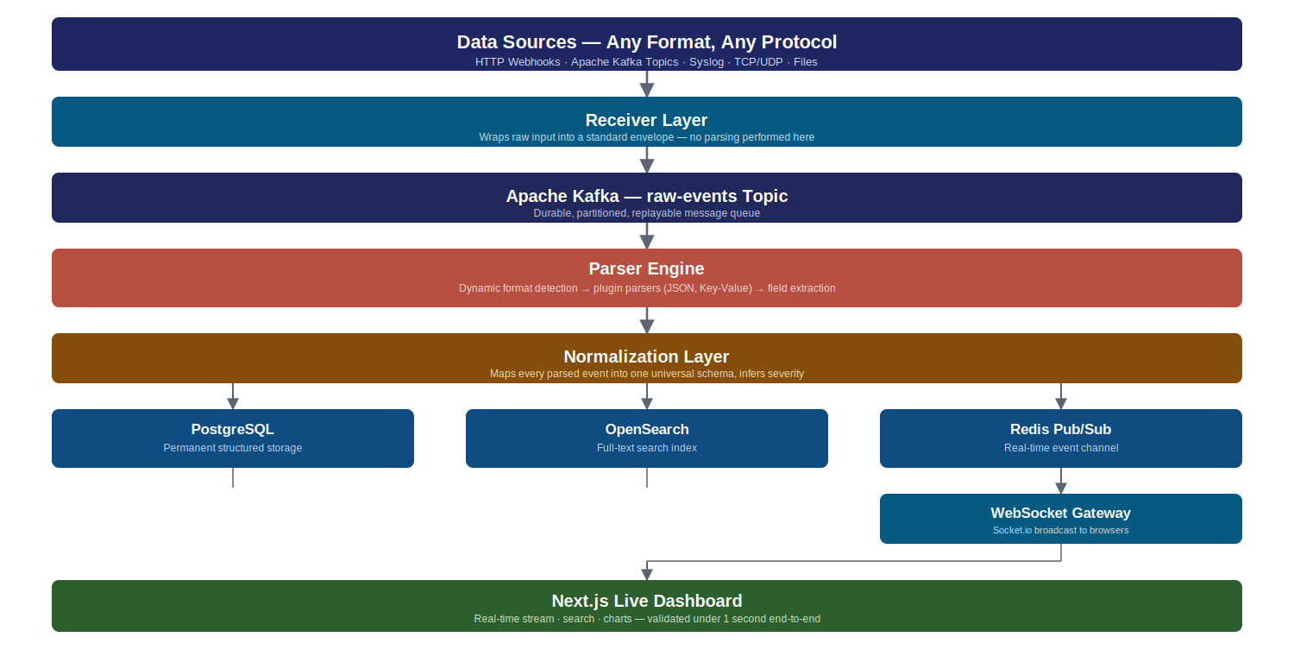
System Architecture — Overview
Dhruv Rathore · 23052240 · ISTRAC Lucknow
6 / 28
Notes:
This is the complete data path. Every event — regardless of source — passes through these exact eight stages. I'll walk through each one on the following slides.

Slide 7
Technology Stack
Layer | Technology
Runtime | Node.js 20, TypeScript
API Framework | Fastify
Message Queue | Apache Kafka
Search | OpenSearch
Analytics (provisioned) | ClickHouse
Relational Store | PostgreSQL 16
Cache / Pub-Sub | Redis 7
Real-time Transport | Socket.io
Frontend | Next.js 14
Infrastructure | Docker, Docker Compose
Dhruv Rathore · 23052240 · ISTRAC Lucknow
7 / 28
Notes:
Every technology here was chosen for a specific reason, not by default. I'm happy to go deeper into any of these choices during questions.

Slide 8
Receiver Layer
Accepts data via HTTP POST and Kafka topic consumption
Each receiver does exactly one job: wrap raw input into a standard envelope
No parsing or business logic happens here — pure ingestion
Validated working with both HTTP and external Kafka sources simultaneously
interface RawEnvelope {
id: string
rawData: string
sourceType: string
sourceId: string
receivedAt: number
meta: Record<string, unknown>
}
Dhruv Rathore · 23052240 · ISTRAC Lucknow
8 / 28
Notes:
The receiver's only responsibility is to accept data and tag it with metadata — where it came from, when it arrived. It never tries to understand the content. That separation is what keeps the system extensible.

Slide 9
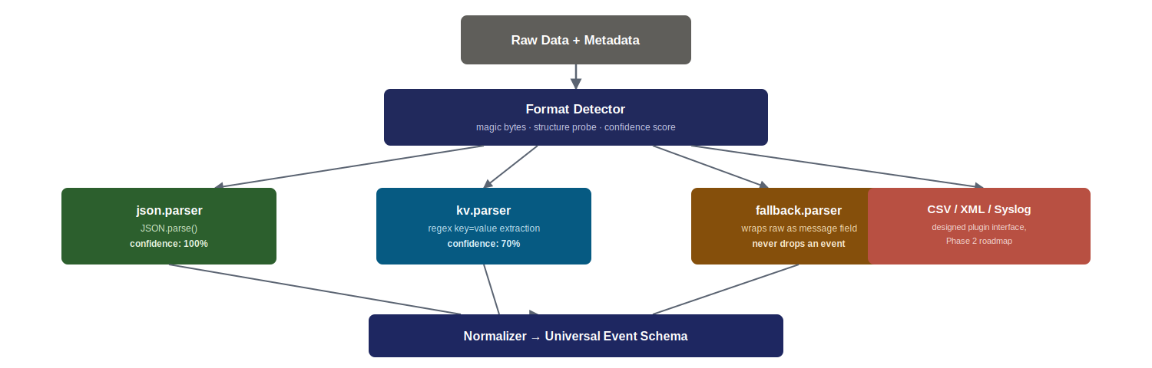
Parser Engine — Plugin-Based Pipeline
New parsers register canParse() and parse() — added without modifying the pipeline itself
Dhruv Rathore · 23052240 · ISTRAC Lucknow
9 / 28
Notes:
This is the heart of the any-format requirement. Instead of one parser trying to handle everything, I built a chain of small, focused parsers that each declare whether they can handle a given input. The pipeline tries each one in order until something succeeds.

Slide 10
Normalization Layer
Before — Chaos
After — One Schema
{level: 'err', msg: 'disk full'}
level=warn host=db-02
<event><sev>info</sev></event>
{
id, timestamp, source,
severity, category, tags,
raw,
data: { ...dynamic fields }
}
→
Dhruv Rathore · 23052240 · ISTRAC Lucknow
10 / 28
Notes:
This is what makes the dashboard format-agnostic. No matter what came in — JSON, key-value, anything — it leaves this layer in exactly the same shape. The frontend never needs to know what kind of data it's looking at.

Slide 11
Storage Strategy
PostgreSQL
OpenSearch
Redis
ClickHouse
Permanent structured storage, relationships, querying
Full-text search across all event content
Real-time pub/sub for live dashboard updates
Provisioned for future high-speed analytics
Each store is doing the one thing it's architecturally best at — not one database forced to do everything
Dhruv Rathore · 23052240 · ISTRAC Lucknow
11 / 28
Notes:
I deliberately did not try to force one database to do everything. Each store here is doing the one thing it's architecturally best at.

Slide 12
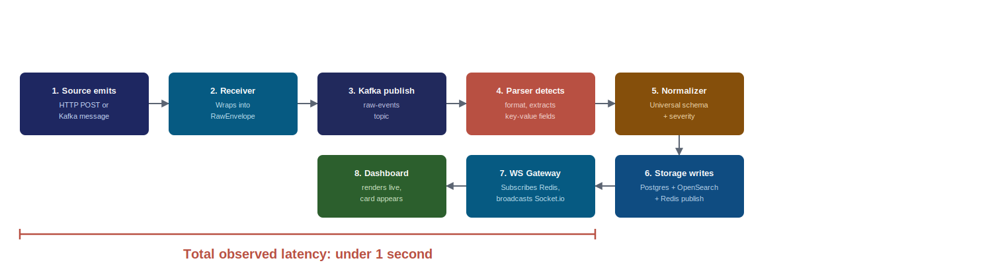
Real-Time Delivery
Observed: events appear on dashboard in under 1 second from ingestion
Dhruv Rathore · 23052240 · ISTRAC Lucknow
12 / 28
Notes:
From the moment data is sent to this system, to the moment it appears live on screen — fully parsed and labeled — takes under one second. That includes going through Kafka, the parser, the normalizer, and three storage writes.

Slide 13
Authentication and Security
JWT with httpOnly Cookies
Tokens inaccessible to client-side scripts — mitigates XSS risk
Refresh Token Rotation
Server-tracked sessions allow individual token revocation
API Key Authentication
Scoped, SHA-256 hashed keys for programmatic access
Bcrypt Password Hashing
Passwords never stored in plaintext, industry-standard hashing
Dhruv Rathore · 23052240 · ISTRAC Lucknow
13 / 28
Notes:
Even as a prototype, I implemented production-pattern authentication — not a toy login form. Tokens are stored in httpOnly cookies specifically to prevent client-side script access, and refresh tokens are tracked server-side so they can be revoked.

Slide 14
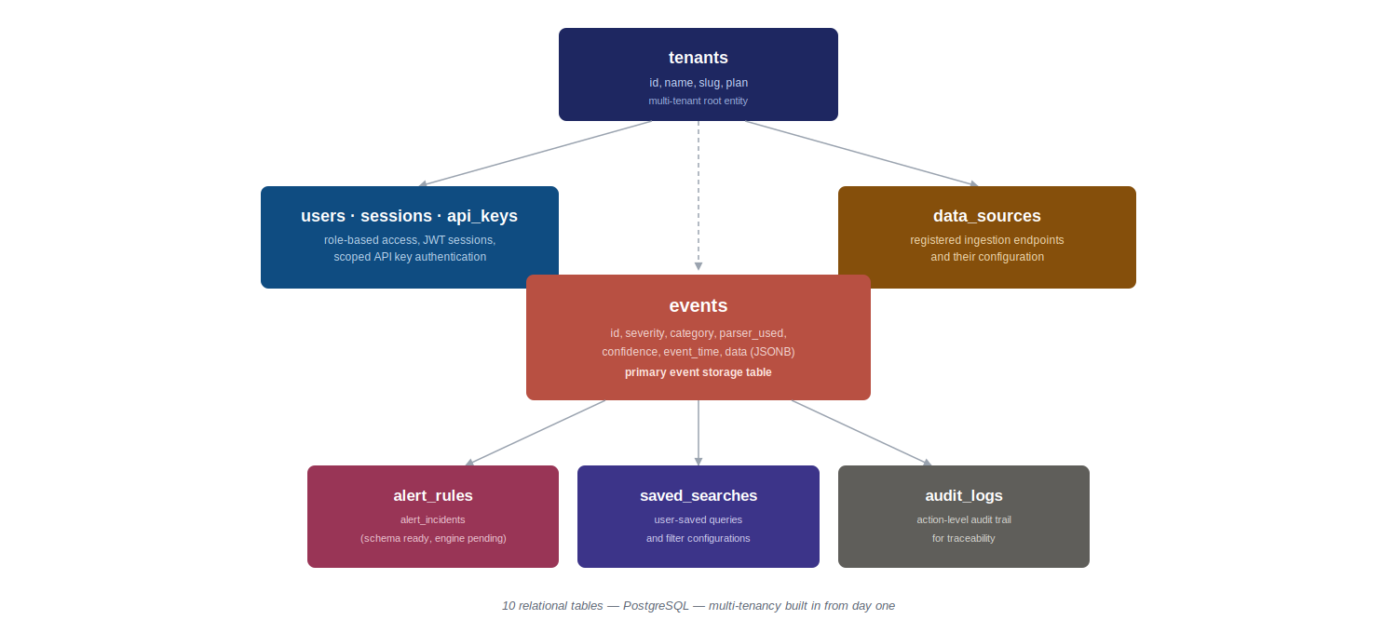
Database Design
Dhruv Rathore · 23052240 · ISTRAC Lucknow
14 / 28
Notes:
The schema was designed for multi-tenancy from day one, even though this prototype runs a single default tenant. That means the system is already structured to support multiple organizations or teams without redesign.

Slide 15
Live Dashboard Walkthrough
Real-time event stream with dynamic field rendering
Severity-based color coding — Critical, Error, Warn, Info, Debug
Search and filter across historical events
Stat cards and charts — events per hour, severity breakdown
Transitioning to Live Demonstration →
Dhruv Rathore · 23052240 · ISTRAC Lucknow
15 / 28
Notes:
Let me show you what this looks like in practice.

Slide 16
KEY TECHNICAL ACHIEVEMENT — 1 of 2
Simultaneous Multi-Source Convergence
Successfully ingested live data from two independent machines simultaneously
One via direct HTTP POST, another via an external Kafka topic
Both streams converged into the same normalized pipeline and same dashboard
Proves the architecture's source-agnostic design works in practice, not just in theory
kafka
source-tagged event
http_webhook
source-tagged event
Both appearing on the same live dashboard, concurrently
Dhruv Rathore · 23052240 · ISTRAC Lucknow
17 / 28
Notes:
This is the moment that validated the entire architecture for me. I had one machine pushing data over HTTP and a completely separate Kafka producer pushing data on another topic — and both streams merged seamlessly into one live view, with neither needing to know about the other.

Slide 17
KEY TECHNICAL ACHIEVEMENT — 2 of 2
Sub-Second End-to-End Latency
End-to-end latency from ingestion to live dashboard render: under 1 second
Pipeline crosses 8 architectural layers in that time — Kafka, parser, normalizer, 3 storage writes, Redis, WebSocket
Achieved without any caching shortcuts — every event is fully parsed, normalized, and persisted
Receiver
Kafka
Parser
Normalizer
3x Storage
Redis
WS Gateway
Dashboard
< 1 second total
Dhruv Rathore · 23052240 · ISTRAC Lucknow
18 / 28
Notes:
Despite crossing eight separate processing stages — including three separate database writes — the system consistently delivered events to the live dashboard in under one second. That's not a shortcut path; every event goes through full parsing and persistence in that window.

Slide 18
Technical Challenges Faced
Module System Incompatibility
Root cause: ESM-only dependency broke CommonJS require() chain
Resolution: Pinned to last compatible version
Distributed State Corruption
Root cause: Stale Kafka broker registration in Zookeeper caused startup crash
Resolution: Diagnosed via Zookeeper ephemeral node lifecycle
Cross-Service Build Isolation
Root cause: Shared types broke inside isolated Docker build contexts
Resolution: Restructured type sharing per service
Dhruv Rathore · 23052240 · ISTRAC Lucknow
19 / 28
Notes:
These weren't surface-level bugs. For example, one issue took the broker down with a NodeExists exception — the cause was stale state in Zookeeper from a previous container lifecycle, not anything wrong with my code. Diagnosing that required understanding how Kafka and Zookeeper maintain broker registration.

Slide 19
Engineering Decisions and Trade-offs
Decision | Chosen Because
Kafka over RabbitMQ / Redis Streams | Replay capability and durable, partitioned retention
Fastify over Express | Higher throughput on a high-frequency ingestion endpoint
OpenSearch over Elasticsearch | Unrestricted open-source licensing for institutional use
Multi-database over one-size-fits-all | Each store optimized for its specific access pattern
Dhruv Rathore · 23052240 · ISTRAC Lucknow
20 / 28
Notes:
Every major component had at least one viable alternative. I want to walk through why I picked what I picked, because the reasoning matters more than the choice itself.

Slide 20
Future Enhancements — Phase 2 Roadmap
1
Alert Engine
Rule-based triggers with webhook/notification delivery — DB schema already in place
2
Additional Parsers
CSV, XML, and Syslog (RFC 5424) plugin support using the existing pipeline interface
3
ClickHouse Integration
Wire the normalizer to enable high-speed historical analytics
4
Formal Load Testing
Instrumented throughput and latency validation at production scale
5
Kubernetes Deployment
Production-grade orchestration with auto-scaling for all services
This prototype validates the architecture — the roadmap above extends it, not redesigns it
Dhruv Rathore · 23052240 · ISTRAC Lucknow
21 / 28
Notes:
This is the natural next phase. The database schema for alerts already exists — what remains is the rule evaluation engine and notification delivery. Similarly, the parser plugin architecture makes adding CSV or Syslog support a contained, well-defined task. None of this requires redesigning what's already been built and validated.

Slide 21
Scalability Design
Property | How It's Achieved
Stateless services | Every service except WS Gateway holds no critical state — scales by adding replicas
Independent scaling | Kafka consumer groups let parser/normalizer replicas scale separately
Natural backpressure | Kafka retains messages if downstream falls behind — no event loss
Replay capability | Any historical raw event can be reprocessed through an updated parser
Dhruv Rathore · 23052240 · ISTRAC Lucknow
22 / 28
Notes:
Scalability wasn't an afterthought bolted on — it's a property of how the services were separated from the beginning. None of them hold critical state that prevents adding more replicas.

Slide 22
Results Achieved
✓
Fully functional end-to-end pipeline — validated, not theoretical
✓
Sub-second latency from ingestion to dashboard, consistently observed
✓
Validated with HTTP and Kafka as simultaneous independent sources
✓
Persistent storage validated to survive full system restart
✓
Working authentication system with protected API routes
Dhruv Rathore · 23052240 · ISTRAC Lucknow
23 / 28
Notes:
To summarize what's actually working right now: a complete pipeline, validated under real conditions, supporting at least two genuinely different source types simultaneously, with everything persisted and protected behind authentication.

Slide 23
Impact and Relevance to ISTRAC
Ground station operations generate continuous, heterogeneous data streams
This architecture demonstrates a viable pattern for unified, format-agnostic monitoring
Reduces dependency on building a new parser/integration for every new data source
Prototype proves the underlying concept is sound and extensible
Problem → This Prototype → Operational Value
Dhruv Rathore · 23052240 · ISTRAC Lucknow
24 / 28
Notes:
The relevance here isn't this specific prototype — it's the pattern. Ground stations will always be acquiring new equipment and new data sources. A monitoring layer that doesn't need to be rebuilt every time has long-term operational value.

Slide 24
Limitations — Honest Assessment
—
Formal load/stress testing not yet performed at production scale
—
Additional parsers (CSV, XML, Syslog) designed but not yet implemented
—
Alert engine schema exists in database but notification logic not yet built
—
Single-node deployment — horizontal scaling validated architecturally, not load-tested
These are scoped decisions given the six-week timeframe, not oversights — each has a clear path forward.
Dhruv Rathore · 23052240 · ISTRAC Lucknow
25 / 28
Notes:
I want to be direct about what this prototype does not yet do. These aren't oversights — they're scoped decisions given the six-week timeframe, and each one has a clear path forward, which I've already covered in the roadmap.

Slide 25
Lessons Learned
Distributed systems fail in ways unit tests don't catch — state corruption, timing, environment mismatches
Designing for extensibility upfront costs more time initially but pays off immediately when adding new sources
Reading error messages precisely — not just retrying — is the difference between a 5-minute fix and a 2-hour one
Clear service boundaries make a six-service system manageable for one person to build and debug
Dhruv Rathore · 23052240 · ISTRAC Lucknow
26 / 28
Notes:
Beyond the technical stack, this project taught me how to debug systems where the failure isn't in your code but in the interaction between services — which is a very different skill from debugging a single application.

Slide 26
Conclusion
Built a complete, validated, end-to-end real-time event ingestion platform
Demonstrated the "any source, any format" requirement with two independent live sources
Established a foundation ready for Phase 2 expansion
Delivered as a working prototype, not a concept or mockup
What I'm presenting today is a working system, not a concept.
Dhruv Rathore · 23052240 · ISTRAC Lucknow
27 / 28
Notes:
What I'm presenting today isn't a concept — it's a working system you could see running right now. It proves the architecture, validates the core requirement, and gives ISTRAC a concrete foundation to build on.

Slide 27
Thank You
Dhruv Rathore · 23052240 · ISTRAC Lucknow
Notes:
Thank you for your time. I'm happy to take any questions, and I can also walk through any part of the codebase or architecture in more depth if useful.

