Slide 1




Project Title – Seasonal Agricultural Performance Analysis
VOIS for Tech Program on DATA ANALYTICS
Internship
Major Project Submission
DHRUV
GURU GOBIND SINGH INDRAPRASTHA UNIVERSITY
AICTE STU ID : STU6a084888b0f0b1778927752
Internship ID: INTERNSHIP_17830691666a4779eecfe8a
Github ID : https://github.com/Dhruv-kundu
Linked In ID: https://www.linkedin.com/in/DhruvKundu

Slide 2

PROBLEM STATEMENT
Agricultural activities are influenced by seasonal variations in environmental conditions, farming practices, resource availability and market conditions. As a result, agricultural performance may differ from one season to another.
However, raw agricultural data does not clearly explain how agricultural performance changes across seasons or what patterns can be observed in different seasonal conditions.
The problem is to analyze the given agricultural dataset and investigate seasonal differences in agricultural performance by identifying meaningful patterns, trends, relationships and variations within the available data.
Importance of the Problem Statement — grounded in your actual findings (the loss rate, the region/season mismatch, the climate-linked risk pattern) rather than generic filler.

Slide 3
Project Description
This project will be carried out on an agricultural data set at farm level consisting of 4,000 data entries from 8 states of India (Andhra Pradesh, Gujarat, Karnataka, Madhya Pradesh, Maharashtra, Punjab, Tamil Nadu, and Telangana), 8 different crops (Wheat, Rice, Maize, Pulses, Cotton, Chilli, Groundnut, and Sugarcane) and 3 seasons of cropping (Kharif, Rabi, and Zaid). This data entry contains various environmental inputs (rainfall, temperature, humidity, sunlight, soil pH/soil moisture), inputs used (type of irrigation, fertilizers, pesticides, seeds, NPK nutrients) and performance measures (yield, production, price, cost,
The primary aim is to transcend from a general exploratory data analysis to a specific question, that is how and why agriculture differs seasonally and if there are any discernible patterns which may be utilized for seasonal planning. The current notebook covers aspects such as data cleaning (eliminating duplicates, median imputation), descriptive statistics, analysis of univariate distributions, outlier detection using QR method, bivariate comparison (season vs. yield/profit/water), multivariate analysis (cropxseason, irrigationxseason, correlation heatmap). In addition to this documentation covers any untouched analytical aspect (regional, risk and economic depth analysis) and extracts insights from the analysis.
It is the place where agricultural economics meets applied data analysis – each farmer observation is taken as one sample, the seasonal segmentation is used as the main approach, and regional segmentation, crop types, and watering approaches are secondary approaches which will answer the question about why the seasons differ (as one cannot say that a season itself is bad, it is bad because of its crops, water scarcity, prices etc.).

Slide 4


Technology Used
Language: Python
Data handling: Pandas, NumPy
Visualization: Matplotlib, Seaborn
Environment: Jupyter Notebook
Statistical methods: Descriptive statistics (mean/median/std/IQR), IQR-based outlier detection, Pearson correlation analysis, groupby-based aggregation for cross-tabulated comparisons (season × crop, season × region, season × irrigation)

Slide 5

WHO ARE THE END USERS?
End User | How they did Use the analysis
Individual/smallholder farmers | Decide which crop-season combination historical ly yields better returns; anticipate disease/pest risk by season to plan preventive spend.
State agriculture departments / extension officers | Use regional performance gaps (e.g., Punjab vs. Andhra Pradesh) to target subsidies, advisories, or irrigation infrastructure investment.
Agri-input companies (seed, fertilizer, irrigation equipment) | Identify which regions/seasons show inefficient input use (e.g., Flood irrigation's poor water efficiency) as a market opportunity for drip/sprinkler products.
NGOs / agricultural researchers | Study seasonal and regional disparities to design interventions (water-use training, price-risk hedging awareness).
Commodity traders/market analysts | Anticipate production volume shifts across seasons to inform pricing and procurement timing.

Slide 6

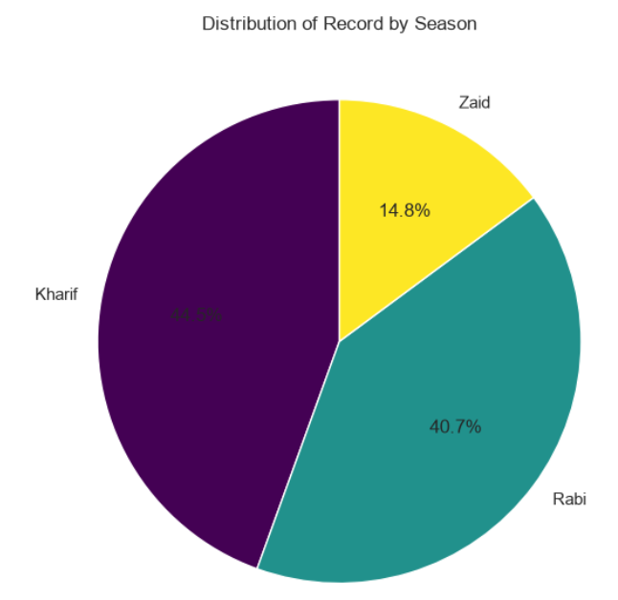
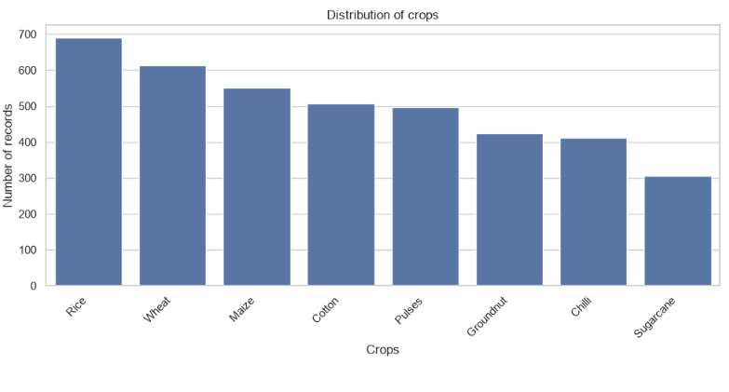
RESULTS
Q1: How are records distributed across seasons? Ans: Kharif has the most records (1,779), followed by Rabi (1,627) and Zaid (594) — Kharif and Rabi dominate the dataset while Zaid is a minority season.
Q2: Which crops are most represented in the dataset? Ans: Rice (690 records) and Wheat (614) are most common; Sugarcane (305) is least represented.

Slide 7
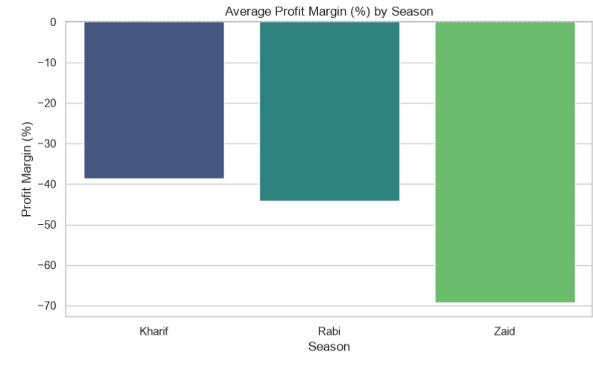
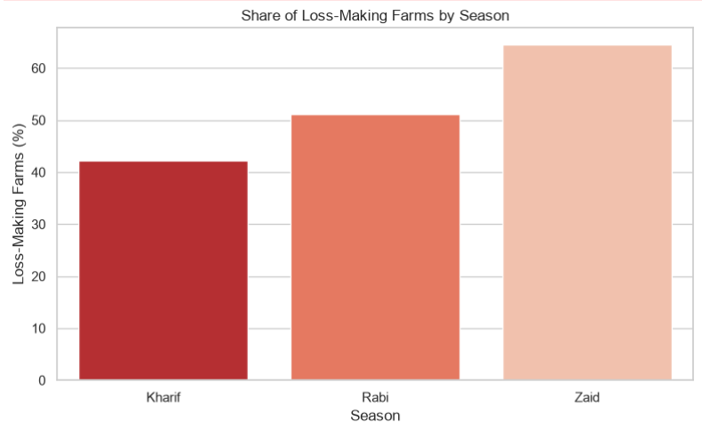
RESULTS : Economic Deep-Dive
Q3: What share of farms are actually losing money, and how does it change by season? Ans: 42.2% in Kharif, 51.1% in Rabi, and 64.5% in Zaid — losses become more common as the season becomes less favorable.
Q4: How steep are seasonal losses in percentage terms? Ans: Average profit margin is -38.6% (Kharif), -44.3% (Rabi), and -69.3% (Zaid) — Zaid's losses are nearly double Kharif's on a margin basis.

Slide 8
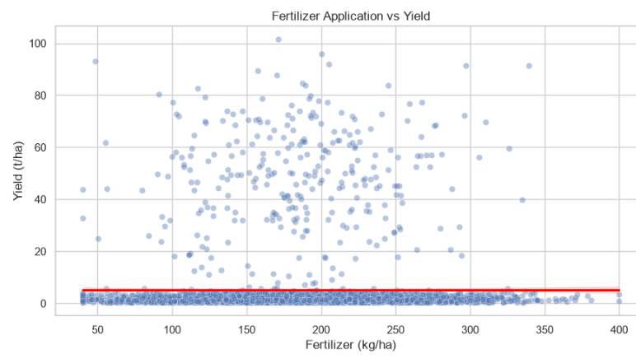
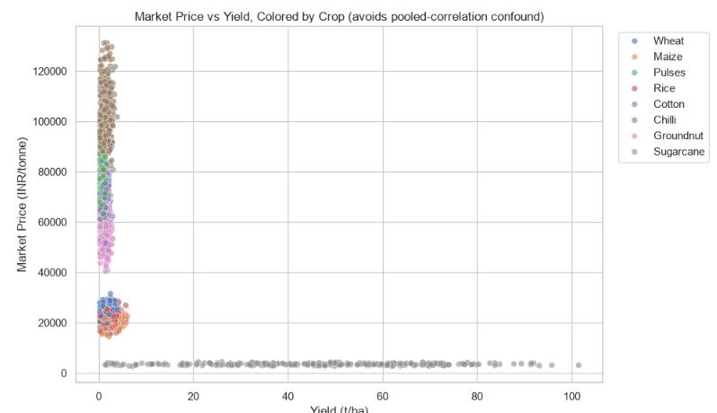
RESULTS : Resource Efficiency
Q6: Is the negative correlation between market price and yield a real economic effect? Ans: No — it's an artifact of pooling all crops together. Once colored/split by crop, each crop's own price-yield relationship looks very different (e.g., Sugarcane: high yield, low price; Pulses: low yield, high price) — it's a crop-mix effect, not a market law.
Q5: Does applying more fertilizer increase yield? Ans: No — the trend line is essentially flat, confirming fertilizer has almost no measurable relationship with yield in this data (r ≈ 0.00).

Slide 9
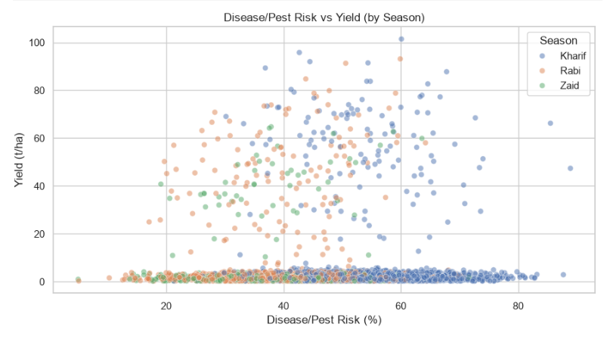
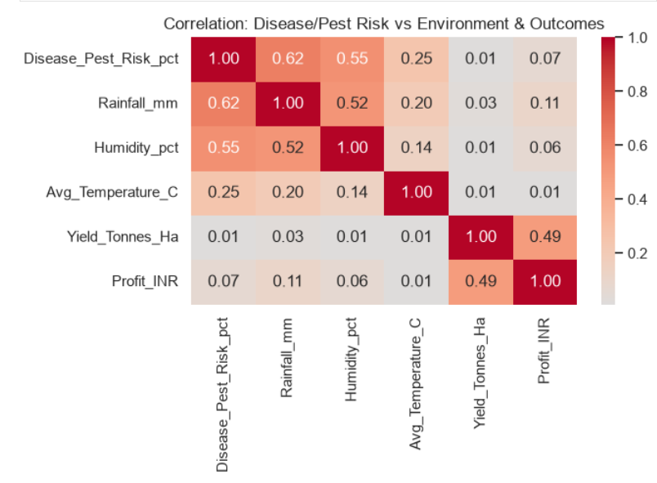
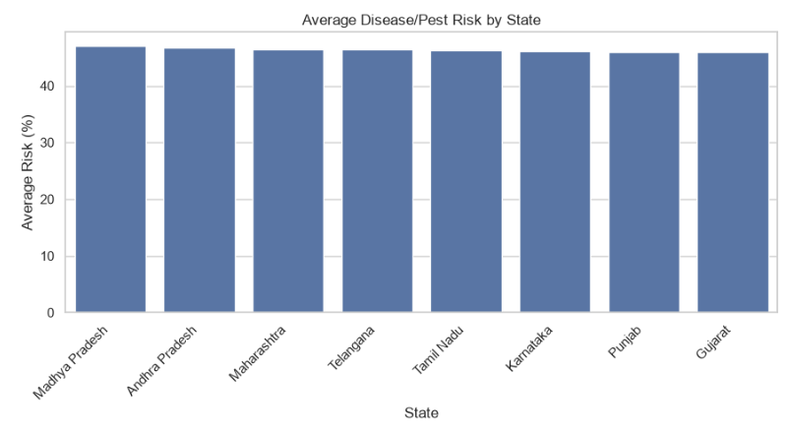
RESULTS : Risk Analysis
Q8: Does higher disease/pest risk actually reduce yield? Ans: Surprisingly, no visible relationship — points are scattered with no trend, and correlation is near zero (r ≈ 0.01).
Q7: What drives disease/pest risk — weather or region? Ans: Weather — risk correlates with rainfall (r ≈ 0.62) and humidity (r ≈ 0.55), while it barely varies across states (45.9%–47.1%), confirming it's climate-driven, not regional.

Slide 10
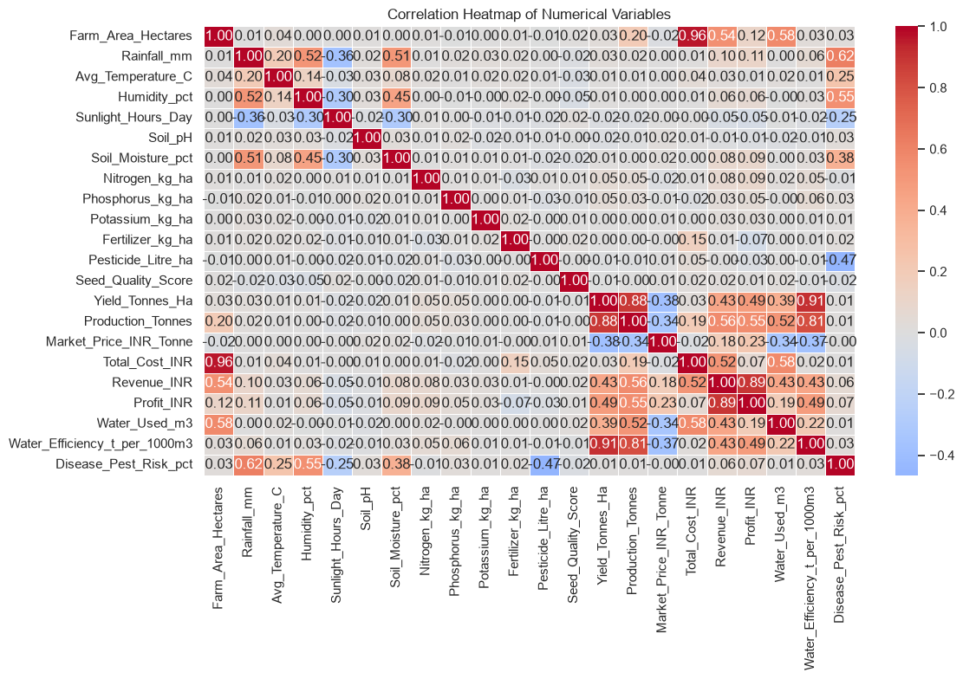
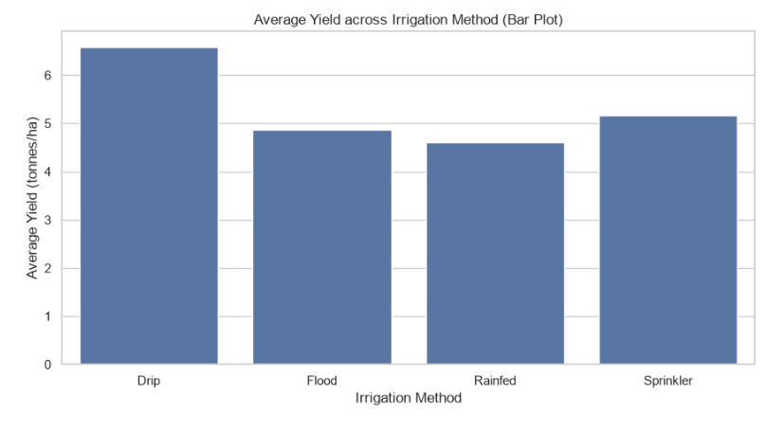
RESULTS
Q10: Which pairs of variables are most strongly correlated overall? Ans: Water Efficiency and Yield are the standout pair (r ≈ 0.91); Yield and Production are also strongly linked (r ≈ 0.88); most environmental and input variables (rainfall, nitrogen, fertilizer) show near-zero correlation with performance outcomes.
Q9: Does profit track with yield? Ans: Moderately (r ≈ 0.49) — higher yield generally means higher profit, but the relationship isn't tight, meaning cost and price differences also drive profit outcomes independently of yield.

Slide 11
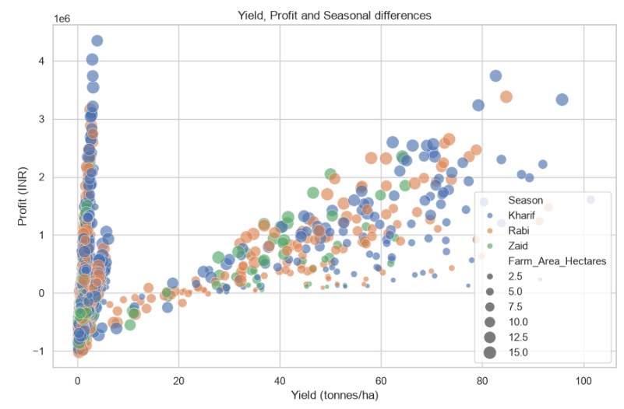
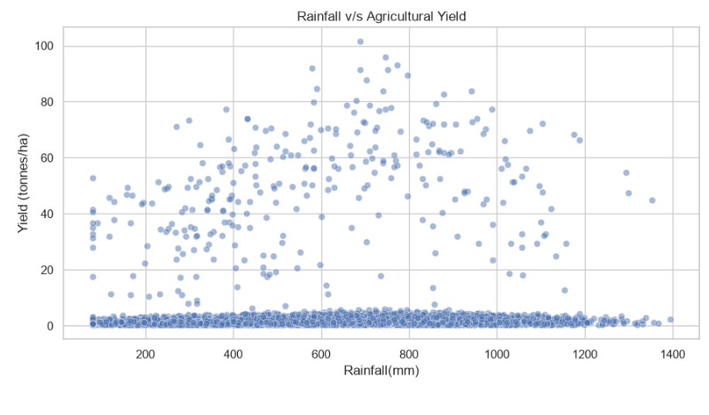
RESULTS
Q11: Does profit track with yield? Ans: Moderately (r ≈ 0.49) — higher yield generally means higher profit, but the relationship isn't tight, meaning cost and price differences also drive profit outcomes independently of yield.
Q12: Does more rainfall lead to higher yield? A: No meaningful relationship — the correlation is essentially zero (r ≈ 0.03), so rainfall alone does not explain yield differences.

Slide 12
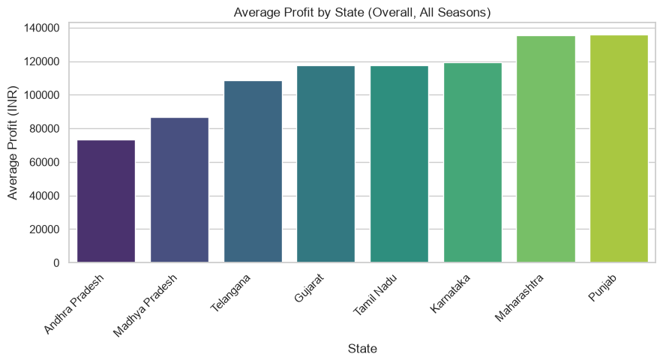
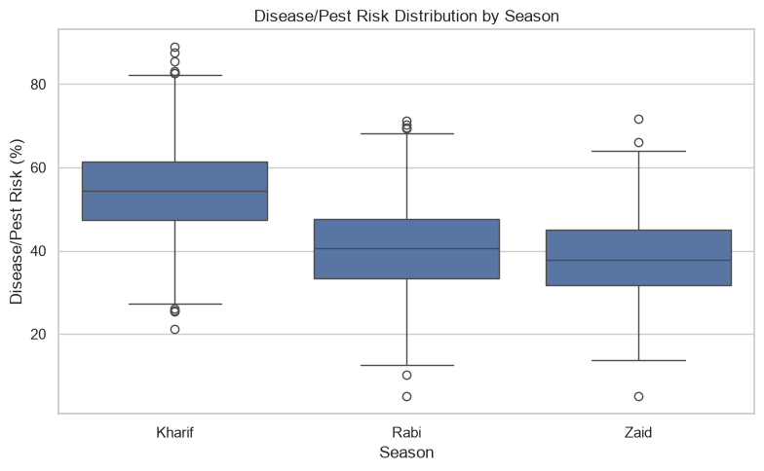
RESULTS
Q13: Which state performs best overall? A: Punjab has the highest overall average profit, followed closely by Maharashtra; Andhra Pradesh ranks lowest.
Q14: Which season carries the highest disease/pest risk? A: Kharif (54.5% average risk) is highest, Zaid (38.2%) is lowest — consistent with Kharif's monsoon rainfall driving humidity-linked risk.

Slide 13
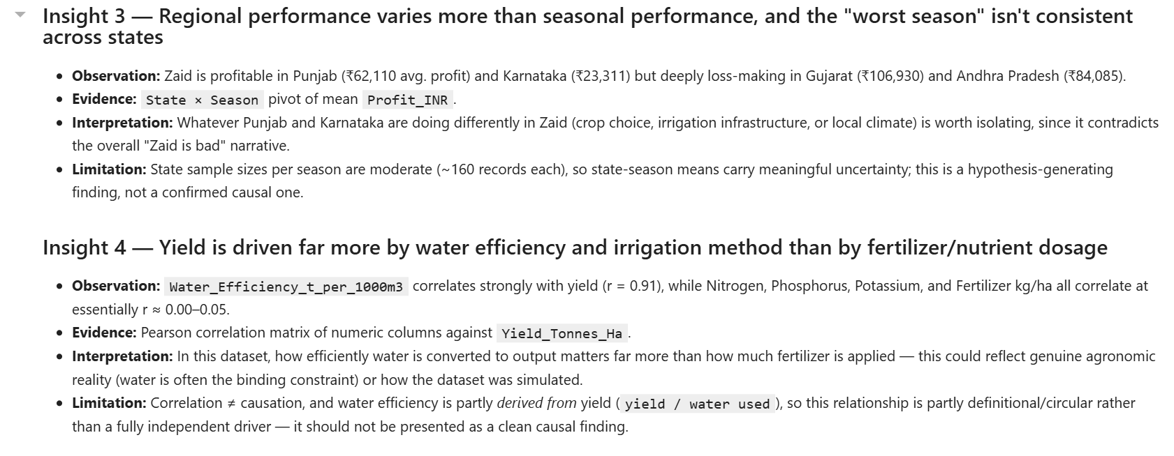
Key Insights
Present in section 14 of the ipynb file few preview are presented here

Slide 14
Future scope
1. Normalizing by crop — Repeat all the yield/profit tests again after splitting Sugarcane out from the other 7 crops (or after switching from total yield to profit per hectare) to avoid one crop driving results due to its sheer volume.
2. Regression/ML prediction — Build a regression/ML model to predict either profit or yield based on season, region, crop, and irrigation, and see what factor has the highest predictive power (not inferred from separate pairwise plots).
3. Validation — Due to possible synthetic nature of the dataset, validate the most important results (e.g., the roughly 49% of losses rate) by government/agriculture survey data to confirm findings before suggesting solutions.

Slide 15
GitHub Link
Portfolio or Github ID : https://github.com/Dhruv-kundu
Major Project Repository Link : https://github.com/Dhruv-kundu/Seasonal-Agricultural-Performance-Analysis

Slide 16
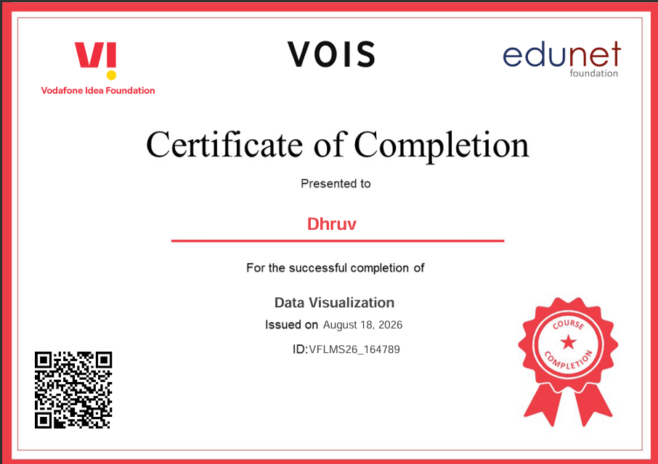
VOIS Course Completion Certificate - Course name- Data Visualization

Slide 17
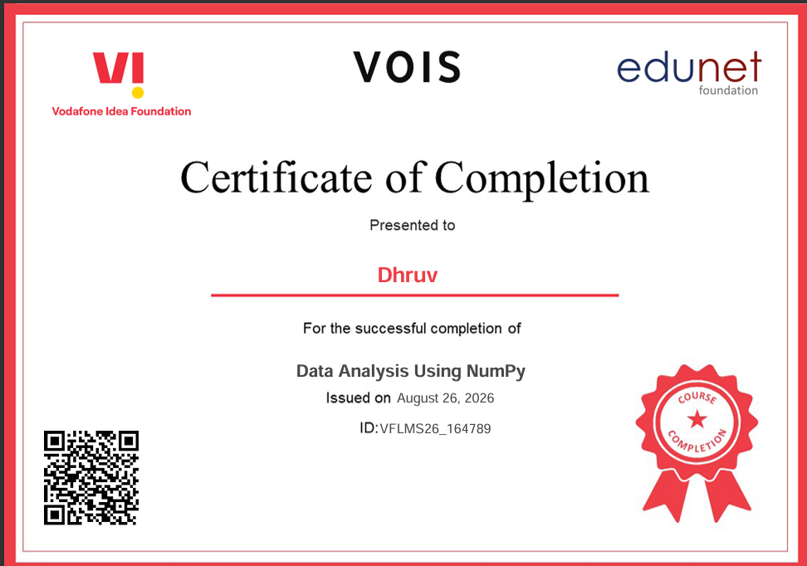
VOIS Course Completion Certificate - Course name- Data Analysis Using NumPy

Slide 18
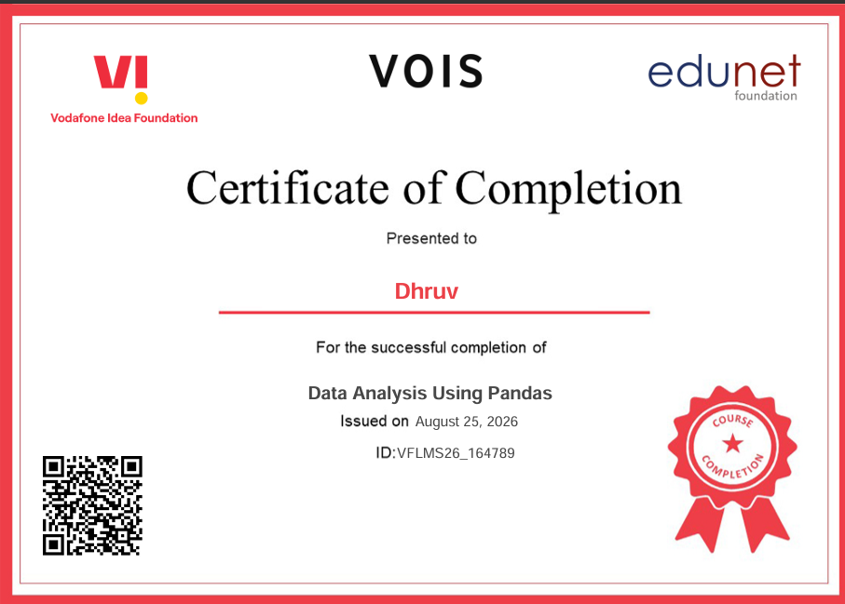
VOIS Course Completion Certificate - Course name- Data Analysis Using Pandas

Slide 19

VOIS Course Completion Certificate - Course name- Embedded Python

Slide 20

VOIS Course Completion Certificate - Course name- GUI Interface - Tkinter

Slide 21
Thank you
Recap
Cleaned and explored a 4,000-record, 8-state, 8-crop, 3-season agricultural dataset
Performed univariate, bivariate, and multivariate analysis
Added regional, risk, and economic-depth analyses (Section 13)
Derived 8 evidence-based insights with limitations and recommendations
.
Submitted as part of [VOIS for Tech Data Analytics Internship AICTE Batch 2026–2027 — Major Project], by [DHRUV], [Guru Gobind Singh Indraprastha University].
.

