Slide 1
End-to-End LangGraph Course
By Dhruv Saxena

Slide 2
SYLLABUS INTRODUCTION
Simple AI Assistant
RAG (Retrieval augmented generation)
Chaining with LCEL (LangChain Expression Language)
Understand Tools and Agents
Building Tools and Agents from Scratch
Building Agents using Langchain Class

Slide 3
SYLLABUS INTRODUCTION
Graph Structure
Understanding about the Graph
Direct Acyclic Graph(DAG) vs Cyclic Graph
What is Langgraph?
Why Langgraph is Required?
Creating LangGraph from Scratch
Creating a LangGraph using inbuilt Classes
Key concepts and terms in LangGraph
Graphs , State, Nodes, Edges,Visualization, Streaming ,Checkpoints, Breakpoints,Configuration, Memory etc.

Slide 4
SYLLABUS INTRODUCTION
Creating CHATBOT with LangGraph
Common Agentic Patterns
Structure Output
Human in Loop
ReAct Agent etc.
Multi-Agent Systems Using LangGraph
RAGs with LangGraph: CRAG, ARAG, and Self-RAG
Real-World projects leveraging LangGraph for AI Solutions.

Slide 5
What is AI Assistant?
AI assistants LLM model which understand to understand what people say and respond helpfully. They're designed to simulate human conversation and learn from every interaction.

Slide 6
What is RAG?
Retrieval-Augmented Generation: An AI framework that combines large language models (LLMs) with information retrieval systems. RAG improves the output of LLMs by referencing external knowledge sources, such as web pages, databases, and knowledge bases, to generate responses. This helps to produce more accurate, relevant, and up-to-date text. RAG is useful for chatbots and conversational agents, such as virtual personal assistants and customer support systems.

Slide 7
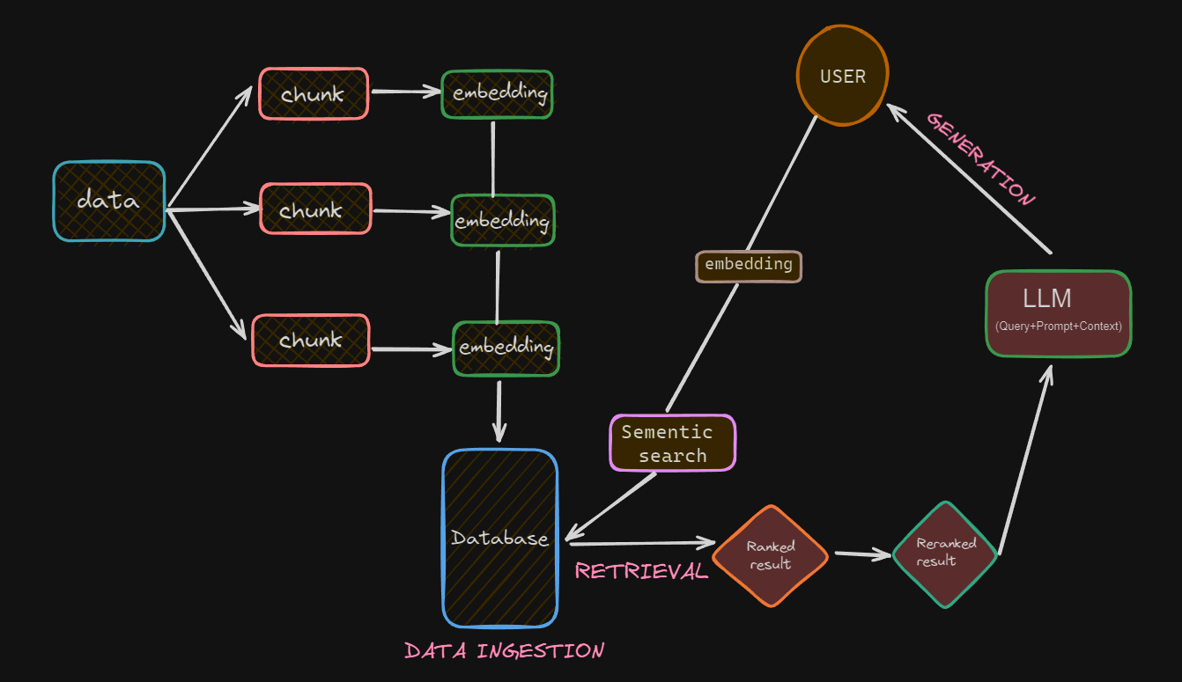

Slide 8
What is Chaining or Chaining with LCEL?
LangChain Chains connect and orchestrate multiple components
Such as prompts, LLMs, retrieval, output parsers.
LCEL makes it easy to build complex chains from basic components, and supports out of the box functionality such as streaming, parallelism, and logging.
Chains that are built with LCEL. In this case and Chains constructed by subclassing from a legacy Chain class.

Slide 9
Chains lets you create a predefined sequence of tools

Slide 10
What is Agent?
The core idea of agents is to use a language model to choose a sequence of actions to take. In chains, a sequence of actions is hardcoded (in code). In agents, a language model is used as a reasoning engine to determine which actions to take and in which order.
And as seen below, the agent creates a chain in real-time, reflects on the question, and goes through a process of action, observation, thought, action, observation, thought…until the final answer is reached.

Slide 11
The agent is then executed using an Agent Executor , which manages the interaction between the agent and the tools.

Slide 12
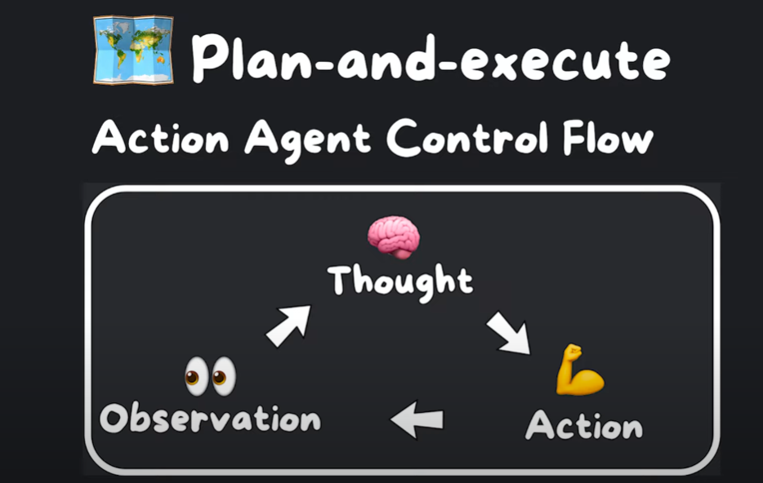

Slide 13
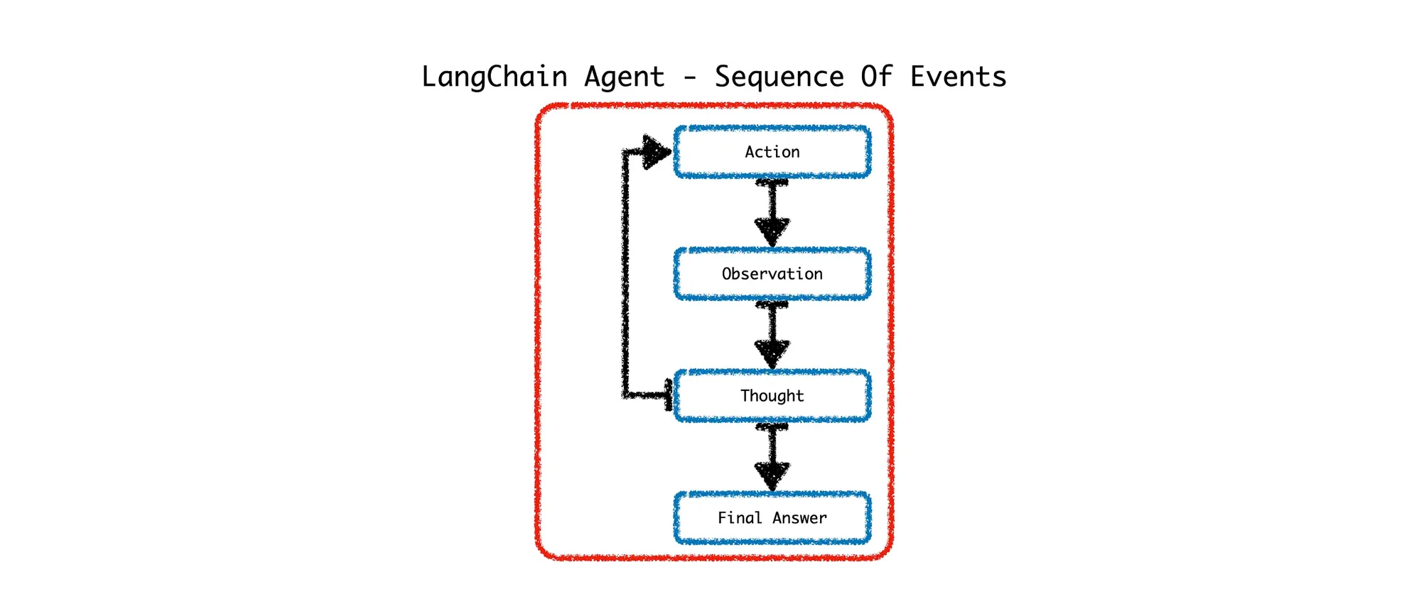

Slide 14
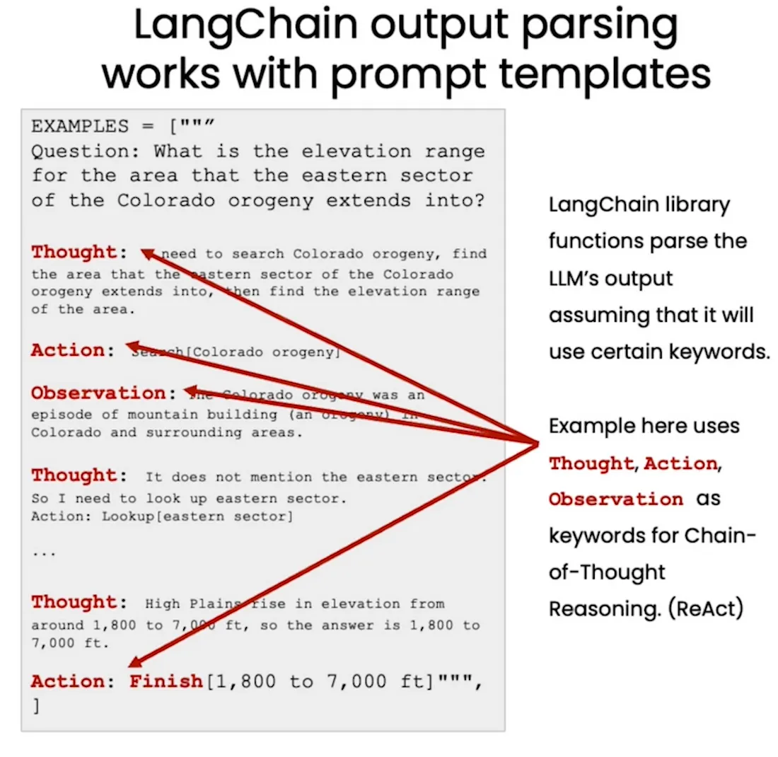

Slide 15
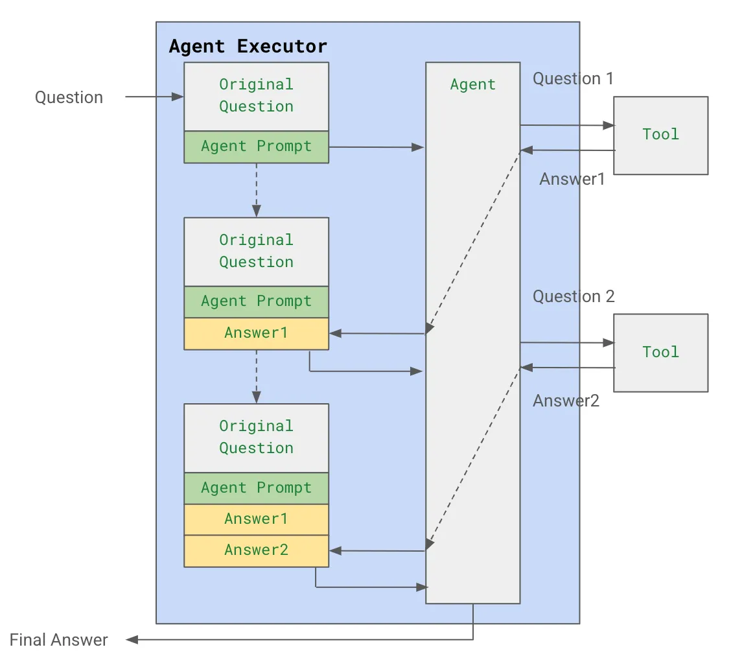

Slide 16
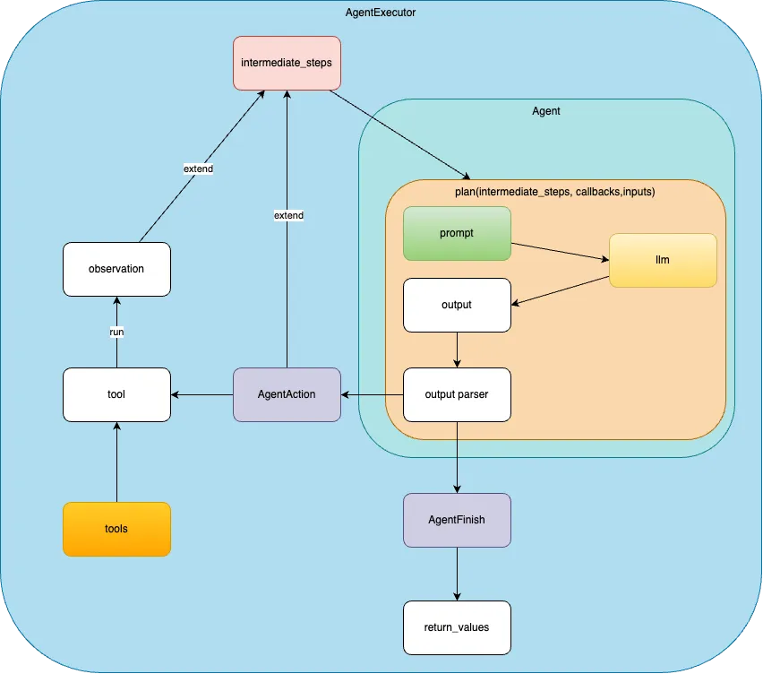

Slide 17
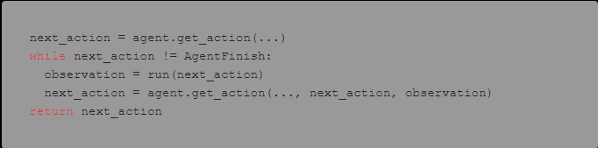

Slide 18
What is Tools?
In LangChain, an “Agent” is an AI entity that interacts with various “Tools” to perform tasks or answer queries. Tools are essentially functions that extend the agent's capabilities by allowing it to perform specific actions, like retrieving the current time or accessing an external database.

Slide 19
Agents let the model use tools in a loop, so that it can decide how many times to use tools.

Slide 20
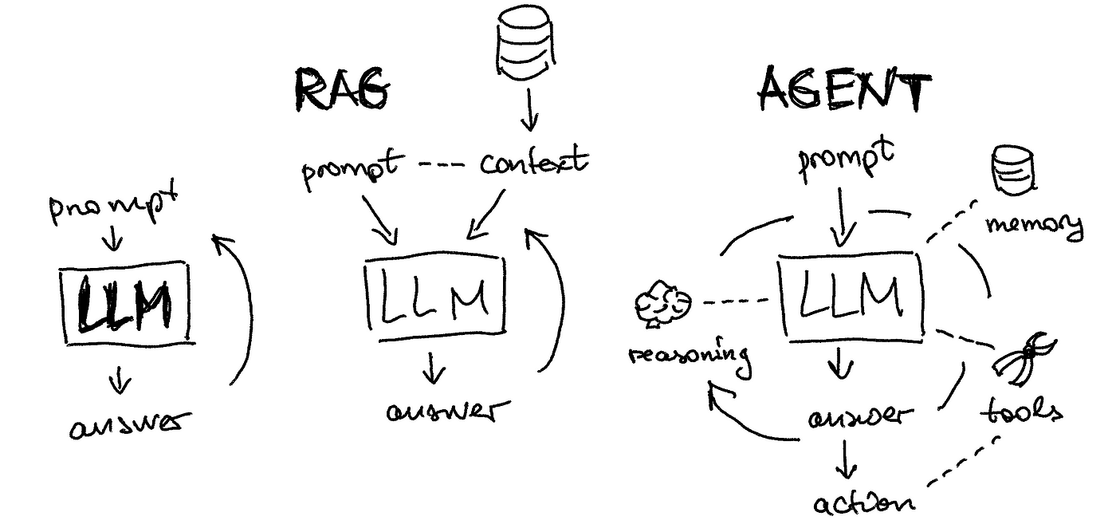

Slide 21
Types of Agents or Agentic Patterns
Tool Calling
Structure Output
Human in Loop
Map- Reduce
MultiAgents
Planning
Reflection(Reflex Agents)
ReAct Agent(Learning Agents)
Hierarchical Agents

Slide 22
Benefits of AI Agents
Enhanced Efficiency and Productivity
Improved Decision-Making
24/7 Availability and Scalability
Personalized Customer Experiences
Cost Reduction and Increased Revenue
Innovation and New Opportunities

Slide 23
AI Agent Applications Domain
Healthcare
Education
E-Commerce and Retail
Finance
Manufacturing
Marketing
Recruitment

Slide 24
Product Examples of Artificial Intelligent Agents
Intelligent Personal Assistants
Chatbots
Autonomous Robots
Game Playing Agents
Fraud Detection Agents

Slide 25
Built-in AI Agent Framework or Platform
AutoGen
Crewai
PhiData
Cogniflow
LangChain
Llama-Index
Vertex AI Agent Builder
D-iD etc…

Slide 26
Famous Built In project on Top of AI Agents
BabyAGI
Autogpt
MetaGPT
ChatDev
JARVIS
OpenDevin etc…

Slide 27
Introduction of Graph
Graph is a collection of edges and Nodes
Nodes (or vertices): Represent the objects or entities.
Edges (or links): Represent the connections or relationships between the nodes.
Directed: Edges have a direction (like an arrow), indicating a one-way relationship.

Slide 28
Introduction of Graph
A directed cyclic graph (DCG) and a directed acyclic graph (DAG) are types of graphs that describe relationships between nodes, but they differ in how cycles (loops) are handled:
1. Directed Cyclic Graph (DCG):
Directed: Each edge has a direction, indicating a one-way relationship between nodes.
Cyclic: Contains at least one cycle, meaning you can start at a node, follow directed edges, and eventually return to the same node.
Example: In a DCG, if node A points to node B, and node B points back to node A, there’s a cycle.

Slide 29
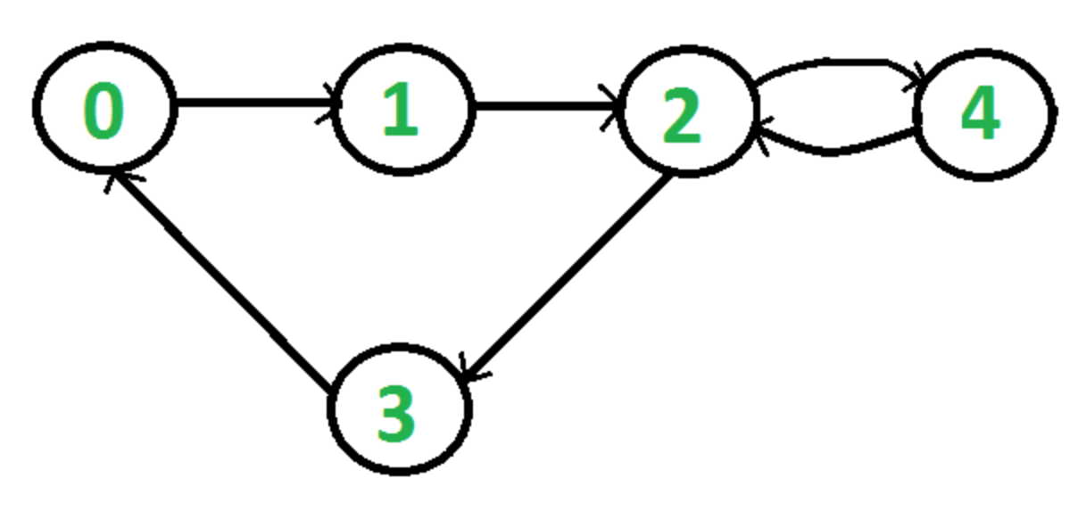

Slide 30
Introduction of Graph
2. Directed Acyclic Graph (DAG):
Directed: Each edge has a direction.
Acyclic: Contains no cycles, meaning there’s no way to start at a node and follow directed edges to return to that same node.
Example: A DAG is often used in workflows (like task scheduling), where each task must follow a certain sequence without repeating any step.
Key Difference:
A DCG allows circular paths, while a DAG strictly forbids them.

Slide 31
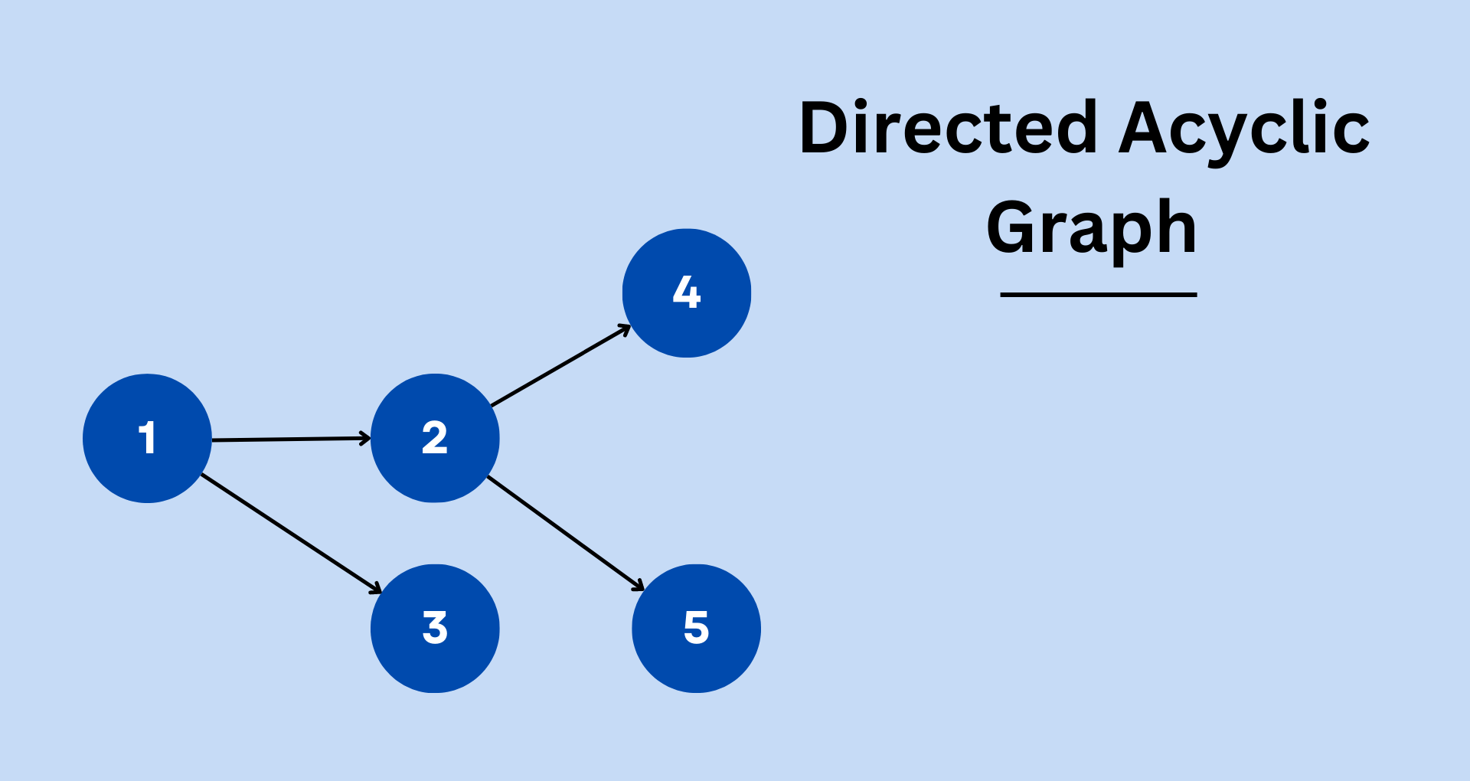

Slide 32
What is Langraph?
LangGraph is an advanced library built on top of LangChain, designed to enhance your Large Language Model (LLM) applications by introducing cyclic computational capabilities.
Lang Graph is a module built on top of LangChain to better enable creation of cyclical graphs, often needed for agent runtimes.
LangGraph introduces the ability to add cycles, enabling more complex, agent-like behaviors where you can call an LLM in a loop, asking it what action to take next.

Slide 33
While LangChain allows the creation of Directed Acyclic Graphs (DAGs) for linear workflows, LangGraph takes this a step further by enabling the addition of cycles,

Slide 34
Which are essential for developing complex, agent-like behaviors. These behaviors allow LLMs to continuously loop through a process, dynamically deciding what action to take next based on evolving conditions.

Slide 35
What is Langraph?
The aim of LangGraph is to have level of control when it comes to executing autonomous AI agents.

Slide 36
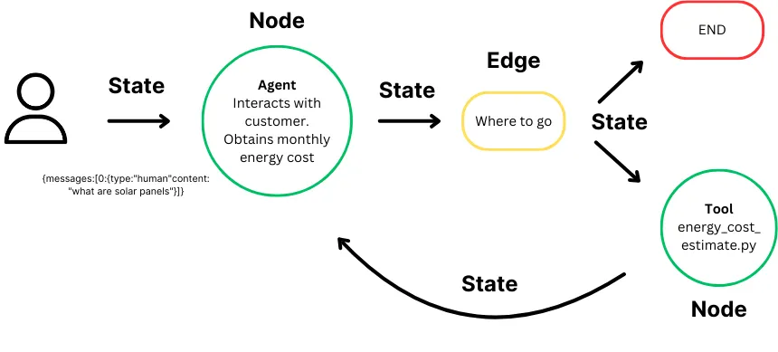
What is Langraph?

Slide 37
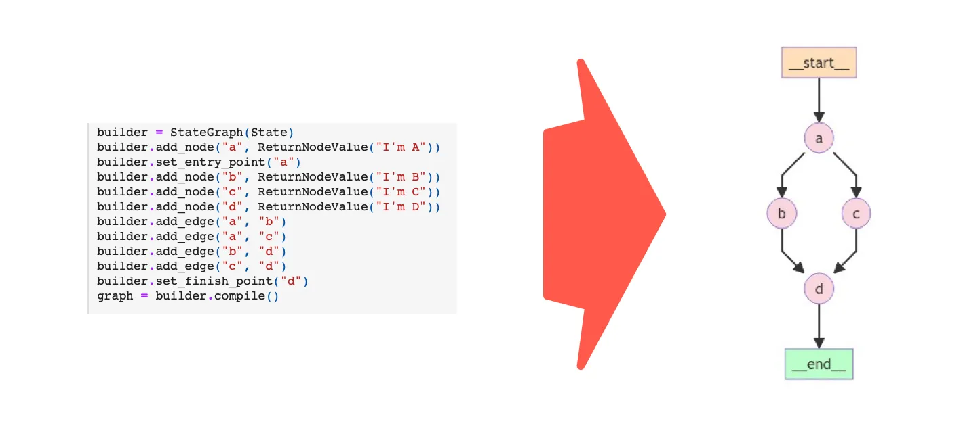
LangGraph Example

Slide 38
Why is Langraph?
LangGraph is framework-agnostic, with each node functioning as a regular Python function.It extends the core Runnable API (a shared interface for streaming, async, and batch calls) to facilitate:
Seamless state management across multiple conversation turns or tool usages.
Flexible routing between nodes based on dynamic criteria
Smooth transitions between LLMs and human intervention
Persistence for long-running, multi-session applications

Slide 39
LangGraph vs LangChain Agents
LangGraph is an orchestration framework for complex agentic systems and is more low-level and controllable than LangChain agents. On the other hand, LangChain provides a standard interface (LangChain Agents in their Previous Version)to interact with models and other components, to Automate the Flow.

Slide 40
Important Terms of Langgraph
Graphs: At its core, LangGraph models agent workflows as graphs. You define the behavior of your agents using three key components:
State: A shared data structure that represents the current snapshot of your application. It can be any Python type, but is typically a Type Dict or Pydantic Base Model.
Nodes: Python functions that encode the logic of your agents. They receive the current State as input, perform some computation or side-effect, and return an updated State.
Edges: Python functions that determine which Node to execute next based on the current State. They can be conditional branches or fixed transitions.

Slide 41
Important Terms of Langgraph
Edges define how the logic is routed and how the graph decides to stop. This is a big part of how your agents work and how different nodes communicate with each other. There are a few key types of edges:
Normal Edges: Go directly from one node to the next.
Conditional Edges: Call a function to determine which node(s) to go to next.
Entry Point: Which node to call first when user input arrives.
Conditional Entry Point: Call a function to determine which node(s) to call first when user input arrives.

Slide 42
Important Terms of Langgraph
START Node
The START Node is a special node that represents the node sends user input to the graph. The main purpose for referencing this node is to determine which nodes should be called first.
from langgraph.graph import START
graph.add_edge(START, "node_a")
END Node
The END Node is a special node that represents a terminal node. This node is referenced when you want to denote which edges have no actions after they are done.
from langgraph.graph import END
graph.add_edge("node_a", END)

Slide 43
Important Terms of Langgraph
StateGraph: The StateGraph class is the main graph class to uses. This is parameterized by a user defined State object.
Message Graph: The Message Graph class is a special type of graph. The State of a Message Graph is ONLY a list of messages. This class is rarely used except for chatbots, as most applications require the State to be more complex than a list of messages.
Compiling your graph: To build your graph, you first define the state, you then add nodes and edges, and then you compile it.
graph = graph_builder.compile(...)

Slide 44
Important Terms of Langgraph
Visualization
It's often nice to be able to visualize graphs, especially as they get more complex. LangGraph comes with several built-in ways to visualize graphs. See this how-to guide for more info.
Streaming
LangGraph is built with first class support for streaming. There are several different ways to stream back results

Slide 45
Checkpointer
LangGraph has a built-in persistence layer, implemented through checkpointers. When you use a checkpointer with a graph, you can interact with the state of that graph. When you use a checkpointer with a graph, you can interact with and manage the graph's state. The checkpointer saves a checkpoint of the graph state at every super-step, enabling several powerful capabilities:
Configuration
When creating a graph, you can also mark that certain parts of the graph are configurable. This is commonly done to enable easily switching between models or system prompts. This allows you to create a single "cognitive architecture" (the graph) but have multiple different instance of it.

Slide 46
“The best way to predict the future is to create it.”
-Dhruv Saxena

