Slide 1





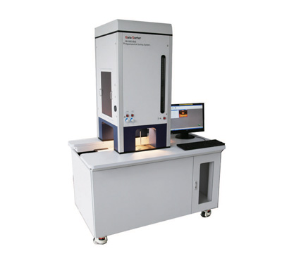
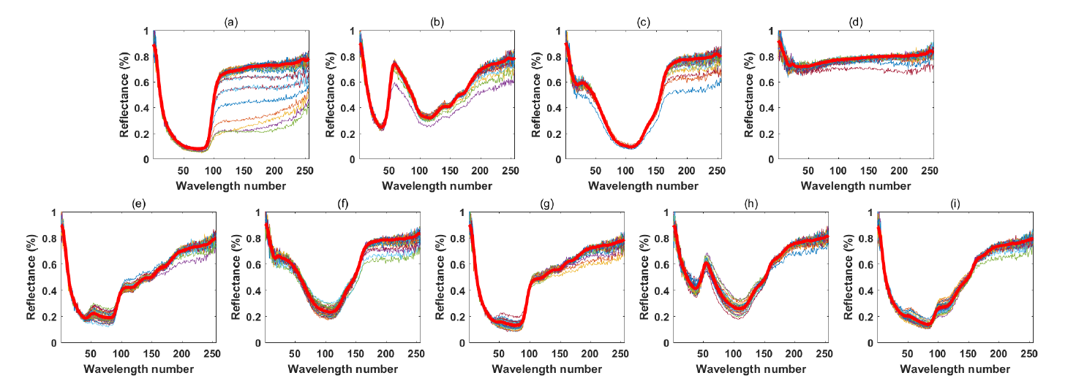
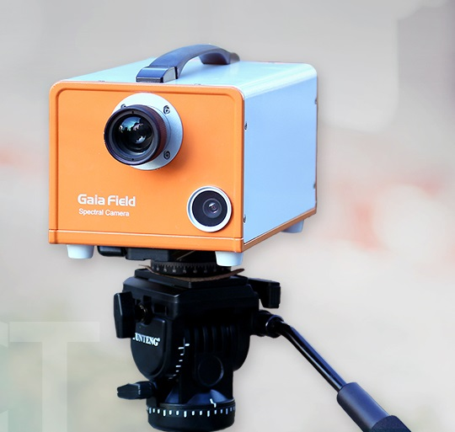
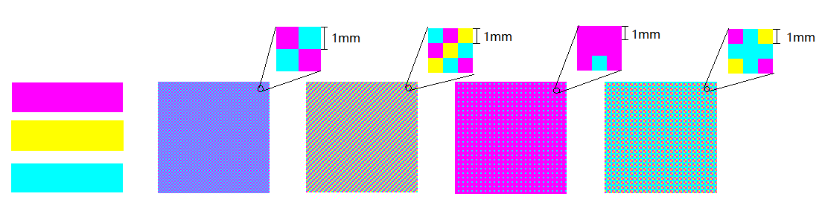
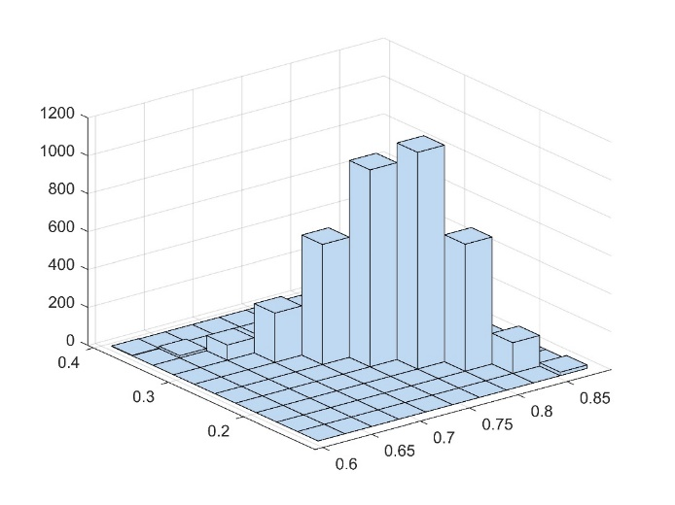
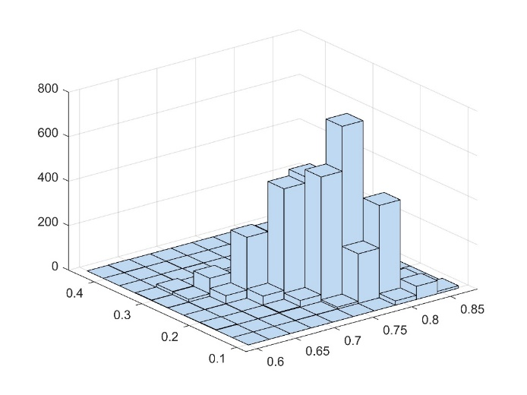
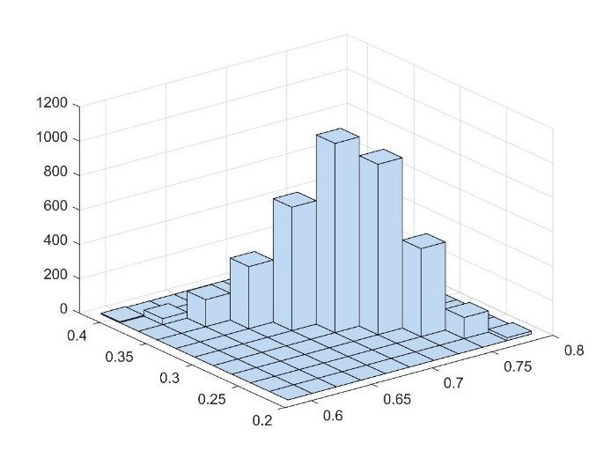
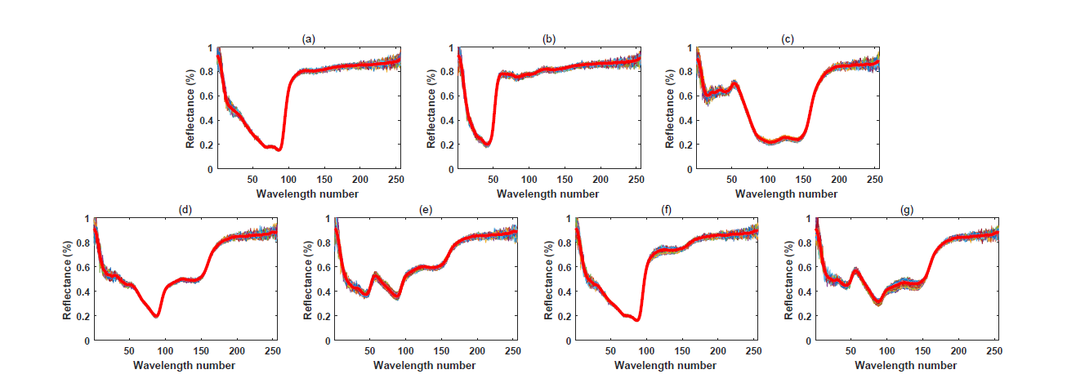
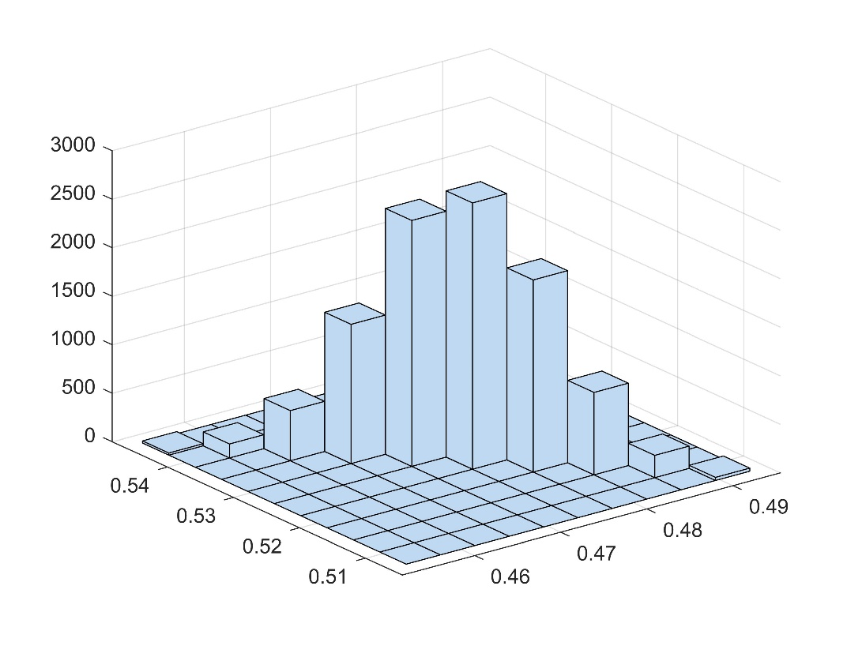
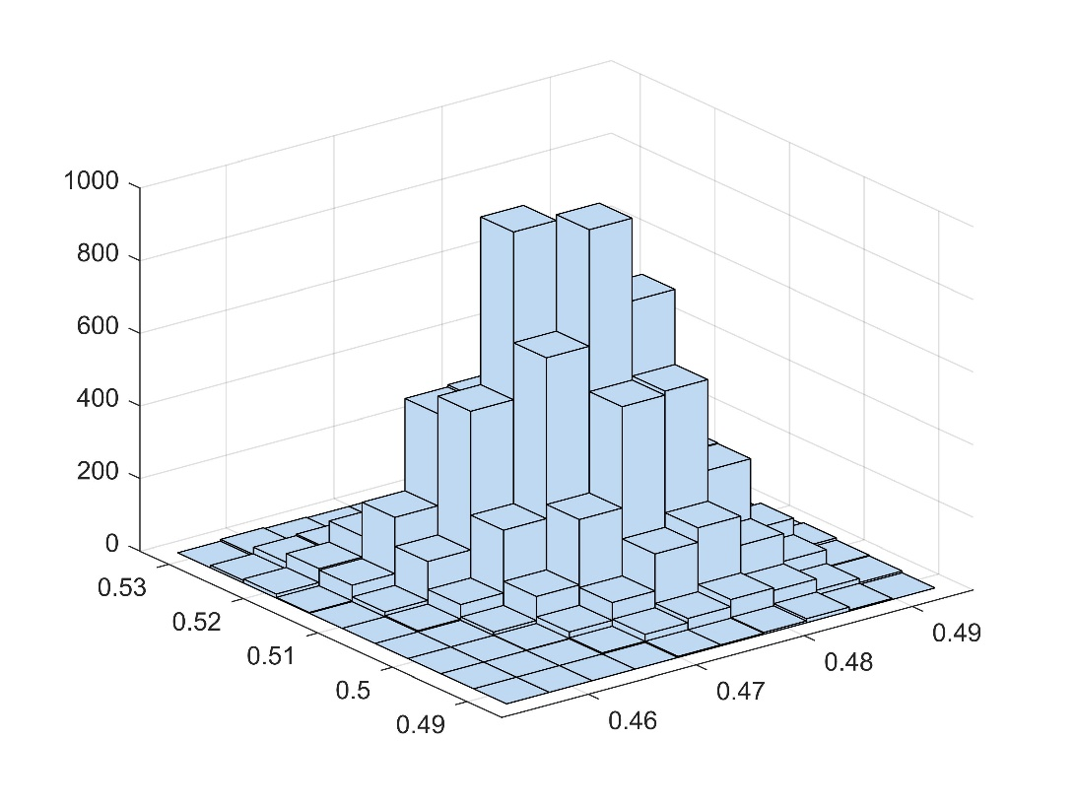
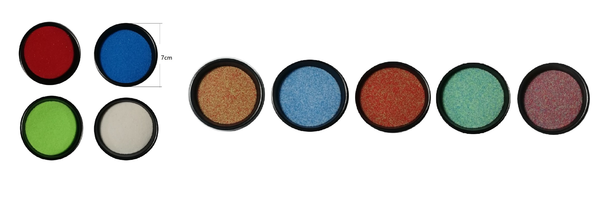


A DATASET WITH GROUND-TRUTH FOR HYPERSPECTRAL UNMIXING
Min Zhao¹, Jie Chen²
Northwestern Polytechnical University, China
Introduction and contributions
We firstly applied linear unmixing algorithms FCLS and NCLS to Scene ΙΙ, we then applied nonlinear unmixing algorithm K-Hype to the data.
Introduction
In this work, we create several experimental scenes in our laboratory with controlled settings where the pure material spectra and material compositions are known. We then capture these scenes by a hyperspectral device in order to provide a public available dataset.
 | Red | Green | Blue | White | RMSE
Mixture 1 | 62.20% | 37.80% | 0 | 0 | 0.1312
Mixture 2 | 0 | 0 | 75.04% | 24.96% | 0.2543
Mixture 3 | 76.86% | 23.14% | 0 | 0 | 0.0779
Mixture 4 | 0 | 40.08% | 48.49% | 11.43% | 0.1674
Mixture 5 | 46.73% | 6.12% | 47.16% | 0 | 0.1347
Contributions
Fig.1. Photograph of laboratory equipment.
We create a lab-made dataset with ground-truth for evaluating hyperspectral unmixing algorithms. The dataset is available on the page of the corresponding author’s website http://www.jie-chen.com/.
We apply several typical unmixing techniques to these data. We find that checkboard-type data can simulate linear unmixng, and intimately mixed materials can simulate nonlinear unmixing.
Fig.5. Spectral curves of Scene ΙΙ: (a)-(d) endmembers, (e)-(i) different mixtures. Spectral curves of 50 pixels are provided for each endmember/mixture. Thick red curves represent the mean curves.
Table 6. FCLS results of Scene ΙΙ.
Experimental scenes and data description
 | Red | Green | Blue | White | RMSE
Mixture 1 | 59.81% | 33.10% | 0 | 0 | 0.1468
Mixture 2 | 0 | 0 | 77.82% | 23.98% | 0.2736
Mixture 3 | 75.16% | 19.81% | 0 | 0 | 0.0891
Mixture 4 | 0 | 42.00% | 48.80% | 10.18% | 0.1769
Mixture 5 | 45.27% | 3.80% | 44.98% | 0 | 0.1358
 | Red | Green | Blue | White
Mixture 1 | 50% | 50% | 0 | 0
Mixture 2 | 0 | 0 | 50% | 50%
Mixture 3 | 70% | 30% | 0 | 0
Mixture 4 | 0 | 33.33% | 33.33% | 33.33%
Mixture 5 | 22.22% | 22.22% | 55.56% | 0
Checkboard-type data (Scene Ι)
Table 7. NCLS results of Scene ΙΙ.
Simulated linear mixture.
Motivation
Table 3. Ground-truth of Scene ΙΙ.
 | Red | Green | Blue | White | RMSE
Mixture 1 | 58.55% | 41.45% | 0 | 0 | 0.0931
Mixture 2 | 0 | 0 | 76.52% | 23.48% | 0.2676
Mixture 3 | 70.13% | 29.87% | 0 | 0 | 0.0290
Mixture 4 | 0 | 37.20% | 43.05% | 19.75% | 0.1076
Mixture 5 | 43.38% | 19.93% | 36.69% | 0 | 0.0613
Though both synthetic data and real data are used in the literature, on the one hand synthetic data are generated by the assumed mathematical models, on the other hand, it is difficult to get ground-truth for a real dataset. This lab-made dataset helps to reduce the gap between the theoretical research and practice, and allows the researchers to evaluate their unmixing algorithms in a quantifiable and comparable manner.
(a)
(b)
(c)
(d)
(e)
Spectral unmixing results
Table 8. K-Hype results of Scene ΙΙ.
Fig.2. Scene Ι: (a) Three endmembers. (b) to (e): Four checkerboard-type mixtures.
Results of Scene Ι
We applied Fully Constrained Least Square method (FCLS) and Nonnegative Least Square method (NCLS).
METHODS AND DATA
 | Magenta | Yellow | Cyan | RMSE
Mixture 1 | 47.44% | 0 | 52.56% | 0.0215
Mixture 2 | 35.97% | 28.09% | 35.94% | 0.0438
Mixture 3 | 89.22% | 0.09% | 10.69% | 0.0145
Mixture 4 | 24.07% | 16.91% | 59.02% | 0.0463
(a)
(b)
(c)
Fig.7. The histogram of the estimates for Mixture 3 of Scene ΙΙ: (a) FCLS, (b) NCLS, (c) K-Hype.
Hyperspectral device description and settings
Fig.3. Spectral curves of Scene Ι: (a)-(c) endmembers, (d)-(g) different mixtures. Spectral curves of 50 pixels are provided for each endmember/mixture. Thick red curves represent the mean curves.
The hyperspectral data is collected by the system GaiaSorter and GaiaField in our laboratory. GaiaField is a push-boom hyperspectral camera covering wavelength from 400nm to 1000nm, with a spectral resolution up to 0.58nm. GaiaSorter controls the moving speed of the conveyer and illuminates with four tungsten-bromine lamps.
Table 4. FCLS results of Scene Ι.
References
 | Magenta | Yellow | Cyan | RMSE
Mixture 1 | 47.47% | 0 | 50.89% | 0.0162
Mixture 2 | 35.33% | 28.88% | 34.52% | 0.0372
Mixture 3 | 89.24% | 0 | 10.17% | 0.0147
Mixture 4 | 22.92% | 18.32% | 56.50% | 0.0348
[1] D. C. Heinz and C.-I. Chang, “Fully constrained least squares linear mixture analysis for material quantification in hyperspectral imagery,” IEEE Transactions on Geoscience and Remote Sensing, vol. 39, no. 3, pp. 529–545, 2001.
 | Magenta | Yellow | Cyan
Mixture 1 | 50% | 0 | 50%
Mixture 2 | 33.33% | 33.33% | 33.33%
Mixture 3 | 88.89% | 0 | 11.11%
Mixture 4 | 22.22% | 22.22% | 55.56%
Moving speed of loading platform | 4.7cm/s
Spectral resolution | 256
Spatial resolution | 650×348
Distance between lens and samples | 40cm
Exposure time | 5ms
Table 5. NCLS results of Scene Ι.
[2] J. Chen, C. Richard, and P. Honeine, “Nonlinear unmixing of hyperspectral data based on a linear-mixture/nonlinear-fluctuation model,” IEEE Transactions on Signal Processing, vol. 61, no. 2, pp. 480–492, 2013.
Table 2. Ground-truth of Scene Ι.
Mixed granules (Scene ΙΙ)
Table 1. Equipment parameters.
Simulated intimate mixture.
Data preprocessing
Data download link
We apply black-white normalization for our acquired data. This calibration is carried out by recording an image of black (B) and another for white (W) to remove the effect of dark current of the camera sensor and avoid the uneven light intensity of each band.
(a)
(b)
(b)
(c)
(d)
(e)
(f)
Fig.6. The histogram of the estimates for Mixture 1 of Scene Ι: (a) FCLS, (b) NCLS.
(a)
Results of Scene ΙΙ
Fig.4. Scene ΙΙ: (a) Pure colored quartz sands. (b) to (f): Five mixtures.

