Slide 1

Freefex

Slide 2

Need VFX…Here is FreeFex..!!!
FreeFex provides a platform to glamorize your graphics, FreeFex offer Free virtual spells which will enchant your graphics with spontaneous attraction.
We have every type of visual aid to help you with your design, graphics, videos, and CG content.

Slide 3

Why Freefex?
FreeFex is open source platform for providing various Visual Effects. FreeFex also allows many animators, graphics creators to upload their works here commission-free. We grant the user to download and have preview of the required VFX as per their need.

Slide 4
The tools that are used
HTML
CSS
JAVA-SCRIPT
VS-CODE

Slide 5
Users :
Patron
Freelance graphic designers
Short film makers
Animators
Cinematographer
Illustrator
Many more….

Slide 6
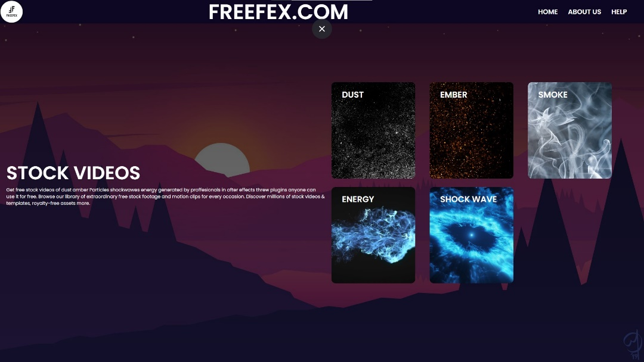
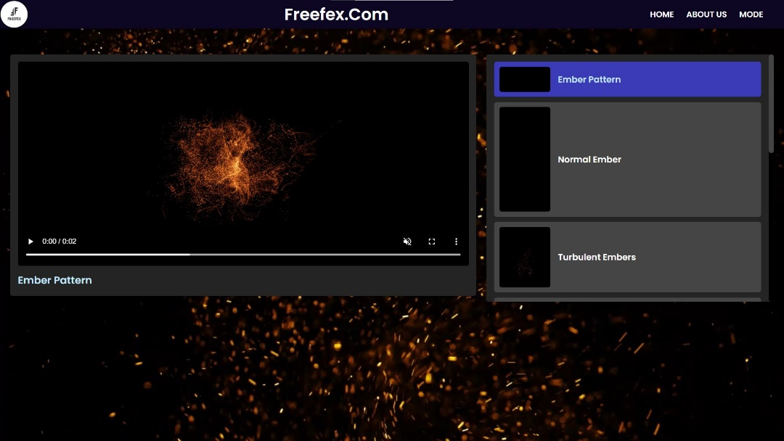
UI of The Freefex

Slide 7
MEMBERS
Thummar Bansari-(200840131026)
Parekh Dhruvkumar-(200840131053)
Jariwala Jeet-(200840131058)

Slide 8
T h a n k Y o u

