Slide 1

Group 7 | Group 7
Mitul Ranpariya | AU2240165
Dhruv Patel | AU2240166
Parth Mevada | AU2240172
Pratik Malviya | AU2240193
Sameer Gediya | AU2240195
CSE623:
Machine Learning
Theory and Practices

Slide 2
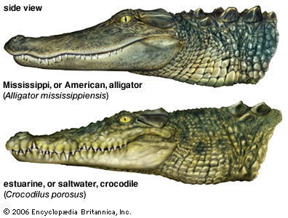


Introduction
Project Name: Machine Learning-Based Approach for Automated Biometric Identification of Mugger Crocodiles
Purpose of the Project: To develop a biometric identification system for Mugger Crocodiles using machine learning techniques

Slide 3
Problem Statement
Crocodile identification is crucial for conservation.
Challenges in Manual Identification:
Crocodiles do not have distinct external features (e.g., fur patterns seen in tigers or leopards).
Physical tagging can be stressful and invasive.
Manual photo-based identification is time-consuming and susceptible to human error.

Slide 4
Instructor’s Feedback
Two Feedbacks by Instructor:
In our last meeting, the dataset was not yet prepared.
As advised by the faculty, we first analyzed the dataset before officially starting the project.
The content for this presentation is based on open-source materials already available.
:

Slide 5
Our Work: From Image to Insight
Our Work: From Image to Insight
Collected images using UAVs (drones) and DSLR cameras in Mugger habitats across Gujarat.
Manually labeled each crocodile for creating a reliable dataset.
Isolated scute patterns using bounding box-based cropping to reduce background noise.
Applied feature extraction techniques:
SIFT – detects distinctive local features.
HOG – captures texture and edge orientations.
LBP – identifies micro-patterns in textures.
ORB – fast, rotation-invariant keypoints.

Slide 6
Our Work: Smart Classification & Augmentation
Used SVM classifier (RBF kernel) for accurate and interpretable predictions.
Implemented Synthetic Data Augmentation by adding Gaussian noise to:
Enrich the dataset
Prevent overfitting
Improve generalization
Trained and validated the model on real + synthetic feature vectors.
Set a confidence threshold of 65% for predictions to ensure reliability.

Slide 7
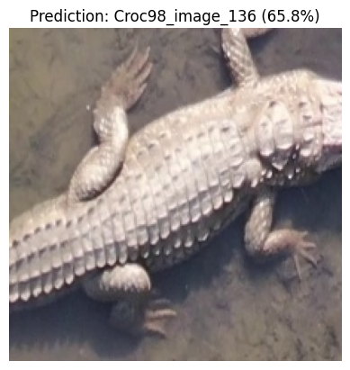
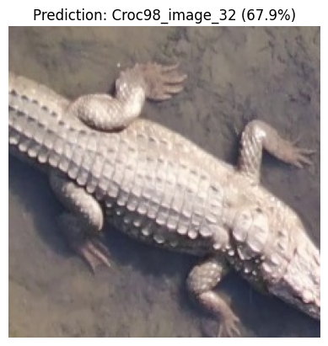
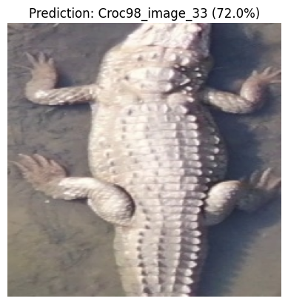
Results

Slide 8
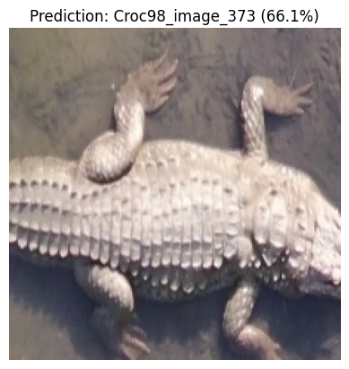
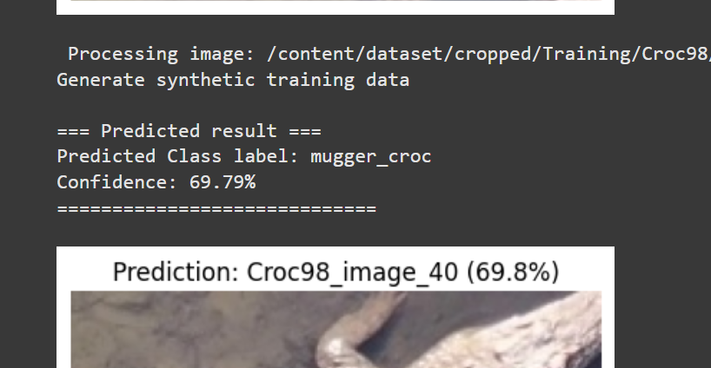
Results

Slide 9
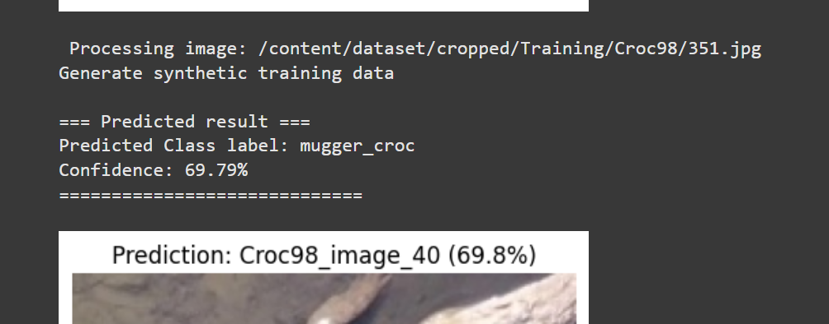
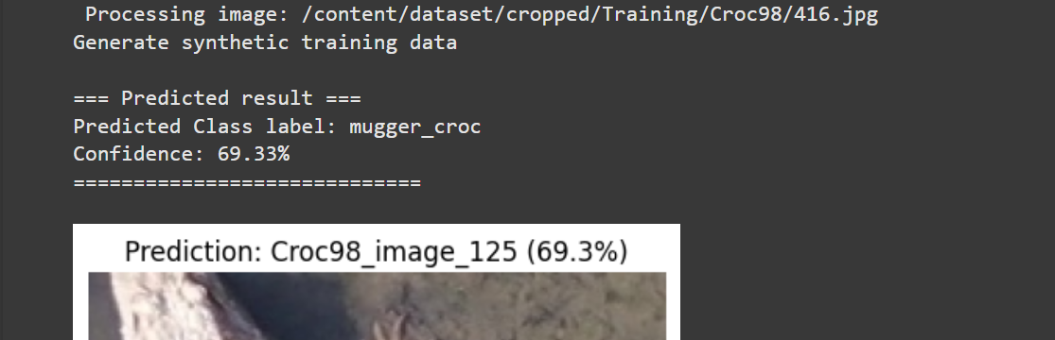
Results

Slide 10
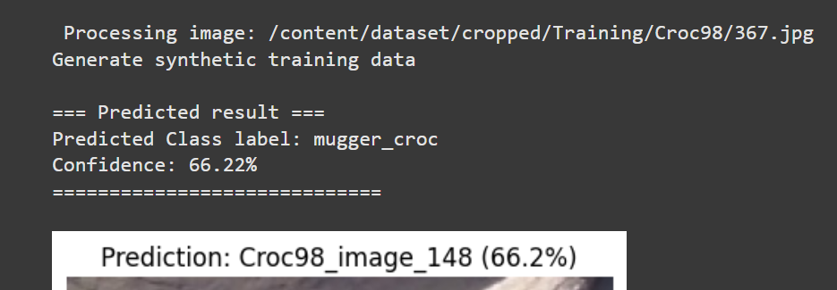
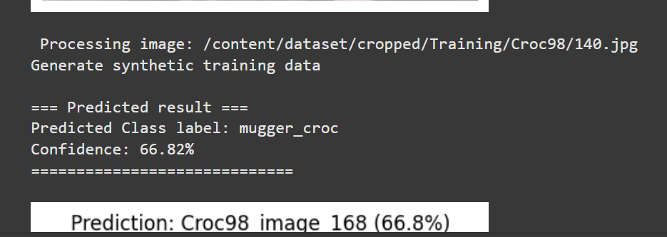
Results

Slide 11
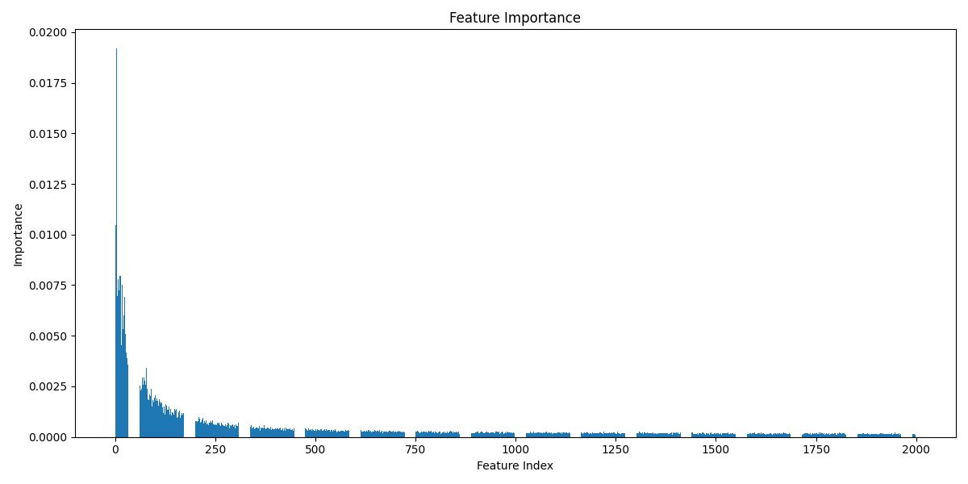
Results

Slide 12
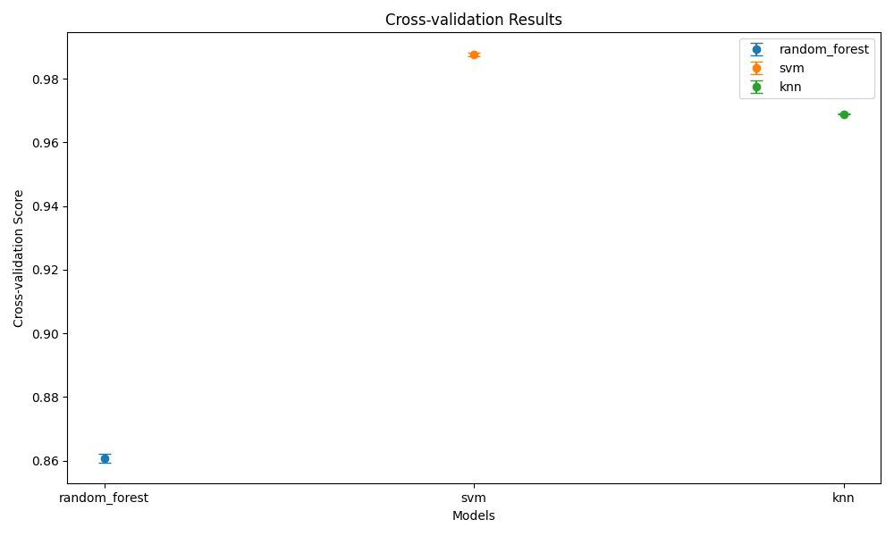
Results

Slide 13
Future Scope
Enhanced Detection with Deep Learning
Use advanced models like YOLOv8 or Faster R-CNN for more accurate scute detection under challenging conditions.
Larger and More Diverse Dataset
Include more individuals and varied environmental conditions to improve model generalization and robustness.
Real-Time Deployment on Mobile and UAVs
Optimize the system for drones and smartphones to enable real-time identification during field surveys.
Extension to Long-Term Monitoring
Track individuals over time to support behavioral studies and long-term conservation planning.
:

Slide 14
References
[1] R. C. Gonzalez and R. E. Woods, ”Digital Image Processing”, 4th ed.,
Pearson, 2018.
[2] C. Szegedy et al., ”Going Deeper With Convolutions,” in Proc. IEEE
Conference32 on Computer Vision and Pattern Recognition (CVPR), pp.
1-9, 2015.
[3] C. Bishop, ”Pattern Recognition and Machine Learning,” Springer, 2006.
[4] K. He, X. Zhang, S. Ren, and J. Sun, ”Deep Residual Learning for
Image Recognition,” in IEEE CVPR, pp. 770-778, 2016.
Notes:
How its work??
An LDR works by decreasing its resistance when exposed to light: as light intensity increases, photons provide energy to electrons in the LDR, causing them to move from the valence to the conduction band, thereby increasing conductivity.

Slide 15
THANK YOU

