Slide 1
Separate Factual and Non-Factual data in News articles
- Dhruv Kaushik (MT18037)
Subhani Shaik (MT18117)
Palla Akhil Kumar(MT18130)

Slide 2
Problem Statement
News Article usually contains factual as well as non-factual statements. Our goal is to develop a model that can Retrieve Factual information from a given news-article.
Facts:
events which have actually happened.
statements which can be proved to be true.
Non-Factual Information:
sentiments, beliefs, opinions, predictions, etc.
Factual statements are highlighted in bold in below sample snippet:
News Article Snippet: The hydrocarbon sector performed poorly with crude oil(-3.3%) and natural gas(-6.9%) reporting decline in output and refineries posting a tepid 1.2% rise in May after a 17.9% rise in April. Overall industrial activity is relatively weak. A cause for concern is weak capex, construction and realty. Road projects are picking up, which might offset in a few months."

Slide 3
Related work
Subjectivity vs. Objectivity
Closely related problem. The difference is objectivity often also includes unprejudiced reporting and fairness in writing.
Wiebe and Rilo et al. developed rule-based sentence level subjective vs. objective classifier based on general subjectivity clues and POS features.
Chenlo and Losada et al. concluded n-grams and sentiment lexicon features perform well consistently for subjectivity and polarity classification.
Biyani et al. studied methods to predict subjectivity orientation of online forum threads for use in improving their retrieval.
Jayawardene et al. explored paragraph level subjectivity and objectivity content analysis of online news reporting on health care reforms.

Slide 4
Related work
Document Level Factual vs. Non-factual Classifier (DLFNC)
DLFNC categorizes whole document as subjective text (nonfactual) or objective text (factual).
Hong Yu, Vasileios et al. created a DLFNC based on token-based (n-grams) and syntactic features (POS).
A. Stepinski and V. Mittal et al. developed a DLFNC to classify complete news article as fact or opinion using Passive Aggressive Algorithm trained on token based features.
Drawback:
Wiebe et al. proved that on average only around 44% of sentences in a news collection were found to be subjective.
Giving same label to all sentences is inaccurate solution.

Slide 5
Related work
Sentence Level Factual vs. Non-factual Classifier(SLFNC)
SLFNC classifies each sentence in an article as factual or non-factual in nature
Hassan, et al. developed sentence level fact classifier to automate fact checking in political debates.
The work by Oraby, Reed et al. explored distinguishing factual arguments from emotional arguments in online dialogue.
Regmi and Bal et al. proposed a framework to determine facts and opinions in news media using a lexicon of factual verbs and expressions.
Kastner and Monz et al. developed model to automatically generate news highlights based on facts extracted using keyword extraction and summarization.

Slide 6
Method 1 - SVM
MPQA corpus dataset
Feature Extraction: For SVM
N-grams Features: Average count of Factual and Non-Factual Unigrams, Bigrams and Trigrams in sentence.
Part-of-speech (POS) tags: Count of distinct POS tags in sentence
Entity types: Count of distinct Entities in sentence
Sentiment Score: Sentiment score of sentence
Subjective patterns (T-pattern): Count of the 5 T-Patterns in statement
(T-patterns list shown on next page)

Slide 7
Our Contribution
T-patterns
6. POS Pattern: Average count of Factual and Non-Factual trigrams and fourgrams of POS Tags.
Classification Model:
Linear Support Vector Machine (SVM)
The hyper parameters are tuned using GridSearch with cross-validation of 5 folds.

Slide 8
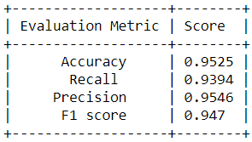
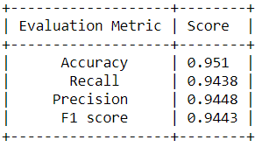
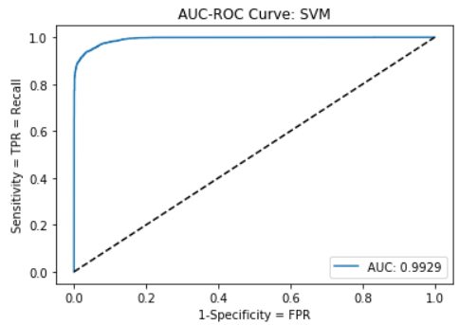
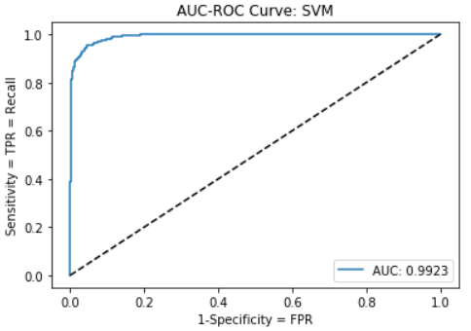
Results for SVM
Results for Training data
Results for Testing data
ROC Curve for Training data
ROC Curve for Testing data

Slide 9
Method 2 - LSTM and GRU
Feature extraction: for LSTM and GRU
Feature vector for a statement in LSTM is list of word embeddings for all tokens in the statement.
The word embedding for a statement is obtained by using Word2vec module of Gensim library, trained over Wikipedia articles corpus.
Length of sentences are different. Thus, dummy word embedding, containing all zeroes, are padded to bring feature vector of each sentence dimension 140.

Slide 10
LSTM/GRU model description
LSTM
Used several variants of LSTM like 2 layers, 3 layers, with dropout rate, without dropout, cutting down the maximum length of sentence (ignoring some unnecessary sentences) and taking average of the word embeddings.
We trained on these architectures by setting parameters learning rate of 0.0001, epochs=10, Adam optimizer technique and batch size of 16, dropout rate=0.2.
GRU
We used GRU with 3 layers.
We trained on these architectures by setting parameters learning rate of 0.0001, epochs=30, Adam optimizer technique and batch size of 16, dropout rate=0.2.

Slide 11
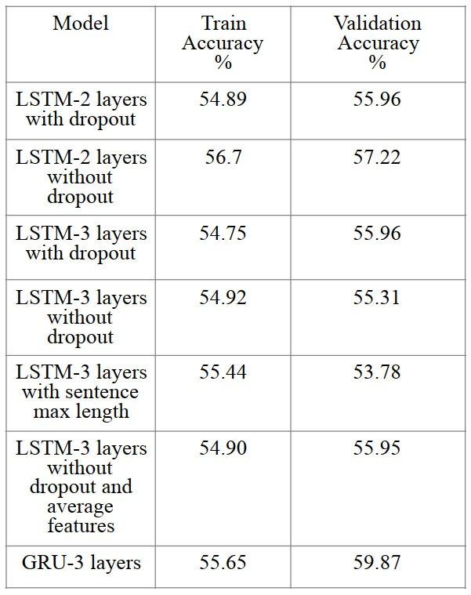
LSTM/GRU Results

Slide 12
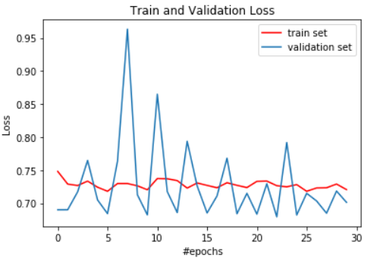
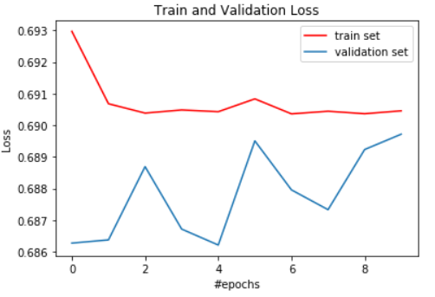
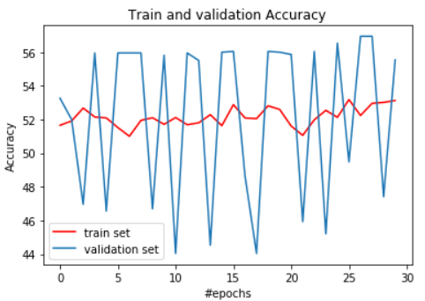
LSTM/GRU Results
GRU with 3 layers
LSTM ,3 layers, without dropout
GRU with 3 layers

Slide 13
Conclusion
The Linear SVM classifier model developed in this project performs this task efficiently .
It works more accurately over short or medium-sized statements than long statements, as long statement usually contains both subjective as well as objective type of phrases.
LSTM and GRU don’t performed well because of dataset features.
We will get better results by Hand-crafted features to extract Factual information from news-article.

Slide 14
Thank You

