Slide 1


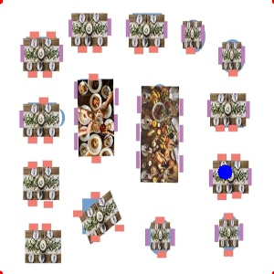
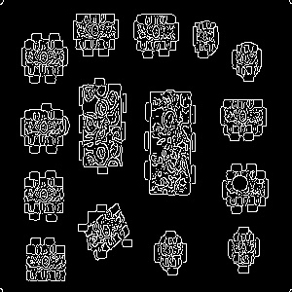
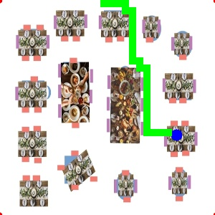
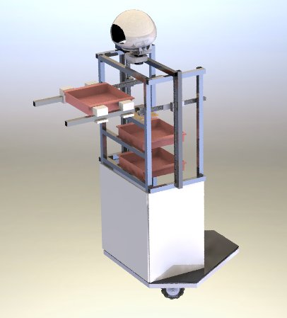
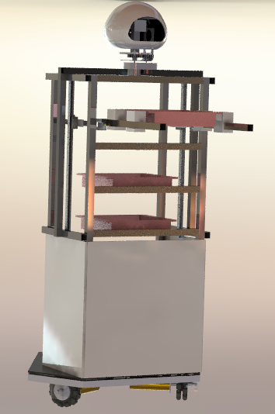
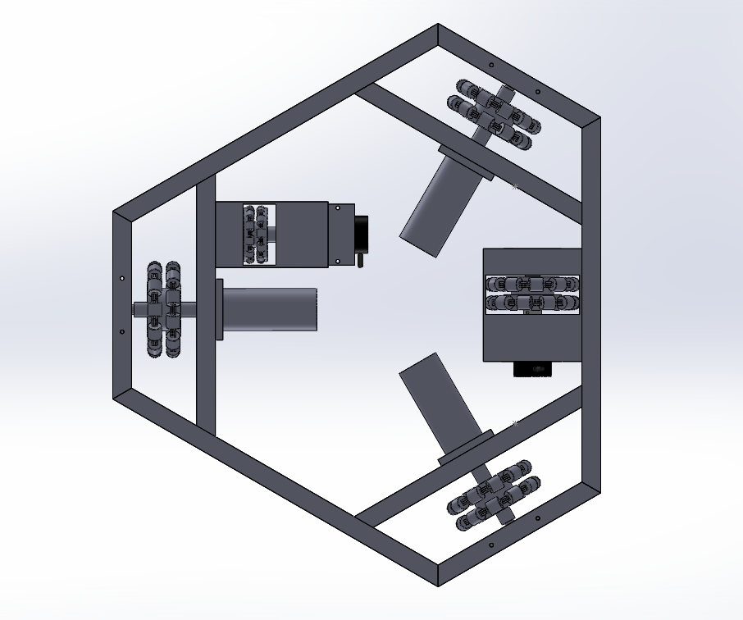
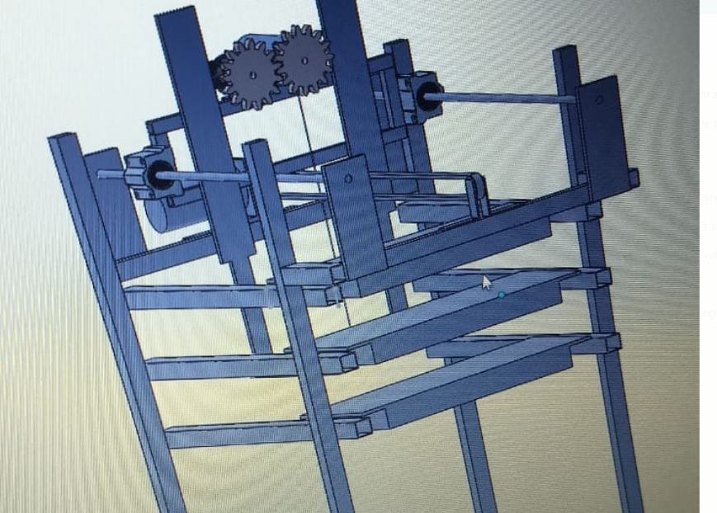
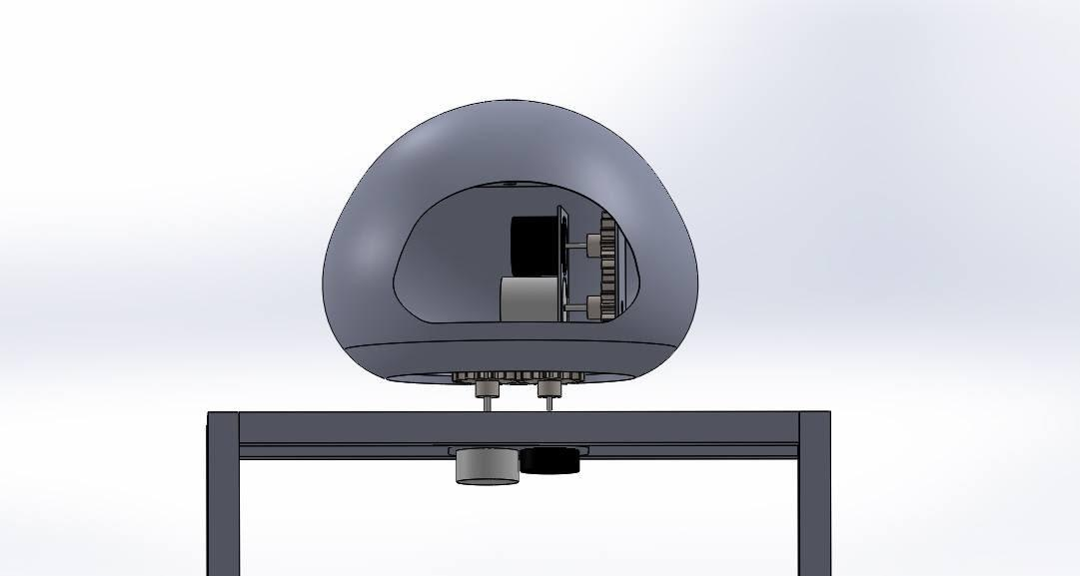
Restaurant of the Future
Dhruv Sehgal, Nikhil Kumar, Prachi Agarwal, Pranjal Mishra, Pratham Meena, Pratikesh Thakur,
Riya Bhalla, Shreeyash Geda, Shubhanshu Agarwal and Tejasva Soni
Indian Institute of Technology, Roorkee
Abstract/Introduction
The use of robots as waiters in restaurants is on an increasing trend in the service industry. Restaurants owners have begun to look towards robots to aid in serving the customers due to shortage of waiters Developed a prototype of an Omni wheeled based mobile waiter robot for trial runs in a casual dining food outlet. Unlike existing waiter robots, it is autonomous, has higher payload and is able to travel and dock at the target table and take multiple order at the same time. ONGOING WORK ‘ROBOT’ restaurant in Chennai, India employed four robotic waiters. A restaurant in Chengdu, China employed ten robots as waiters which carry dishes around and give simple greetings to customer.
Results
ECONOMIC VALUE Efficient robotic waiters deployed in markets around the world cost from $6,000 to $30,000. Our robot cost approximately 38,867 Rs or 550 $.
Fig. 5 Top View Image of Restaurant
Fig. 6 Edge Detection
Fig. 7 Result
Component | Cost(INR)
Aluminium Pipes | 6000
Omni Wheels | 3117
Linear Slides | 180
Rotary Encoders | 6160
Actuators | 9710
Machined Parts | 2800
Steel Pipes | 150
Camera | 450
LED Panels | 300
Electronics | 10000
Restaurant of the Future
Methodology
MECHANICAL DESIGN The design involves: Three wheel omni-chassis Frame Structure and lift mechanism Head ELECTRONIC ASPECTS:
Conclusion
Current Scenario Currently designed robot are based on line following mechanism which requires change in the floor design. Can carry only one item at a time thus less efficient. Another drawback is that the robots just take the order from kitchen to table, after that either the customer has to take the food from the bot or a waiter walks with the robot to serve the food, which obviously doesn’t make any sense. OUTCOME Effective and efficient work as we are using robots. Reduces customer waiting time. One-time investment in the system. Work can be faster and may reduce the cost of labor. As customers place their own orders, waiter staff numbers can be reduced. Applications are performed with precision and high repeatability.
Fig. 1 Omni Chassis
Fig. 2 Lift and Tray Mechanism
Fig. 3 Head Mechanism
References
https://pypi.org/project/gTTS/https://arxiv.org/pdf/1710.07557.pdf https://github.com/Shreeyash-iitr/Emotion-Recognition https://en.wikipedia.org/wiki/Dijkstra%27s_algorithm https://docs.opencv.org/3.0-beta/doc/py_tutorials/py_imgproc/py_table_of_contents_imgproc/py_table_of_contents_imgproc.html
Path Planning
Overhead Camera to detect obstacles
Navigation
Encoder based Navigation of the Omni Chassis
Human Interaction
Verbally take orders or to serve the food on the table
Figure 4

