Slide 1
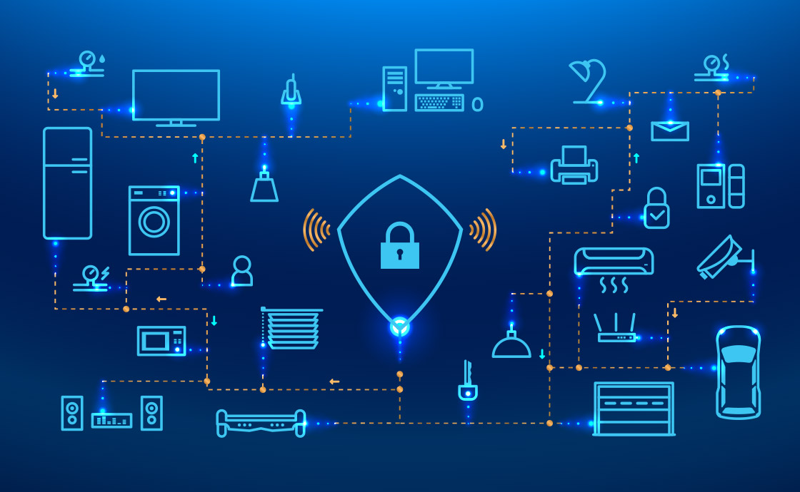
Welcome
Lets Get Started

Slide 2
Image Steganography

Slide 3
Outline
Introduction
Application
Objective
Literature
Proposed System (Demo)
Analysis
Conclusion
Future Work
Reference
What is Steganography ?

Slide 4
Introduction
What is Steganography ?
Steganography is the technique of hiding secret data within an ordinary, non-secret, file or message in order to avoid detection, the secret data is then extracted at its destination.
The different methods of Steganography are:
Text Based Steganography
Image Based Steganography
Audio Based Steganography
Video Based Steganography
What is Image Based Steganography ?

Slide 5
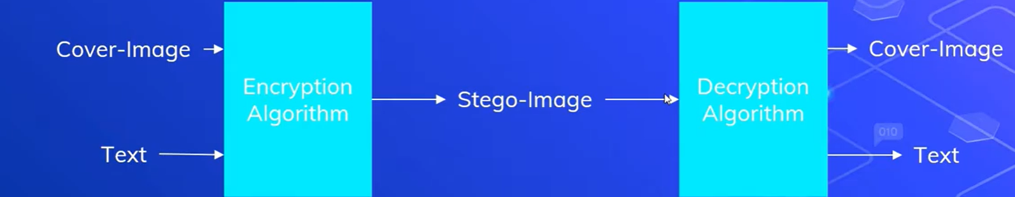
Introduction
What is Image Based Steganography ?
Image Steganography refers to the process of hiding data within an image file.
The image selected for this purpose is called the cover-image and the image obtained after steganography is called the stego-image.
Fig. 1 Basic Image Steganography

Slide 6
Application
Secure Private Files and Documents.
Hide Passwords and Encryption Keys.
Transport Highly Private Documents between International Governments.
Transmit message/data without revealing the existence of available message

Slide 7
Objective
To hide a secret message within an object. It will be done in such a way that the presence of message is not visible.

Slide 8
Literature
Image Based Steganography can be performed using two methods :
Least Significant Bit (LSB) Method
Discrete Cosine Transform Method
In this application we make use of the Least Significant Bit (LSB) Method

Slide 9
Literature
LSB Method
The most common and popular method of modern day steganography is to make use of LSB of picture’s pixel information.
This technique works best when the file is longer than the message file and if image is grayscale.
When applying LSB techniques to each byte of a 24 bit image, three bits can be encoded into each pixel.

Slide 10
Literature
How LSB Method is embedded Data
Read Input
Extract Pixels From Cover Image
Extract Characters From Text
Extract Characters From Key
Embed Data in image
Choose Pixels and Place characters from Stego Key in Pixels.
Add Terminal Symbol indicating end of key.
Insert characters from the message in the pixels.
Stego Image Ready

Slide 11
Literature
How LSB Method is Extracted Data
Extract Lsbs
Extract Least Significant Bits from Pixels Of Stego Image
Extract Key
Read key in Image, till the occurrence the entered of Termination character.
If retrieved key matches the entered key, extract data from the
Extract Message
Read Characters from the LSBs of the Image Pixels
Combine all extracted characters, to form original message.

Slide 12
Literature
Example:
We can use images to hide things if we replace the last bit of every color’s byte with a bit from the message.
Message A-01000001
Image with 3 pixels
Pixel 1: 11111000 11001001 00000011
Pixel 2: 11111000 11001001 00000011
Pixel 3: 11111000 11001001 00000011

Slide 13
Literature
Now we hide our message in the image.
Message: 01000001
Image with 3 pixels
Pixel 1: 11111000 11001001 00000010
Pixel 2: 11111000 11001000 00000010
Pixel 3: 11111000 11001001 00000011
New image:

Slide 14
Literature
AES
AES is an encryption standard chosen by the National Institute of Standards and Technology(NIST), USA to protect classified information. It has been accepted world wide as a desirable algorithm to encrypt sensitive data.
It is a block cipher which operates on block size of 128 bits for both encrypting as well as decrypting.
Each Round performs same operations.

Slide 15
Literature
AES Working
AES basically repeats 4 major functions to encrypt data. It takes 128 bit block of data and a key[ layman's term password] and gives a cipher text as output.
The functions are:
I. Sub Bytes
II. Shift Rows
III. Mix Columns
IV. Add Key

Slide 16
Literature
AES Working
The number of rounds performed by the algorithm strictly depends on the size of key.
The following table gives overview of no. Of rounds performed with the input of varying key lengths:
Key Size(in bits) Rounds 128...........................................................10 192...........................................................12 256...........................................................14
The larger the number of keys the more secure will be the data. The time taken by s/w to encrypt will increase with no. of rounds.

Slide 17
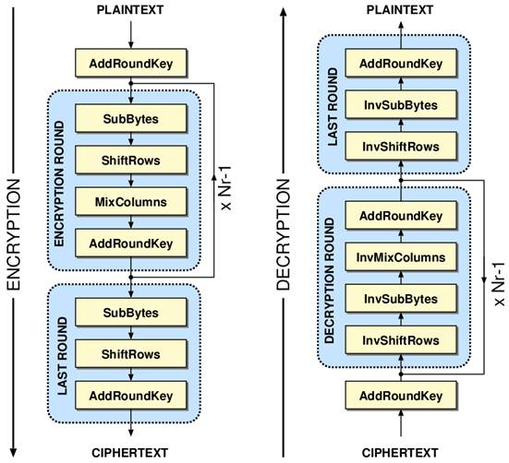
Literature
AES Working
Fig. 2 AES Simple Encryption and Decryption

Slide 18
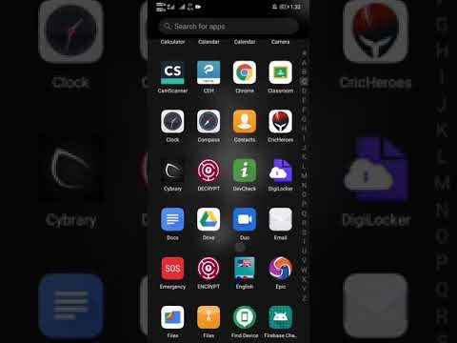
Proposed System (Demo)
Fig. 3 Proposed system Demo

Slide 19
Analysis
In this project we mainly concentrated on embedding the data into an image. We have designed the steganography application which embedded the data into the image.
Normally, after embedding the data into the image, the image may lose its resolution. In the proposed approach, the image remains unchanged in its resolution as well in size.
The speed of embedding the data into the image is also high in the proposed approach such that the image is protected and the data to the destination is sent securely.
There are many steganography algorithms available like JSteg, F5 and LSB algorithms.
We have used the Least Significant Bit algorithm in designing the steganography application because LSB algorithm works efficiently when we consider bit map images .bmp files. The speed of embedding is also high when using LSB compared to the JSteg algorithm.

Slide 20
Conclusion
In the present world, the data transfers using internet is rapidly growing because it is so easier as well as faster to transfer the data to destination. So, many individuals and business people use to transfer business documents, important information using internet.
Security is an important issue while transferring the data using internet because any unauthorized individual can hack the data and make it useless or obtain information un- intended to him.
So Hiding a message with steganography methods reduces the chance of a message being detected or hack.

Slide 21
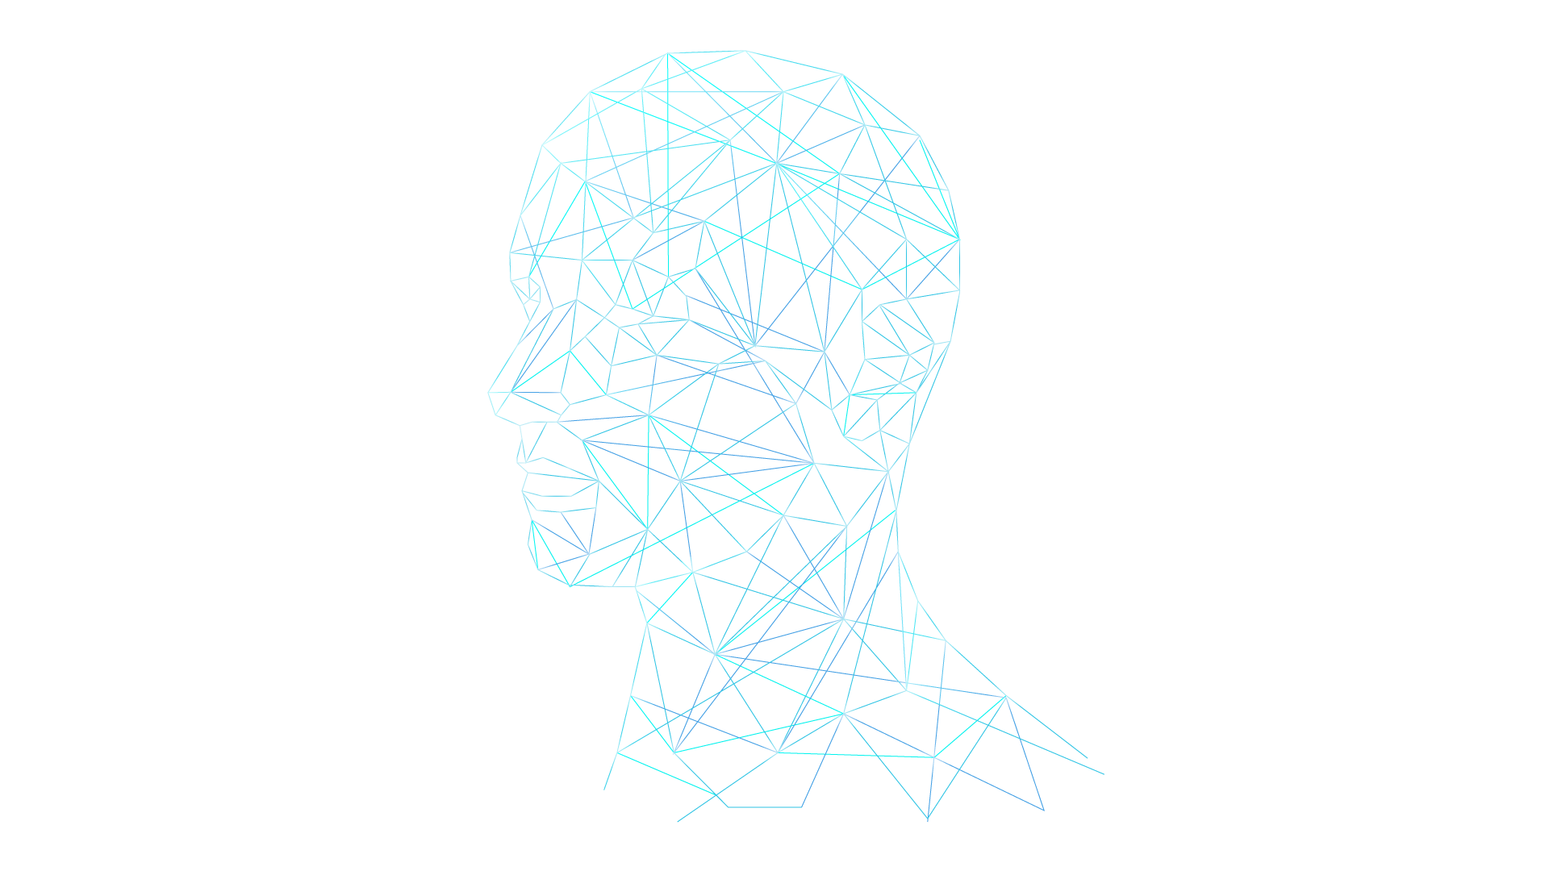
Future Work
In Future we are going to embed this system in chat application as we discussed in present world, the data transfers using internet is rapidly growing because it is so easier as well as faster to transfer the data to destination.
We can see that so many fake images are share in chat. So to we use image steganography as origin finder.
For that we will store use-id in stego image so that we can find out easily.

Slide 22
References
https://www.geeksforgeeks.org/image-steganography-in-cryptography/
https://searchsecurity.techtarget.com/definition/steganography
https://lyra-kdf.net/guide-rise-fall-5-best-key-encryption-algorithms/
https://www.tutorialspoint.com/cryptography/advanced_encryption_standard.htm
https://www.irjet.net/archives/V5/i4/IRJET-V5I4337.pdf

Slide 23
Thank You So Much

