Slide 1

Benefits of playing outdoor games
MADE BY:DHRUV KHANDEWAL(KALVIUM)

Slide 2

Benefits of playing outdoor games are:-
Physical fitness
Mental well-being
Cognitive development
Social interaction
Creativity
Vitamin D intake
Stress reduction
Environment awareness
This Photo by Unknown Author is licensed under CC BY-ND

Slide 3

Physical fitness:-
A fantastic way to keep ourselves physically fit.
Increase muscle Strength
Increase bone Health
Maintain coordination and Balance
Increase flexibility , etc

Slide 4

Mental well-being:-
Spending time outdoors and participating in games can have a positive impact on mental health.
Fresh air and natural surroundings help reduce stress, anxiety, and depression.
Outdoor activities encourage mindfulness and relaxation, contributing to improved mental well-being.

Slide 5
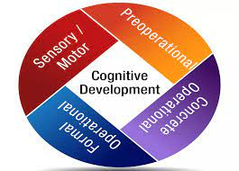
Cognitive development:-
Many outdoor games require strategic thinking, problem-solving, and quick decision-making.
Engaging in such activities stimulates the brain and enhances cognitive functions.
Exposure to varying terrains and environments also sharpens sensory perception and spatial awareness.

Slide 6

Social interaction:-
Outdoor games often involve group participation, fostering social interaction and teamwork.
Playing with others promotes communication, cooperation, and the development of interpersonal skills.
These skills are valuable in both personal and professional contexts.

Slide 7

Creativity:-
The outdoors provide a diverse and dynamic environment for imaginative play.
Children can invent new games, explore their surroundings, and use their creativity to come up with new ways to interact with the environment.

Slide 8

Vitamin D intake:-
Being outdoors exposes us to natural sunlight, which is a crucial source of vitamin D.
Vitamin D is essential for maintaining strong bones, regulating the immune system, and promoting overall well-being.

Slide 9

Stress reduction:-
Spending time outdoors and participating in physical activities can reduce stress levels.
The combination of exercise, fresh air, and natural surroundings creates a calming and rejuvenating experience that helps alleviate stress.

Slide 10
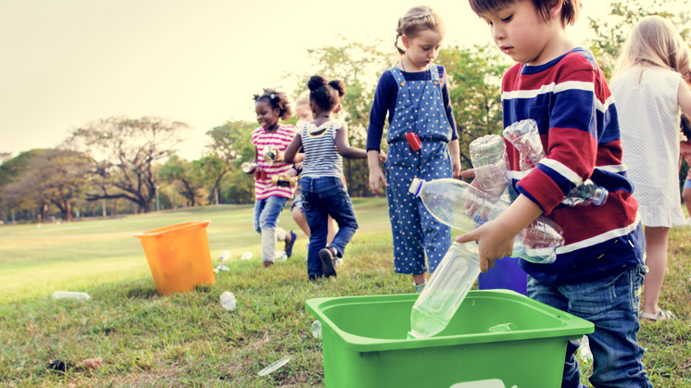
Environment awareness
Outdoor games encourage a connection with the natural world, raising awareness about environmental conservation.
Outdoor games encourage a connection with the natural world, raising awareness about environmental conservation.
Activities like hiking, nature walks, and outdoor exploration instill a sense of responsibility for preserving the environment.

Slide 11
Conclusion
In conclusion, the benefits of outdoor games are abundant and diverse, touching on various aspects of our physical, mental, and social well-being.
By engaging in these activities, we tap into the innate connection between humans and the natural world, revitalizing our bodies and minds in the process.

Slide 12
Thank you

