Slide 1
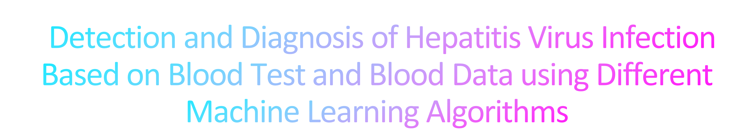
20BEC009 - ANSHUL DANI
20BEC024 - DHRUV DHOLARIYA
SUBMITTED TO: - PROF. BHUPENDRA FATANIYA

Slide 2
The objective of this research is to select the best method for hepatitis diagnosis, prevention, and therapy.
Hepatitis patients' life expectancy appears to be relatively low.
They used neural networks in this assignment's comparative comparison of several machine learning tools.
The accuracy rate and an average rectangle error are used to determine the metric's success.
The Machine Learning Algorithms (ML), including Naive Bayes, Support Vector Machines (SVM), and K Nearest Neighbor (K- NEAREST NEIGHBOUR), were regarded as classification and prediction methods for Data Segmentation for Detecting and Diagnosing Hepatitis illness.
An overview of the algorithms was done. concentrating on how accurately diseases are diagnosed.

Slide 3
K-nearest neighbor (KNN) algorithm is a machine learning algorithm that can be used for virus detection.
The KNN algorithm is a type of supervised learning, where the algorithm learns to recognize patterns in data by using labeled training data.
In virus detection, the KNN algorithm can be used to identify new viruses by comparing them with known viruses in a database.
The algorithm works by calculating the distance between the new virus and the known viruses in the database.
The distance is calculated based on the features of the virus, such as its genetic sequence or structural characteristics.
The KNN algorithm then classifies the new virus based on the class of the nearest neighbors in the database.
For example, if the new virus is more similar to viruses in the database that are known to cause disease, then the KNN algorithm may classify the new virus as a potential pathogen.

Slide 4
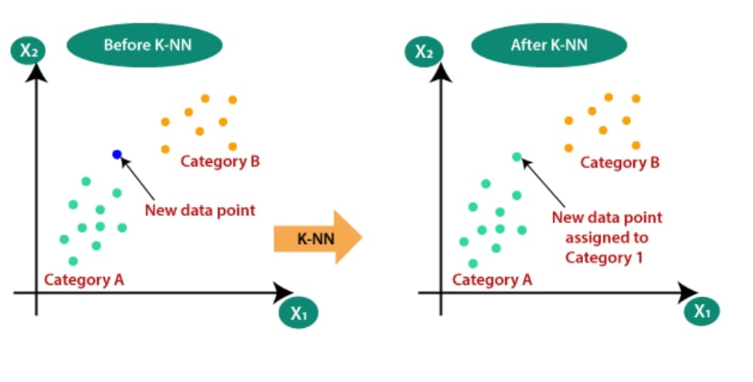

Slide 5
Linear Support Vector Machines (SVMs) can also be used for virus detection. SVMs are a type of machine learning algorithm that is often used for classification tasks, such as identifying viruses as either pathogenic or non-pathogenic.In virus detection, SVMs can be trained on labeled data to identify patterns in the features of viruses that are associated with pathogenicity. These features may include genetic sequences, structural characteristics, or other properties of the virus.The SVM algorithm creates a hyperplane that separates the pathogenic viruses from the non-pathogenic viruses in the feature space. The hyperplane is chosen such that it maximally separates the two classes, with the largest possible margin between the closest points from each class.
SVM with Radial Basis Function (RBF) kernel is another machine learning algorithm that can be used for virus detection. The RBF kernel is a non-linear function that can map the features of the virus to a high-dimensional space, allowing for the detection of non-linear patterns in the data.In virus detection, the SVM with RBF kernel can be trained on labeled data to identify patterns in the features of viruses that are associated with pathogenicity, similar to the linear SVM algorithm. However, the RBF kernel can capture more complex relationships between the features, allowing for more accurate classification.

Slide 6
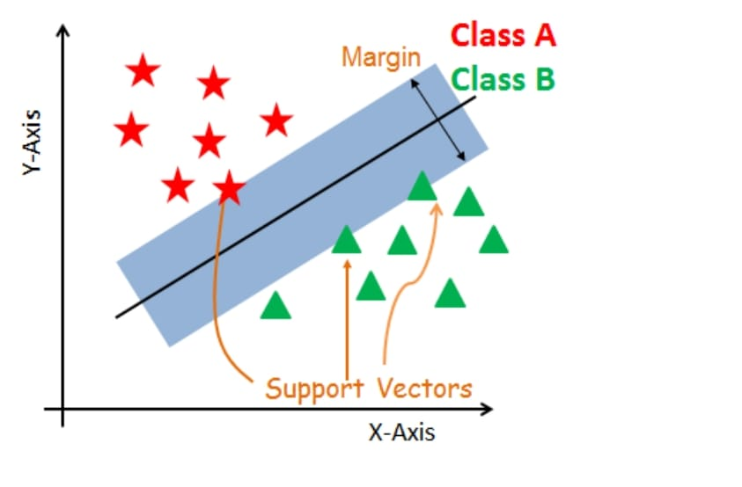

Slide 7
Random Forest is another machine learning algorithm that can be used for virus detection.
It is a type of ensemble learning algorithm that builds multiple decision trees and combines their predictions to make a final classification.
In virus detection, the Random Forest algorithm can be trained on labeled data to identify patterns in the features of viruses that are associated with pathogenicity.
These features may include genetic sequences, structural characteristics, or other properties of the virus.
The Random Forest algorithm builds multiple decision trees, each using a different subset of the features and a random subset of the labeled data.
Each tree makes a prediction based on the features of the virus, and the final classification is determined by combining the predictions of all the trees.

Slide 8
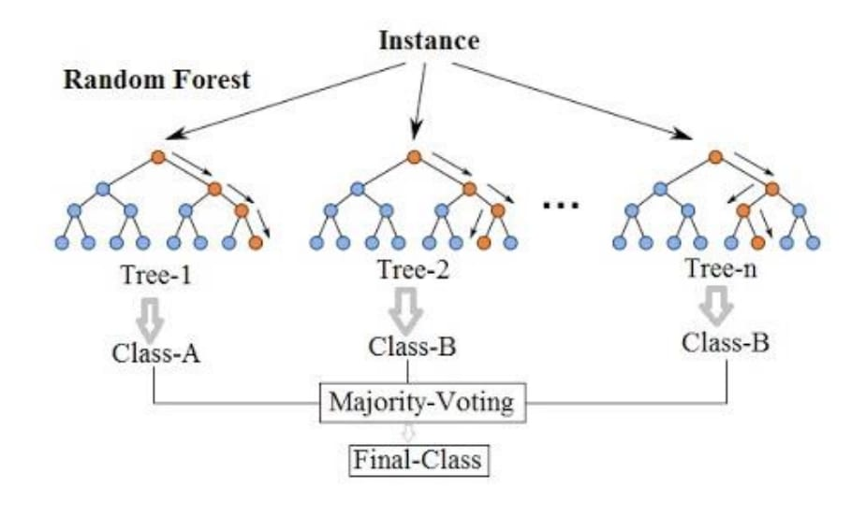

Slide 9
Logistic Regression is a statistical learning algorithm that can also be used for virus detection.
It is a type of supervised learning algorithm that is used to predict binary outcomes, such as whether a virus is pathogenic or non-pathogenic.
In virus detection, the Logistic Regression algorithm can be trained on labeled data to identify patterns in the features of viruses that are associated with pathogenicity.
These features may include genetic sequences, structural characteristics, or other properties of the virus.
The Logistic Regression algorithm models the probability of a virus being pathogenic as a function of its features.
The algorithm fits a logistic function to the data, which allows the output to be interpreted as a probability.
During training, the algorithm adjusts the weights assigned to each feature to minimize the error between the predicted probability and the actual label.

Slide 10
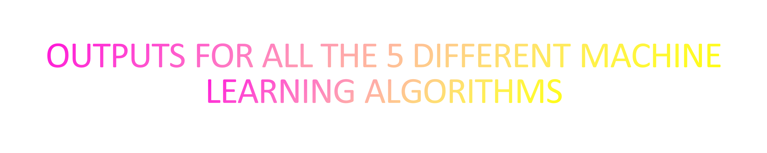

Slide 11
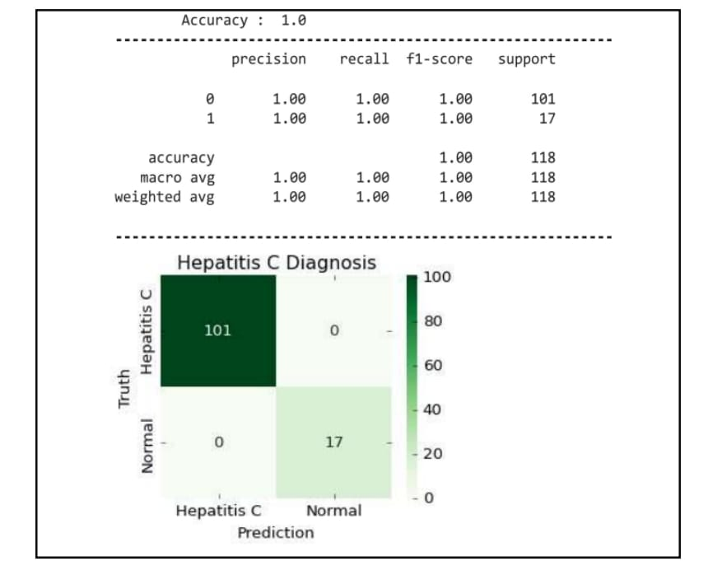
LOGISTIC REGRESSION

Slide 12
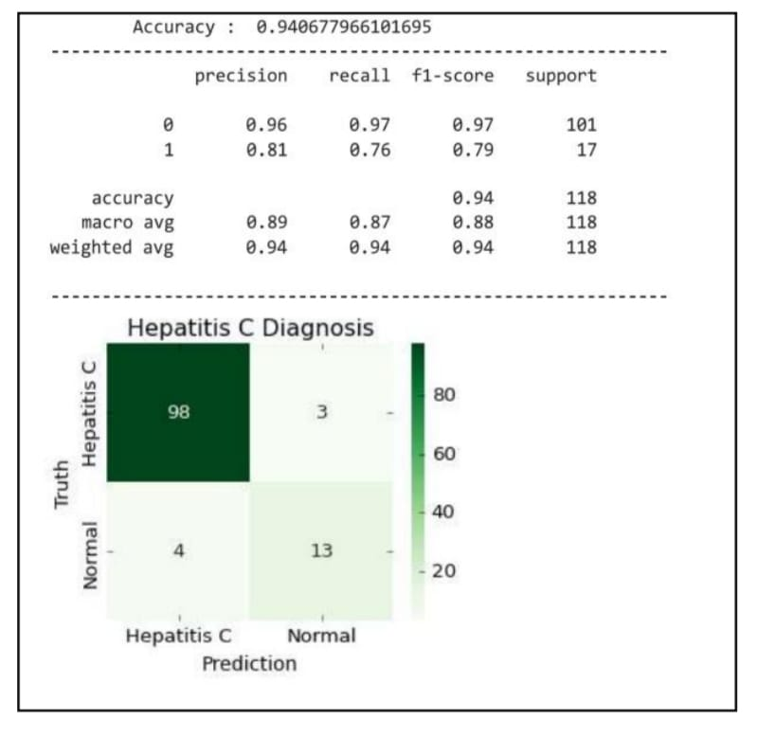
K NEAREST NEIGHBOUR

Slide 13
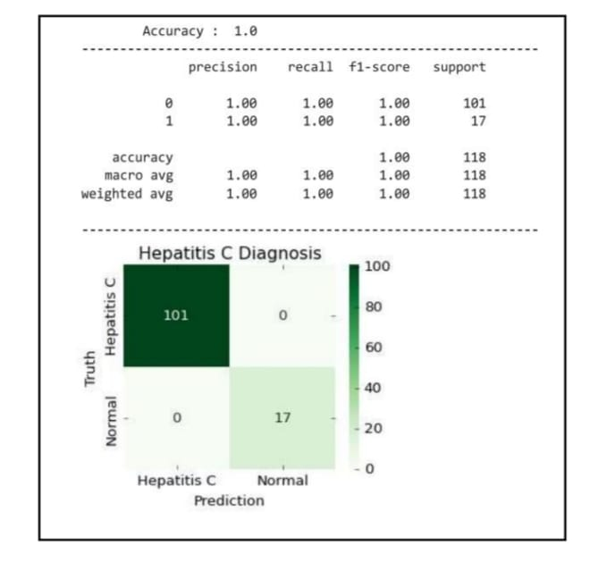
LINEAR SUPPORT VECTOR MACHINE

Slide 14
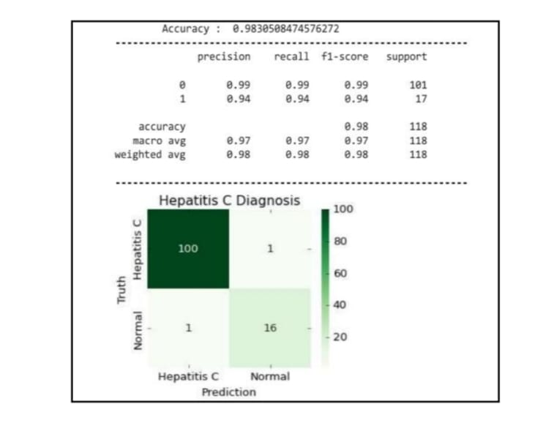
RBF SUPPORT VECTOR MACHINE

Slide 15
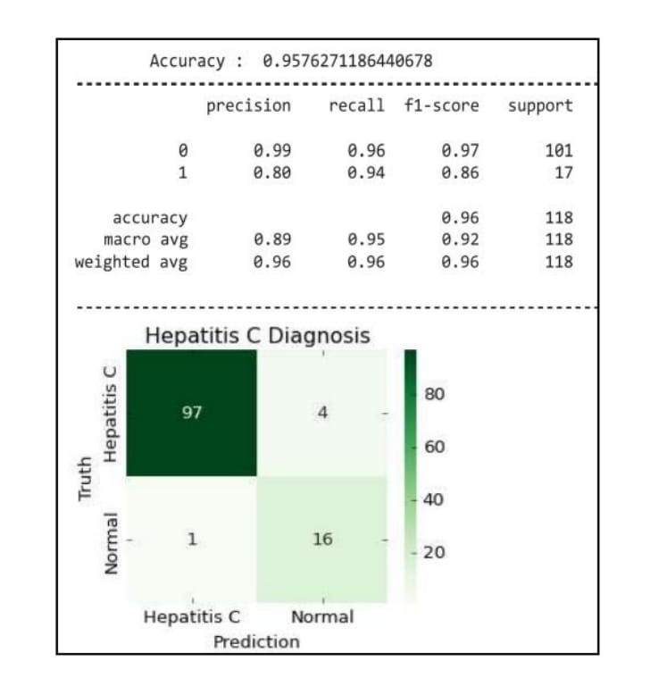
RANDOM FOREST MODEL

Slide 16
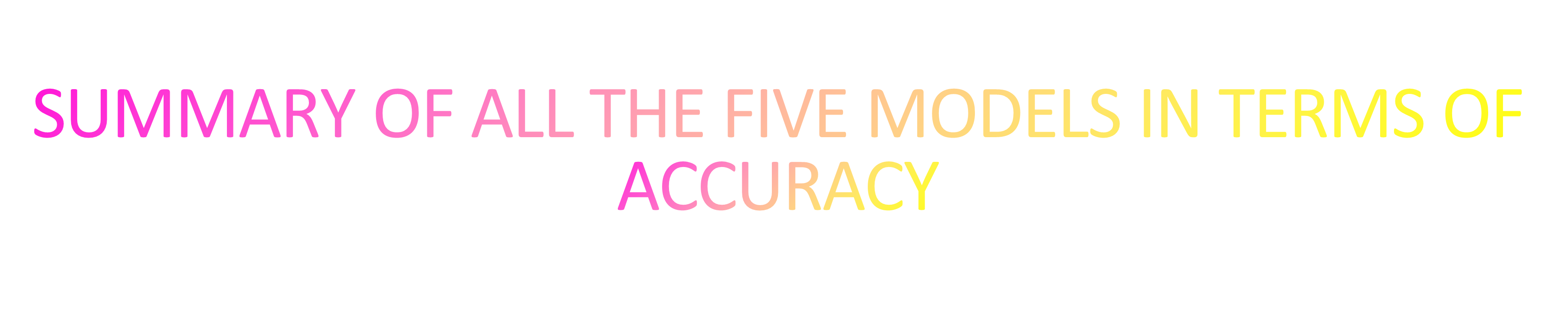
LOGISTIC REGRESSION – 100%
KNN – 94.06%
SVM (LINEAR) – 100%
SVM (RBF) – 98.30%
RANDOM FOREST CLASSIFIER – 95.76%

Slide 17
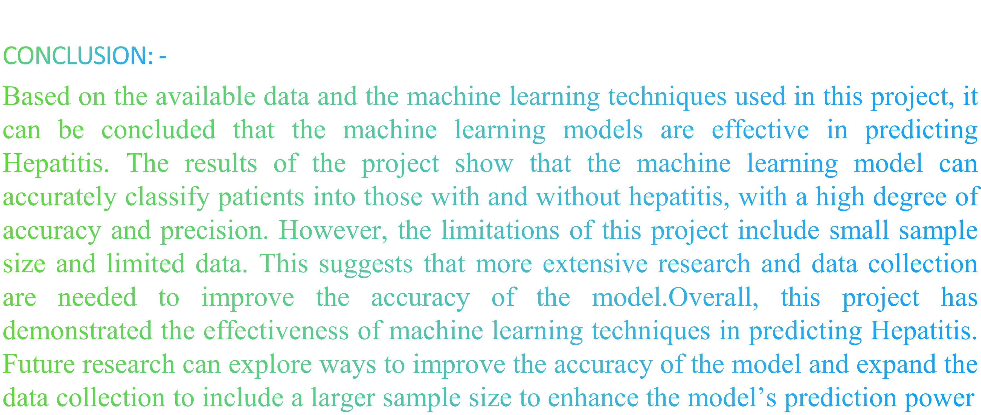

Slide 18


