Slide 1
LeadFlowML DSL
A textX + CWL approach for classifying new sales cases from historical training data
textX grammar
CWL generation
ML scoring
Jupyter demo
sales
DSL
generated
trained
new-case
data
spec
CWL
model
predictions
End-to-end project package: executive summary, executed notebook, source package, and presentation

Slide 2
Why use a DSL here?
The project translates domain intent into a reproducible workflow.
Domain abstraction
Portable workflow
Execution clarity
The analyst writes business concepts like data, features, model, metrics, and outputs instead of low-level orchestration code.
The DSL is compiled into reusable CWL CommandLineTools and a Workflow with explicit inputs, outputs, and dependencies.
Training, validation, and scoring remain separate tools, so results are easier to test, reproduce, and explain.
Key design choice: keep the user-facing language compact, then let the processor generate the executable workflow layer.
grammar → model
CommandLineTool + Workflow
reusable ML components
Notes:
[Sources] - Tomassetti, Quick Domain-Specific Languages in Python with textX (textX uses the same meta-language to define grammar and model structure). - Karle et al., Parsl+CWL: Towards Combining the Python and CWL Ecosystems (CWL CommandLineTools and Workflows, portability, and runner responsibilities).

Slide 3
DSL surface syntax
One compact specification is enough to describe the ML case-classification pipeline.
project LeadQualification
description "Classify new sales leads from historical CRM cases using a reproducible workflow."
data
train "data/train_sales_cases.csv"
score "data/new_sales_cases.csv"
id lead_id
target qualified
features
numeric age, annual_income, website_visits, prior_purchases, support_tickets
categorical region, channel, loyalty_segment
model
algorithm logistic_regression
test_size 0.25
random_state 42
Semantic mapping
• data → workflow inputs
• features → preprocessing schema
• model → training/evaluation behavior
• outputs → artifact locations
Target users edit file paths, feature groups, algorithm choice, and classification threshold without touching Python internals.
The same grammar supports multiple scenarios: default logistic regression and an alternate random-forest version are both included in the package.
This keeps the language focused on the business problem rather than general-purpose syntax.
default scenario
alternate scenario

Slide 4
Implementation architecture
textX parsing and CWL generation separate language design from execution mechanics.
LeadFlow DSL
textX model
DSL processor
ML runtime
Artifacts
Human-authored spec
Parsed object graph
Generates CWL + JSON
validate/train/score
model + report + CSV
Reusable CWL steps
The architecture follows the literature emphasis on reusable components, explicit tool interfaces, and portable workflow descriptions.
validate_data.cwl
train_model.cwl
score_cases.cwl
workflow.cwl
Notes:
[Sources] - Karle et al., Parsl+CWL (CWL tool definitions become reusable executable components; workflows specify dependencies rather than execution order). - Lampa et al., SciPipe (reusable components, parameterized ML workflows, and reduced fragmentation are important for complex ML pipelines).

Slide 5
Generated CWL workflow
The DSL processor emits standard CWL YAML rather than a custom runtime-only format.
cwlVersion: v1.2
class: Workflow
doc: Generated from LeadFlow DSL project LeadQualification
inputs:
train_csv: File
score_csv: File
outputs:
validation_report:
type: File
outputSource: validate/validation_report
model_file:
type: File
outputSource: train/model_file
report_file:
type: File
outputSource: train/report_file
predictions_file:
type: File
outputSource: score/predictions_file
steps:
validate:
run: validate_data.cwl
validate
train
score
Outputs
validation_report.json
evaluation_report.json
new_case_predictions.csv
Notes:
[Sources] - Karle et al., Parsl+CWL (CommandLineTools define interfaces; Workflows connect steps via inputs/outputs; cwltool validates and executes CWL descriptions).

Slide 6
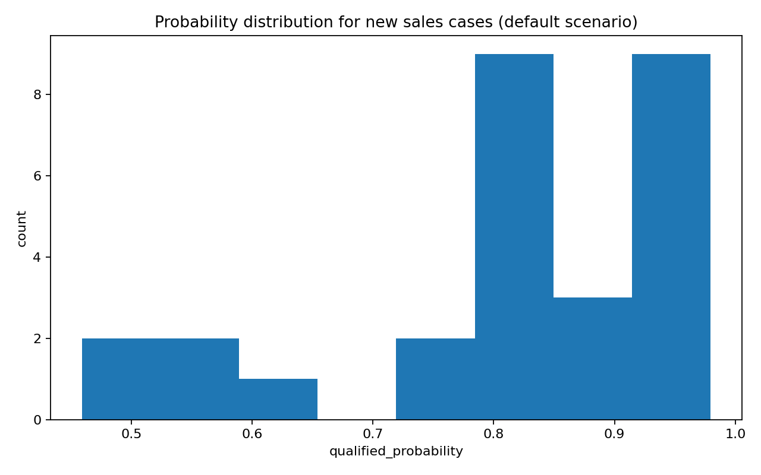
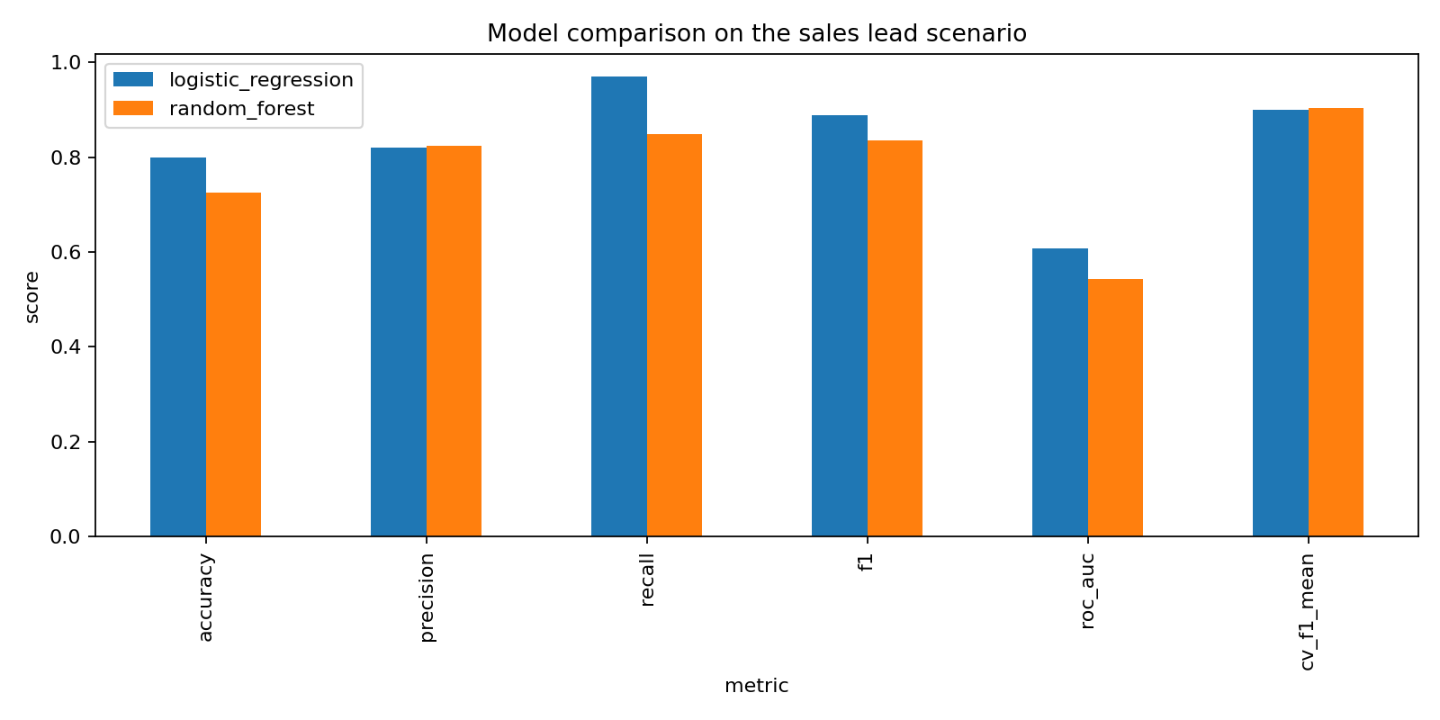
Notebook demo results
Two scenarios were executed from the same DSL family: default logistic regression and alternate random forest.
Default model
Accuracy 0.800 F1 0.889
CV mean F1 0.899
Alt model
Accuracy 0.725 F1 0.836
Takeaway: the notebook demonstrates that changing the DSL specification changes the end-to-end behavior without changing the orchestration code.

Slide 7
Submission package
Everything requested in the assignment is included as a coherent project package.
Checklist
LeadFlowML_Project/
├── Executive_Summary_LeadFlowML.docx
├── notebooks/LeadFlowML_demo_executed.ipynb
├── dsl/leadflow.tx
├── workflows/*.leadflow
├── src/*.py
├── generated_cwl/*.cwl
├── data/*.csv
├── outputs/*.json, *.csv
└── README.md
Executive summary in Word
Executed notebook showing multiple scenarios
Full source package ready to zip and upload
Presentation deck for the group contest
Recommended upload: one ZIP containing the project folder plus the PPTX copy if D2L asks for separate files.

Slide 8
End-to-end DSL lifecycle
Design a domain language → parse with textX → generate CWL → run ML workflow → classify new cases
domain clarity
portable execution
reproducible outputs
easy scenario switching
Next extension ideas: hyperparameter sweeps, model registry export, deployment targets, or richer validation rules in the DSL.

