Slide 1
OBSTACLE AVOIDANCE ROBOT
BY
DHRUV GUPTA (2101MC17)
Mini-Project of CS227 Lab

Slide 2
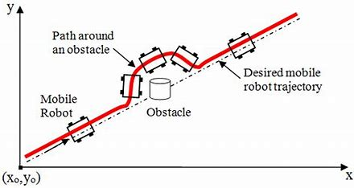
What Is A Obstacle Avoidance Robot?
Obstacle avoidance Robot is designed in order to navigate the robot in unknown environment by avoiding collisions.

Slide 3
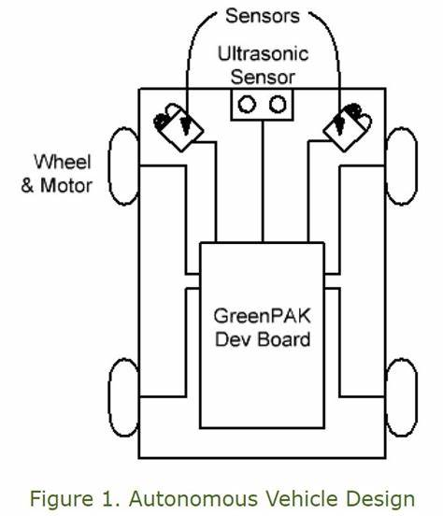
Block Diagram

Slide 4
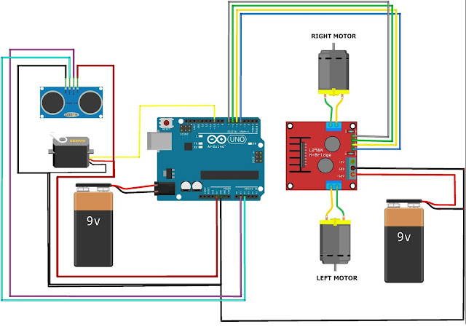
Circuit Diagram
Ultrasonic sensor
Arduino Uno
Servo Motor
Motor Driver Shield

Slide 5
My Robot
In this project my robot senses any obstacle in its path, avoids it and resumes its running.
Involves the pre-computation of an obstacle-free path which a controller guides the robot.
Used data-driven approach using ultrasonic sensor and to scan in all directions I used servo motor which aid to ultrasonic sensor.

Slide 6
Components
Arduino UNO
Motor Driver Shield
Ultrasonic Sensor
Servo Motor
Gear Motor, Frame And Wheels Set

Slide 7
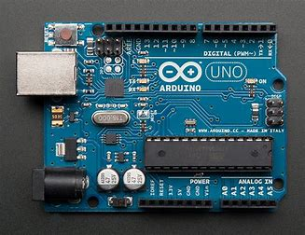
What Is Arduino UNO?
Arduino Uno is an open-source microcontroller board based on the Microchip ATmega 328P microcontroller and developed by Arduino.cc.

Slide 8
Working Of Arduino Uno
The Arduino Uno contains a set of analog and digital pins that are input and output pins which are used to connect the board to other components.
There are a total of fourteen I/O pins placed inboard in which six are analog input pins.
The board has a USB connection that can be used to a power supply to the board.

Slide 9
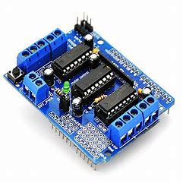
What Is Motor Driver Shield?
The L293D Motor driver shield is one of the best ways for controlling DC motor, Servo motor, and Stepper motors in a single board.

Slide 10
Working Of Motor Driver Shield
It can control the rotation direction and speed of four DC motors, two Servo motor, and two Stepper motors.
It is easy to connect with an Arduino UNO or MEGA.
This shield especially using Arduino projects like robotics and CNC.
This module consists of two L293d dual-channel H-Bridge motor driver IC and a 74HC595 shift register IC

Slide 11
What Is Sensor?
A sensor is a device that detects and responds to some type of input from the physical environment.
The specific input could be light, heat, motion, moisture, pressure etc.
The output is generally that is converted to human-readable form.
Examples are Ultrasonic sensor, Geophone, Hall effect sensor, AFR sensor, IR sensor, Engine coolant temperature sensor etc.

Slide 12
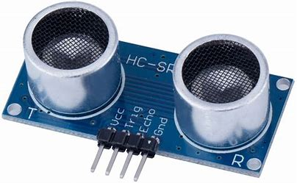
Ultrasonic Sensor
Ultrasonic sensors are electronic devices that calculate the target’s distance by emission of ultrasonic sound waves and convert those waves into electrical signals.
The speed of emitted ultrasonic waves traveling speed is faster than the audible sound.

Slide 13
Working Of Ultrasonic Sensor
Ultrasonic sensors work by sending out a sound wave at a frequency above the range of human hearing.
The transducer of the sensor acts as a microphone to receive and send the ultrasonic sound.
Our ultrasonic sensor, like many others, use a single transducer to send a pulse and to receive the echo.
The sensor determines the distance to a target by measuring time lapses between the sending and receiving of the ultrasonic pulse.

Slide 14
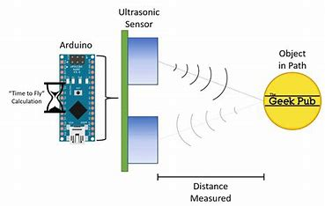
Continue...
The working principle of this module is simple. It sends an ultrasonic pulse out at 40kHz which travels through the air and if there is an obstacle or object, it will bounce back to the sensor.
By calculating the travel time and the speed of sound, the distance can be calculated.

Slide 15
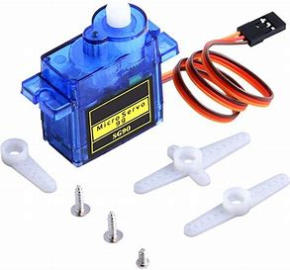
Servo Motor
Actuator - A device that causes a machine or other device to operate.
A servomotor is a rotary actuator or linear actuator that allows for precise control of angular or linear position, velocity and acceleration.
It consists of a suitable motor coupled to a sensor for position feedback.

Slide 16
Working Mechanism Of Servo Motor
It consists of three parts:
1. Controlled device
2. Output sensor
3. Feedback system
It is a closed-loop system where it uses a positive feedback system to control motion and the final position of the shaft.
The device is controlled by a feedback signal generated by comparing output signal and reference input signal.

Slide 17
Continue...
Here reference input signal is compared to the reference output signal and the third signal is produced by the feedback system. And this third signal acts as an input signal to the control the device.
This signal is present as long as the feedback signal is generated or there is a difference between the reference input signal and reference output signal.
So the main task of servomechanism is to maintain the output of a system at the desired value at presence of noises.

Slide 18
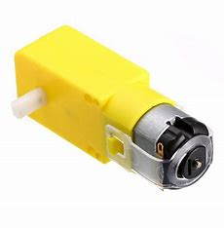
Gear Motor
Gear motor is a special type of electrical motor. The main purpose of gear motor is to produce high torque while using a low horsepower, or low speed, motor output.

Slide 19
Applications Of Obstacle Avoiding Robots
Obstacle avoiding robots can be used in almost all mobile robot navigation systems.
They can also be used in dangerous environments, where human penetration could be fatal.
Automated lawn mover.
They can be applied at toys where small children will play.
They can be used for army applications and mines as well.

Slide 20
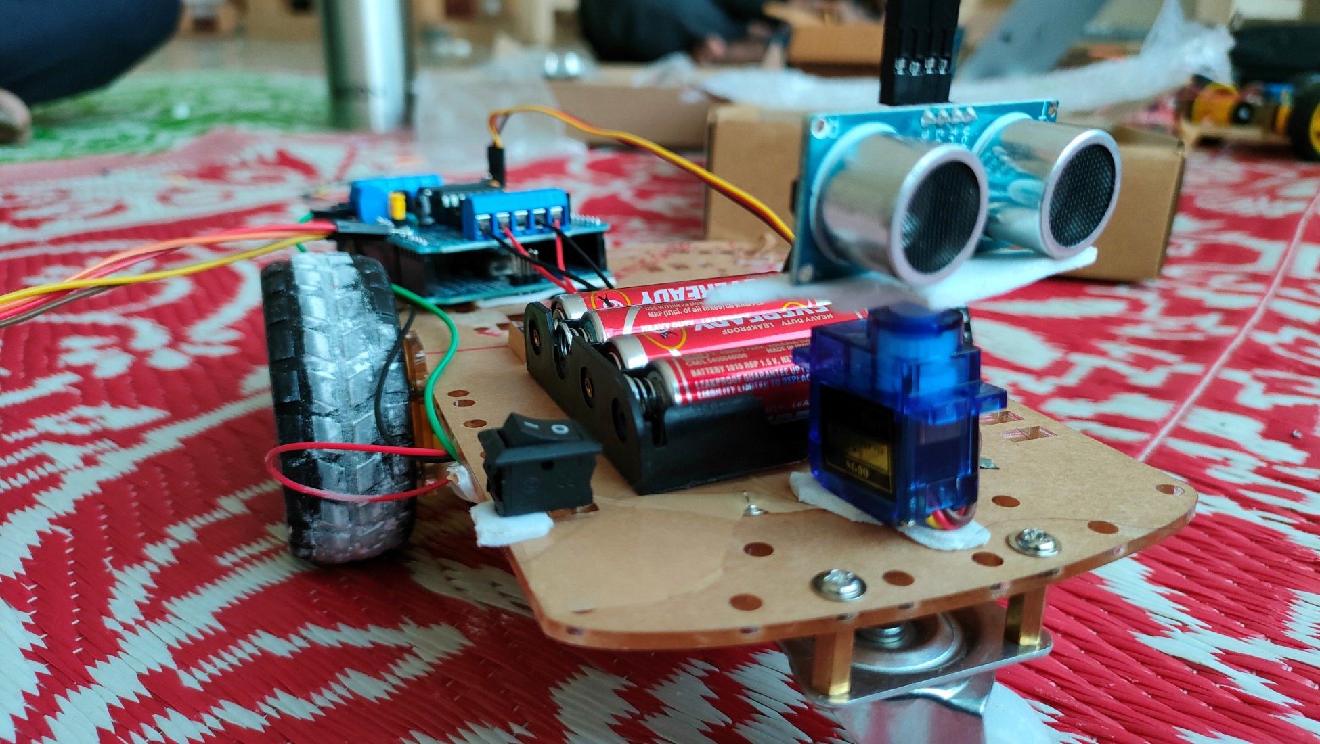
A Picture Of My Robot

Slide 21

A Short Demonstration Of My Mini Project

Slide 22
Code
#include <AFMotor.h>
#include <NewPing.h>
#include <Servo.h>
#define TRIG_PIN A1
#define ECHO_PIN A0
#define MAX_DISTANCE 200
#define MAX_SPEED 255 // sets speed of DC motors
#define MAX_SPEED_OFFSET 20
NewPing sonar(TRIG_PIN, ECHO_PIN, MAX_DISTANCE);
AF_DCMotor motor3(3, MOTOR34_1KHZ);
AF_DCMotor motor4(4, MOTOR34_1KHZ);
Servo myservo;
boolean goesForward = false;
int distance = 100;
int speedSet = 0;
void setup() {
myservo.attach(10);
myservo.write(115);
delay(2000);
distance = readPing();
delay(100);
distance = readPing();
delay(100);
distance = readPing();
delay(100);
distance = readPing();
delay(100);
}

Slide 23
Continue...
void loop() {
int distanceR = 0;
int distanceL = 0;
delay(40);
if (distance <= 15) {
moveStop();
delay(100);
moveBackward();
delay(300);
moveStop();
delay(200);
distanceR = lookRight();
delay(200);
distanceL = lookLeft();
delay(200);
if (distanceR >= distanceL) {
turnRight();
moveStop();
} else {
turnLeft();
moveStop();
}
} else {
moveForward();
}
distance = readPing();
}
int lookRight() {
myservo.write(50);
delay(500);
int distance = readPing();
delay(100);
myservo.write(115);
return distance;
}
int lookLeft() {
myservo.write(170);
delay(500);
int distance = readPing();
delay(100);
myservo.write(115);
return distance;
delay(100);
}

Slide 24
Continue...
int readPing() {
delay(70);
int cm = sonar.ping_cm();
if (cm == 0) {
cm = 250;
}
return cm;
}
void moveStop() {
motor3.run(RELEASE);
motor4.run(RELEASE);
}
void moveForward() {
if (!goesForward) {
goesForward = true;
motor3.run(FORWARD);
motor4.run(FORWARD);
for (speedSet = 0; speedSet < MAX_SPEED; speedSet += 2) // slowly bring the speed up to avoid loading down the batteries too quickly
{
motor3.setSpeed(speedSet);
motor4.setSpeed(speedSet);
delay(5);
}
}
}
void moveBackward() {
goesForward = false;
motor3.run(BACKWARD);
motor4.run(BACKWARD);
for (speedSet = 0; speedSet < MAX_SPEED; speedSet += 2) // slowly bring the speed up to avoid loading down the batteries too quickly
{
motor3.setSpeed(speedSet);
motor4.setSpeed(speedSet);
delay(5);
}
}
void turnRight() {
motor3.run(FORWARD);
motor4.run(BACKWARD);
delay(500);
motor3.run(FORWARD);
motor4.run(FORWARD);
}
void turnLeft() {
motor3.run(BACKWARD);
motor4.run(FORWARD);
delay(500);
motor3.run(FORWARD);
motor4.run(FORWARD);
}

Slide 25
References
www.google.co.in
www.wikipedia.com
www.slideshare.com
www.maxbotix.com
www.circuitdigest.com
www.educba.com
www.sunfounder.cc

Slide 26
THANK YOU
Presented by
Dhruv Gupta (2101MC17)

