Slide 1

KONKAN GYANPEETH COLLEGE OF ENGINEERING, KARJAT Affiliated to University of Mumbai, Approved by AICTE, New Delhi.
Automatic Image Captioning Using Deep Learning.
Project Members:
Dhruv Solanki
Tejal Supe
Siddhi Undirkar
Under the Guidance of:
Prof. J.P.Patil

Slide 2
CONTENTS:
Abstract
Introduction
Literature Survey
Objectives
Architecture
Phases
CNN(Convolution Neural Networks)
LSTM(Long Short Term Memory)
VGG16 Model
Scope
Output
Evaluate (BLUE)
Conclusion
References

Slide 3
Abstract
Image captioning means automatically generating a caption for an image. Automatically creating the description of an image using any natural language sentences is a very challenging task.
It requires expertise of both image processing as well as natural language processing. Sharing photos through the internet (e.g. Instagram, Facebook, etc.), which becomes a common practice, leads to archives in the order of millions of images.
Manual annotation is time consuming and extremely labor-intensive work. Thereafter, computer-assisted system are desired to lesson these difficulties by automation using machine learning.
The annoted image can be used for retrieval purposes, in image processing algorithms, intelligent scanner, digital cameras, photocopiers, and printers. Our goal is to create system which will annotate images based on previously learned datasets.

Slide 4
Introduction
Image annotation refers to the tagging of images with appropriate keywords. The process of annotating images manually is time-consuming and extremely labor-intensive work. Thereafter, computer-assisted systems are desired to lessen these difficulties by automation.
The automatic image annotation is targeted to assign a few relevant text keywords to an input image that reflects its visual content. Machine learning techniques are used to develop the image annotation systems to map the low-level (visual) features to high-level concepts or semantics.
We are going to use two neural network algorithm which is Convolutional Neural Network (CNN) and Recurrent Neural Network (RNN) based Long Short Term Memory (LSTM). In the project CNN will be used to train the images as well as to detect the objects in the image with the help of various pre trained models and RNN based LSTM will be used to generate captions from the generated object keyword

Slide 5
Literature survey
Sr. No. | Paper Title | Author’s Name | Techniques Used
1 | Image Captioning Using CNN and LSTM | Ali Ashraf Mohamad | Technique - CNN , LSTM Dataset – Flickr8k Accuracy – BLEU-0.46
2 | Bottom-Up and Top-Down Attention for Image Captioning and Visual Question Answering | Peter Anderson, Damien Teney, Mark Johnson , Stephen Gould, Lei Zhang, Xiaodong He, Chris Buehler | Technique - Faster R-CNN Dataset – MSCOCO Evaluation Matrix – BLEU-4 – 36.9 CIDEr – 117.9 SPICE – 21.5
3 | Transfer Learning Using VGG16 with Deep CNN for classifying Image | Srikanth Tammina | Model : VGG16

Slide 6
Sr. No | Paper Title | Author’s | Techniques used
4 | Deep Learning based Automatic Image Caption Generation | Varsha Kesavan, Vaidehi Muley , Megha Kolhekar | Techniques – CNN(Encoder), RNN(Decoder) Dataset – MSCOCO Pre Trained Model - VGG16 model(Encoder) GRU network(Decoder)
5 | Guiding the Long-Short Term Memory model for Image Caption Generation | Xu Jia, Efstratios Gavves, Basura Fernando, Tinne Tuytelaars. | Techniques- LSTM , gLSTM Dataset - Flickr8K, Flickr30K and MS COCO Evaluation Matrix – BLEU, METEOR
6 | Image Captioning with Semantic Attention | Quanzeng You, Hailin Jin, Zhaowen Wang, Chen Fang, Jiebo Luo | Techniques – RNN Dataset – MSCOCO , Flickr30K Evaluation Matrix – BLEU, METEOR, ROUGE-L, CIDEr

Slide 7
Objectives
The objective of our project is to extract the features of a given image and to automatically caption the objects present in the image.
To build a system that will identify multiple objects from a given image.
To create a system that will be able to caption the objects present in the image.
To be able to train the model created to identify and caption the images.
To be able to test and evaluate the performance of the system of both the training and testing phase.

Slide 8
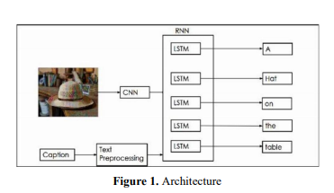
Architecture:

Slide 9
Phases:
Phase 1: Prepare Photo Data
Phase 2: Prepare Text Data
Phase 3: Develop Deep Learning Model
Phase 4: Evaluate Model
Phase 5: Generate New Captions

Slide 10
CNN(Convolution Neural Networks):
The convolutional neural network, or CNN for short, is a specialized type of neural network model designed for working with two-dimensional image data, although they can be used with one-dimensional and three-dimensional data.
Convolutional neural networks do not learn a single filter; they, in fact, learn multiple features in parallel for a given input.
CNN is often called as encoder because it encodes the content of the image into a smaller feature vector.

Slide 11
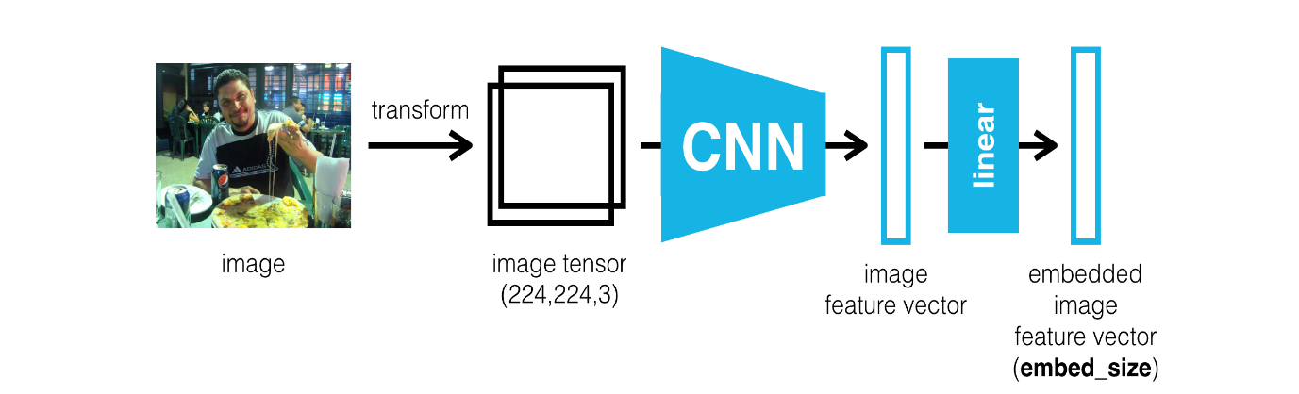
CNN Model:

Slide 12
LSTM(Long Short Term Memory):
Recurrent neural networks (RNN) are the state of the art algorithm that remembers its input, due to an internal memory, which makes it perfectly suited for machine learning problems that involve sequential data.
RNN remembers things for just small durations of time, i.e. if we need the information after a small time it may be reproducible, but once a lot of words are fed in, this information gets lost somewhere.
This issue can be resolved by applying a slightly tweaked version of RNNs – the Long Short-Term Memory Networks. Long Short-Term Memory (LSTM) networks are a type of recurrent neural network capable of learning order dependence in sequence prediction problems.
Lstm is called as decode because it decodes the vector and try to turn into a caption.

Slide 13
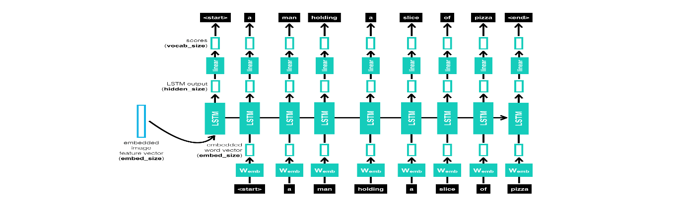
LSTM Model:

Slide 14
VGG16
There are various pre-trained Convolutional Neural Network Trained model such as VGG19, VGG16, Inceptionv3, ResNet, Mobile Net etc. but in our project we are going to use VGG16 pre-trained CNN model.VGG16 has 13 convolutional layers, some of which are followed by maximum pooling layers and then 4 fully connected layers and finally a 1000-way softmax classifier.
At last there are 3 fully connected layer followed by last softmaxlayer.In our project we are going to cut-off the last layer because vgg16 is use to classify the image but we don’t want to classify the image but just get fixed-length information vector of image.

Slide 15
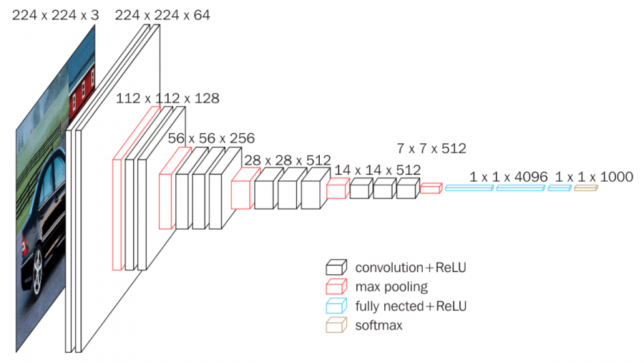
VGG16 Model

Slide 16
Scope
The scope of this project is to classify the images from the different classes available which makes it easy to search an image based on a keyword.
The system developed in this project is such that it will add a caption to multiple objects present in an image.
The images after been identified and captioned will be saved into the separate database.

Slide 17
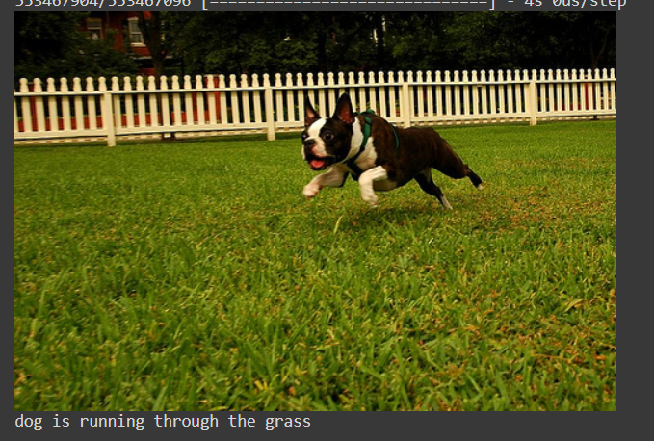
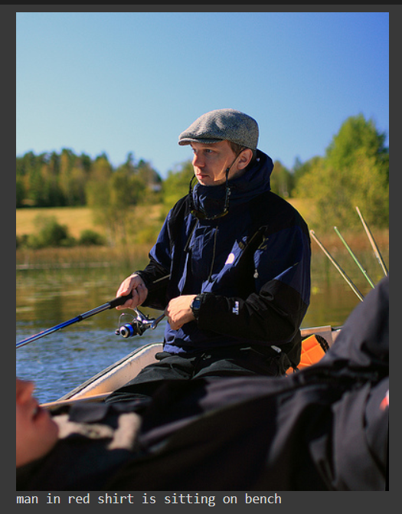
Output

Slide 18
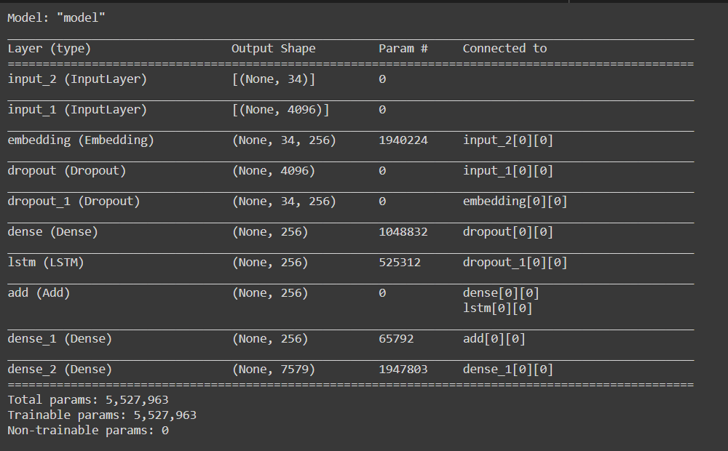
Model

Slide 19
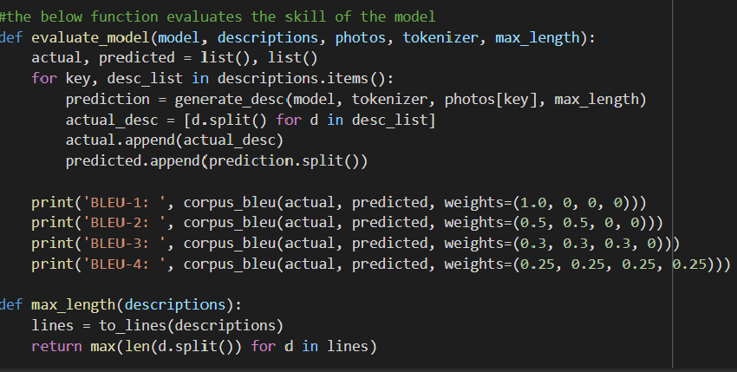
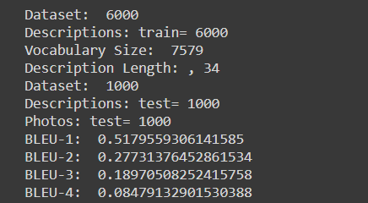
Evaluation Metrics

Slide 20
Conclusion
Through this project, we learned about the deep learning techniques used for image captioning problem.
We learned that the result of generated captions is influenced by the training dataset.
The Flickr8k dataset contains many outdoor images of humans and dogs and our model gives better results on outdoor images with people and dogs and confuses many different things in other images to dogs and people.
We have implemented pre-trained CNN and LSTM model and used BLUE evaluation metrics.
The Bilingual Evaluation Understudy Score, or BLEU for short, is a metric for evaluating a generated sentence to a reference sentence. A perfect match results in a score of 1.0, whereas a perfect mismatch results in a score of 0.0.
We have Achieved a Effective BLUE score of 0.5179 for our model.

Slide 21
References
www.researchgate.net/publication/332109738_A_Survey_in_Deep_Learning_Model_for_Image_Annotation.
www.researchgate.net/publication/328993377_Building_Detection_and_Segmentation_Using_a_CNN_with_Automatically_Generated_Training_Data
Claudio Cusano, Gianluigi Ciocca. Image nnnoto/ion usinpSVM
Mahdia Bakalem, Nadjia Benblidia. A Comparative /rape Annotation. 978-1-4799- 4796-6/13/ c 2013 IEEE. (2012).

Slide 22
THANK YOU!

