Slide 1
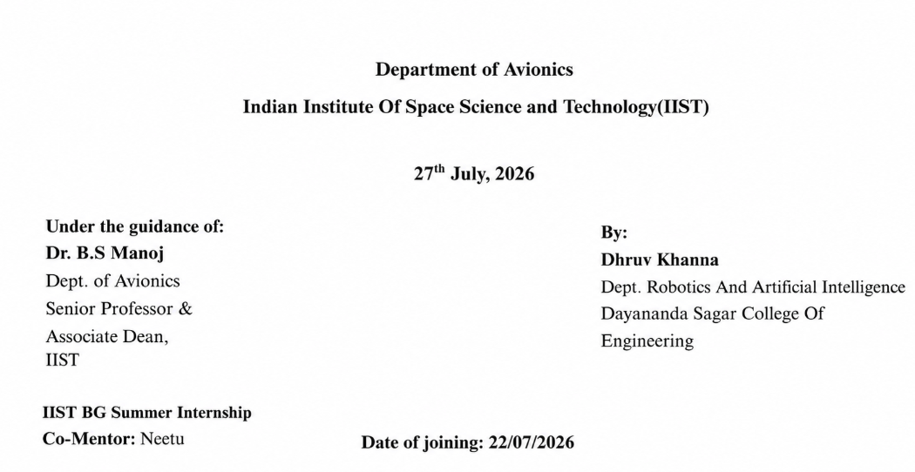
TOPIC - Handover Optimization
Neethu Sajeev

Slide 2
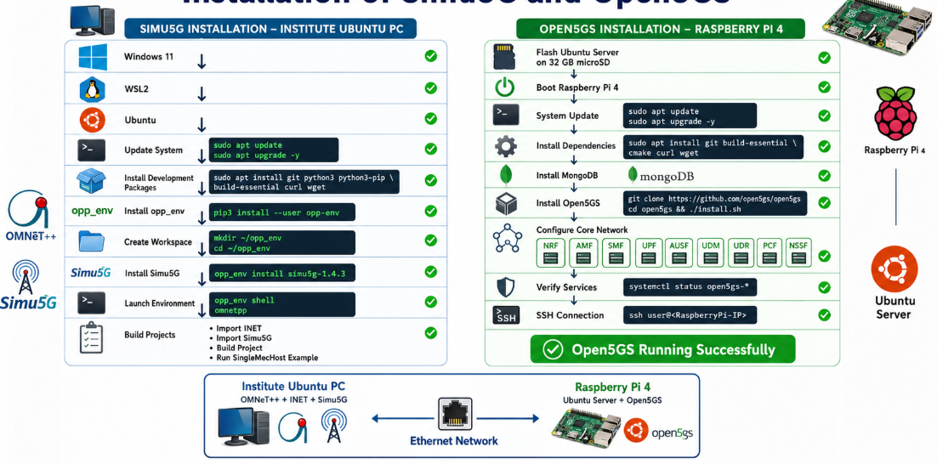







Objective
The objective of this work was to install and configure Open5GS on a Raspberry Pi 4 and verify whether it could communicate with Simu5G installed on the institute's Ubuntu PC.

Slide 3
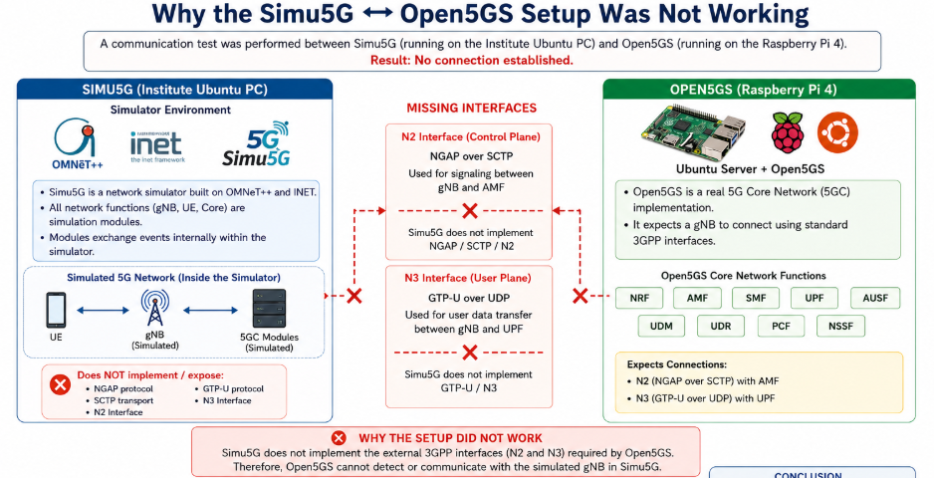
Network Configuration Issues Configuring static IP addresses, Ethernet settings, and establishing communication between the institute PC and Raspberry Pi.
Connectivity Issues Troubleshooting SSH access, Raspberry Pi IP discovery, network reachability, and communication between devices.
Dependency and Service Management Resolving software dependencies, configuring MongoDB, verifying Open5GS services, and troubleshooting WebUI accessibility.
Architecture Compatibility Identifying that direct communication between Simu5G and Open5GS is not supported because Simu5G does not implement the external 3GPP N2 (NGAP over SCTP) and N3 (GTP-U) interfaces required by Open5GS.

Slide 4
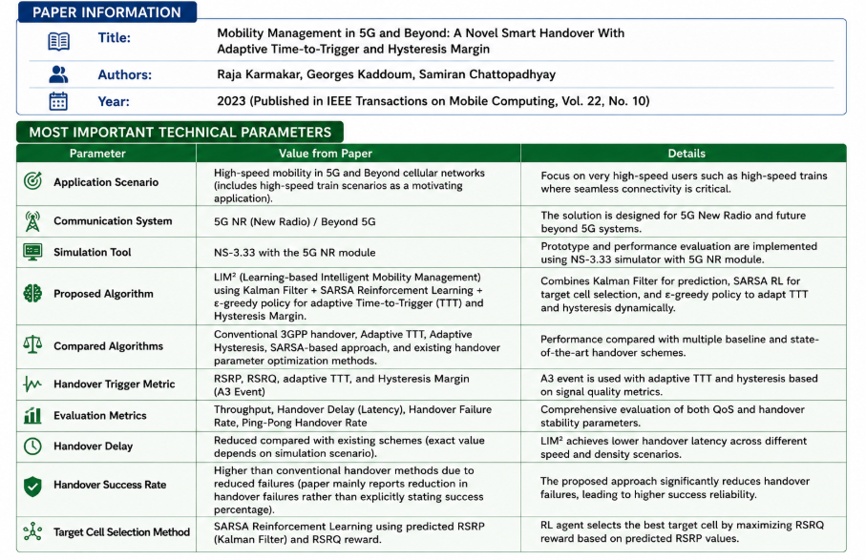
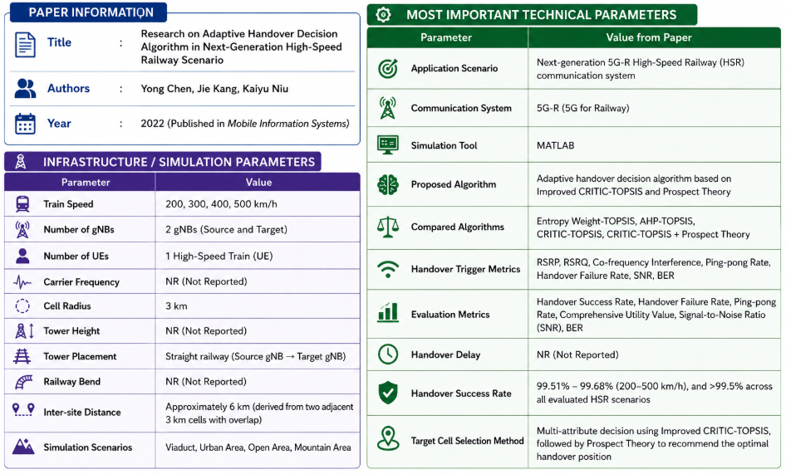
LIM² (Learning-based Intelligent Mobility Management) uses a Kalman Filter to predict the future Reference Signal Received Power (RSRP) of the serving and neighboring cells by filtering measurement noise, enabling more accurate signal quality
It then employs SARSA (State–Action–Reward–State–Action) Reinforcement Learning to intelligently select the best target cell based on the predicted RSRP and Reference Signal Received Quality (RSRQ), continuously learning from previous handover decisions to maximize network performance.
Finally, an ε-greedy policy dynamically adjusts the Time-to-Trigger (TTT) and Hysteresis Margin, balancing exploration of new parameter values and exploitation of the best-performing values to reduce handover delay, failures, and ping-pong effects
Improved CRITIC-TOPSIS performs multi-attribute handover decisions using RSRP, RSRQ, and co-frequency interference, assigning objective weights to each parameter.
Prospect Theory evaluates handover risk based on ping-pong rate, handover failure rate, SNR, and BER to identify the safest handover position.
The algorithm combines the TOPSIS score and Prospect Theory utility to recommend the optimal handover position, achieving a handover success rate above 99.5%.

Slide 5
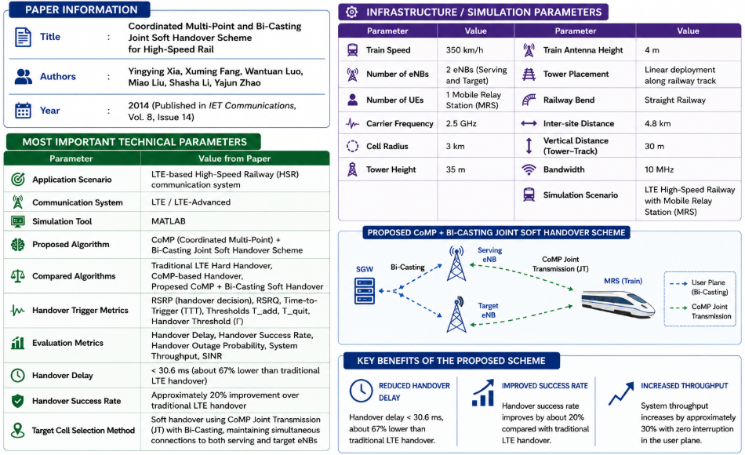
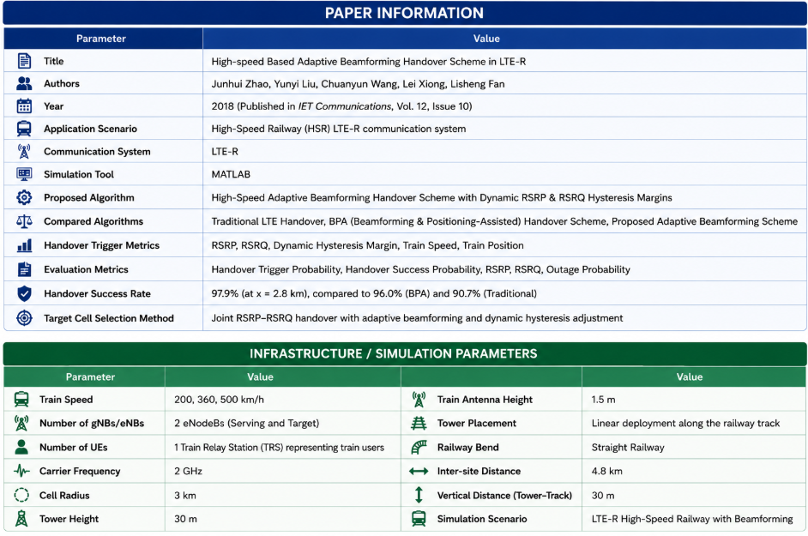
The proposed scheme combines CoMP (Coordinated Multi-Point) and Bi-Casting to achieve soft handover, allowing the train to maintain simultaneous connections with both the serving and target eNBs.
CoMP Joint Transmission (JT) improves signal quality by transmitting identical data from multiple eNBs, while Bi-Casting duplicates user packets from the Serving Gateway (SGW) to both eNBs, eliminating packet loss during handover.
The proposed scheme uses adaptive beamforming, where the serving and target eNodeBs dynamically adjust their beamforming gains to improve signal quality when the train enters the overlapping region.
A joint RSRP–RSRQ handover algorithm dynamically adjusts the hysteresis margins based on the train's speed and position, enabling earlier and more reliable handover while reducing unnecessary handovers.
By combining beamforming with adaptive hysteresis control, the algorithm significantly improves handover trigger probability and achieves a handover success rate of 97.9%, outperforming traditional and BPA handover schemes.

Slide 6
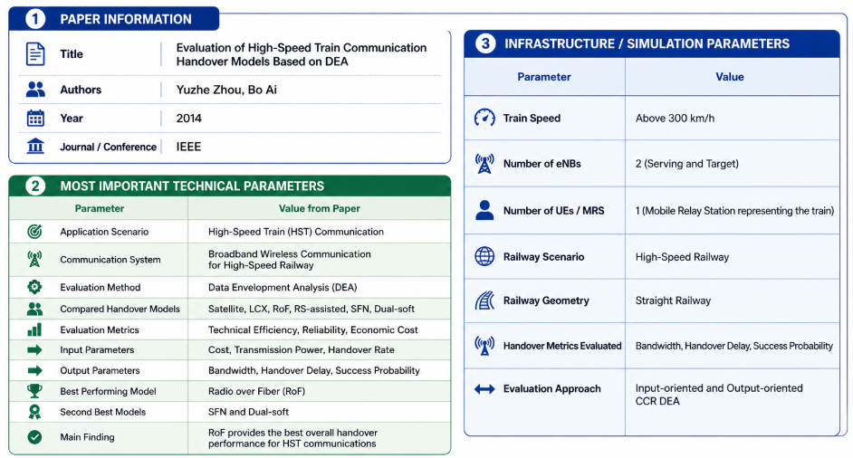
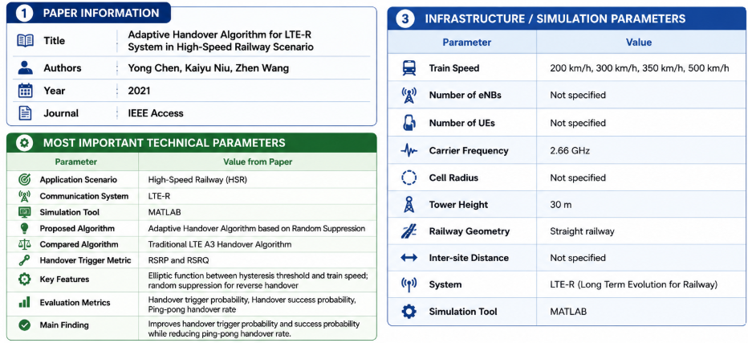
Data Envelopment Analysis (DEA) is a mathematical decision-making technique that evaluates the relative efficiency of multiple systems (called Decision Making Units - DMUs) by comparing their inputs and outputs.
In this paper, the six handover models (Satellite, LCX, RoF, RS-assisted, SFN, and Dual-soft) are treated as DMUs, where cost, transmission power, and handover rate are considered as inputs, while bandwidth, handover delay, and handover success probability are considered as outputs.
The DEA framework computes Technical Efficiency (TE), Allocative Efficiency (AE), and Cost Efficiency (CE) to rank the handover models, concluding that the Radio over Fiber (RoF) model provides the best overall performance for high-speed train communications.
The algorithm adaptively adjusts the RSRP hysteresis threshold using an elliptic function based on train speed and position for timely handovers.
It uses both RSRP and RSRQ as handover decision metrics to improve decision accuracy and reliability.
A random suppression mechanism reduces ping-pong handovers while improving handover success probability.

Slide 7
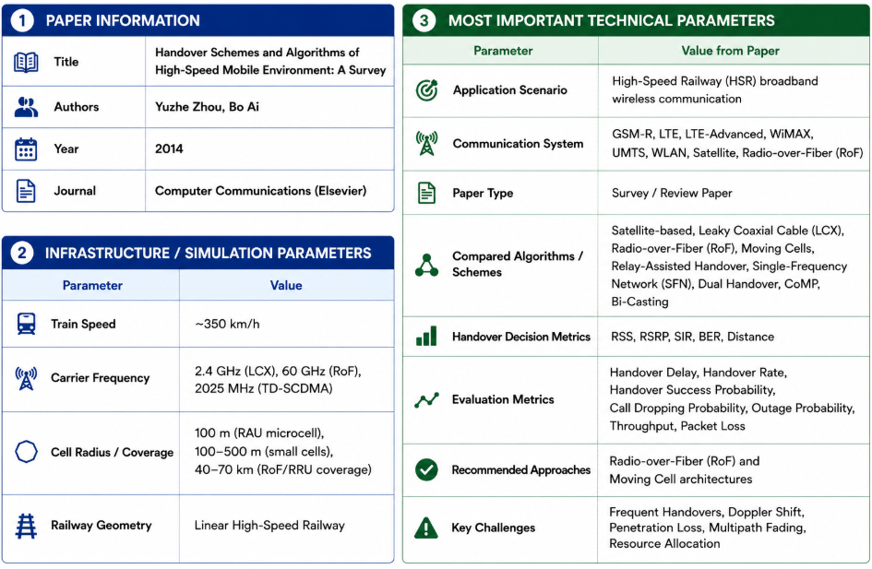
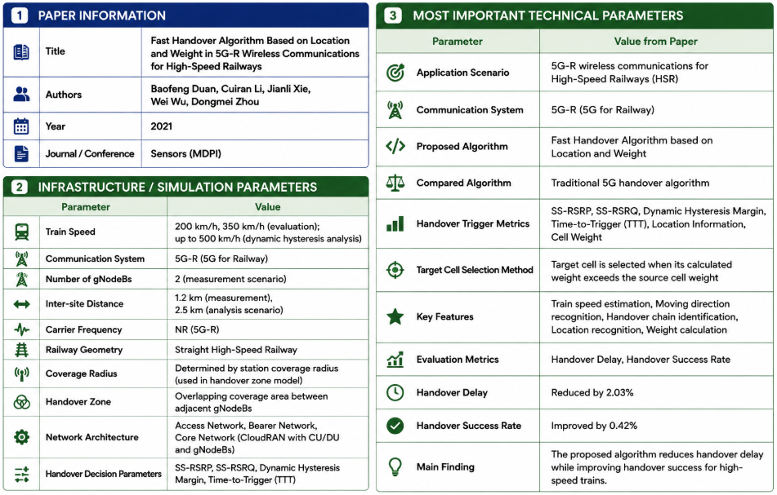
It compares various handover architectures, including Radio-over-Fiber (RoF), Moving Cells, Relay-Assisted Handover, CoMP, Dual Handover, and Bi-Casting, based on their advantages, limitations, and performance.
The survey concludes that RoF and Moving Cell architectures are the most promising solutions for achieving seamless, reliable, and low-latency handovers in future high-speed railway networks.
The algorithm estimates the train's speed and direction, recognizes its location, and identifies the appropriate handover chain before triggering the handover.
It calculates a weight for the target and source cells using measurement report parameters and triggers handover only when the target cell's weight exceeds the source cell's weight.
This location- and weight-based handover strategy reduces handover delay and improves the handover success rate for high-speed railway communications.

Slide 8
Future Scope
Objective
Develop an AI-assisted handover evaluation framework that identifies the most suitable handover algorithm for high-speed railway communication based on simulation results obtained from Simu5G.
Proposed Methodology
1. Simu5G Network Simulation
Model a realistic 5G High-Speed Railway (HSR) communication environment in Simu5G.
Configure network scenarios using the parameters extracted from the surveyed research papers, including train speed, carrier frequency, cell radius, inter-site distance, number of gNBs, and other available simulation parameters.
2. Performance Evaluation
Perform multiple simulation runs for different handover algorithms and collect important performance metrics, including:
Handover Delay
Handover Success Rate
Throughput
SINR
RSRP
RSRQ
Packet Loss
Ping-Pong Handover Rate
Outage Probability
Network Latency
3. Dataset Preparation
Organize the simulation results into a structured dataset.
Each record will represent the performance of a specific handover algorithm under different network conditions.
The dataset will be used as the input for AI model development.
4. AI-Based Evaluation Model
Develop a machine learning model capable of:
Learning the relationship between network parameters and handover performance.
Comparing the performance of different handover algorithms.
Predicting the most suitable handover algorithm for a given railway scenario.

Slide 9
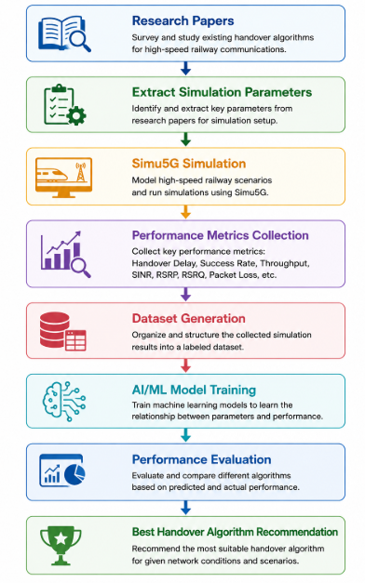
5. Intelligent Decision Support System
The final framework will:
Accept simulation parameters and network conditions as input.
Evaluate multiple handover algorithms.
Recommend the best-performing algorithm based on predicted performance.
Assist researchers in selecting suitable handover strategies for future 5G/6G railway communication systems.
Expected Outcome
An AI-driven handover evaluation framework that combines Simu5G simulation with machine learning to automatically analyze network performance and recommend the optimal handover algorithm for different high-speed railway scenarios.

