Slide 1
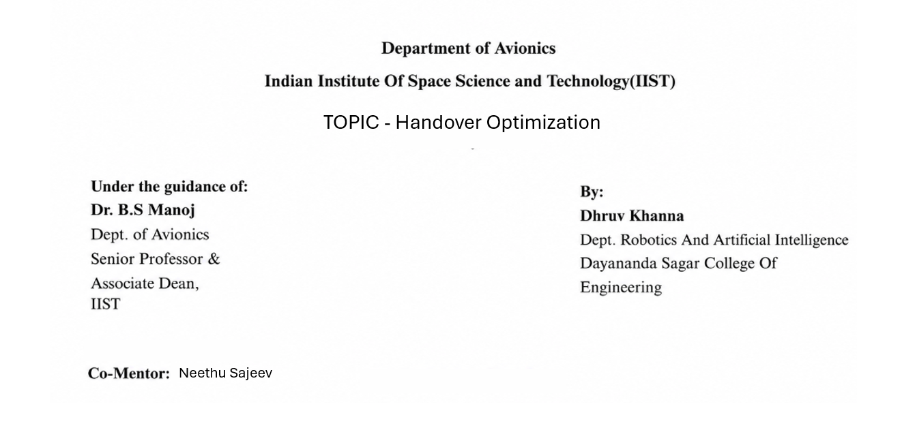

Slide 2
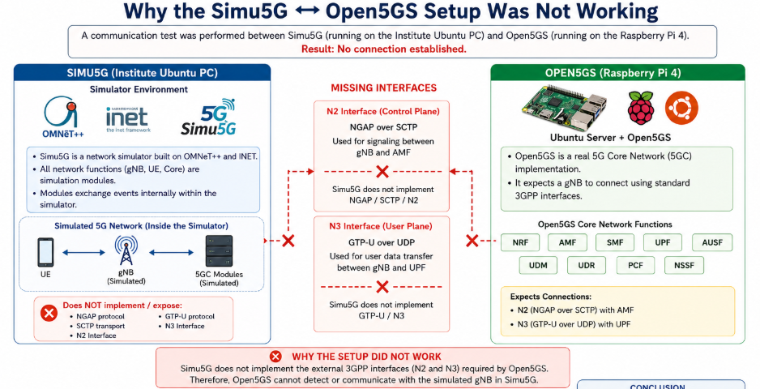
Project Objective – 1
Install and configure Open5GS on a Raspberry Pi 4 to create a standalone 5G Core Network.
Install and configure Simu5G on Ubuntu (WSL) for 5G Radio Access Network (RAN) simulation.
Investigate the possibility of integrating Simu5G with Open5GS to create an end-to-end 5G testbed.
Analyse whether this integrated setup can be used for High-Speed Railway (HSR) handover research.
Challenges Encountered
Successfully configured Ubuntu, WSL, Nix, OMNeT++, INET, and Simu5G.
Configured Raspberry Pi networking, SSH, MongoDB, Open5GS services, and WebUI.
Resolved multiple installation, dependency, and compilation issues during the setup.
After detailed investigation, found that Simu5G does not natively support direct communication with an external Open5GS core because it lacks the required 3GPP N2 (NGAP) and N3 (GTP-U) interfaces needed for interoperability.

Slide 3
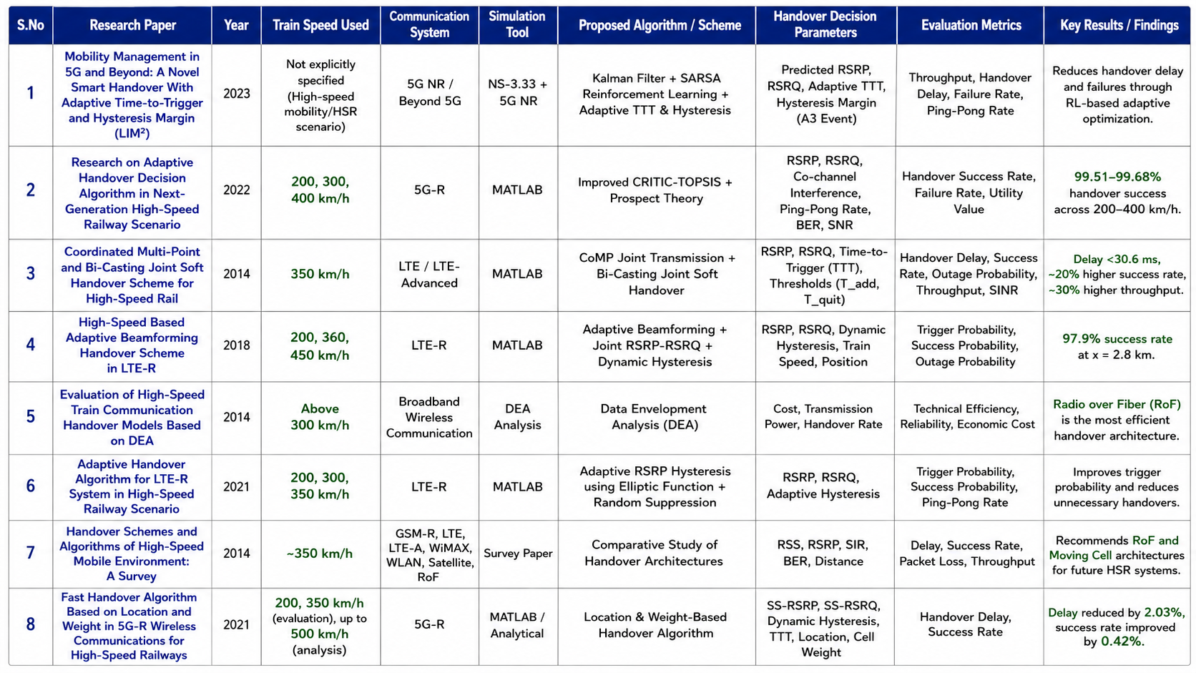
Survey papers

Slide 4
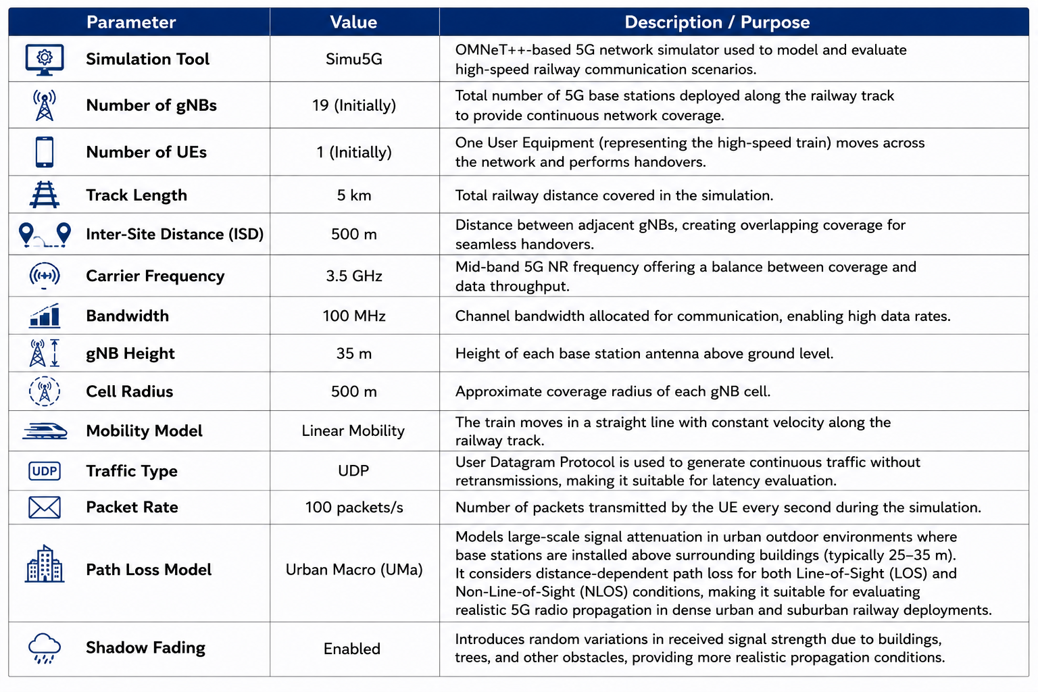
Project Objective - 2
Simulation Parameters

Slide 5
Network Topology
The network topology was designed to emulate a 5G High-Speed Railway (HSR) communication environment.
Initial Deployment
19 gNBs arranged in a two-layer hexagonal topology.
Layer 1: 10 gNBs positioned along the railway track to provide primary coverage.
Layer 2: 9 gNBs deployed to introduce neighbouring-cell interference and emulate a realistic cellular environment.
User Equipment (UE) Configuration
Initially, a single UE represented the train.
Modified Deployment
During experimentation, it was observed that the second-layer gNBs did not actively participate in handover events.
The topology was therefore simplified to 10 gNBs positioned along the railway track, enabling clearer observation and analysis of handover behaviour.
Parameter | Value
Horizontal gNB Spacing | 500 m
Horizontal Offset | 250 m (ISD / 2)
Vertical Spacing | ≈ 433 m (500 × √3 / 2)
Inter-Site Distance (ISD) | 500 m

Slide 6
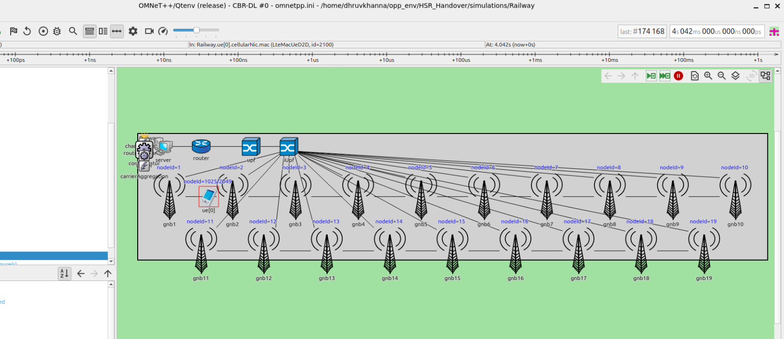
Component | Summary
Server | The server acts as the application host that generates or receives network traffic during the simulation. It sends UDP packets to the UE through the 5G core network for performance evaluation.
Router | The router forwards IP packets between the server and the 5G core network. It serves as the gateway connecting the external network (Internet) to the core network.
UPF (User Plane Function) | The UPF is a core component of the 5G Core responsible for forwarding user data packets between the core network and the radio access network. It performs packet routing, forwarding, and QoS enforcement while maintaining data connectivity.
iUPF (Intermediate User Plane Function) | The iUPF is an intermediate user plane node placed between the UPF and the gNBs to distribute traffic efficiently. It is commonly used in hierarchical 5G architectures to improve scalability, support edge computing, and reduce latency.

Slide 7
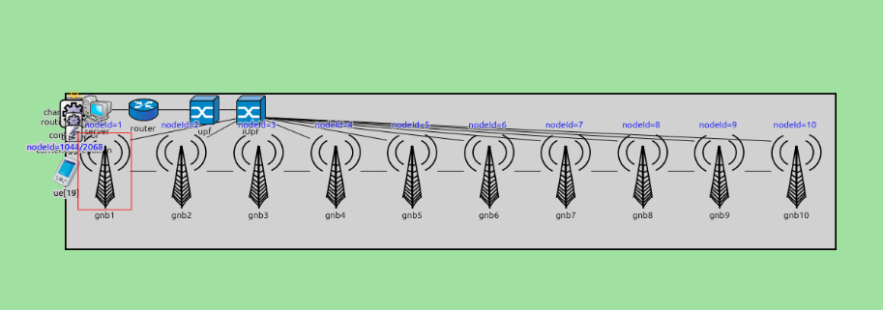
Multi-UE Train Modeling
To better represent a real high-speed train environment, the simulation was extended from a single User Equipment (UE) to 20 UEs, where each UE represents an individual passenger device inside the train.
Phase 1 – Single UE
Initial simulations performed using 1 UE.
Used to validate network connectivity and initial handover behaviour.
Phase 2 – 20 UEs
Number of UEs increased from 1 to 20.
Each UE represents a passenger device inside the train.
UEs initially arranged with 1 m spacing, representing a 20 m long train coach.
Common mobility parameters were maintained for all UEs to emulate train movement.
Phase 3 – Co-located UE Evaluation
All 20 UEs were placed at the same location.
Performed to observe network behaviour when multiple users simultaneously experience identical radio conditions.
Used to evaluate traffic load and collective network performance.

Slide 8
Environment Setup Specifications
Simulation Area
**.mobility.constraintAreaMinX = 0m
**.mobility.constraintAreaMaxX = 5000m
**.mobility.constraintAreaMinY = 300m
**.mobility.constraintAreaMaxY = 1200m
**.mobility.constraintAreaMinZ = 0m
**.mobility.constraintAreaMaxZ = 100m
Carrier Configuration
*.carrierAggregation.numComponentCarriers = 1
*.carrierAggregation.componentCarrier[0].carrierFrequency = 3.5GHz
*.carrierAggregation.componentCarrier[0].numBands = 50
gNB Deployment
*.gnb1.mobility.initialX = 250m
*.gnb2.mobility.initialX = 750m
*.gnb3.mobility.initialX = 1250m
...
*.gnb10.mobility.initialX = 4750m
*.gnb*.mobility.initialY = 500m
*.gnb*.mobility.initialZ = 35m
X2 Connectivity
*.gnb1.numX2Apps = 1
*.gnb2.numX2Apps = 2
*.gnb3.numX2Apps = 2
*.gnb4.numX2Apps = 2
*.gnb5.numX2Apps = 2
.
.
.
*.gnb10.numX2Apps = 1

Slide 9
UE Configuration
*.numUe = 20
*.ue[*].servingNodeId = 0
*.ue[*].nrServingNodeId = 1
**.dynamicCellAssociation = true
**.enableHandover = true
Train Mobility
*.ue[*].mobility.typename = "LinearMobility"
*.ue[*].mobility.initialX = 0m
*.ue[*].mobility.initialY = 500m
*.ue[*].mobility.speed = 138.89mps
*.ue[*].mobility.initialMovementHeading = 0deg
Handover Parameters
*.ue[*].cellularNic.nrPhy.timeToTrigger = 80ms
*.ue[*].cellularNic.nrPhy.hysteresis = 2dB
Statistics Recording
output-scalar-file = ${resultdir}/${configname}/${iterationvars}-${repetition}.sca
output-vector-file = ${resultdir}/${configname}/${iterationvars}-${repetition}.vec
**.scalar-recording = true
**.vector-recording = true
UDP Traffic Configuration
*.server.app[*].typename = "CbrSender"
*.server.app[*].packetSize = 100B
*.server.app[*].samplingTime = 0.01s
*.ue[*].app[*].typename = "CbrReceiver"

Slide 10
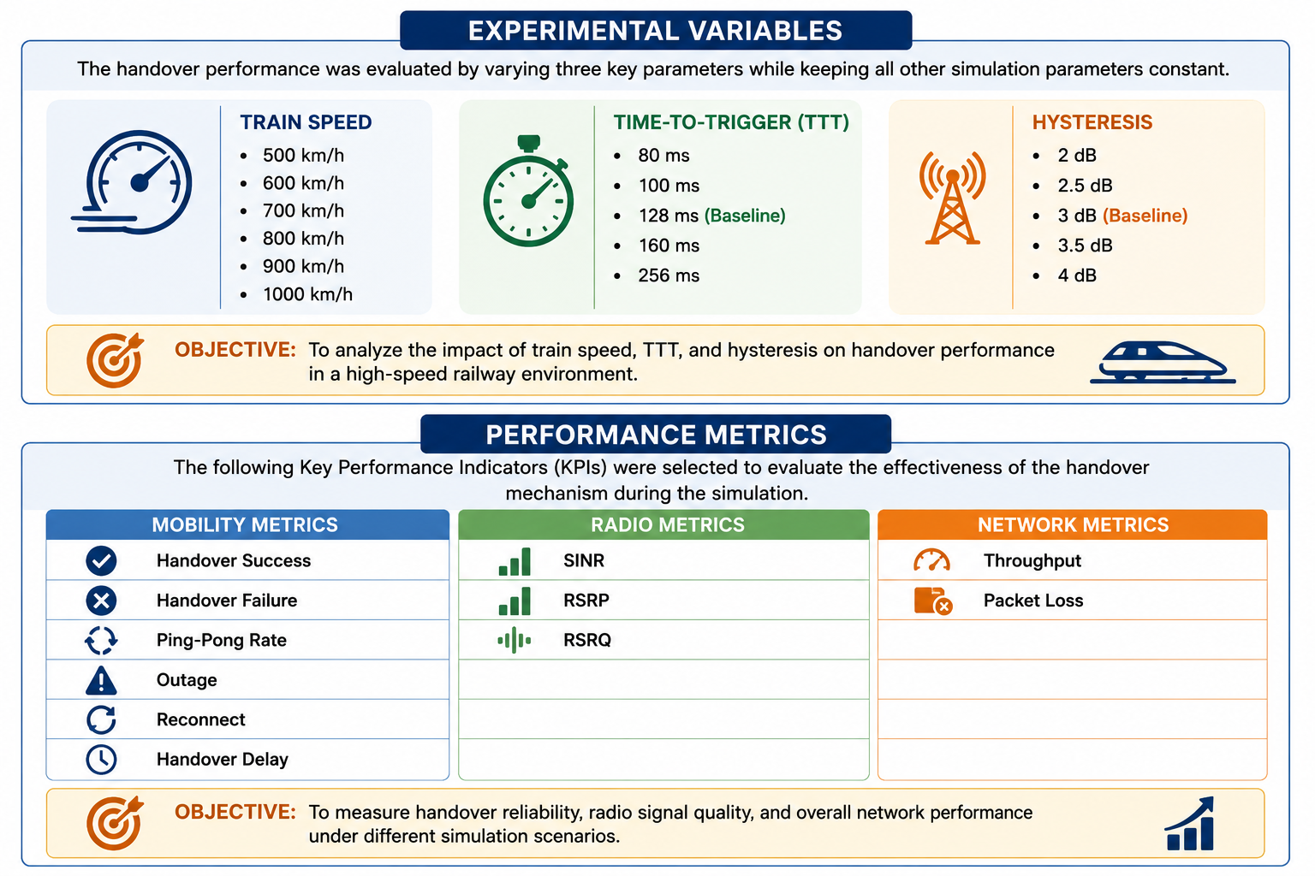
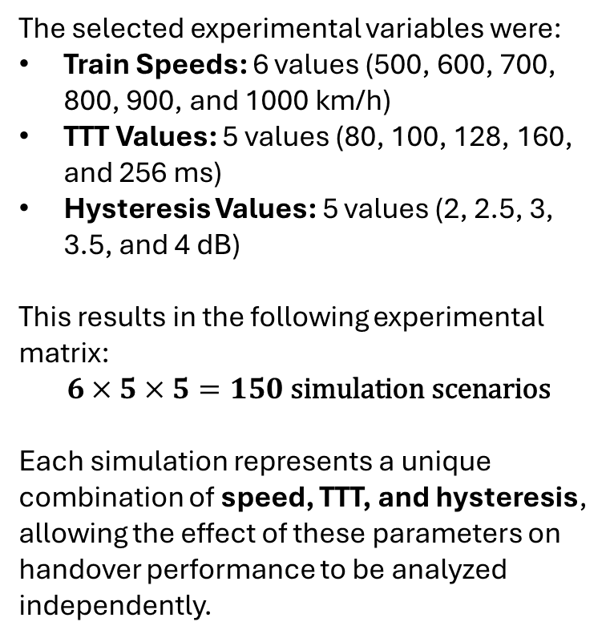
The selected experimental variables were:
Train Speeds: 6 values (500, 600, 700, 800, 900, and 1000 km/h)
TTT Values: 5 values (80, 100, 128, 160, and 256 ms)
Hysteresis Values: 5 values (2, 2.5, 3, 3.5, and 4 dB)
This results in the following experimental matrix:
$$6×5×5=150\text{ simulation scenarios}$$
Each simulation represents a unique combination of speed, TTT, and hysteresis, allowing the effect of these parameters on handover performance to be analyzed independently.

Slide 11
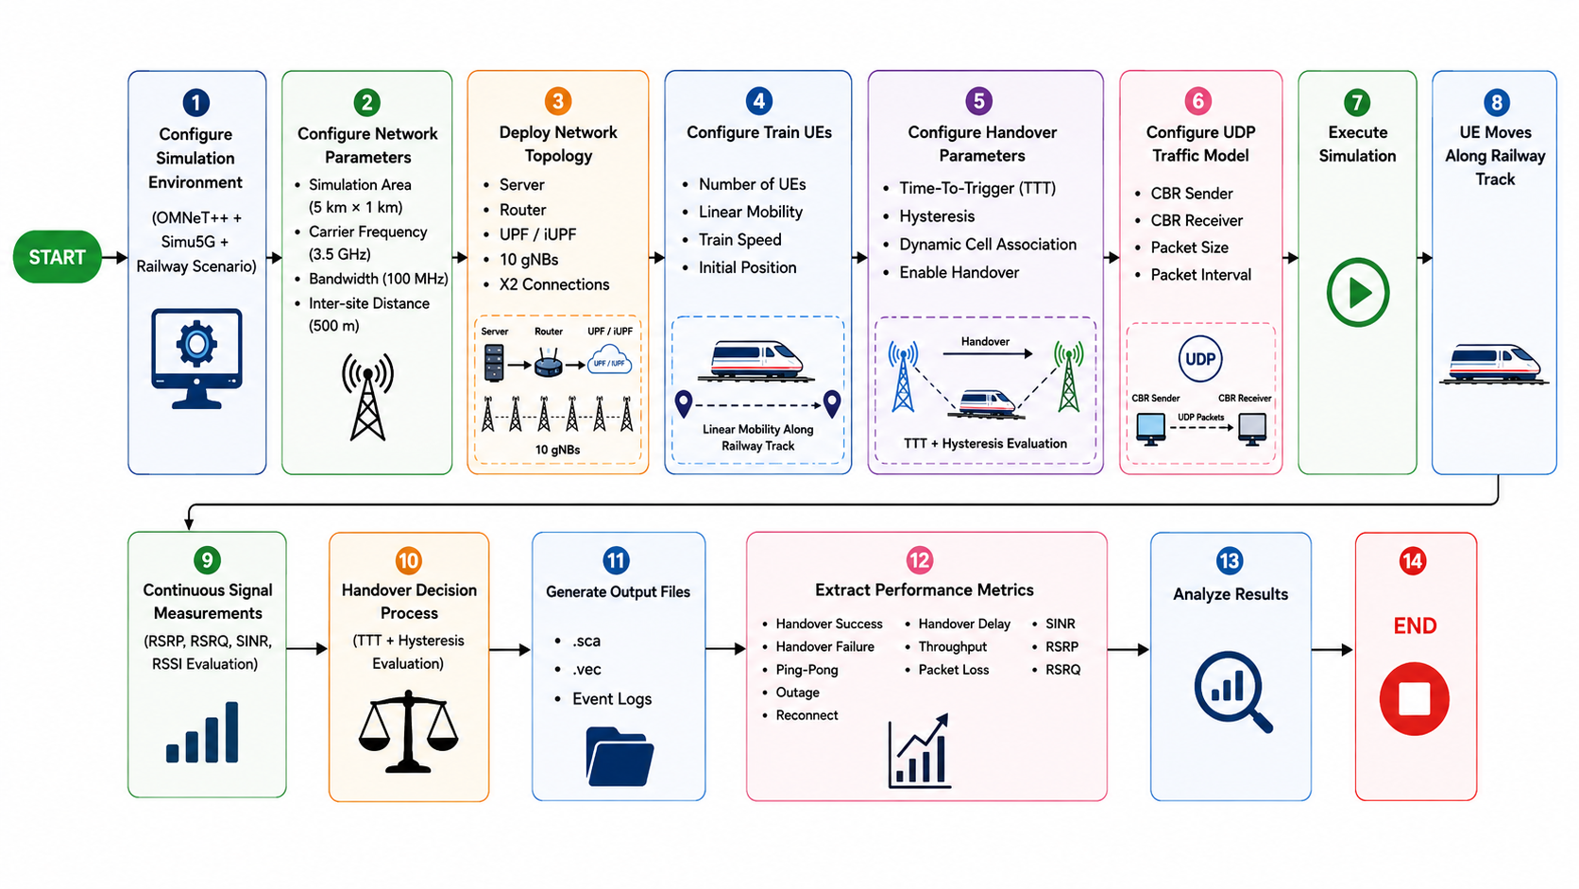

Complete Flow

Slide 12
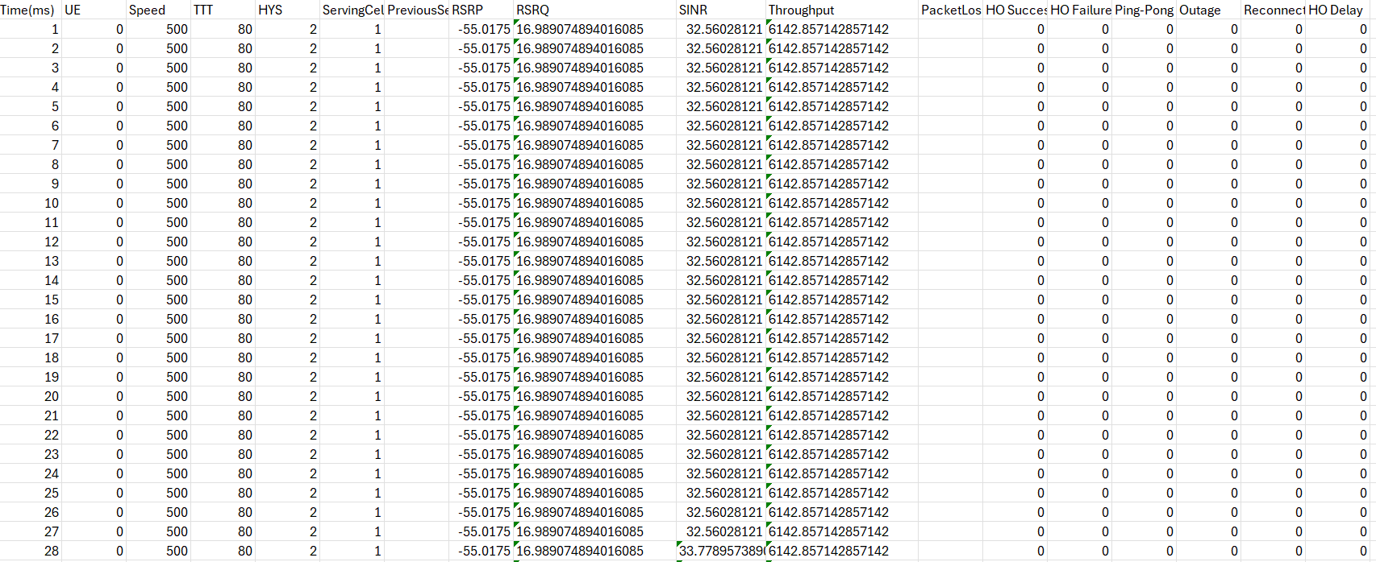
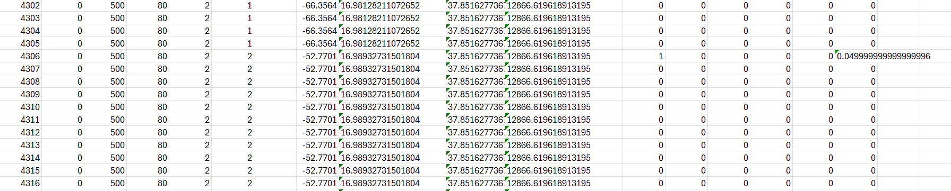
Result Obtained

Slide 13
Challenge Faced During Implementation
Problem Identified
During the implementation of the High-Speed Railway handover scenario, the simulation was configured for Standalone 5G NR (SA), where each UE connects to only one serving gNB at a time.
However, during testing, the handover process did not complete successfully even though neighboring cells were detected and handover events were triggered.
Identified Limitation
The NR PHY layer in Simu5G internally contains code that is also used for Dual Connectivity (DC).
Standalone NR: UE connects to one gNB.
Dual Connectivity: UE can connect to two gNBs simultaneously (one Master and one Secondary).
Our project uses Standalone NR only, but parts of the handover implementation still execute logic intended for Dual Connectivity.
As a result, the handover procedure could not be completed correctly.
Observed Effects
During simulation, the following behaviors were observed:
Handover trigger events were generated.
Neighbor cell measurements were received.
Candidate cell information was detected.
The serving cell ID did not update correctly.
Most performance metrics remained zero because the handover never completed.

Slide 14
A3 Handover Analysis
Event A3 Handover Process
The simulation implemented the 3GPP Event A3 handover algorithm, where a handover is initiated when the neighboring cell provides a stronger signal than the serving cell by the configured Hysteresis value for the specified Time-To-Trigger (TTT) duration.
A3 Handover Condition
Neighbour Cell Signal > Serving Cell Signal + Hysteresis (for TTT duration)
Observations During Simulation
Neighbouring gNB signal measurements were successfully received.
Event A3 conditions were evaluated continuously.
Candidate target cells were identified.
Time-To-Trigger timers were activated.
Handover trigger events were generated successfully.
These observations confirmed that the A3 handover decision algorithm was functioning correctly.
Final Outcome
Although the A3 handover decision was successfully triggered, the handover execution phase could not be completed because the internal NR handover implementation in Simu5G followed code paths intended for Dual Connectivity rather than pure Standalone NR operation.
As a result:
The serving cell was not updated.
The UE remained connected to the original gNB.
Complete handover execution did not occur.
Most handover-related performance metrics remained zero.

Slide 15
In real 5G deployments, there are two common architectures:
1. Standalone (SA)
UE -- gNB1
The UE is connected to only one gNB.
During handover:
gNB1 – HO →gNB2
The UE disconnects from gNB1 and connects to gNB2.
2. Dual Connectivity (DC)
Master gNB
│
UE
│
Secondary gNB
The UE is connected to both gNBs simultaneously.
This improves:
reliability
throughput
smoother mobility
The second connection is not mainly to avoid ping-pong. It is primarily to maintain connectivity and increase data capacity during mobility.
Key Takeaway
Event A3 successfully detected when a handover should occur, but the actual handover execution could not be completed due to limitations in the current Simu5G NR Standalone handover implementation.

Slide 16
Future Work: AI-Based Handover Evaluation Framework
AI-Based Evaluation Model
The next phase of this project aims to develop a Machine Learning model capable of:
Learning the relationship between network parameters and handover performance.
Comparing the performance of different handover algorithms.
Predicting the most suitable handover algorithm for different High-Speed Railway scenarios.
Intelligent Decision Support System
The proposed framework will:
Accept simulation parameters and network conditions as input.
Evaluate multiple handover algorithms.
Predict network performance using AI models.
Recommend the best-performing handover algorithm for a given railway scenario.
Expected Outcome
Develop an AI-driven framework that combines Simu5G simulation with Machine Learning.
Automate the analysis of handover performance across different network conditions.
Assist researchers in selecting optimal handover strategies for future 5G and 6G High-Speed Railway communication systems.
Reduce the time required for manual evaluation of multiple handover algorithms.

Slide 17


